Slide 1
Title: Predicting Patient No-Shows for Medical Appointments Subtitle: A Machine Learning Approach
Presented by: Haya Hussain
Tools Used: Power BI, Python (scikit-learn), Pandas

Slide 2
Objective: Analyze and predict patient no-shows to help optimize appointment scheduling and improve healthcare efficiency
Approach:
Descriptive analysis in Power BI.
Predictive modeling in Python using Logistic Regression & Train-Test Split.
Dataset Summary
Records: 4746 (filtered from original ~110k)
Target Column: No_show (Yes/No)
Key Features:
Age, Gender, Neighbourhood
Waiting Days (Scheduled vs. Appointment)
SMS Received
Appointment Day, Weekday
Health Flags: Hypertension, Diabetes, etc.

Slide 3
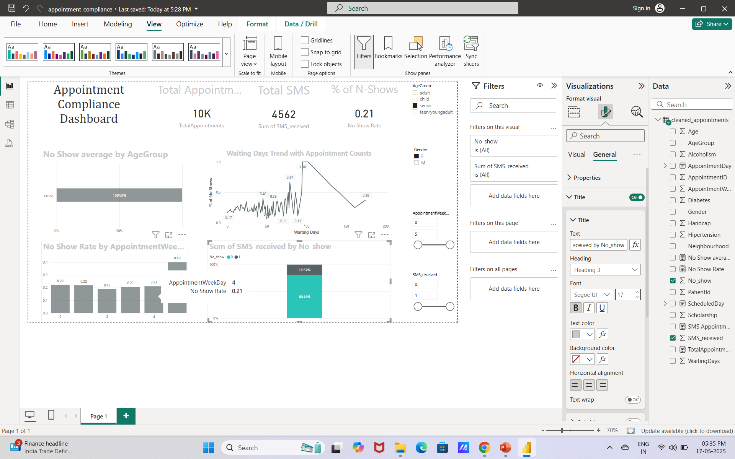
Key KPIs (Power BI Dashboard)
Metric | Value
Total Appointments | 4746
SMS Reminders Sent | 2071
No-Show Rate | 20.0%

Slide 4

Visual Insights – No-Show Behaviour
Age Group:
Seniors had 100% no-show (may need verification — possible data issue).
Weekday:
No-show rate remains between 19% and 22% across weekdays.
Waiting Days:
Longer waiting times increase no-show probability.
Peak observed around 57% no-show after certain delay thresholds

Slide 5
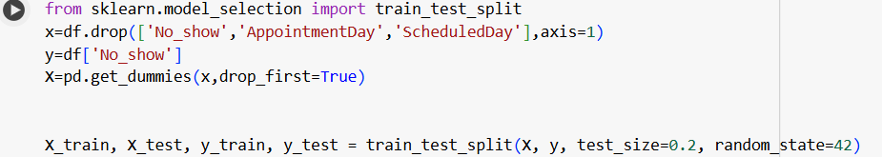
Machine Learning Workflow
Used One-Hot Encoding for categorical data.
Split: 80% Train / 20% Test
Model Used
Logistic Regression (baseline classifier)
Future models could include:
Random Forest
XGBoost
Decision Trees

Slide 6
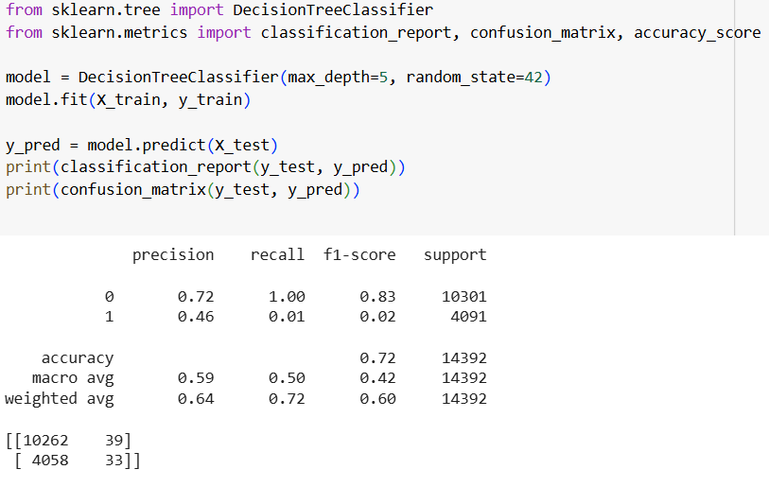
Model Performance
Accuracy: 72%
Overall correct predictions.
Precision (Class 1): Only 46% of predicted no-shows were actually no-shows.
Recall (Class 1): 1% → Model failed to correctly identify no-shows.
F1-Score (Class 1): Only 0.02, indicating poor performance for the minority class.
Insights
The model is biased toward the majority class (shows) due to class imbalance.
Although accuracy is high (72%), it masks the poor recall for the minority class (no-shows).
Very few no-shows were detected correctly, which limits practical use for prevention.

Slide 7
Business Recommendations
Send SMS reminders consistently — they greatly reduce no-shows.
Reduce waiting periods between scheduling and appointments.
Prioritize at-risk groups like seniors and chronic patients for reminders and follow-ups.
Limitations
Seniors group needs data verification (100% no-show may be misleading).
Limited features — no external data like weather, traffic, or income level.
Dataset is Brazil-specific, so generalization may be limited.

Slide 8
Thank You
Presented by: Haya Hussain Tools Used: Power BI | Python | Scikit-learn

