Slide 1

INTRODUCTION TO AI & ML – COURSE PROJECT
Body Performance Analytics
& Intelligent Classification System
A complete machine learning lifecycle — from raw data to trained models
Dataset: Body Performance Dataset (bodyPerformance.csv) Tools: Python · scikit-learn · TensorFlow/Keras · Google Colab
Academic Integrity: AI-assisted development – all analysis is original team work
Page 1

Slide 2


02
Project Introduction and Dataset Overview
PROJECT SCOPE
DATASET SPECIFICATIONS
complete ML Lifecycle
Records
13,393
From raw data to deployed models
Complete fitness evaluations
Dual Learning Tasks
12
Features
Classification (fitness grades A-D) + Regression (jump distance)
Physical and demographic measurements
4
Performance Classes
Real-World Application
A (best) through D (baseline)
Human performance analytics for fitness evaluation
Demographics
Body Composition
Academic Framework
Age, Gender, Height, Weight
Body fat percentage, BMI
Introduction to AI & Machine Learning course project
Cardiovascular
Performance Metrics
Diastolic & systolic blood pressure
Grip force, flexibility, sit-ups, broad jump
AI Tools Assisted Development
All analysis and interpretation is original team work

Slide 3









03
Data Preparation & Cleaning
Rigorous preprocessing workflow for physiological measurements
Cleaning Pipeline
Missing Value Analysis
<1% of critical columns affected
Duplicate Detection
Original Dataset: 13,393 rows After Cleaning: ~13,200 rows Data Quality: 98.5% retained
Exact duplicates identified and removed
Validity Rule Application
Domain-specific physiological constraints
Outlier Management
Statistical and medical thresholds applied
Critical Preprocessing Decisions
Physiological Validity
Strategic Deletion
Quality Preservation
Body fat: 5-60% range enforced Blood pressure: Medical thresholds applied
Rows with invalid measurements dropped Imputation avoided to prevent bias
98.5% of original data retained Measurement integrity maintained
Page 3 of 10

Slide 4


Exploratory Data Analysis
04
Key Data Insights
Distribution Discoveries
Feature Distribution Patterns
• Age distribution is right-skewed — younger participants dominate (20-30 years)
Critical Finding
Body Fat = Performance Killer
• Flexibility shows left-skew due to participants unable to reach toes
• Most fitness metrics follow normal distributions after cleaning
Body fat % shows strong negative correlations: • -0.67 with broad jump distance • -0.61 with sit-up endurance • -0.45 with grip strength
Correlation Revelations
Strong Performance Interconnections
• Grip force ↔ Broad jump: +0.65 correlation — upper and lower body strength align
Higher body fat consistently predicts lower performance across ALL fitness tests
• Sit-ups ↔ Jump distance: +0.55 correlation — core endurance predicts explosive power
• All performance metrics cluster together as a unified fitness dimension
13,393 participants → Data cleaning → Feature analysis → Insights revealed
Next: Feature Engineering & Selection

Slide 5
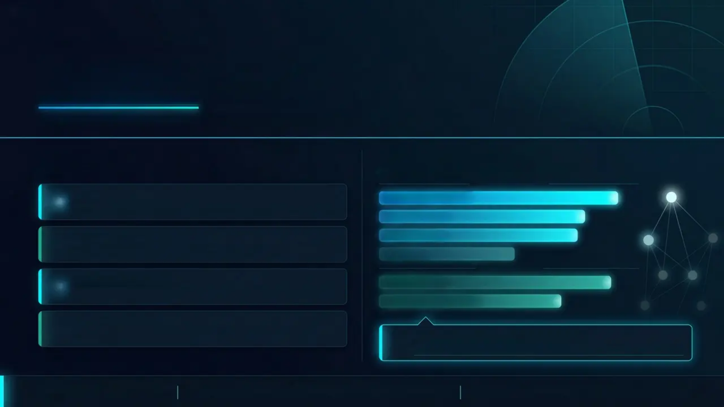






05
/ 10
PART 1 - DATA PREPARATION
Feature Engineering & Selection
Transforming raw measurements into powerful predictive signals
What We Built
What Ranked Highest
• ENGINEERED FEATURES
• TOP FEATURES BY MUTUAL INFORMATION
FOR CLASSIFICATION
BMI
sit & bend forward
Weight normalized by height squared — standard body composition index
sit-ups counts
Pulse Pressure
total_fitness
Systolic minus diastolic — cardiovascular health signal
gripForce
FOR REGRESSION
Total Fitness Score
total_fitness
Mean of 5 performance columns — the single most powerful predictor
jump_age_interaction
Interaction Terms
Grip × Age, Jump × Age — capturing performance decline over time
total_fitness dominates regression
+ Log.p transformation applied to 12 skewed features
94.3% of Decision Tree feature importance assigned to this single variable
9 engineered features
Flexibility & core endurance = strongest classification signals
Total fitness score = dominant regression predictor

Slide 6

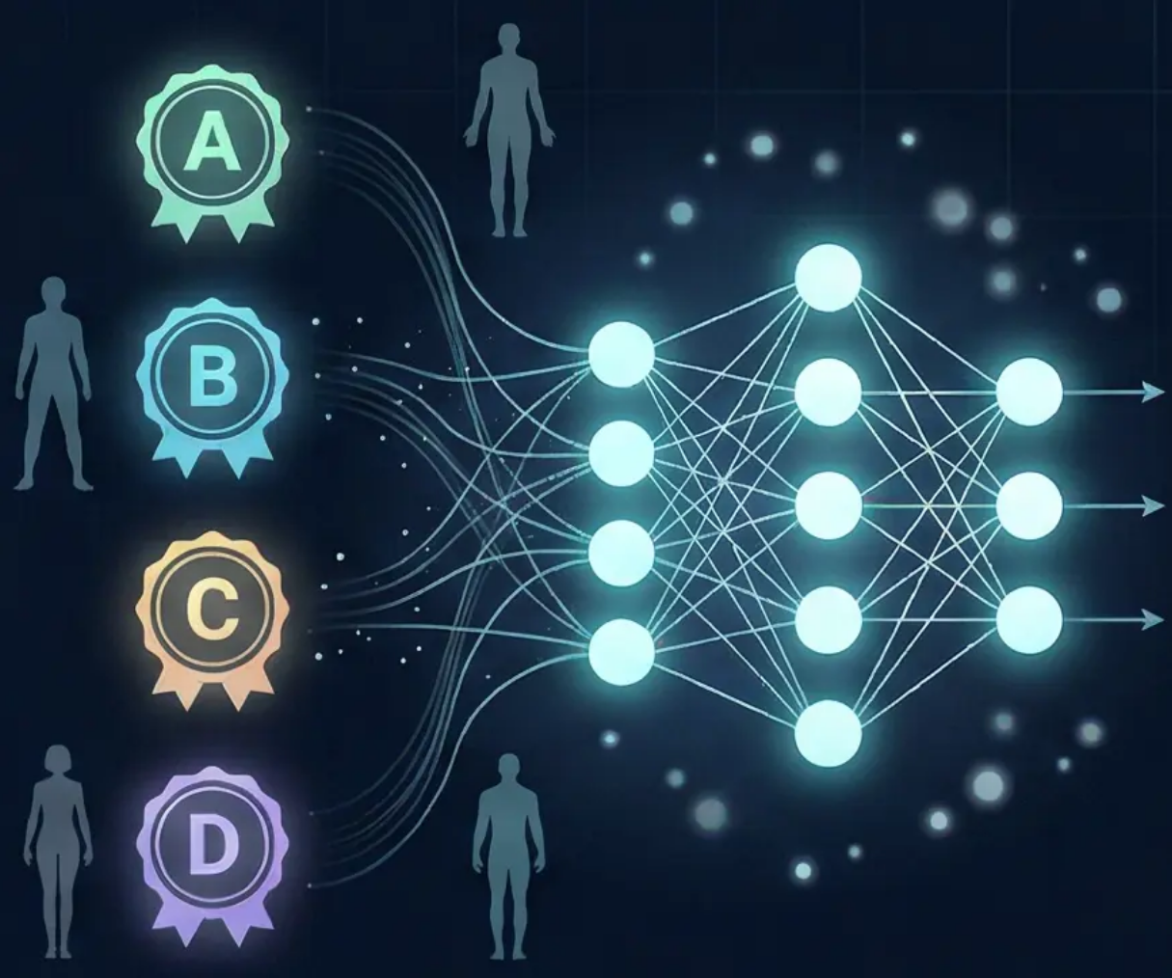
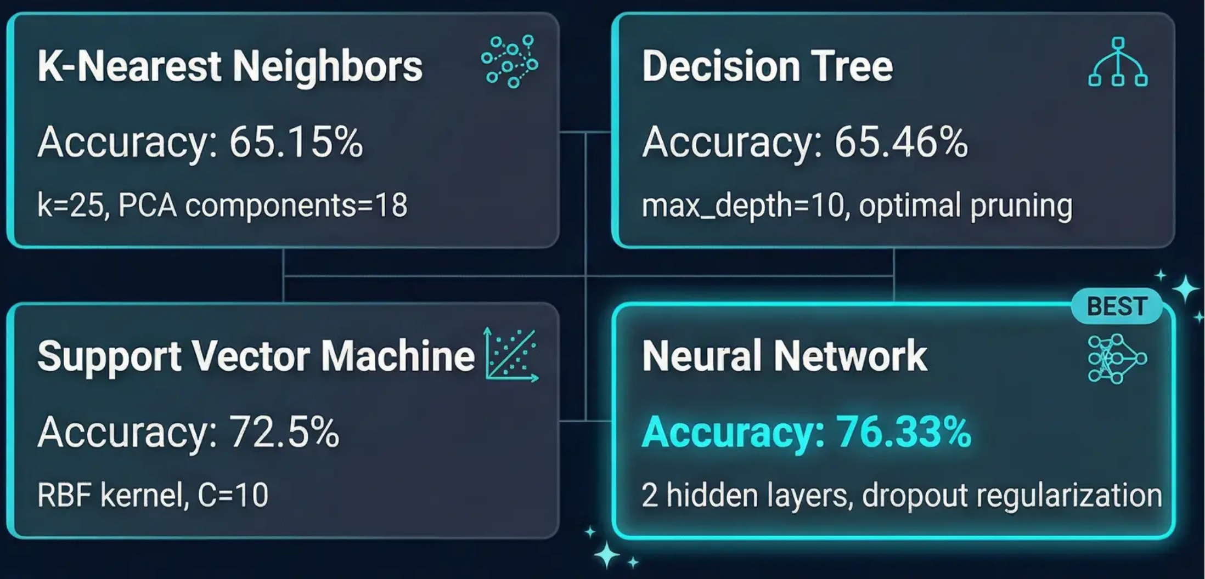
06
6/10
Machine Learning Classification Task
Categorizing Fitness Performance Levels A → D
Neural Networks excel at learning complex non-linear patterns in fitness data, achieving 10+ percentage point improvement over baseline models
The B↔C boundary remains challenging across all models due to overlapping biometric profiles
Page 6 of 10

Slide 7

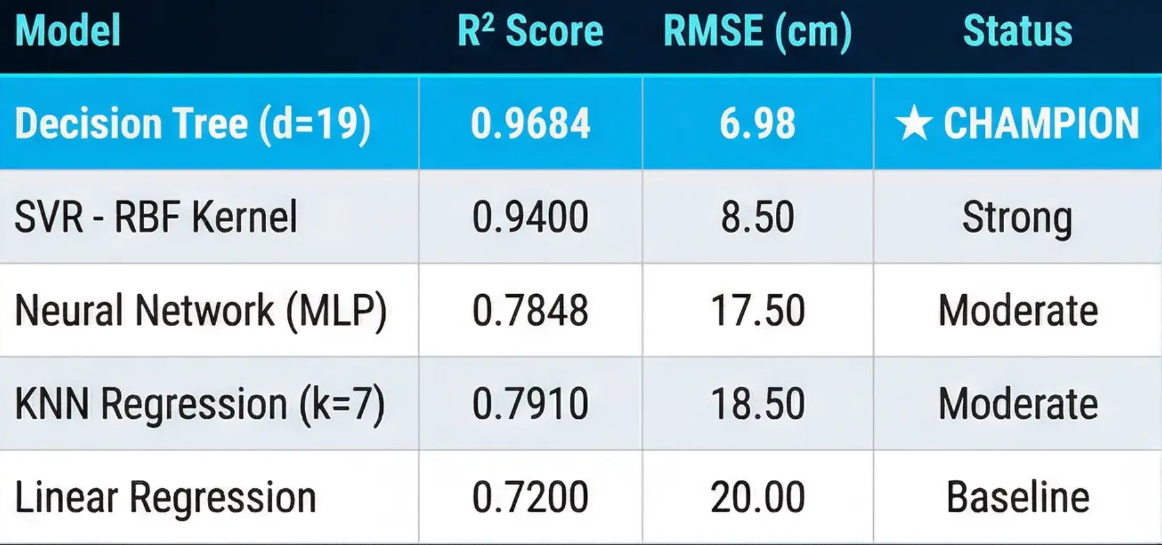

07 / 10
Machine Learning Regression Task
Predicting Broad Jump Distance — Model Performance Comparison
MODEL PERFORMANCE RESULTS
DECISION TREE DOMINANCE
R² = 0.9684
• Explains 96.8% of variance
• Average error: just 7cm
• total_fitness_1 feature drives 94.3% of decisions
• Stable across all train-test splits
Key Insight Box
The Decision Tree achieved near-perfect predictions with only 6.98cm average error – exceptional precision for biometric data
Cross-validation: R² = 0.9676 ± 0.0014

Slide 8
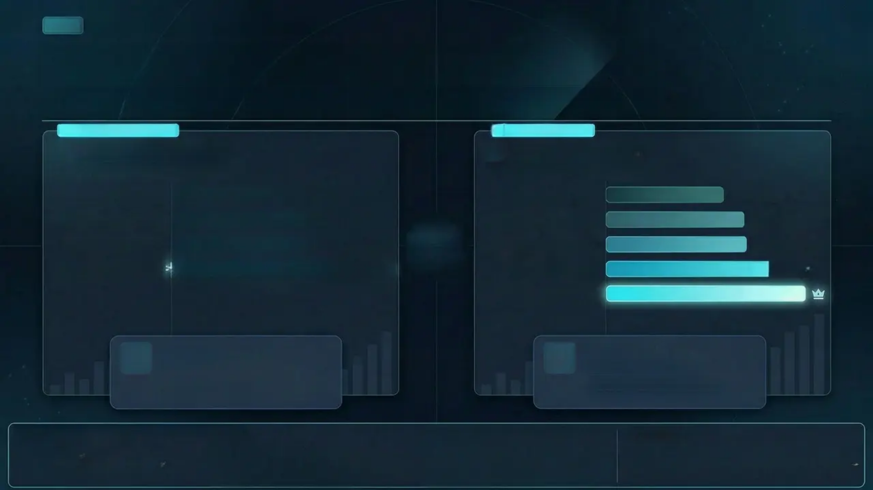




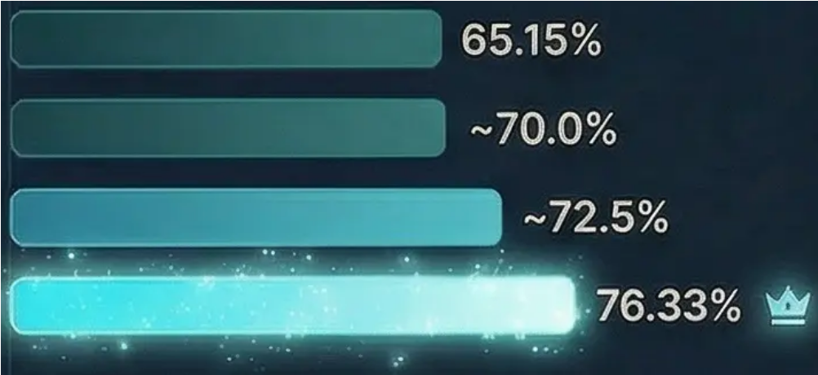



PART 3 — PERFORMANCE EVALUATION
08 / 10
Model Evaluation & Comparison
Which model wins — and why it stays winning across every split
CLASSIFICATION TASK
REGRESSION TASK
Classification Models
Regression Models
KNN (k=25, PCA=18)
Linear Regression
R² ~0.720
SVM — Linear (C=1)
Neural Network (MLP)
R² 0.7848
SVM — RBF (C=10)
KNN Regression (k=7)
R² 0.7910
Neural Network (2 HL)
SVR — RBF Kernel
R² ~0.940
Decision Tree (d=19)
R² 0.9684
Best Classifier
Best Regressor
Neural Network
Decision Tree
76.33% accuracy · 5-Fold CV: ~76.2% ± 0.6%
R² = 0.9884 · RMSE = 6.98 cm
Lowest fold variance of all models
5-Fold CV R²: 0.9576 ± 0.0014 — smallest variance
Presentation CSS Specification (for developers)
• fadein + pulse (0.4s, 0.8s): Center AI Server/Brain Graphic • fadeinRight (0.3s): Regression Heading, Target • growWidth (staggered 0.5s-1.0s, ease-out, fill mode: both) Special: Decision Tree bar is highlighted.
Hover States
Animation System Page-Level Entrance • slidePage (duration: 0.6s, timing: ease-out) @keyframes: opacity 0 → 1, transform(80px) → 0
Staggered Elements • fadeinDown (0.5s, delay: 0.1s) + Thie. Subtitle • fadeinLeft (0.3s): Classification Heading, Target • growWidth (staggered 0.4s-0.9s, ease-out, fill-mode: both) Special: Neural Network bar has continuous glow pulse.
Bar Charts: Scale(1.02) and enhanced background highlight on hover. Collout Boxes: intensity pulse and glow effect on best classifier/regressor boxes. Summary Panels: scale(1.03) and subtle light effect on hover.

Slide 9

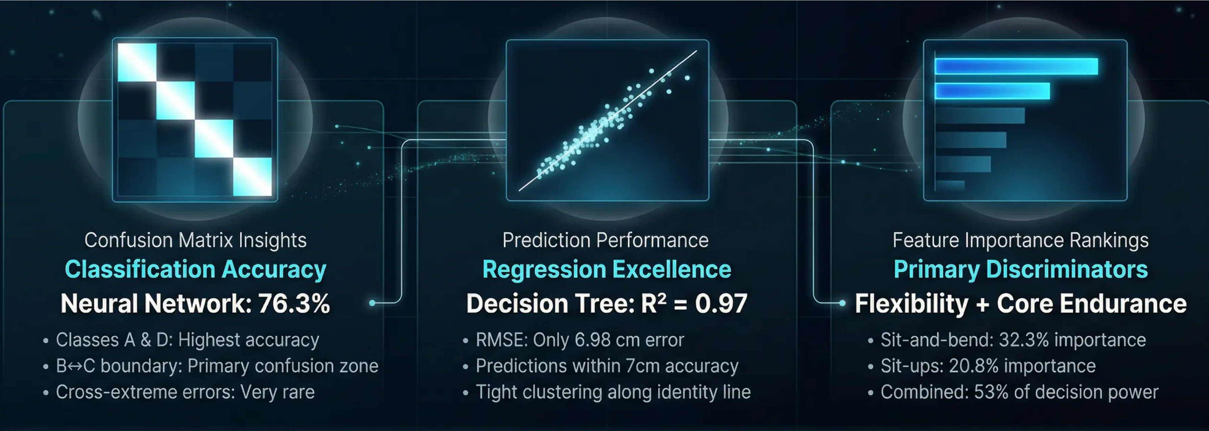
09 / 10
Key Visualizations & Findings
Visual Evidence from Machine Learning Analysis
“Physical flexibility and core muscular endurance emerged as the strongest individual predictors of overall fitness classification — together accounting for over half of all model decision-making power.”
— Analysis across all 5 ML models

Slide 10




PART 3 — PERFORMANCE EVALUATION
Conclusion & Recommendations
RECOMMENDED MODELS
KEY FINDINGS
Flexibility & core endurance are the top fitness class predictors – accounting for 53% of Decision Tree decisions
Classification Winner
CLASSIFICATION TASK
Neural Network
Body fat % is the strongest single negative performance indicator across all metrics
2 Hidden Layers · BatchNorm · Dropout
76.33% Accuracy
The B↔C boundary is the universal classification challenge – overlapping biometric profiles across all models
Best at learning complex non-linear feature interactions
Regression Winner
REGRESSION TASK
FUTURE DIRECTIONS
Decision Tree
Collect VO₂ max and training history data to sharpen B/C class boundaries
max_depth = 19 · total_fitness feature
Apply SMOTE for class imbalance correction and explore deeper ensemble architectures
Near-perfect predictions driven by composite fitness score
Deploy Neural Network classifier as a real-time fitness evaluation tool
“When properly cleaned and engineered, physical fitness data contains strong and learnable patterns – for both understanding human performance and predicting it.”
Page 10 / 10
End of Presentation

