Slide 1
A Comparison of
Traceability
in MDE Mega-Models
Maximilian Meffert

Slide 2
1.
What is Traceability ?

Slide 3
Origins
Requirement Engineering:
How can I validate/prove that
all requirements are met?
On what information can I
base such validation/prove?

Slide 4
Idea
Engineering activities leave traces.
E.g. Version Control records:
  Modification (Change)
  Date
  User
  Comment

Slide 5
Traces
”[...] a relationship between two or more products of the development process [...]”
- IEEE
”[...] (possibly) non-material indication or evidence what has existed or happened [...]”
- OED
Answers to:
What ?
Who ?
Where ?
How ?
When ?
Why ?

Slide 6
Traceability
”[...] the ability to chronologically interrelate uniquely identifiable entities in an a way that matters. [...] [It] refers to the capability for tracing artifacts along a set of chained [manual or automated] operations.”
- Paige et al.
“The degree to which each element in a software development product establishes its reason for existing.”
- IEEE
The subject is expanded to general artifact/model traceability.

Slide 7
Traceability Links
”[...] a relationship between two or more products of the development process [...]”
- IEEE
Requirement
Class
realized-by

Slide 8
Traceability Link Types
Type | Description
Dependency Link | Change Impact
Refinement Link | Abstraction/Composition/Aggregation Hierarchies
Evolution Link | Downstream Transformation
Satisfiability Link | Compliance/Conformance
Overlap Link | Share of Information, Difference in Representation
Conflict Link | Conflict between artifacts
Rationalization Link | Justification/Rationale for transformations
Contribution Link | Stakeholder association
accordng to Spanoudakis an Zisman

Slide 9
Traceability Categories
Pre Model | Intra Model | Post Model
Traceability between early non-model artifacts and first models | Traceability between models during model-refinement | Traceability between final models and artifacts generated by them
accordng to Paige et al.

Slide 10
Traceability Objectives
Technical Comprehension | System Management
Supporting special audits Improving changeability Proving system adequateness Extracting metrics Tracking rationale Finding reusable elements Documenting re-engineering Supporting design decisions Change impact analysis Synchronizing models Extracting best practices Understanding the system Extracting best practices | Prioritizing requirements Proving system adequateness Extracting metrics Monitoring progress Assessing the development process Establishing accountability Documenting re-engineering Extracting best practices Change impact analysis Driving product-line development Understanding the system
Traceability Objectives accordng to Winkler and von Pilgrim
(but re-categorized)

Slide 11
2.
Comparison of
MDE Mega-Models

Slide 12
Comparison Scheme
Model | Traceability Link Types | Traceability Categories | Traceability Objectives

Slide 13
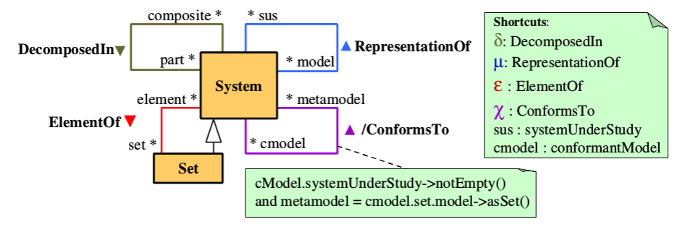
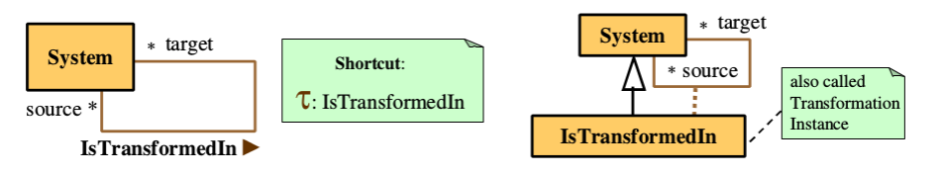
The MDE Mega-Model
by Favre et al.

Slide 14
The MDE Mega-Model
Relation | Traceability Link Type
DecomposedIn | Refinement
ElementOf | Refinement
RepresentationOf | Overlap (implicit)
ConformsTo | Satisfiability, Dependency
IsTransformedIn | Evolution
The MDE Mega-Model | Dependency, Refinement, Evolution, Satisfiability, Overlap (implicit) | Pre Model, Intra Model, Post Model | Technical Comprehension

Slide 15
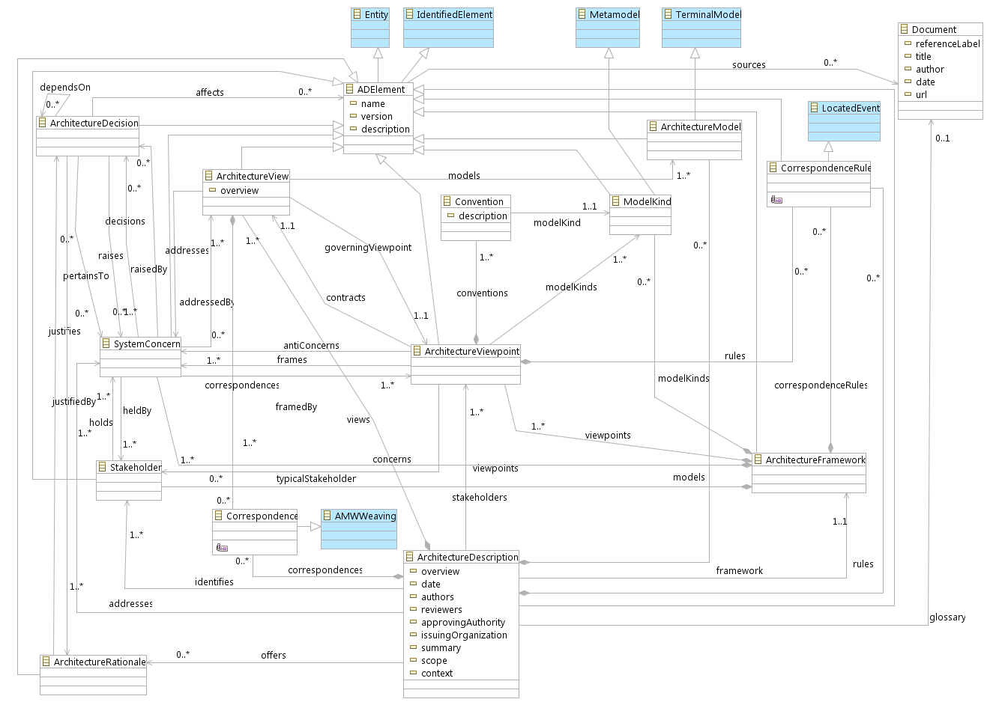
MEGAF
by Hillard et al.

Slide 16
MEGAF
Relation | Traceability Link Type
ArchitectureFramework modelKinds ModelKind | Refinement
ArchitectureViewpoint contracts ArchitectureView | Satisfiability, Dependency
ArchitectureRationale justifies ArchitectureDecision, ArchitectureDescription identifies Stakeholder | Rationalization, Dependency
Stakeholder holds SystemConcern | Contribution
MEGAF | Dependency, Refinement, Satisfiability, Rationalization, Contribution | Pre Model (framed) Intra Model (framed) Post Model (framed) | Technical Comprehension, System Management

Slide 17
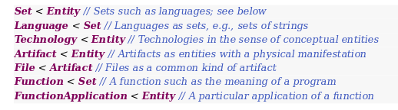
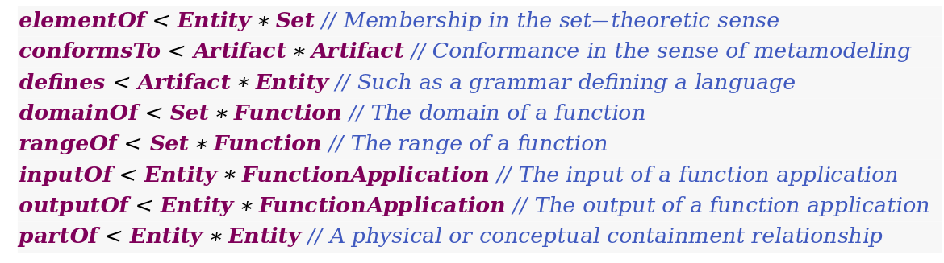


MegaL
by Lämmel & Varanovich

Slide 18
MegaL
Relation | Traceability Link Type
elementOf, partOf, domainOf, rangeOf | Refinement
conformsTo, defines, domainOf, rangeOf | Satisfiability, Dependency
inputOf, outputOf | Evolution (Overlap)
MegaL | Refinement, Satisfiability Dependency, Evolution (Overlap) | (Intra Model) Post Model | Technical Comprehension

Slide 19
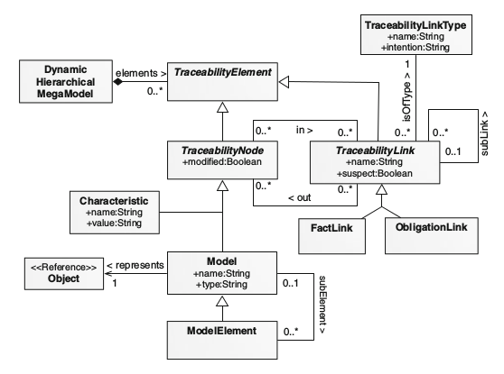
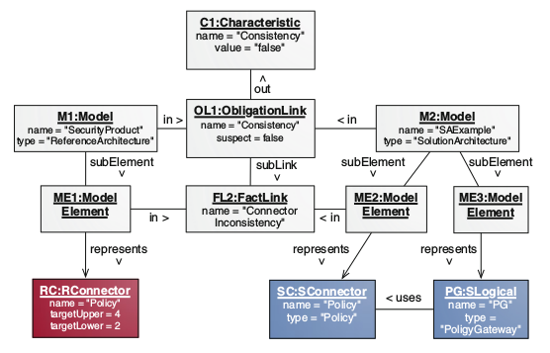
Dynamic Hierarchical
Mega-Models
(Explicit traceability model)
Top-Down Hierarchy
Reference Model
Solution Model
Inconsistency because RConnector requests
at least 2 users, but only SConnector exists.
by Seibel et al.

Slide 20
Dynamic Hierarchical
Mega-Models
Explicit Traceability Model for MDE Tool Support
Special interest in hierarchical between traceability links of different abstraction levels
e.g. links between models may imply, that corresponding links between their elements exist
Dynamic Hierarchical Mega-Models | Conflict (Custom Types) | Intra Model | Technical Comprehension, System Management

Slide 21
Conclusion
Model | Traceability Link Types | Traceability Categories | Traceability Objectives
The MDE Mega-Model | Dependency Refinement Evolution Satisfiability Overlap | Pre Model Intra Model Post Model | Technical Comprehension
MEGAF (GMM4SA) | Dependency Refinement Satisfiability Rationalization Contribution | Pre Model (framed) Intra Model (framed) Post Model (framed) | Technical Comprehension System Management
Dynamic Hierarchical Mega-Models | Conflict (Custom Types) | Intra Model | Technical Comprehension System Management
MegaL | Dependency Refinement Satisfiability Overlap Evolution (implicit) | Post Model | Technical Comprehension

Slide 22
Fin.

