Slide 1
Traceability & Mega-Modeling
How to combine?

Slide 2
Traceability Relationships
Traceability information is usually expected in form of relationships or meta-data
(IEEE and others)

Slide 3
Researching Mega-Model
Background Info finding the...

Slide 4
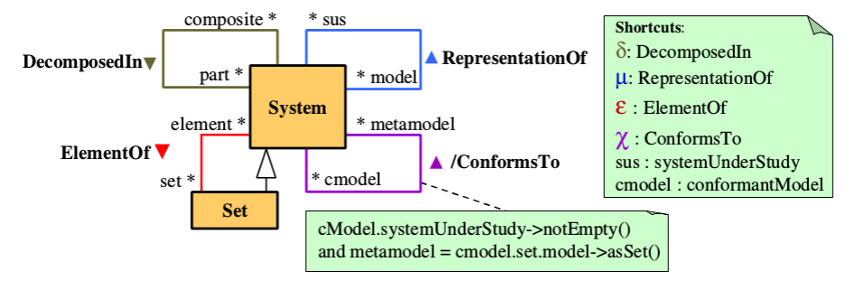
...MDE Mega-Model
(Only 4 here...)
[Favre et al.]
Identifies 5 relations important to MDE.

Slide 5
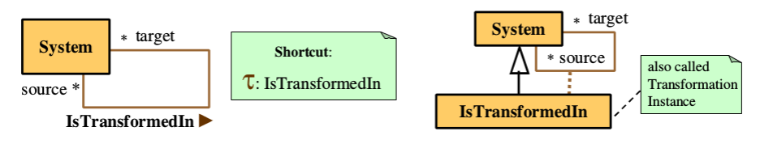
MDE Mega-Model Transformations
[Favre et al.]
(… the 5th goes here.)
Transformation: x τ x'
Transformation Instance : (x, x')

Slide 6
Wait a minute...
Traceability Link == Relations && Transformation Instance == Relations
Does
Transformation Instance == Traceability Link ???

Slide 7
How come?

Slide 8
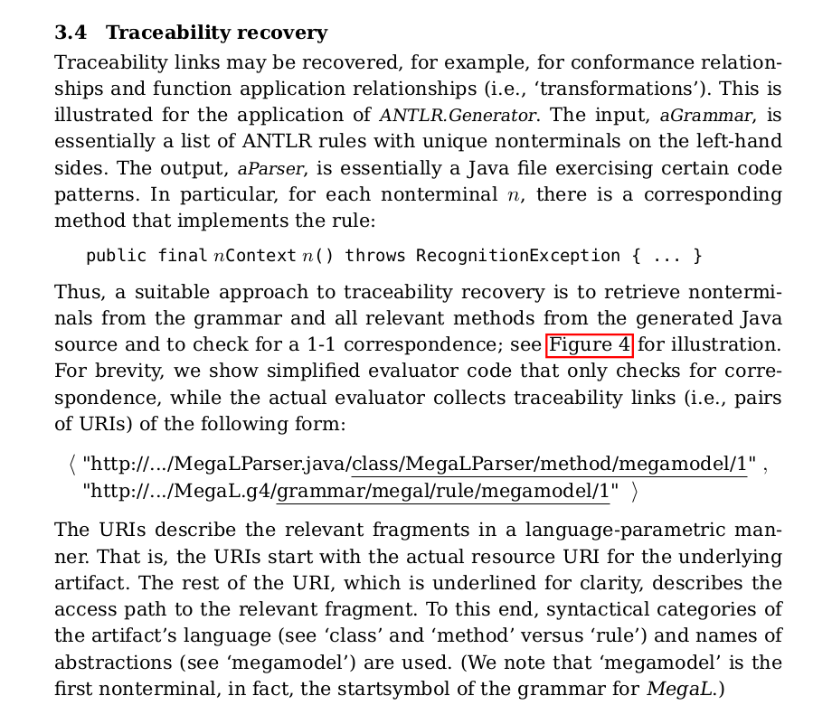
MegaL Traceability Recovery
Recovered traceability links resemble transformation instances of τ

Slide 9
Hidden Traceability Links?
Relation | Instance
x ε y | (x,y)
x μ y | (x,y)
x δ y | (x,y)
x χ y | (x,y)
x τ x' | (x,x')
(In a set theoretical sense.)

Slide 10
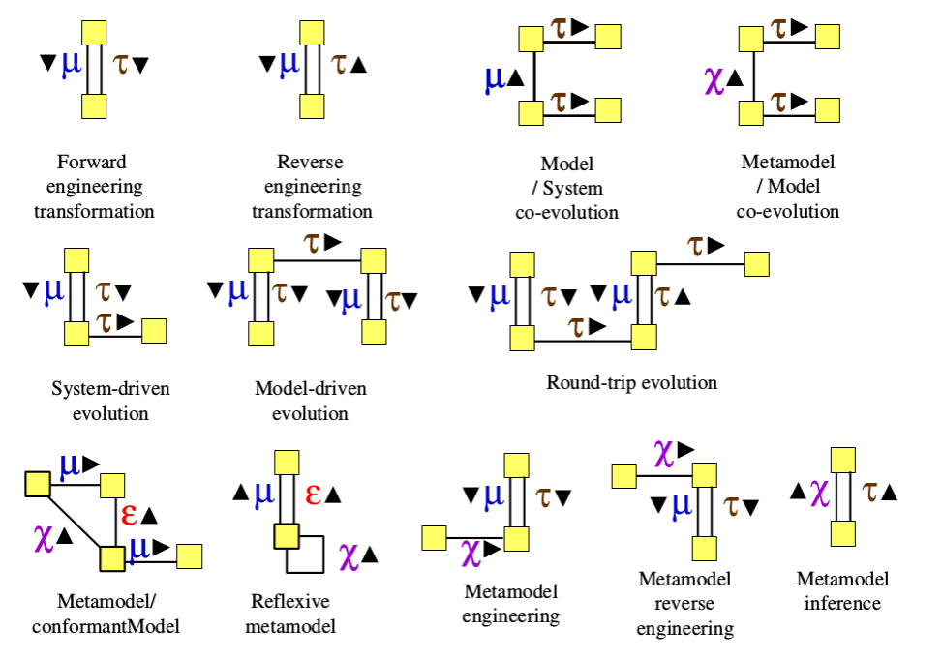
Hidden Mega- (Traceability-) Patterns?
[Favre et al.]

Slide 11
Evidence?

Slide 12
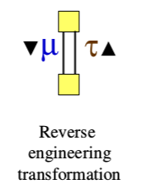
MegaL Traceability Recovery
Function Application: ANTLR.Generator
Recovered Traceability Link: (aParser, aGrammar)
Would imply:
    aParser μ aGrammar && aGrammar τ aParser
    => Reverse engineering transformation Pattern

