Slide 1
Softlang Working Group
http://softlang.wikidot.com/
MegaL
Traceabiltiy Recovery
https://github.com/maxmeffert/megal-tr
A Fragment Model
& ANTLR Backed Plugins
Meeting 2016-06-28
University of Koblenz-Landau
Maximilian Meffert

Slide 2
Quick Recap
(1.)
Type
Modeling
(2.)
Entity
Fragmentation
& Resolution
(3.)
Relationship
Recovery
Development Process
(1.) Models the fragment types of the domain
(2.) Extracts the fragments from a domain instance (Fragmentation) & resolves further specializations if necessary (Resolution)
(3.) Recovers relationships between fragments
[not discussed now]

Slide 3
Quick Recap
JavaFragment < Fragment
// type declarations
JavaClass < JavaFragment
JavaInterface < JavaFragment
JavaEnum < JavaFragment
// member declarations
JavaInnerClass < JavaFragment
JavaMethod < JavaFragment
JavaConstructor < JavaMethod
JavaField < JavaFragment
JavaAnnotation < JavaFragment
public class Foo {
static public class Bar {
private void getBar () {
}
}
private String bar;
public String getBar() {
return bar;
}
public void setBar(String bar) {
this.bar = bar;
}
}

Slide 4
Quick Recap
aJavaFile: File
aJavaFile elementOf Java
aJavaFile = 'workspace:/org.softlang.megal.plugins/input/Foo.java'
aJavaFile.Foo#0: JavaClass
aJavaFile.Foo#0 partOf aJavaFile
aJavaFile.Foo#0 = 'file:/.../Foo.java#/0/Foo/JavaClass'
aJavaFile.Foo#0.Bar#0: JavaInnerClass
aJavaFile.Foo#0.Bar#0 partOf aJavaFile.Foo#0
aJavaFile.Foo#0.Bar#0 = 'file:/.../Foo.java#/0/Foo/JavaClass/0/Bar/JavaInnerClass'
aJavaFile.Foo#0.Bar#0.getBar#0: JavaMethod
aJavaFile.Foo#0.Bar#0.getBar#0 partOf aJavaFile.Foo#0.Bar#0
aJavaFile.Foo#0.Bar#0.getBar#0 = 'file:/.../Foo.java#/0/Foo/JavaClass/0/Bar/JavaInnerClass/0/getBar/JavaMethod'
aJavaFile.Foo#0.bar#1: JavaField
aJavaFile.Foo#0.bar#1 partOf aJavaFile.Foo#0
aJavaFile.Foo#0.bar#1 = 'file:/.../Foo.java#/0/Foo/JavaClass/1/bar/JavaField'
aJavaFile.Foo#0.getBar#2: JavaMethod
aJavaFile.Foo#0.getBar#2 partOf aJavaFile.Foo#0
aJavaFile.Foo#0.getBar#2 = 'file:/.../Foo.java#/0/Foo/JavaClass/2/getBar/JavaMethod'
aJavaFile.Foo#0.setBar#3: JavaMethod
aJavaFile.Foo#0.setBar#3 partOf aJavaFile.Foo#0
aJavaFile.Foo#0.setBar#3 = 'file:/.../Foo.java#/0/Foo/JavaClass/3/setBar/JavaMethod'
Fragmentation Result

Slide 5
Qualified Fragment Names
aJavaFile.Bar#0.[…].doStuff#666
Name of the declared entity
Short name of the fragment
Index of the fragment in its compound
Where a Qualified Fragment Name (QFN) conforms to:
QFN : ENAME Fragment+
Fragment : ‘.’ FNAME ‘#’ INDEX
ENAME : \S+
FNAME : \w+
INDEX : \d+

Slide 6
Qualified Fragment Names
QFNs are used as identifiers for the derived entities
QFNs depict parthood relationships
  So partOf-reasoning is triggered in the next evaluation cycle
Indexes depict the position of fragments in their respective compounds

Slide 7
Fragment URIs
Generic URI Form:
scheme:[//[user:password@]host[:port]][/]path[?query][#fragment]
Fragment URI Form:
scheme://location#fragment
Where fragment conforms to:
Fragment : ‘/’ INDEX ‘/’ NAME ‘/’ TYPE (‘/’ Fragment )*
INDEX : \d+
NAME : \w+
TYPE : \w+
file://path/to/Foo.java#/0/Foo/JavaClass/2/getBar/JavaMethod

Slide 8
Fragment Model & KB
public class Foo {
static public class Bar {
private void getBar () {
}
}
private String bar;
public String getBar() {
return bar;
}
public void setBar(String bar) {
this.bar = bar;
}
}
A computational fragment model should be loosely based on syntax trees.
Scope defines parthood.

Slide 9
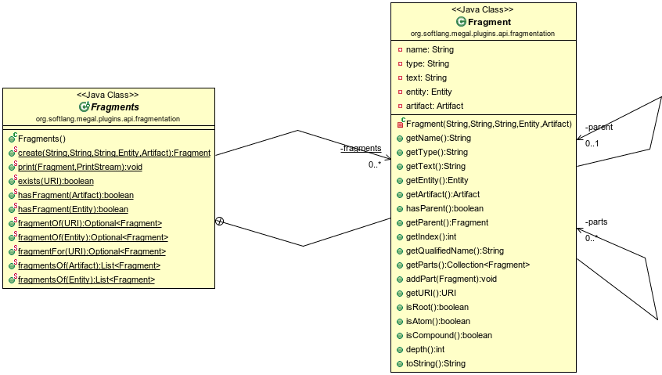
Fragment Model & KB

Slide 10
Fragment Model & KB
Fragments store the manifestation text and additional meta-info
Fragments build a simple generic tree corresponding to the original AST
  A leaf node is called atom
  A non-leaf node is called compound
A Fragment KB (Fragments) exists separately from the Megamodel KB during the evaluation process

Slide 11
ANTLR Baked Plugins
File < Artifact
elementOf < File (+) * Language
realizationOf < Plugin * Entity
partOf < Plugin * Plugin
Java : Language
…
aJavaFile : File
aJavaFile elementOf Java
…
JavaAcceptor: Plugin
JavaAcceptor realizationOf Java
JavaAcceptor partOf FileElementOfLanguage
JavaAcceptor = 'classpath:org.softlang.megal.plugins.impl.java.JavaAcceptor'
…
JavaFragmentizer : Plugin
JavaFragmentizer realizationOf Java
JavaFragmentizer partOf FileFragmentReasoner
JavaFragmentizer = 'classpath:org.softlang.megal.plugins.impl.java.JavaFragmentizer'

Slide 12
ANTLR Backed Plugins
Some entities are elementOf a language
Some plugins are realizationOf a language
Thus bound manifestations may need to be parsed for further analysis
Also plugins may be partOf other plugins
So actual KB derivations and parsing/anlysis can be decoupled

Slide 13
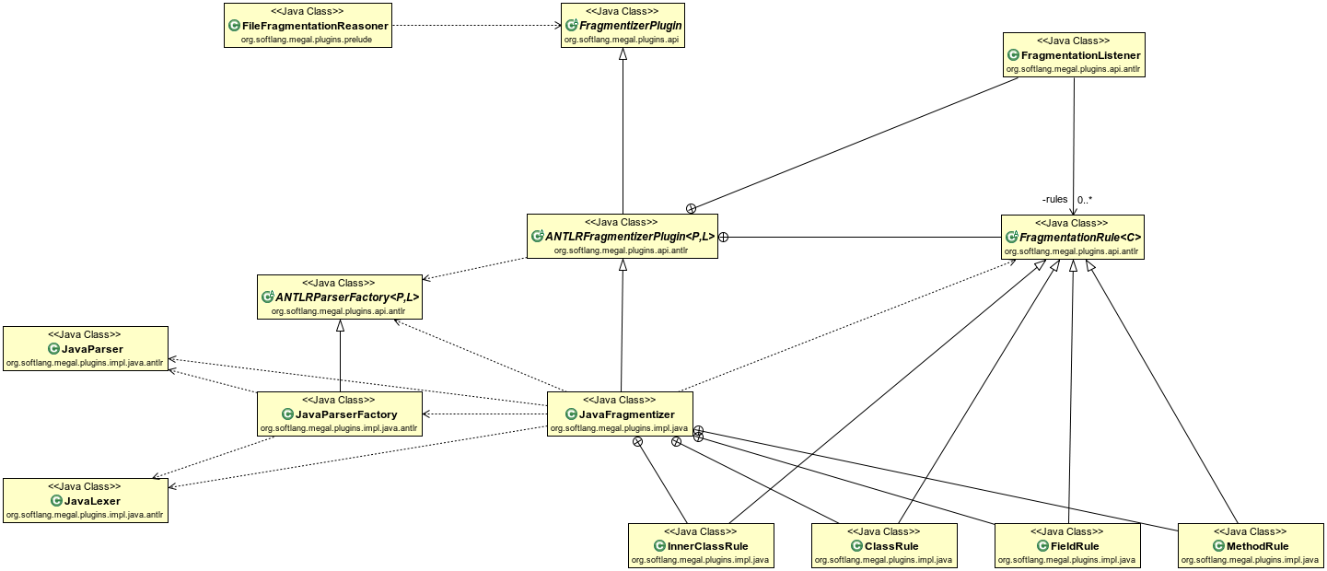
ANTLR Backed Plugins
Java Fragmentation

Slide 14
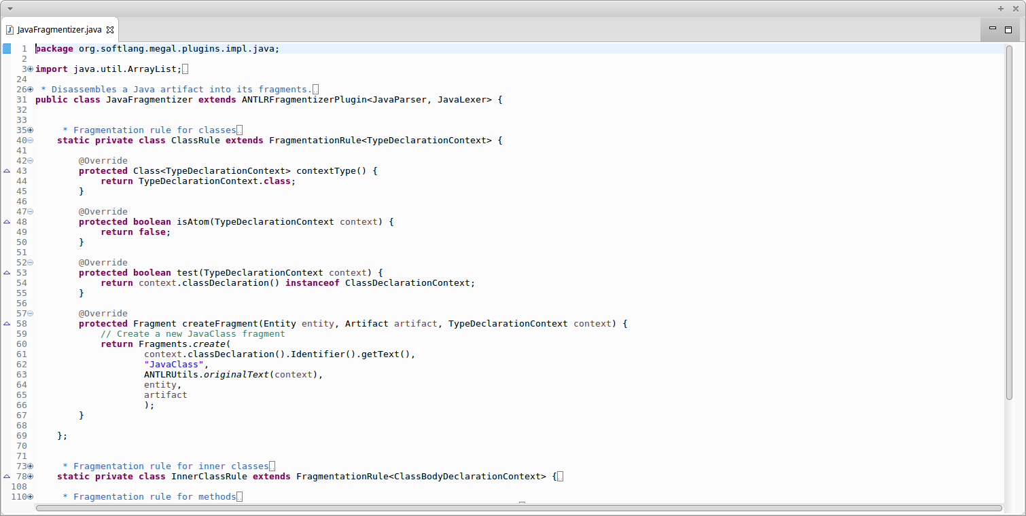
ANTLR Backed Plugins
Java Fragmentation

Slide 15
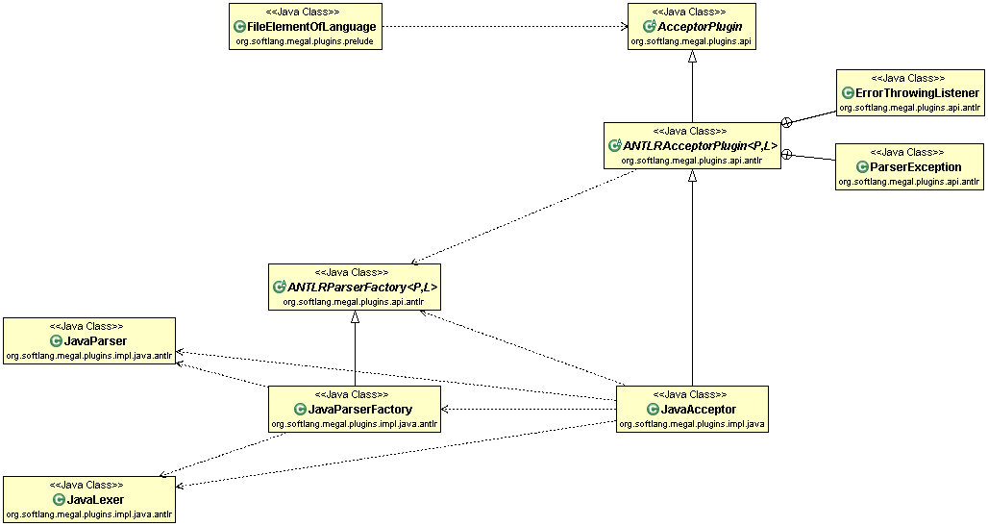
ANTLR Backed Plugins
Java Acceptance

Slide 16
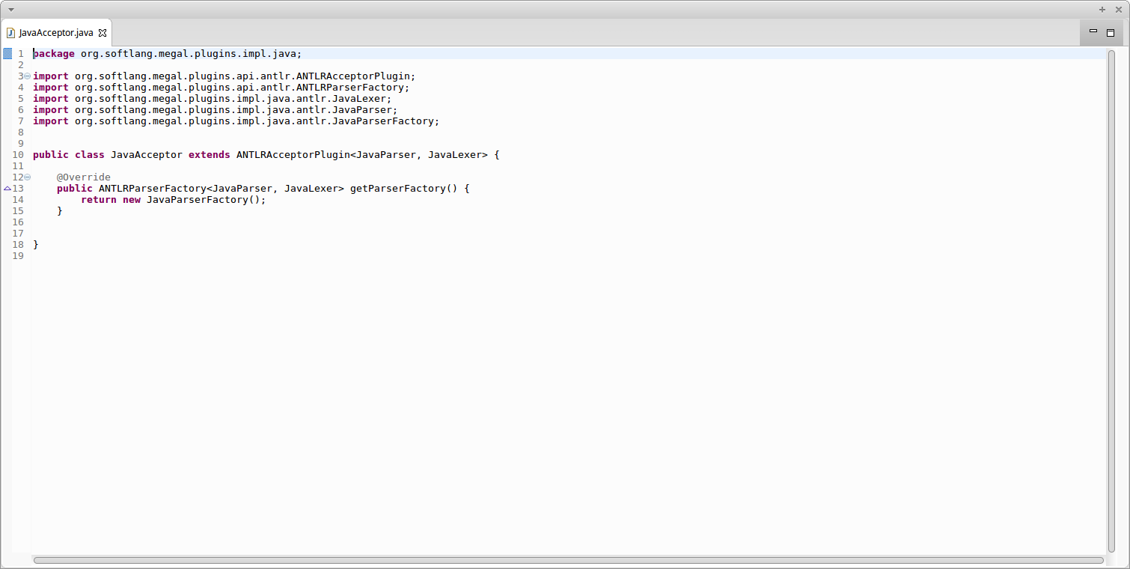
ANTLR Backed Plugins
Java Acceptance

Slide 17
ANTLR Backed Plugins
ABPs make the MegaL Plugin API extensible for various languages
Acceptance plugins can be created effortless, just by providing a Parser-Lexer pair
Fragmentation plugins can be created by providing by set of “rules” for ANTLR ParserRuleContext instances

Slide 18
XML Fragmentation
XMLFragment < Fragment
XMLElement < XMLFragment
XMLAttribute < XMLFragment
XMLNSAttriubte < XMLAttribute
<company
xmlns:”http://www.101companies.org”
xmlns:xsi="http://www.w3.org/2001/XMLSchema-instance"
xsi:schemaLocation="http://www.101companies.org path/to/companies.xsd"
>
<name>…</name>
<departments>
<department name=”Research”>
…
</department>
</departments>
</company>

Slide 19
XSD Fragmentation
XML: Language
XSD: Language
XSD subsetOf XML
XMLFragment < Fragment
XMLElement < XMLFragment
XMLAttribute < XMLFragment
XMLNSAttribute < XMLAttribute
XSDFragment < XMLFragment
XSDSchema < XMLAttribute // or XSDFragment ???
XSDElement < XMLElement // or XSDFragment ???
XSDElementName < XMLAttribute // or XSDFragment ???
XSDComplexType < XMLElement // or XSDFragment ???
Because XSD is a subset of XML,
some uncertainty for XSD fragment type specializations may exist!

Slide 20
XSD Fragmentation
XML: Language
XSD: Language
XSD subsetOf XML
XMLFragmentizer : Plugin
XMLFragmentizer realizationOf XML
XMLFragmentizer partOf FileFragmentReasoner
XMLFragmentizer = 'classpath:org.softlang.megal.plugins.impl.xml.XMLFragmentizer'
XSDFragmentizer : Plugin
XSDFragmentizer realizationOf XSD
XSDFragmentizer partOf FileFragmentReasoner
XSDFragmentizer = 'classpath:org.softlang.megal.plugins.impl.xsd.XSDFragmentizer'
Because XSD is a subset of XML,
XML fragmentation is currently also applied to
entities which are element of XSD!

Slide 21
XML Namespace Specialization
XMLFragment < Fragment
XMLElement < XMLFragment
XMLAttribute < XMLFragment
XMLNSAttriubte < XMLAttribute
!
Concept
Only
Use XML Namespace Attributes as anchors for further fragment type specialization
Analysis of XSD artifacts should infer new entity types
This would also cover XSD Fragmentation
(DTD support may also be necessary)

Slide 22
XML Namespace Specialization
.xml
.xsd
(W3C)
XMLSchema
.dtd
.xsd
.xsd
(2.)
Fragmentize XSD ax XML. Derive XML Fragment Types.
Specialize Fragments for a given Namespace.
(1.)
Fragmentize Plain XML
(3.)
Fragmentize DTD as XML

Slide 23
TODO
Implement further Java fragments:
  Interface, Enum, Annotation, …
Implement SQL/DDL Fragmentation
(?) Implement XML Namespace Specialization
(?) Merge with main repository
  Integration of Fragment Model & KB
    Add manifestation support to Entity class
    Change binding type from plain Object to java.net.URI

