Slide 1
Tool of slope calculation
Manual
2018.6.16
Takeshi Nagata

Slide 2
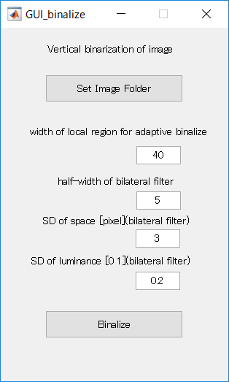
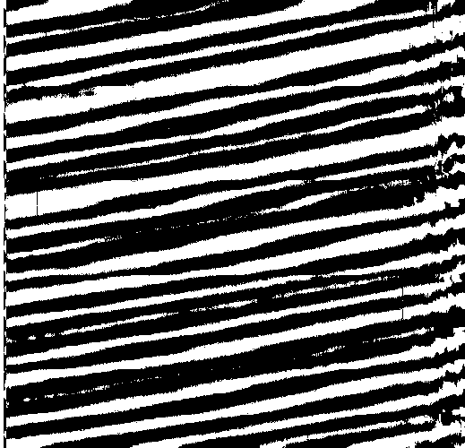
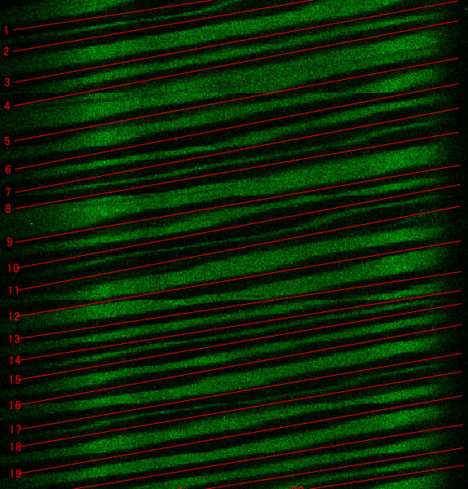
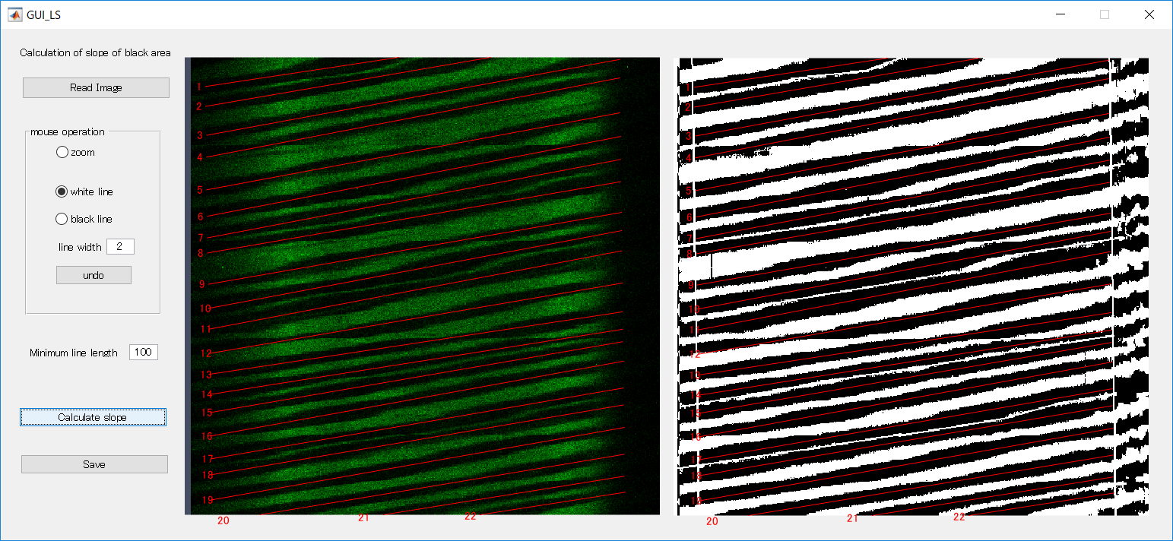
This software consists of the following two tools.
To use these, Matlab is needed.
Binarization tool
Slope calculation tool
Read the image and output binarized image. Perform batch processing on the images in the specified folder.
Read the image and calculate the slope for the black area of ​​the binarized image. You can also edit binarized images.

Slide 3
Binarization tool
Start Matlab, move to the software folder, type “main_binalize”, the GUI will start up.
This tool reads the image in the folder, performs smoothing and binarization, and outputs the binarized image to the same folder.
Specify image folder.
This tool binarizes each vertical line. The threshold of binarization can be obtained adaptively for each pixel. The threshold is adaptively determined within the range of the length specified here.
Specify the radius of the smoothing range of coordinate.
Specify the standard deviation of the smoothing range of coordinate.
Specify the standard deviation of the smoothing range of luminance.
Max of luminance is 1.
Output binarized images to the same folder. "Binarize_" is appended to the file name.

Slide 4
2. Slope calculation tool
Start Matlab, move to the software folder, type “main_LS”, the GUI will start up.
This tool reads the binary image and calculates the slope. It is also possible to edit binarized images.

Slide 5
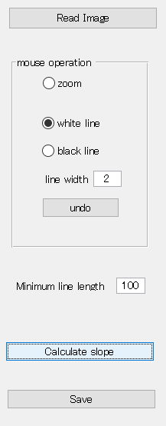
Specify the original image, not the binarized image.
If you specify the original image, the binary image is also automatically loaded.
Zoom the image by mouse operation.
Plot line on the binarized image by mouse operation. Click the start and end points.
Specify line width [pixel].
Delete the line. It returns to the previous operation for the number of times you clicked.
Specify minimum line length.
Calculate the slope for straight lines longer than the specified length.
Calculate the slope and plot the line.
Save the results (edited binarized image, csv file of slope information, line plot image, etc).

Slide 6
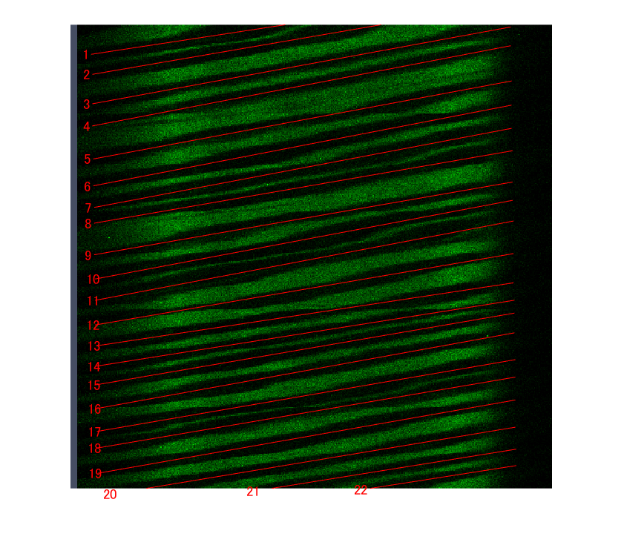
■csv file of slope information
In the CSV file, the slope, length, start point, and end point of each straight line are recorded. Line numbers are the same as those displayed on the image.
Y
X

