Slide 1


Scaling Sugarscape Simulation with AWS Batch
Hayate Saito

Slide 2
Project Overview
What is Sugarscape?
Goal: Run 900 simulations (9models * 100 seeds)
Problem: Takes too long on one machine

Slide 3
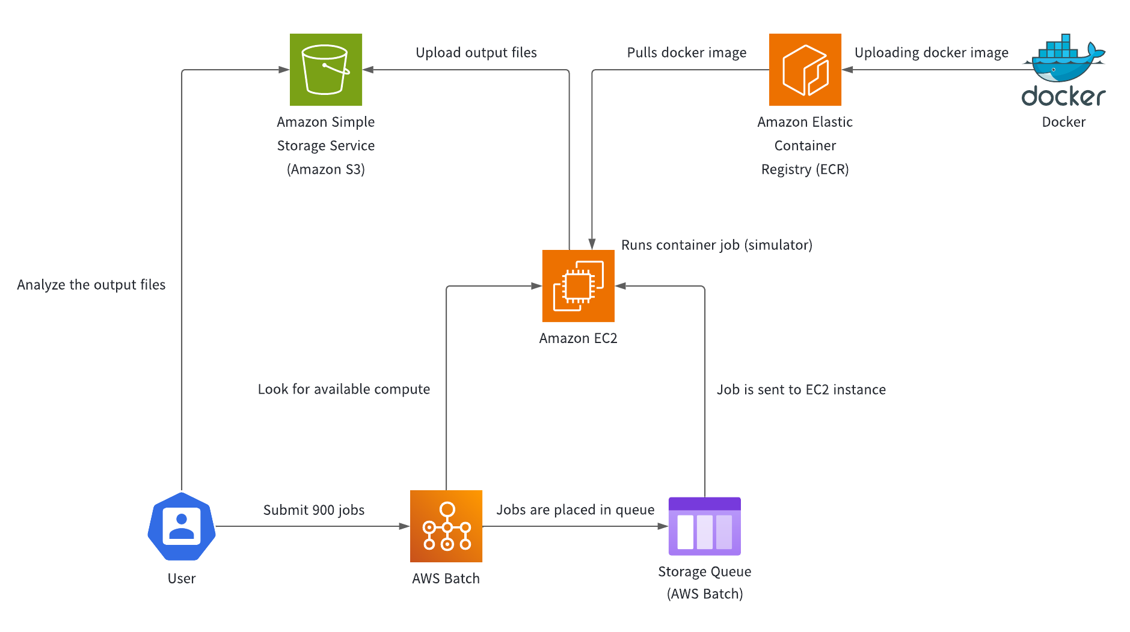
Architecture Diagram

Slide 4
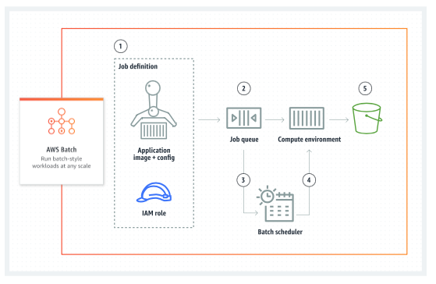
AWS Batch

Slide 5
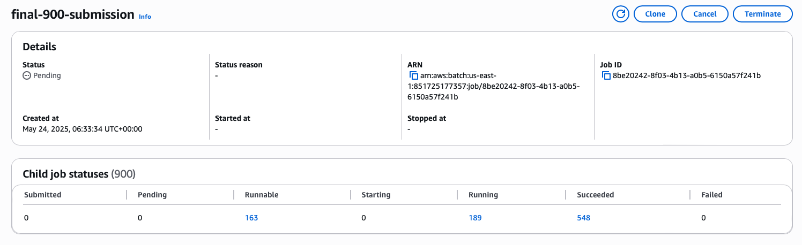
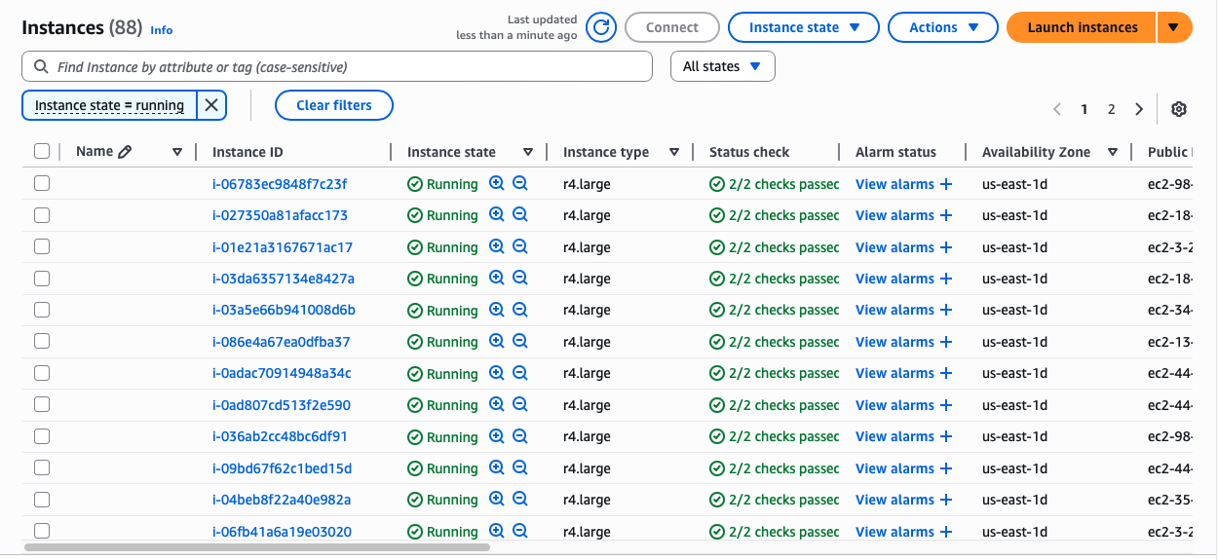
Scaling
11:34 pm – 2:02 am

Slide 6
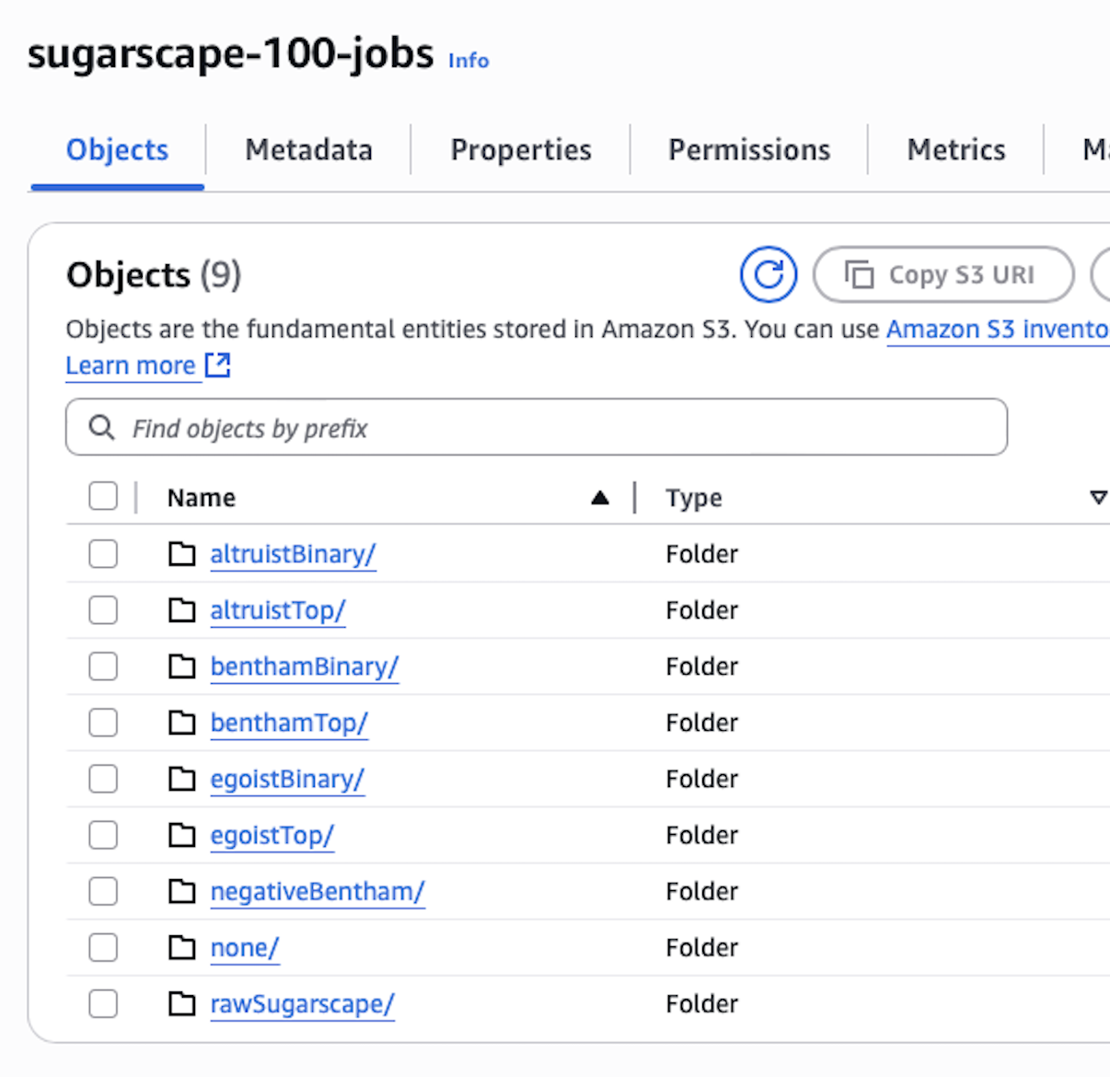
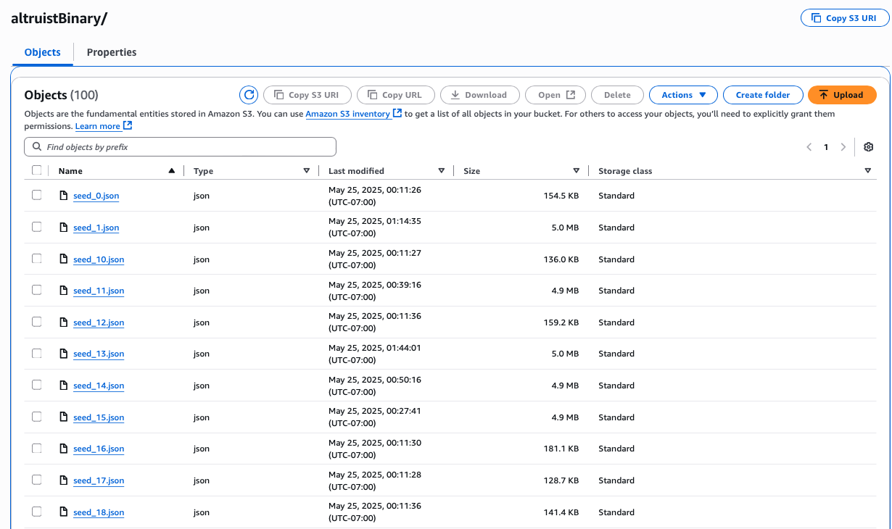
Data Collected
900 JSON log files in Amazon S3

Slide 7
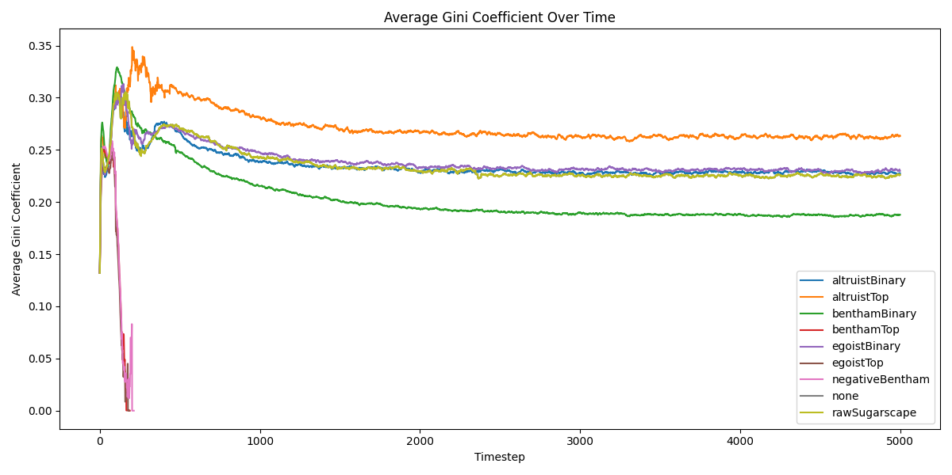
Gini Over Time

Slide 8
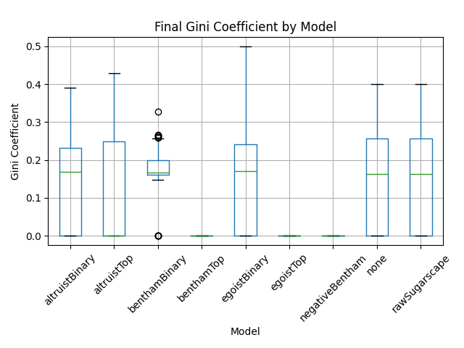
Final Gini by Model

Slide 9
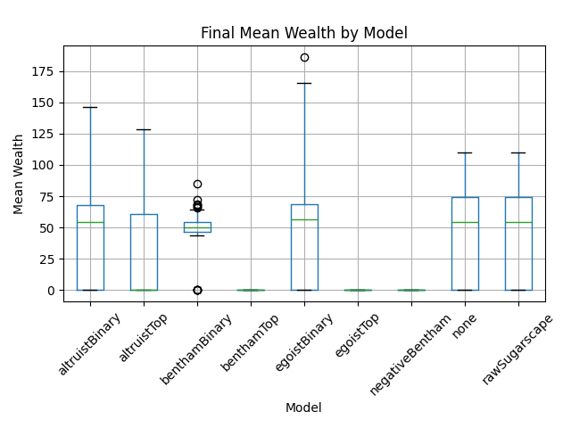
Final Wealth by Model

Slide 10
Challenges and Lessons Learned
Scaling EC2 instances
AWS Batch settings

Slide 11
Thank you

