Slide 1

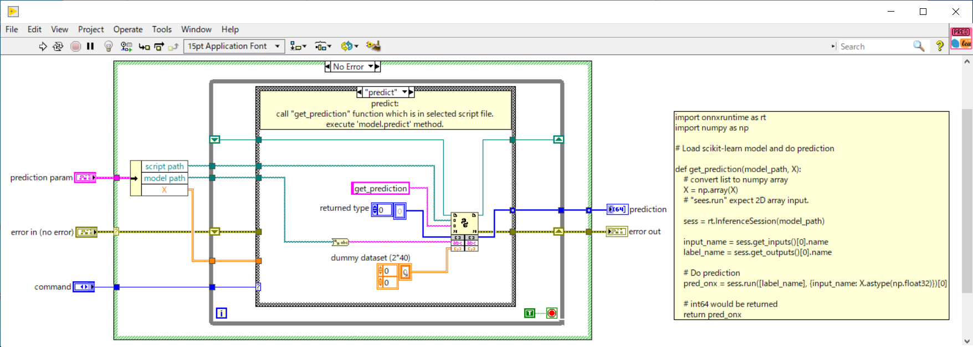

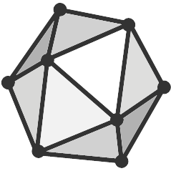

Generate tabular data
Execute predict.py
Return predicted result
Bind
Export trained model
(onnx format)
FROM Python:3.6.13
+ Numpy
+ Pandas
+ scikit-learn
+ skl2onn
CMD [ "python", "./train.py" ]
docker run -it /
–mount type=bind,src=“$PWD”,dst=/usr/src/app

