Slide 1
THESIS 1 PROGRESS REPORT • FIRST MONITORING
Persona-Based Multi-Agent LLM Debate as an Automated Playtester:
Validating Game Difficulty Data Against Human Performance Baselines
AUTHOR
Submitted By
Muhammad Haydar Maulana [203012510020]
Concentration: Informatics Software Engineering
Master of Informatics (MIF), Telkom University
E-mail: haydariday@gmail.com
Notes:
[Slide 1/17 | 00:00 - 00:30 | 0:30] Title Slide
Good morning to my supervisors and the monitoring committee. My name is Muhammad Haydar Maulana, working under the supervision of Doctor Arfive Gandhi and Doctor Jati Hiliamsyah Husen. Today I will present my Thesis 1 progress report on a persona-based multi-agent LLM debate playtester for game difficulty. This presentation covers the five sections of the report, from the background and objectives to the research method, pilot results and analysis.

Slide 2
SECTION 1 • BACKGROUND
1. Background: The Playtesting Cost Problem
Why game difficulty balancing matters and why manual playtesting is prohibitive for indie developers.
1A
1B
1C
Why Difficulty Matters
• Key question: "Is the game hard enough for the intended player?" [2].
• Too hard: Drives players away and causes early frustration [3].
• Too easy: Quickly becomes stale and loses engagement [3].
• Impact: Both extremes hurt retention, player reviews and reception [3], [4], [5].
Manual Playtesting Limits
• How designers test: Repeated human playtesting sessions [2].
• Resource-intensive: Requires many human testers over multiple sessions [2], [6], [7].
• Iterative burden: Must be repeated after every significant design update [6], [7].
• Indie barrier: Prohibitive cost and time for budget-constrained indie developers.
Automated Alternatives
• Hand-crafted agents: Programmed agents [6] and math models [8] need heavy per-game coding.
• Deep RL: Needs large training compute while playing unlike human players [9].
• LLM agents: Play games from text rules alone without task-specific training [10], [11], [12].
• Difficulty tracking: Xiao and Yang [1] show LLM difficulty in Wordle follows human difficulty.
Key Takeaway: LLM agents avoid per-game engineering and RL training while experiencing difficulty that tracks human players [1].
Muhammad Haydar Maulana [203012510020] | Master of Informatics, Telkom University • Refs: Xiao & Yang [1]; Weber [2]; Karavidas [3]; Prasetya [6]; Zhao [7]; Francillette [8]; Delfosse [9]
Slide 2 / 17
Notes:
[Slide 2/17 | 00:30 - 01:30 | 1:00] 1. Background: The Playtesting Cost Problem
Section 1 covers the background of the research. During development, game designers keep asking whether their game is hard enough for the intended player [2]. A game that is too hard drives players away while one that is too easy soon becomes stale, both of which risk losing players [3], [4], [5]. Manual playtesting is resource-intensive since it needs many testers over many sessions and has to be repeated after every design change [2], [6], [7]. For indie game developers, this cost is often prohibitive. Programmed test agents [6] and mathematical models [8] need heavy engineering per game, while deep reinforcement learning needs large training resources and plays unlike humans [9]. Large language models instead play games from text rules alone [10], [11], [12]. Xiao and Yang [1] show that the difficulty LLM agents experience in Wordle follows that of human players.

Slide 3
SECTION 1 • BACKGROUND
1. Background: The Gap in Playstyle Diversity and Consensus
Moving from single-agent LLM playtesting to a consistent, human-aligned multi-agent debate playtester.
RESEARCH GAP
CONDITIONS
The Research Gap in LLM Playtesting
• Single playstyle limitation: Prior LLM playtesters [1] rely on a single agent playing with one rigid prompt style.
• Human strategic diversity: Real players differ in strategy, as some take risks while others play safely.
• Strategic reasoning fidelity: Single LLMs replicate human strategic behavior less closely than multi-agent systems do [13].
• Missing consensus: Multi-agent debate could reconcile several playstyles into one consensus action, yet remains absent from difficulty measurement.
Two Required Conditions Before Use
• 1. Outcome consistency across runs: Since LLM outputs vary between calls, the same puzzle can end differently. Xiao and Yang [1] play 20 runs per puzzle yet report only the mean, leaving run-to-run consistency unknown.
• 2. Agreement with human difficulty: A consistent playtester that finds every puzzle equally easy is still of no practical value.
• Actionable insights: Practical utility for game designers requires direct expert validation.
Proposed Solution: Persona-Based Multi-Agent LLM Debate on Wordle
• Objective Difficulty: Measured from play outcomes (guesses used) rather than subjective player perceptions [14].
• Why Wordle: Short games, deterministic feedback, studied in [1] and backed by public human guess distributions.
• Practical Value: Gives indie developers a cheaper source of difficulty data that still reflects diverse human players.
Muhammad Haydar Maulana [203012510020] | Master of Informatics, Telkom University • Refs: Xiao & Yang [1]; Sreedhar & Chilton [13]; Constant et al. [14]
Slide 3 / 17
Notes:
[Slide 3/17 | 01:30 - 02:30 | 1:00] 1. Background: The Gap in Playstyle Diversity and Consensus
However, existing LLM playtesters rely on a single agent with only one playstyle. Human players are more diverse, as some take risks while others play safely, while single LLMs replicate human strategic behavior less closely than multi-agent systems do [13]. Multi-agent debate could reconcile several playstyles into one consensus action, yet such frameworks remain absent from difficulty measurement. Two conditions must hold before such a playtester can be used. First, its outcomes must be consistent across runs because LLM outputs vary between calls. Xiao and Yang [1] play each Wordle puzzle 20 times yet report only the average, so this consistency remains unknown. Second, its outcomes must agree with human difficulty, while its value for designers also requires expert validation. We therefore establish a persona-based multi-agent LLM debate playtester that measures objective difficulty from play outcomes [14] on Wordle.

Slide 4
SECTION 2.1 – 2.3 • FOUNDATIONS
2. Objective and Hypotheses: RQs, Objectives and Hypotheses
Direct alignment between the three research questions, the three research objectives and the three hypotheses.
RQs
OBJECTIVES
HYPOTHESES
2.1 Research Questions
• RQ1 (Consistency): How consistent are the Wordle playtest outcomes produced by the persona-based multi-agent debate playtester across repeated runs on the same puzzles?
• RQ2 (Human Agreement): To what extent do the Wordle difficulty estimates derived from the playtester's outcomes agree with human difficulty, measured by average guess scores and difficulty categories?
• RQ3 (Expert Utility): How do industry experts evaluate the utility and efficacy of multi-agent LLM debate for automated difficulty testing?
2.2 Objectives
• Objective 1: Implement a multi-agent LLM debate framework that operationalizes difficulty measurement through diverse personas, transforming point estimates into consensus-based assessments, with Wordle as the case study.
• Objective 2: Evaluate outcome consistency across repeated runs and validate agreement with human performance baselines (answers RQ1 and RQ2).
• Objective 3: Gather expert evaluations regarding utility and efficacy in game development workflows (answers RQ3).
2.3 Hypotheses
• Note: The pilot study is descriptive; H1 and H2 are tested in the final study, while H3 is tested via expert evaluation.
• H1 (Consistency): Within-puzzle standard deviation stays below a margin that is fixed from the pilot results before the final run.
• H2 (Human Agreement): Ranks puzzles in the same order of difficulty as humans while difficulty categories agree beyond chance.
• H3 (Expert Viability): Industry experts evaluate the framework as viable for automated playtesting.
Muhammad Haydar Maulana [203012510020] | Master of Informatics, Telkom University
Slide 4 / 17
Notes:
[Slide 4/17 | 02:30 - 03:45 | 1:15] 2. Objective and Hypotheses: RQs, Objectives and Hypotheses
Section 2 defines our research questions, objectives and hypotheses. Under Section 2.1, RQ1 asks how consistent the Wordle playtest outcomes are across repeated runs on the same puzzles. RQ2 asks to what extent the difficulty estimates derived from those outcomes agree with human difficulty, measured by average guess scores and difficulty categories. RQ3 asks how industry experts evaluate the utility and efficacy of multi-agent LLM debate for automated difficulty testing. Under Section 2.2, our three objectives match these questions. First, we implement the persona-based debate framework on Wordle. Second, we evaluate outcome consistency and human agreement for RQ1 and RQ2, after which we gather expert evaluations for RQ3. Under Section 2.3, the pilot study is descriptive, so our three hypotheses are tested in the final study. H1 states that within-puzzle standard deviation stays below a margin fixed from the pilot. H2 states that the playtester ranks puzzles in the same order as humans while its categories agree beyond chance. H3 states that industry experts will evaluate the framework as viable.

Slide 5
SECTION 2.4 • CONCEPT
2.4 Method and Concept
Synthesizing persona-based playtesting and multi-agent debate for LLM game difficulty measurement.
PILLAR 1
PILLAR 2
PILLAR 3
Playstyle Personas
• Adopted from persona-based playtesting (Holmgård et al. [15]).
• Represents distinct player tendencies (risk-taking, cautious, casual daily play) rather than a single monolithic player.
Multi-Agent Debate Consensus
• Adopted from manager-led multi-agent debate (Liang et al. [16]).
• Advisors critique proposals across rounds while a managing Game Master synthesizes the consensus action.
LLM Difficulty Measurement
• Applied to the outcome-based playtesting setup of Xiao and Yang [1].
• Compares completed playthrough guess counts against human performance baselines on the same puzzles.
VS. SINGLE AGENT
VALIDATION FOCUS
Difference from Single-Agent Playtesting [1]
• Xiao and Yang [1]: Uses a single LLM agent with one prompt style to play each puzzle.
• Our Playtester: Lets several agents with different playstyles (Bold, Cautious, Casual) debate and decide each guess together under a Game Master.
Difference from Benchmark Studies [13], [17]
• Benchmark Studies [13], [17]: Compare multi-agent systems against single-agent baselines on generic reasoning benchmarks.
• Our Validation Focus: Validates the playtester as a complete system against human difficulty data and industry experts, rather than claiming debate beats a single agent.
Muhammad Haydar Maulana [203012510020] | Master of Informatics, Telkom University • Refs: Xiao & Yang [1]; Sreedhar & Chilton [13]; Holmgård et al. [15]; Liang et al. [16]; Smit et al. [17]
Slide 5 / 17
Notes:
[Slide 5/17 | 03:45 - 04:30 | 0:45] 2.4 Method and Concept
Section 2.4 explains the method and concept behind the framework. It takes playstyle personas from persona-based playtesting [15] while taking the consensus process from multi-agent debate [16]. Both components are then applied to the LLM difficulty measurement of Xiao and Yang [1]. Unlike that work, which uses one agent, our playtester lets several agents with different playstyles decide each guess together. Unlike studies that compare multi-agent systems with a single agent [13], [17], this research validates the playtester as a system rather than claiming that debate beats a single agent.

Slide 6
SECTION 3.1 • LITERATURE
3.1 Existing Software, Systems and Methods
Comparison of hand-crafted, learning-based and LLM-based playtesting and debate methods.
Hand-Crafted Playtesters
• Strengths: Highly controlled behavior; no neural training required.
• APLib Goal Agents (Prasetya et al. [6]): Builds test agents with explicit goal structures, requiring heavy programming effort and a steep learning curve.
• Platformer Math Model (Francillette et al. [8]): Needs no complex AI, yet is restricted to platformer games with a complex setup.
• Core Limitation: Must be rebuilt from scratch for each new game or genre.
Learning-Based Playtesters
• Human-Move DNN (Gudmundsson et al. [18]): Trains a deep network on human moves to predict level difficulty, yet requires a large dataset of prior human play.
• Deep RL (Delfosse et al. [9]): Learns from self-play without human data, yet demands substantial training resources and lacks human behavioral patterns.
• Procedural Personas (Holmgård et al. [15]): Models playstyles via MCTS, yet still relies on heuristics evolved for the specific game.
LLMs & Multi-Agent Debate
• Rule-Only Play: Match-3 board-to-text [7] and Slay the Spire planning [19] without specialized training.
• Single-Agent Difficulty (Xiao & Yang [1]): Measures Wordle difficulty; needs a handicap so hard levels do not all tie at a loss.
• Debate & Personas: MIMIC [20] adds personality traits; Du et al. [21] and Liang et al. [16] use multi-round debate with a manager.
• Open Risks: Debate gains depend on setup [17] and agents may drift from assigned personas [22].
Muhammad Haydar Maulana [203012510020] | Master of Informatics, Telkom University • Refs: Xiao [1]; Prasetya [6]; Zhao [7]; Francillette [8]; Delfosse [9]; Holmgård [15]; Liang [16]; Smit [17]; Gudmundsson [18]; Bateni [19]; Chen [20]; Du [21]; Baltaji [22]
Slide 6 / 17
Notes:
[Slide 6/17 | 04:30 - 05:20 | 0:50] 3.1 Existing Software, Systems and Methods
Section 3 presents our research method, starting with existing systems in Section 3.1. Hand-crafted playtesters, such as goal agents in APLib [6] and mathematical platformer models [8], are controlled but must be rebuilt for each game. Learning-based methods reduce manual coding. Gudmundsson et al. [18] train a neural network on human moves, yet this requires large human play logs. Deep reinforcement learning needs heavy training while lacking human behavior patterns [9], whereas procedural personas still rely on game-specific heuristics [15]. LLM playtesters instead play from rules alone across match-3 games [7], Slay the Spire [19] and Wordle [1], while MIMIC adds personality traits [20]. Multi-agent debate combines agents through revision [21] and a manager [16], although setup [17] and persona drift [22] matter.

Slide 7
SECTION 3.2 • SPECIFICATION
3.2 Software, System and Method Requirement Specification
System features (3.2.1), LLM integration requirements (3.2.2) and expert evaluation participants (3.2.3).
FEATURES
MODEL SELECTION
1. Multi-Agent Debate Loop: Support multiple agents collaborating across rounds within each turn.
2. State-to-Text Extraction: Pull structured Wordle state data and render it into readable text for the LLM.
3. Diverse Personas: Assign distinct strategic viewpoints so agents do not agree immediately.
4. Adaptive GM Stopping: Allow the Game Master to stop debate once enough perspectives are heard and finalize the consensus action.
5. Engine Execution: Validate and execute the consensus action directly inside the Wordle environment.
6. Complete Audit Logging: Record every model call, debate decision and game outcome for downstream analysis.
LLM Integration (DeepSeek-V4.1-Flash)
• Model Selection: Chosen over OpenAI GPT contenders because disabling thinking mode allows a fixed temperature at a low cost per game.
• Three Capabilities Required: (1) Multi-step reasoning over game states, (2) Context window fitting rules + state + full turn transcript, (3) Reliable JSON replies (with repair retries and token/time logging).
PARTICIPANTS
• Target Pool: 5 to 7 industry experts recruited via professional networks and game development communities.
• Inclusion Criteria: Game designers, QA testers or producers with ≥ 3 years of industry experience and hands-on work in difficulty balancing or player experience (puzzle, strategy or roguelike games preferred).
• Ethics: Informed consent obtained; names and responses kept strictly anonymous.
Muhammad Haydar Maulana [203012510020] | Master of Informatics, Telkom University
Slide 7 / 17
Notes:
[Slide 7/17 | 05:20 - 06:10 | 0:50] 3.2 Software, System and Method Requirement Specification
Section 3.2 specifies the requirements across features, LLM integration and participants. Under Section 3.2.1, the system must support multiple agents in a debate loop while converting the Wordle state into readable text. It must also assign distinct personas, let a Game Master finalize the consensus guess, execute that guess in the engine and log every call and outcome. Under Section 3.2.2, we selected DeepSeek-V4.1-Flash because disabling its thinking mode allows a fixed temperature at a low cost. The model handles multi-step reasoning, fits the turn transcript in context and returns valid JSON replies with token logging. Under Section 3.2.3, RQ3 will recruit five to seven game designers, QA testers or producers with at least three years of experience in difficulty balancing.

Slide 8
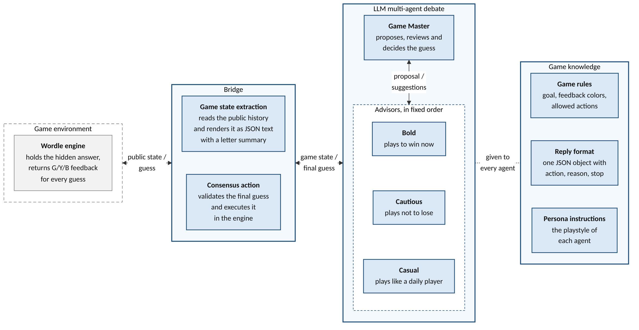
SECTION 3.3.1 – 3.3.2 • DESIGN
3.3.1 – 3.3.2 Playtester Framework and Debate Personas
The three-part architecture around Wordle (Figure 1) and the four personas grounded in explore–exploit play (Table 1).
Table 1. The personas of the debate (1 Managing Agent + 3 Playstyle Advisors).
Persona | Role | Playstyle
Game Master | Managing agent | Neutral. Proposes a guess, evaluates every advisor's argument and keeps or revises its proposal.
Bold | Advisor | Plays to win now. Prefers guesses that could still be the answer and accepts the risk of using more guesses later.
Cautious | Advisor | Plays not to lose. Prefers guesses that rule out the most remaining letters, even if they cannot be the answer.
Casual | Advisor | Plays like a typical daily player. Prefers common, familiar words with a habitual opener and does not compute letter statistics.
Theoretical Grounding & Advisor Sizing
• Explore vs. Exploit [24]: Cautious explores fresh letters like optimal Wordle play (`LIGHT` → `FERMS` [25]); Bold exploits candidates [26]; Casual mirrors typical daily heuristic play [15], [23].
• 3 Advisors: Debates with 3 agents yield clear gains [21], whereas adding more debaters raises token cost and causes context forgetting [16].
Figure 1. The multi-agent debate playtester framework for Wordle (game environment in dashed box).
Muhammad Haydar Maulana [203012510020] | Master of Informatics, Telkom University • Refs: Zhao & Tang [7]; Holmgård [15]; Liang [16]; Du [21]; Drachen [23]; Wilson [24]; Bertsimas [25]; J. Liang [26]
Slide 8 / 17
Notes:
[Slide 8/17 | 06:10 - 07:10 | 1:00] 3.3.1 – 3.3.2 Playtester Framework and Debate Personas
Section 3.3 covers the system design, beginning with the playtester framework in Figure 1 and the personas in Table 1. As Figure 1 shows, the framework places three parts around the Wordle environment: the bridge, the multi-agent debate and the game knowledge. In each turn, the bridge converts the public game state into text [7]. The agents then debate the next guess using the game knowledge, after which the bridge executes the final guess. Table 1 lists the four debate personas: one neutral Game Master and three playstyle advisors. In Wordle, players face a trade-off between exploration and exploitation [24]. Cautious explores by testing fresh letters even if the word cannot be the answer, matching optimal play [25]. Bold exploits by guessing words that could win immediately [26], while Casual picks familiar daily words without letter statistics. Three advisors capture these playstyles without the forgetting and higher cost of larger debates [16], [21].

Slide 9
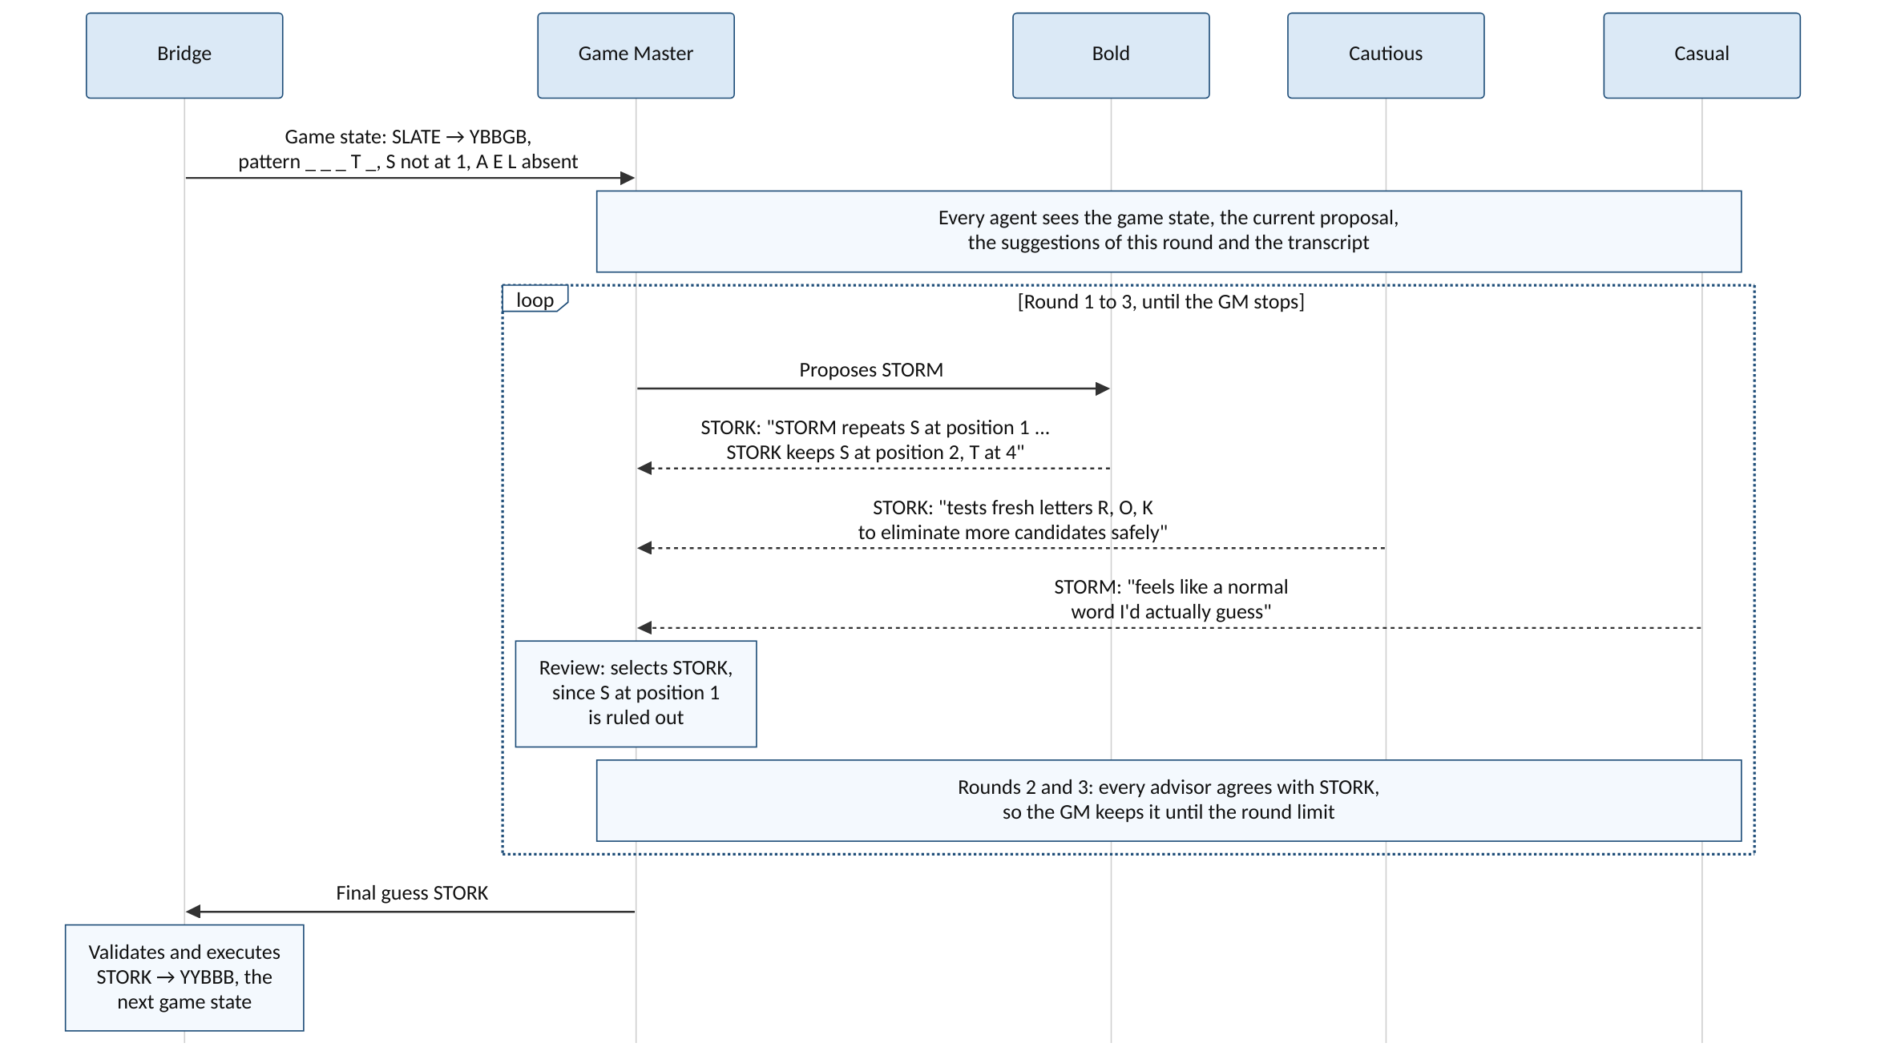
SECTION 3.3.3 – 3.3.6 • DESIGN
3.3.3 – 3.3.6 Bridge, Debate Protocol, Knowledge and Turn Statistics
Public-only state extraction, reciprocal debate with adaptive stopping (Figure 2) and persona verification logs.
3.3.3 Bridge: State & Consensus Action
• Public JSON State: Guess history (G/Y/B) + keyboard summary (`_ _ _ T _`, misplaced S, absent letters). Hides answer and limit.
• Validation: Verifies final guess is an unplayed word in the 14,855-word allowed list [27] before executing.
3.3.4 Debate Protocol & Adaptive Stopping
• Turn Order: (1) GM proposes → (2) Bold, Cautious, Casual critique in fixed order → (3) GM reviews and decides [16].
• Adaptive Break: GM stops early when consensus is reached, capped at 3 rounds. Invalid JSON/word triggers up to 2 retries.
3.3.5 Game Knowledge & 3.3.6 Turn Statistics
• Game Knowledge: Static rules, JSON reply schema (`action`, `reason`, `stop`) and per-agent persona prompt.
• Turn Statistics: Logs proposals, suggestions and candidate validity to verify Cautious suggests non-candidates more often than Bold [22], [28].
Figure 2. Debate protocol in Turn 2 of a pilot game: Bold and Cautious correct GM's STORM (S ruled out at pos 1) to STORK.
Muhammad Haydar Maulana [203012510020] | Master of Informatics, Telkom University • Refs: Liang et al. [16]; Baltaji et al. [22]; Atkins [27]; Licato et al. [28]
Slide 9 / 17
Notes:
[Slide 9/17 | 07:10 - 08:20 | 1:10] 3.3.3 – 3.3.6 Bridge, Debate Protocol, Knowledge and Turn Statistics
Sections 3.3.3 through 3.3.6 detail the bridge, the debate protocol, the game knowledge and the turn statistics. The bridge extracts the guess history and a keyboard letter summary with confirmed positions, misplaced letters and absent letters, while leaving out the answer word and guess limit. After the debate, the bridge validates the final guess against the 14,855-word allowed list [27] and executes it. Figure 2 shows the debate protocol on a real pilot turn [16]. First, the Game Master proposes STORM even though S was already ruled out at position 1. Next, Bold and Cautious both point this out and suggest STORK, whereas Casual agrees with STORM because it feels familiar. The Game Master adopts STORK in its review, after which all advisors agree up to the three-round limit. Meanwhile, the game knowledge gives the rules, JSON format and persona prompt, while turn statistics log whether each suggested word could still be the answer [22], [28].

Slide 10
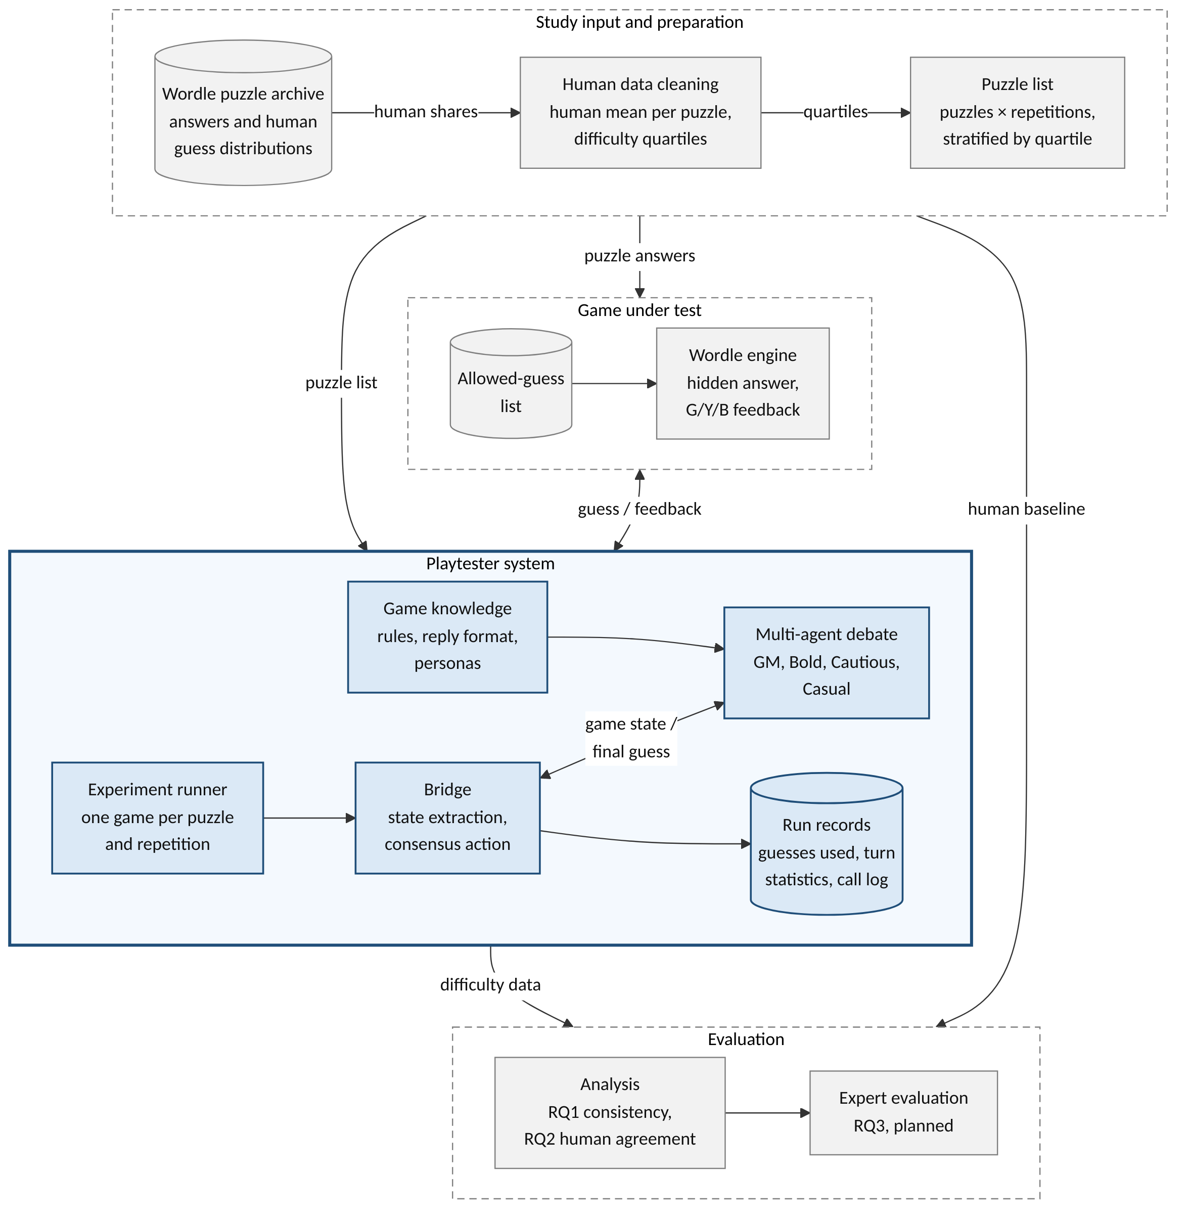
SECTION 3.4.1 • METHOD
3.4.1 Study Pipeline
Strict information boundary from the puzzle archive to outside evaluation (Figure 3).
Preparation & Strict Information Boundary
• Wordle Puzzle Archive: Answers and human guess distributions enter the study input step, where human shares go only to data cleaning and outside evaluation [1].
• Game Under Test: Puzzle answers go only to the Wordle engine (with the 14,855-word allowed list) and never enter any agent prompt.
• Zero Data Leakage: Neither the answer word nor the human score ever enters a prompt, so the playtester cannot copy the difficulty it is measured against [1].
Playtester System & Outside Evaluation
• Manifest-Only Input: The playtester system receives only the stratified puzzle list (puzzles × repetitions).
• Turn-by-Turn Play & Run Records: The experiment runner plays each puzzle and repetition as a separate game via the bridge and multi-agent debate, saving guesses used, turn debates and call logs.
• Outside Evaluation: Analysis compares run records with the human baseline for RQ1 and RQ2 [1], followed by the planned expert evaluation (RQ3).
Figure 3. Study pipeline from input to output (solid box = playtester system; dashed boxes = study steps and game).
Muhammad Haydar Maulana [203012510020] | Master of Informatics, Telkom University • Refs: Xiao & Yang [1]
Slide 10 / 17
Notes:
[Slide 10/17 | 08:20 - 08:50 | 0:30] 3.4.1 Study Pipeline
Section 3.4 covers the experiment design, starting with the study pipeline in Figure 3. In Figure 3, the solid box in the center is the playtester system, while the dashed boxes are the study steps and the game around it. From the Wordle archive, puzzle answers go only to the Wordle engine, while human shares go only to data cleaning and outside evaluation. The playtester takes only the puzzle list and outputs run records with guesses used, turn debates and call logs for RQ1 and RQ2 evaluation. Because neither the answer nor the human score enters any prompt, the playtester cannot copy the difficulty it is measured against [1].

Slide 11
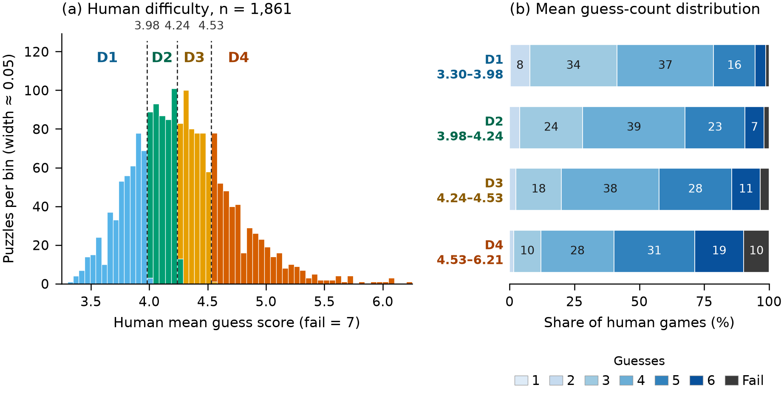
SECTION 3.4.2 • METHOD
3.4.2 Human Performance Baseline Data
Engaging Data 7-bin guess distribution across 1,861 cleaned puzzles and frozen D1–D4 quartiles (Figure 4).
Engaging Data Archive & Data Cleaning
• Human Guess Distribution [29]: Daily share of players solving each Wordle puzzle in 1 to 6 guesses; remaining unsolved share is scored as 7.
• 7-Bin Objective Difficulty [14]: Each puzzle has a 7-bin outcome distribution measuring objective play performance rather than subjective perception.
• Data Cleaning: Removed 4 puzzles for data errors (missing sample size or implausible solved share), leaving 1,861 of 1,865 puzzles.
Frozen Difficulty Quartiles (D1 to D4)
• Equal Quartile Split: The 1,861 cleaned puzzles are sorted by human mean and divided into four equal quartiles from D1 (easiest) to D4 (hardest).
• Frozen Cut-Points: Cut-points at 3.98, 4.24 and 4.53 guesses were frozen before any pilot run started.
• Narrow Middle Spread: As Figure 4(a) shows, the two middle quartiles (D2 and D3) span only 0.55 guesses between 3.98 and 4.53.
Figure 4. Human difficulty of the 1,861 cleaned puzzles: (a) quartile cut-points, (b) 7-bin distributions by quartile.
Muhammad Haydar Maulana [203012510020] | Master of Informatics, Telkom University • Refs: Constant et al. [14]; Engaging Data [29]
Slide 11 / 17
Notes:
[Slide 11/17 | 08:50 - 09:20 | 0:30] 3.4.2 Human Performance Baseline Data
Section 3.4.2 describes the human data in Figure 4. The baseline comes from the Engaging Data Wordle archive [29], which gives the share of players solving each puzzle in 1 to 6 guesses, with unsolved games scored as 7. Each puzzle therefore has a 7-bin distribution measuring objective difficulty [14]. Removing four records with missing sample sizes or implausible solve shares leaves 1,861 of 1,865 puzzles. These puzzles are sorted by human mean and split into four equal quartiles D1 to D4 at frozen cut-points of 3.98, 4.24 and 4.53 guesses. Figure 4 shows these quartiles, where the two middle quartiles span only 0.55 guesses.

Slide 12
SECTION 3.4.3 – 3.4.4 • METHOD
3.4.3 – 3.4.4 Pilot Design and Evaluation Measures
Two complementary pilot experiments (Table 2), frozen configuration with a 12-guess handicap and dual-scale measures.
Table 2. The two experiments of the pilot study.
Design Parameter | Exp A (deep) | Exp B (wide)
Puzzles | 12 (3 per quartile) | 48 (12 per quartile)
Runs per puzzle | 32 | 3
Sampling | Stratified random, seed 20261013 | Stratified random, seed 20261014, disjoint from Exp A
SCALES
3.4.4 Why Two Scoring Scales? (12-g vs. 6-g)
• The Handicap Problem [1]: LLM agents lose many games within 6 guesses, which would tie hard puzzles at 7. Playing up to 12 hidden guesses keeps hard puzzles apart.
• 12-Guess Score: Actual guesses used (loss = 13). Used for rankings and categories.
• 6-Guess Score: Cuts the same game at 6 guesses (loss = 7), matching human Wordle rules since agents never see the limit. Used for Bias, MAE and loss share.
3.4.3
Sample-Size Rules & Frozen Configuration
• Exp A Sizing (Thompson [30]): 32 runs per puzzle keep all 7 multinomial bin shares within ±20 percentage points simultaneously at 95% confidence (answers RQ1).
• Exp B Sizing (Julious [31]): 12 puzzles per quartile follows the rule of 12 per group for a pilot study (answers RQ2 across 48 puzzles).
• Frozen Config: `DeepSeek-V4.1-Flash` (thinking disabled, temp 0.2, 1,024-token limit) with a hidden 12-guess handicap [1]. Failed games retried once.
METRICS
3.4.4 Statistical Measures for RQ1 and RQ2
• RQ1 (Consistency): Within-puzzle SD (spread across runs), single-game ICC(1,1) and k-run mean ICC(1,k) (reliability of the averaged difficulty score).
• RQ2 (Average Alignment): Pearson r (linear) and Spearman ρ (rank order) with p-values [1]; Bias and MAE compared against a constant human-mean baseline.
• RQ2 (Categories): Playtester means split by rank into four equal quartiles (D1–D4) and compared with human quartiles in a confusion matrix.
Muhammad Haydar Maulana [203012510020] | Master of Informatics, Telkom University • Refs: Xiao & Yang [1]; Thompson [30]; Julious [31]
Slide 12 / 17
Notes:
[Slide 12/17 | 09:20 - 10:05 | 0:45] 3.4.3 – 3.4.4 Pilot Design and Evaluation Measures
Sections 3.4.3 and 3.4.4 cover the pilot design in Table 2 and our evaluation measures. Experiment A is the deep experiment for RQ1, playing 12 puzzles 32 times each. Under Thompson's rule, 32 runs keep all seven bin shares within 20 percentage points at 95 percent confidence [30]. Experiment B is the wide experiment for RQ2, playing 48 disjoint puzzles three times each under Julious's rule of 12 per quartile [31]. Every agent runs on DeepSeek-V4.1-Flash at temperature 0.2 with a hidden 12-guess handicap so hard puzzles do not all tie at 7 [1]. Each game is read on both the 12-guess score and the 6-guess score capped at 7. RQ1 uses within-puzzle standard deviation, ICC(1,1) and ICC(1,k), while RQ2 uses Pearson r, Spearman rho, bias, MAE and a rank-based quartile confusion matrix.

Slide 13
SECTION 4.1 • RESULTS
4.1 Experiment Result: Completion and Cost
Run completion across 543 attempts, failure causes, token consumption and adaptive stopping behavior.
525 / 543
Completed Games
96.7% overall completion rate
383 / 395
Exp A (Deep, 12×32)
11 of 12 puzzles hit all 32 runs
142 / 148
Exp B (Wide, 48×3)
46 of 48 puzzles hit all 3 runs
67s – 71s
Mean Runtime / Game
~80k–89k total tokens per game
RELIABILITY
COST & ROUNDS
Completion & Breakdown of the 18 Failed Attempts
• Total Attempts: 543 attempts across both experiments yielded 525 completed games.
• Invalid Reply (13 attempts): Ended because an agent still returned an invalid JSON or disallowed word after two correction requests.
• Runner Stopped (4 attempts): Cut off in Exp A when a batch run was manually stopped.
• Service Timeout (1 attempt): Ended on a timeout from the model service in Exp A.
• Retry Policy: Each failed game was retried once; 11/12 Exp A and 46/48 Exp B puzzles reached all planned runs.
Token Cost, Runtime and Debate Rounds
• Exp A (Deep) Per Game: Averaged 71 seconds, 75,800 prompt tokens and 3,900 completion tokens.
• Exp B (Wide) Per Game: Averaged 67 seconds, 84,800 prompt tokens and 4,300 completion tokens.
• Model Consistency: Every answered API call returned the exact same model version identifier.
• Adaptive Stopping: The GM ended the debate early in 57 of 2,198 turns (2.6%) in Exp A and 19 of 887 turns (2.1%) in Exp B; all other turns ran to the limit of 3 rounds.
Muhammad Haydar Maulana [203012510020] | Master of Informatics, Telkom University
Slide 13 / 17
Notes:
[Slide 13/17 | 10:05 - 10:50 | 0:45] 4.1 Experiment Result: Completion and Cost
Section 4 presents the experiment results, starting with completion and cost in Section 4.1. The pilot made 543 attempts, of which 525 ended as completed games: 383 in Experiment A and 142 in Experiment B. Thirteen of the 18 failed attempts ended on invalid replies after two repair requests, four were cut off when a run was stopped and one ended on a timeout. After one retry, 11 of 12 deep puzzles and 46 of 48 wide puzzles reached all planned runs. A game averaged 71 seconds with 75,800 prompt tokens in Experiment A, while taking 67 seconds with 84,800 prompt tokens in Experiment B. The Game Master stopped the debate early in 57 of 2,198 turns in Experiment A and 19 of 887 turns in Experiment B.

Slide 14
SECTION 4.2 • RESULTS
4.2 RQ1 Results: Outcome Consistency Across Repeated Runs
Overall measures (Table 3) and within-puzzle SD by quartile (Table 4) across both scoring scales.
Table 3. Overall RQ1 consistency measures on 12-g and 6-g scores.
Table 4. Mean within-puzzle SD (guesses) by human quartile.
Measure | Exp A, 12-g | Exp A, 6-g | Exp B, 12-g | Exp B, 6-g
Within-puzzle SD | 1.53 | 0.96 | 1.52 | 0.85
ICC(1,1), one game | 0.49 | 0.55 | 0.48 | 0.44
ICC(1,k), mean of runs | 0.97 | 0.98 | 0.73 | 0.70
Human Quartile | Exp A, 12-g | Exp A, 6-g | Exp B, 12-g | Exp B, 6-g
D1 (Easiest) | 0.94 | 0.74 | 1.06 | 0.89
D2 | 1.37 | 1.10 | 1.75 | 0.78
D3 | 1.48 | 0.95 | 1.35 | 0.79
D4 (Hardest) | 2.30 | 1.04 | 1.93 | 0.95
ICC(1,1) & ICC(1,k)
D1 → D4 ANALYSIS
Single-Game Spread vs. Multi-Run Reliability
• Single-Game Variance: ICC(1,1) is 0.49 (12-g) and 0.55 (6-g) in Exp A; 0.48 and 0.44 in Exp B. Roughly half of single-run score variance stems from run-to-run noise (~1.5 guesses SD).
• Multi-Run Reliability: Averaging across repeated runs reaches ICC(1,k) = 0.97 (12-g) and 0.98 (6-g) in Exp A (32 runs) and 0.73 in Exp B (3 runs).
• Core Finding: Multi-agent playtesting requires multiple runs per puzzle to average out debate randomness and yield a stable difficulty score.
Quartile Spread Growth with Puzzle Hardness
• 12-Guess SD Growth: Mean within-puzzle SD escalates from 0.94 guesses for D1 (easiest) to 2.30 guesses for D4 (hardest) in Exp A, with Exp B showing a similar climb (1.06 → 1.93).
• Tail & Loss Dynamics: Harder puzzles force longer search paths and occasional losses (loss = 13), creating wider run-to-run dispersion.
• 6-Guess Truncation: Capping games at 6 guesses suppresses this variance (0.74 to 1.10 across quartiles), as failed games are compressed to score 7.
Muhammad Haydar Maulana [203012510020] | Master of Informatics, Telkom University
Slide 14 / 17
Notes:
[Slide 14/17 | 10:50 - 11:45 | 0:55] 4.2 RQ1 Results: Outcome Consistency Across Repeated Runs
Section 4.2 reports the RQ1 consistency results in Tables 3 and 4 across both experiments and both scoring scales. In Experiment A across 12 puzzles with 32 runs each, the within-puzzle standard deviation is 1.53 guesses on the 12-guess score and 0.96 on the 6-guess score. A single game gives an intraclass correlation ICC(1,1) of 0.49 on the 12-guess score and 0.55 on the 6-guess score. However, the mean of 32 games reaches an ICC(1,k) of 0.97 on the 12-guess score and 0.98 on the 6-guess score. In Experiment B across 48 puzzles with three runs each, ICC(1,1) is 0.48 while the three-run mean reaches an ICC(1,k) of 0.73. Table 4 breaks this spread down by quartile. On the 12-guess score, the mean standard deviation rose from 0.94 guesses for D1 puzzles to 2.30 for D4 puzzles. On the 6-guess score, it stayed between 0.74 and 1.10 guesses.

Slide 15
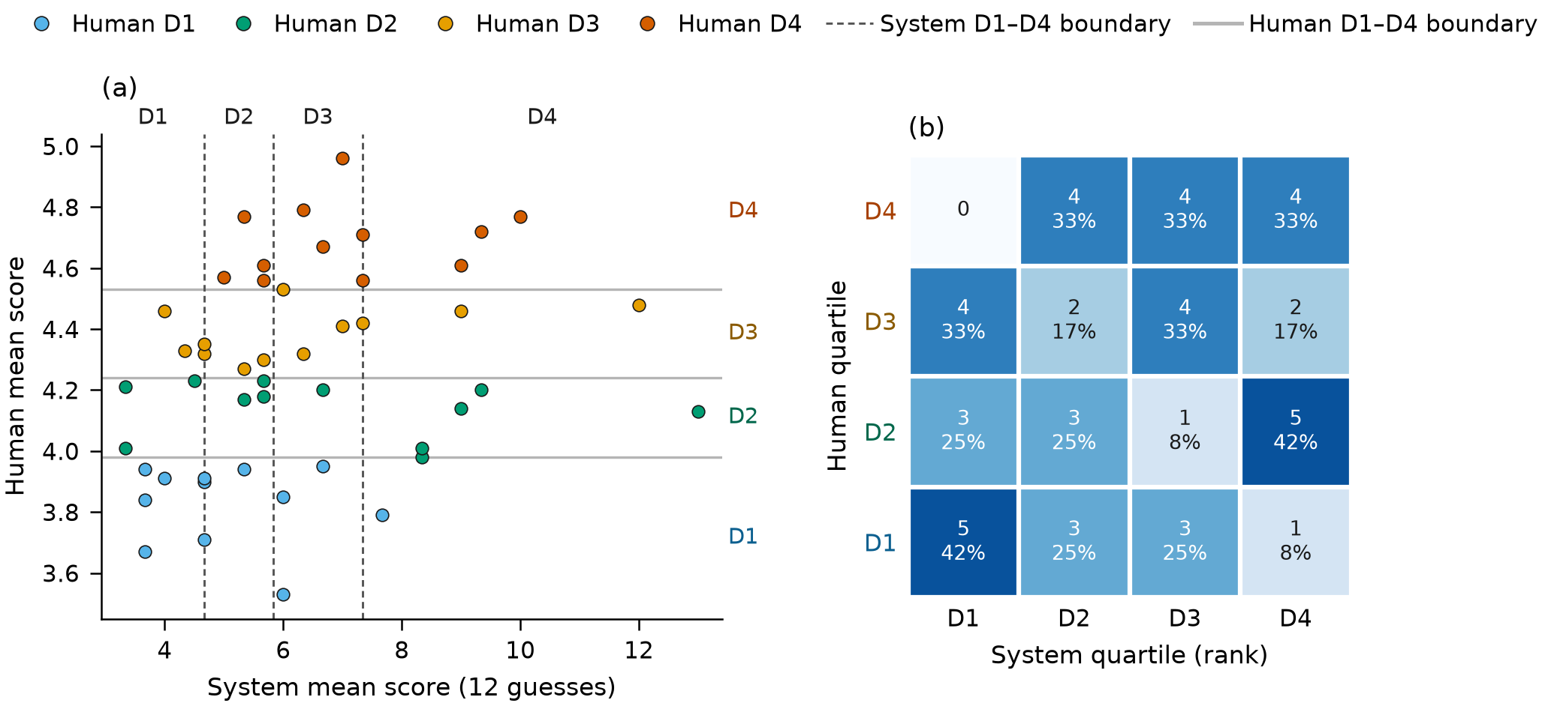
SECTION 4.3 • RESULTS
4.3 RQ2 Results: Agreement with Human Difficulty
Correlation and level error (Table 5) alongside rank-based D1–D4 quartile agreement on Exp B (Figure 5).
Table 5. RQ2 results of Exp B (48×3) and Exp A (12×32) with correlation p-values [1].
Measure | Exp B, 12-g | Exp B, 6-g | Exp A, 12-g | Exp A, 6-g
Playtester avg. guesses | 6.34 | 5.54 | 5.76 | 5.29
Human avg. guesses | 4.26 | 4.26 | 4.25 | 4.25
Pearson r | 0.30 (p=.039) | 0.38 (p=.007) | 0.70 (p=.011) | 0.60 (p=.041)
Spearman ρ | 0.34 (p=.017) | 0.36 (p=.012) | 0.72 (p=.008) | 0.62 (p=.031)
Bias (guesses) | – | +1.28 | – | +1.04
MAE (guesses) | – | 1.38 | – | 1.26
Level Bias vs. Quartile Agreement
• Level Bias: Averages 5.54 vs. 4.26 guesses in Exp B (+1.28 bias, 1.38 MAE); fails within 6 guesses ~27 pp more often than humans in Exp A.
• Quartile Confusion (Fig 5, Exp B): 16/48 exact diagonal, 31/48 within one quartile, 0 human D4 placed in D1 (Exp A: 4/12 exact, 10/12 within one quartile).
Figure 5. Difficulty categories of the 48 wide puzzles in Exp B (split by rank): (a) puzzle means, (b) confusion matrix.
Muhammad Haydar Maulana [203012510020] | Master of Informatics, Telkom University • Refs: Xiao & Yang [1]
Slide 15 / 17
Notes:
[Slide 15/17 | 11:45 - 12:45 | 1:00] 4.3 RQ2 Results: Agreement with Human Difficulty
Section 4.3 reports the RQ2 human agreement results in Table 5 and Figure 5. In Experiment B across 48 puzzles, the playtester's averages correlate with the human averages at Spearman rho equal to 0.34 with a p-value of 0.017. In Experiment A across 12 puzzles with 32 runs each, Spearman rho reaches 0.72 with a p-value of 0.008. On the 6-guess score, the playtester averaged 5.54 guesses on the Experiment B puzzles compared with 4.26 for humans. That is a bias of about 1.3 guesses with an MAE of 1.38 guesses. In Experiment A, the playtester also failed within six guesses about 27 percentage points more often than humans did. Figure 5 compares the rank-based difficulty quartiles for the 48 wide puzzles. Sixteen of the 48 puzzles fell on the diagonal while 31 lay within one quartile, with no human D4 puzzle placed in D1.

Slide 16
SECTION 5.1 – 5.2 • ANALYSIS
5.1 – 5.2 Analysis of RQ1 (Consistency) and RQ2 (Human Agreement)
Why repeated runs are necessary (RQ1) and why the playtester measures relative difficulty better than absolute level (RQ2).
5.1 RQ1
5.2 RQ2
5.1 RQ1 Analysis: Consistency Across Runs
• Single-Run Noise: ICC(1,1) = 0.49 means roughly half of the score variance lies between puzzles while half comes from run-to-run noise (~1.5 guesses spread).
• Multi-Run Reliability: Averaging across runs is highly reliable (ICC(1,k) = 0.97 at 32 runs; 0.73 at 3 runs), proving each puzzle should be played several times before using its mean.
• Why Hard Puzzles Vary More: D4 puzzles produce long games and occasional losses. This variance is essential, as a playtester that wins every game in few guesses cannot separate puzzles.
5.2 RQ2 Analysis: Agreement with Human Difficulty
• Statistically Significant Ranking: Both experiments rank puzzles in the same direction as humans ($p < 0.05$).
• Effect of Run Count on Precision: Ranking is much stronger in Exp A (ρ = 0.72) than Exp B (ρ = 0.34) because 32 runs yield a cleaner puzzle mean, matching Xiao and Yang's best 20-run correlation (r = 0.62) [1].
• Why Raw Scores Cannot Be Read Directly: The playtester plays ~1.3 guesses worse than humans. Its 1.38 MAE is more than twice the 0.55-guess width of the middle two quartiles (3.98 to 4.53), while an MAE close to the bias (+1.28) shows most error is a constant shift.
• Rank-Based Quartiles Work: Splitting by rank places two thirds (31/48) of Exp B puzzles within one quartile of their human category.
Core Finding (Sections 5.1–5.2): Averaging over repeated runs produces a reliable score that measures relative difficulty (ranks and categories) much better than absolute difficulty.
Muhammad Haydar Maulana [203012510020] | Master of Informatics, Telkom University • Refs: Xiao & Yang [1]
Slide 16 / 17
Notes:
[Slide 16/17 | 12:45 - 13:55 | 1:10] 5.1 – 5.2 Analysis of RQ1 (Consistency) and RQ2 (Human Agreement)
Section 5 analyzes the experiment results, starting with RQ1 and RQ2 in Sections 5.1 and 5.2. For RQ1, a single run is only moderately consistent, as its ICC(1,1) of 0.49 means that about half of the score variance comes from run-to-run noise of about 1.5 guesses. However, the mean over many runs is highly reliable, reaching an ICC(1,k) of 0.97 at 32 runs and 0.73 at three runs. That is why a puzzle must be played several times before using its mean. Part of this spread comes from hard puzzles that produce long games and losses, which is needed to separate puzzles. For RQ2, the playtester ranks puzzles in the same direction as humans in both experiments. The ranking is stronger in Experiment A at 0.72 than in Experiment B at 0.34, which is close to the 0.62 correlation of Xiao and Yang [1]. However, the 1.38 MAE is more than twice the 0.55-guess width of the middle two quartiles, while an MAE close to the bias shows a constant shift. Thus, the playtester measures relative difficulty better than absolute difficulty.

Slide 17
SECTION 5.3 – 5.4 • NEXT STEPS
5.3 – 5.4 Planned Expert Evaluation (RQ3) and Final Study Implications
Mixed-method expert evaluation design and the four design decisions fixed before running the final study.
5.3 RQ3
5.4 FINAL STUDY
5.3 RQ3: Expert Evaluation (Planned Next Stage)
• Schedule Position: Follows the quantitative analysis in the research schedule.
• Stimulus Material: The 5–7 industry experts will inspect the final RQ1 consistency and RQ2 human-agreement results.
• Part 1 — Likert-Scale Survey (1 to 5): Experts rate utility and efficacy statements on a 1–5 scale, after which the overall average score is reported.
• Part 2 — Semi-Structured Interviews: Analyzed thematically to capture practical workflow insights, with each recurring theme reported as a share of the expert pool.
5.4 Four Implications Fixed Before the Final Study
1. Reliability-Based Run Sizing: Set the number of runs per puzzle ($k$) so the puzzle mean reaches a target reliability, such as ICC(1,k) ≥ 0.9.
2. Fixed H1 Consistency Margin: Fix the RQ1 hypothesis margin from the pilot spread before the final run (for example, within-puzzle SD ≤ 0.5 on the 6-guess score).
3. Primary RQ2 Measures (H2): Judge agreement with human difficulty primarily through rank correlation and rank-based quartiles.
4. Descriptive Distribution Case Study: Show the guess distributions of the 3 easiest and 3 hardest puzzles by human mean.
Fresh Test Set: The final study will play fresh puzzles that were never used in the pilot.
Muhammad Haydar Maulana [203012510020] | Master of Informatics, Telkom University
Slide 17 / 17
Notes:
[Slide 17/17 | 13:55 - 15:00 | 1:05] 5.3 – 5.4 Planned Expert Evaluation (RQ3) and Final Study Implications
Finally, Sections 5.3 and 5.4 cover the planned expert evaluation for RQ3 and the implications for the final study. The expert evaluation follows the quantitative analysis and combines a Likert-scale survey with semi-structured interviews. Five to seven experts will inspect the final RQ1 and RQ2 results and rate utility statements from 1 to 5, after which the mean rating and interview themes are reported. Before any final run begins, the pilot results fix four design choices for the final study on fresh unseen puzzles. First, the runs per puzzle will be set to reach a reliability target such as an ICC(1,k) of at least 0.9. Second, the H1 consistency margin, such as a within-puzzle standard deviation of at most 0.5 on the 6-guess score, will be fixed from the pilot spread. Third, the primary RQ2 measures will be the rank correlation and rank-based quartiles. Fourth, the three easiest and three hardest puzzles will be shown as a distribution case study. Thank you for your attention.

