Slide 1

Returns. Software. Distribution.
A self-funding holding company that generates deal returns
and reinvests into disruptive software products.
Introducing AllWealth — the all-in-one wealth management platform.
CONFIDENTIAL | FEBRUARY 2026

Slide 2





THE MODEL
Self-funding flywheel. Invest in deals. Build software. Sell into the network.
DEAL RETURNS
FUND SOFTWARE
Pre-IPO, small caps,
critical minerals
Reinvest profits into
AllWealth development
▲
▼
RECURRING REVENUE
SELL TO NETWORK
◀
SaaS ARR at 10x
multiple valuations
FFAU advisors,
Endeavor clients
Funds management
Global distribution
Invest in the deals (returns) AND own equity in AllWealth (valuation upside).

Slide 3
RECENT INVESTMENTS
Deals you've invested in alongside me. Real returns, real capital.
Wolfram
+500%
Equus
+112%
Black Horse Gold
+105%
Breakthrough Minerals
+80%
Apex Critical Minerals
+1%
HoldCo is the vehicle for these deals. Returns fund software development. Self-funding model.

Slide 4
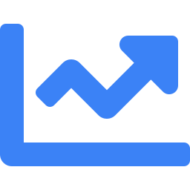
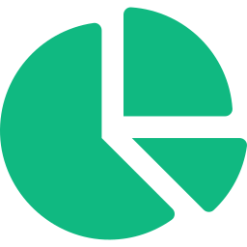





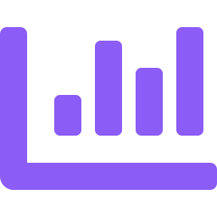

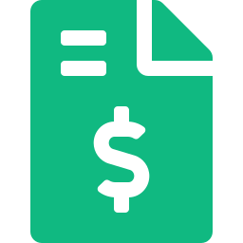


ALL WEALTH
The all-in-one wealth management platform. One product. Two user types. Massive TAM.
FOR ADVISORS
FOR CLIENTS
Market Dashboard
Net Wealth Dashboard
Live global data: sectors, thematics, commodities, forex
Full consolidated view: listed, private, property, cash
Company Analysis
API Bank Feeds
AI deep dives, BUY/HOLD/SELL, key metrics, growth catalysts
Live bank balances, transaction history, expense breakdown
Client Portfolio Overview
Cash Flow & Expenses
Consolidated view across all client accounts
Monthly tracking with categorised expense breakdown
Market Wraps & Email Summaries
Performance Reporting
Daily wraps advisors forward to clients instantly
On-demand reports. Client-ready exports. Full transparency
One-Click Financial Plans
Tax Estimates
AI-generated plans advisors customise and present
Real-time estimated tax position and optimisation
Ask Bro AI Agent
Private Holdings Input
CFA-grade Q&A for any client query in seconds
Property, PE, collectibles tracked alongside listed assets
Addepar: $80,000 USD p.a.
+ $40,000 USD setup. Enterprise only.
AllWealth: From $10/mo per advisor
HNW tier: $20K AUD setup + $20K AUD p.a.

Slide 5
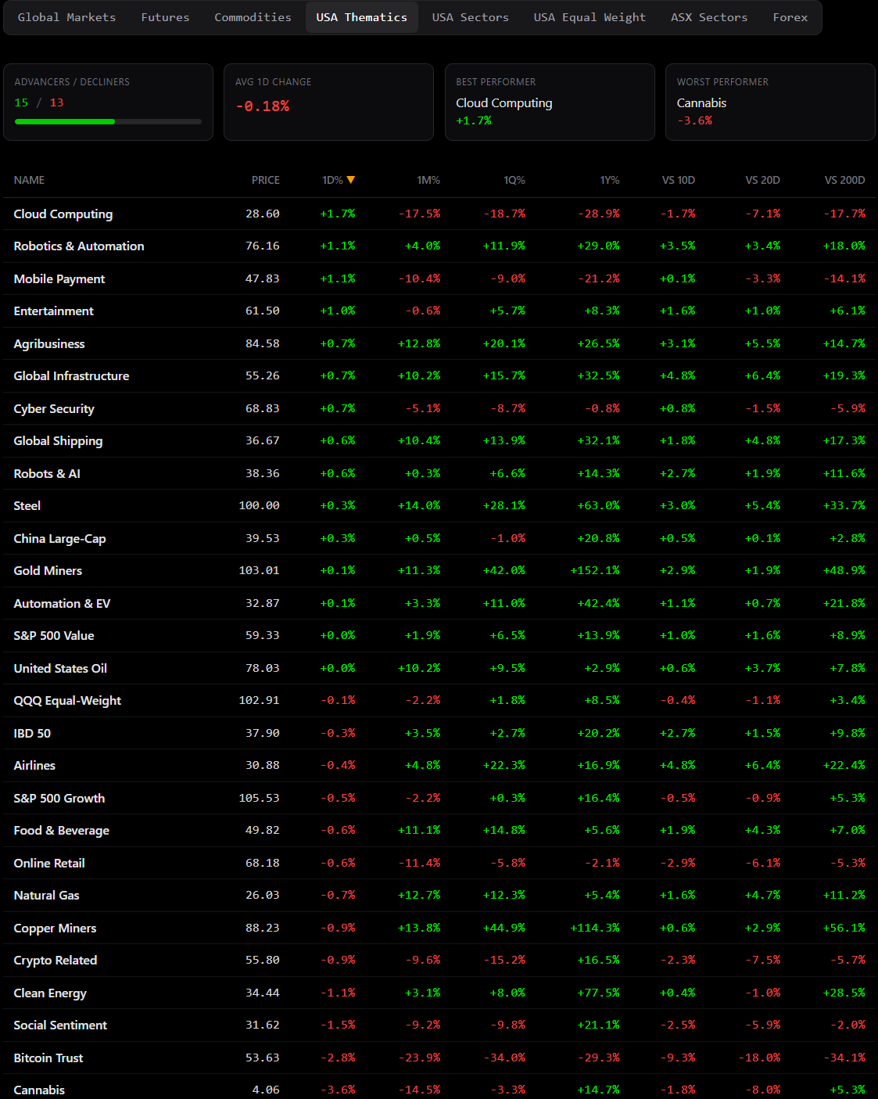
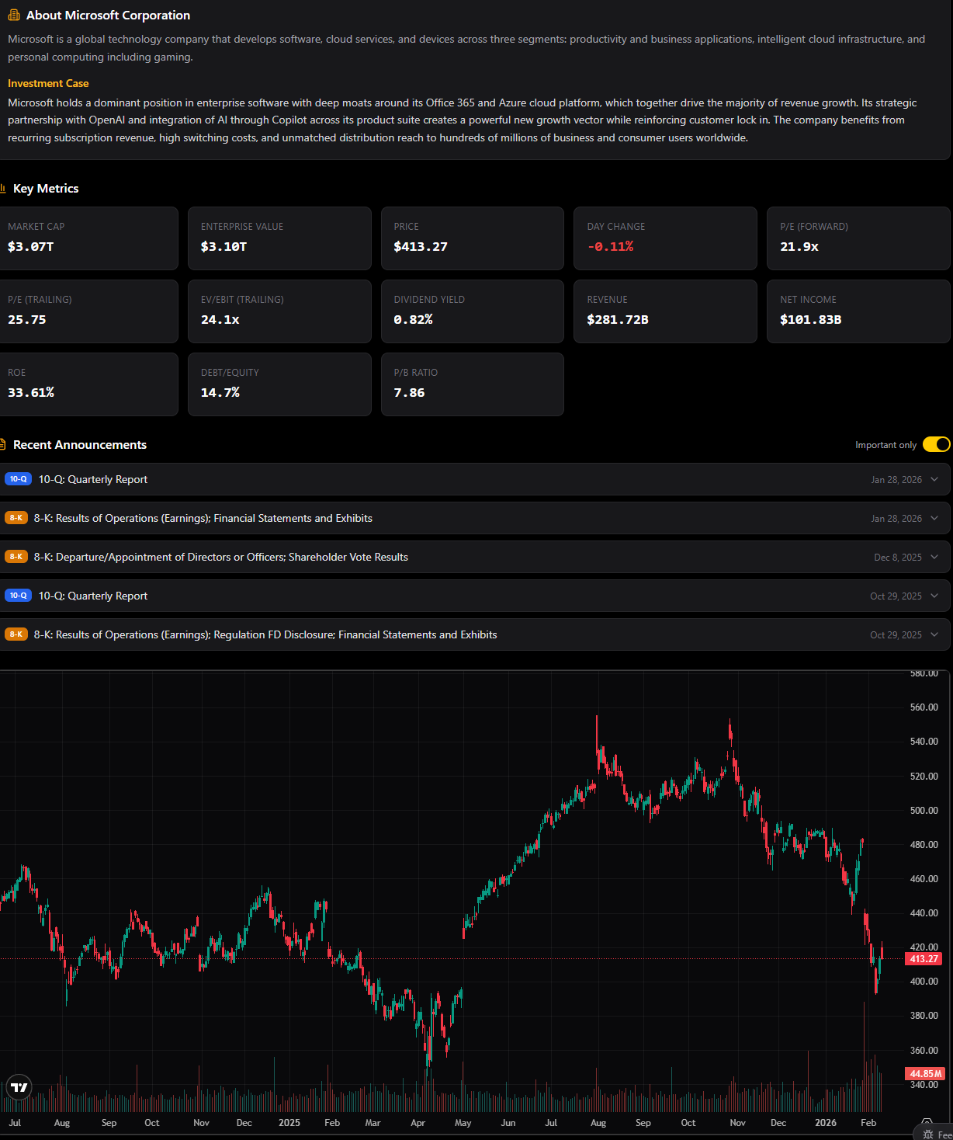
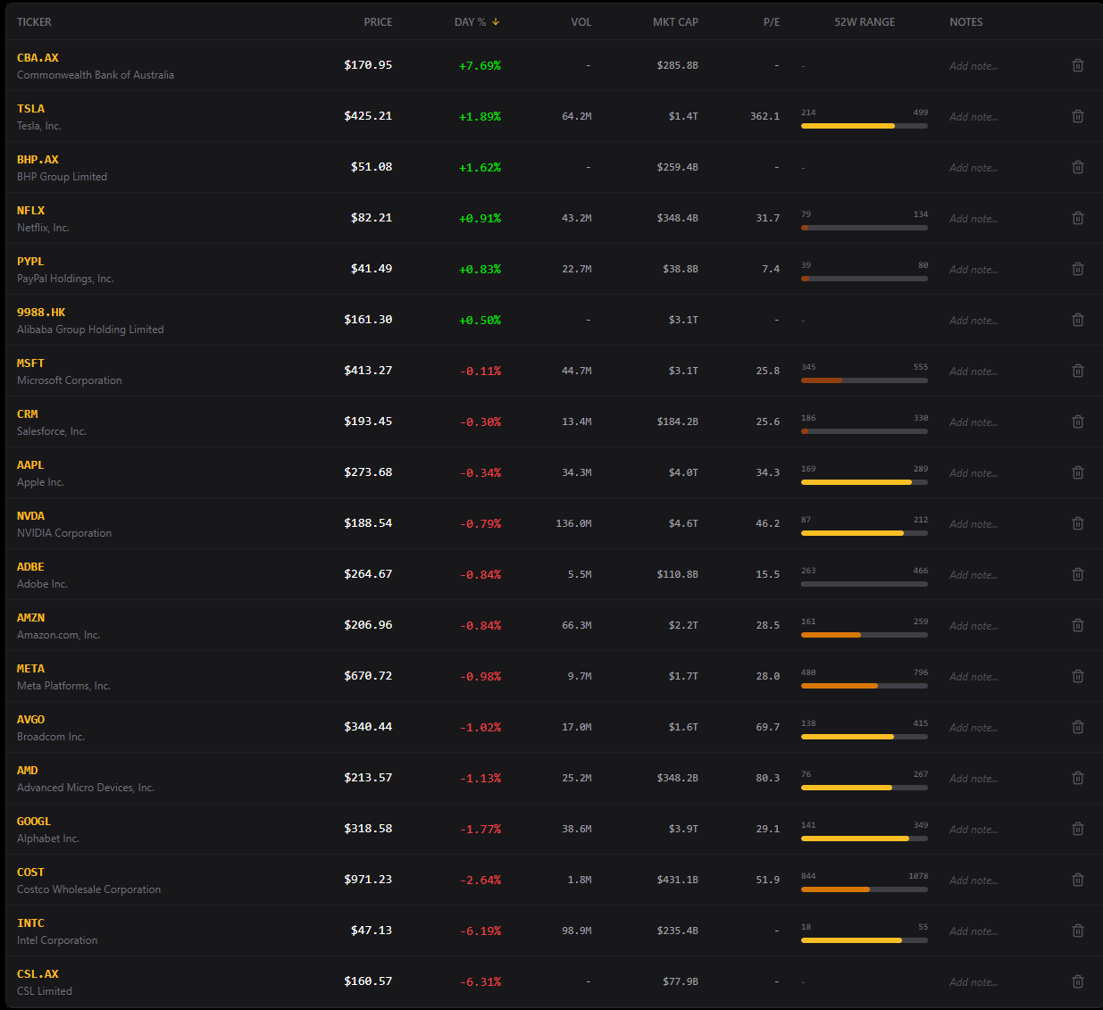
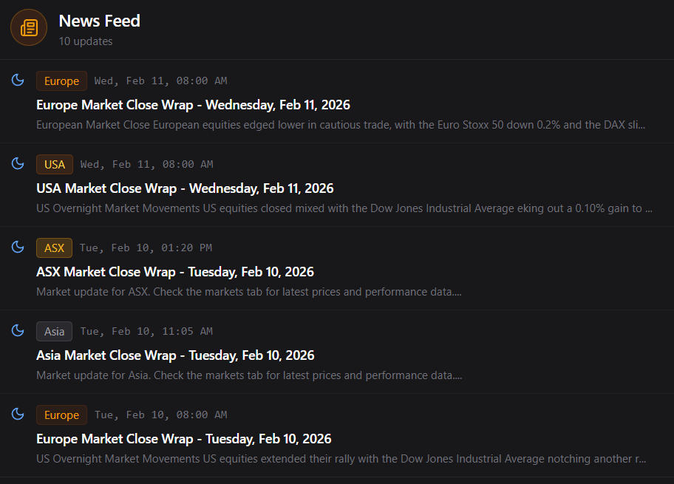
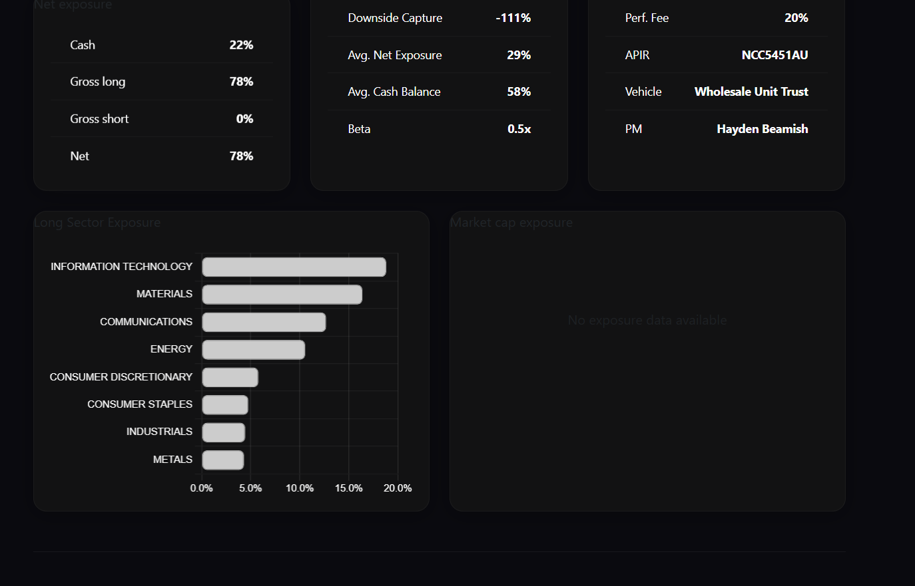
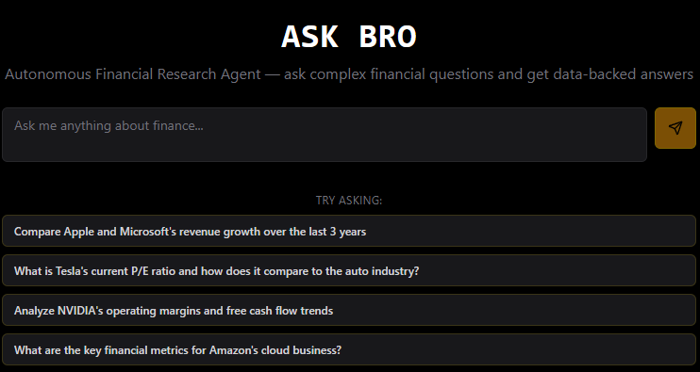
ALLWEALTH: TOOLS ALREADY BUILT
12 tools live. Core platform ready to deploy to advisors and clients.
USA Thematics & Market Data
Company Analysis
Live Watchlist
Email Market Summaries
Portfolio Summary
AI Agent

Slide 6



THE OPPORTUNITY
Immediate distribution. Massive switching costs. Multiple revenue streams.
ADVISOR TIER
CLIENT PORTAL
HNW WEALTH MANAGEMENT
$10/mo per advisor
$5/mo per end client
$20K setup + $20K AUD p.a.
500 FFAU advisors from Day 1
500 advisors x 50 clients = 25,000
FFAU HNW + Endeavor 100 clients
Market data, company analysis, portfolio views, AI tools, market wraps, financial plan generation
Wealth dashboard, bank feeds, expenses, performance, tax estimates. White-labelled for advisor brand
Full platform. Consolidated net wealth. Private holdings. API bank feeds. Dedicated support
Year 1: $60K ARR | Year 5: $1.8M ARR
Year 1: $150K ARR | Year 5: $3.0M ARR
Year 1: $200K ARR | Year 5: $2.0M ARR
COMBINED YEAR 5: $6.8M ARR | $68M VALUATION AT 10x | + deal returns on top

Slide 7
FINANCIAL MODEL
Conservative projections. 10x ARR multiple. Excludes deal returns.
ADVISOR TIER ($10/mo per advisor)
 | Year 1 | Year 2 | Year 3 | Year 5
Advisors | 500 | 2,000 | 5,000 | 15,000
ARR | $60K | $240K | $600K | $1.8M
Valuation (10x) | $600K | $2.4M | $6M | $18M
CLIENT PORTAL ($5/mo per end client)
 | Year 1 | Year 2 | Year 3 | Year 5
End Clients | 2,500 | 10,000 | 25,000 | 50,000
ARR | $150K | $600K | $1.5M | $3.0M
Valuation (10x) | $1.5M | $6.0M | $15M | $30M
HNW WEALTH MANAGEMENT ($20K AUD setup + $20K AUD p.a.)
 | Year 1 | Year 2 | Year 3 | Year 5
Clients | 10 | 25 | 50 | 100
ARR | $200K | $500K | $1.0M | $2.0M
Valuation (10x) | $2.0M | $5.0M | $10M | $20M
COMBINED YEAR 5: $6.8M ARR | $68M VALUATION | + deal returns on top

Slide 8



WHY THIS WORKS
GUARANTEED DISTRIBUTION
FFAU and Endeavor network to start. Low marketing spend to get global traction. This company needs to be a separate entity to EAM/FFAU to get the valuation.
ONE PLATFORM, MASSIVE SWITCHING COSTS
Once advisors link their clients and clients see their full wealth in one place, they never leave. Every new client deepens the moat. AllWealth becomes the operating system for wealth.
SELF-FUNDING, CAPITAL EFFICIENT
Deal returns fund software development. AI-powered vibe coding collapses development costs by 90%+. One developer builds what used to take teams of 50. Personal capital invested alongside.
HOLDCO | hayden@laserbeamcapital.com | allwealth.com.au

