Slide 1



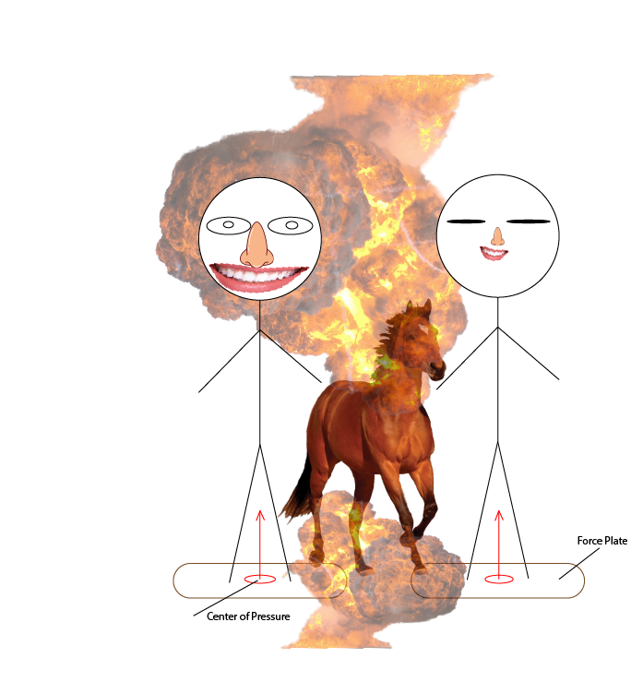
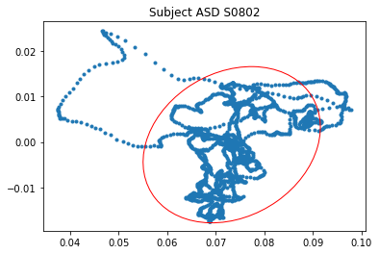
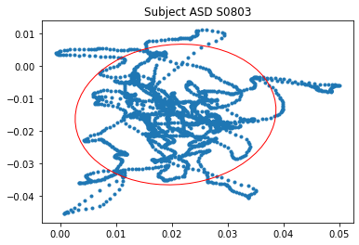
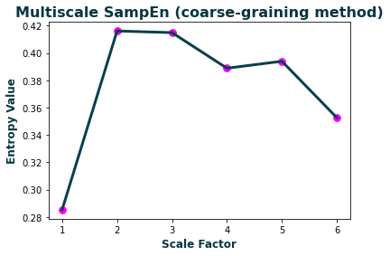
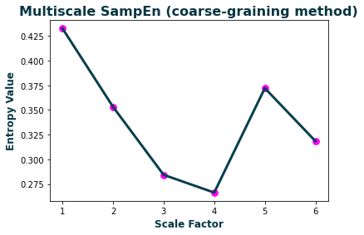
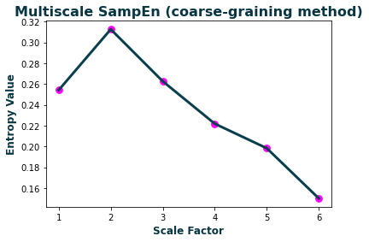
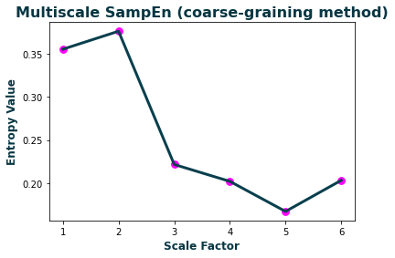
Enhancing early diagnosis of autism with machine learning algorithms using postural control features
Hayden Cressman
Mentor: Yumeng Li, Ph.D.
Abstract
Methods
Findings
Autism spectrum disorder is known to cause deficits in motor functionality and stability when compared to children of typical development. The cause of this is still under research, but it is quantifiable and usable for classification.
In total there were 40 unique TD subject trials and 24 ASD subject trials. For this test we used a force plate and ran each test for 30 seconds at a sampling rate of 60 hz. This gives us their center of pressure data from which we can determine several things such as:
Displacement in the Mediolateral and Anteroposterior Directions
Area of Postural Sway
Entropy in the Mediolateral and Anteroposterior Directions
Complexity Index based off the Entropy
The precision of each classification model can be seen below. Since we are working with a small sample size with possibility of outliers, the precision is fairly high all around. The data was run using a 70-30 split on the total data set.
Eyes Open
Eyes Closed
 | 0.0 | 1.0 | accuracy | macro avg | weighted avg
K-Nearest
precision | 0.9167 | 0.7500 | 0.85 | 0.8333 | 0.86
recall | 0.8462 | 0.8571 | 0.85 | 0.8516 | 0.85
f1-score | 0.8800 | 0.8000 | 0.85 | 0.8400 | 0.85
support | 13.00 | 7.00 | 0.85 | 20.00 | 20.00
Logistic Regression
precision | 1.0000 | 0.7778 | 0.90 | 0.8889 | 0.92
recall | 0.8462 | 1.0000 | 0.90 | 0.9231 | 0.90
f1-score | 0.9167 | 0.8750 | 0.90 | 0.8958 | 0.90
support | 13.00 | 7.00 | 0.90 | 20.00 | 20.00
Decision Tree
precision | 0.9231 | 0.8571 | 0.90 | 0.8901 | 0.90
recall | 0.9231 | 0.8571 | 0.90 | 0.8901 | 0.90
f1-score | 0.9231 | 0.8571 | 0.90 | 0.8901 | 0.90
support | 13.00 | 7.00 | 0.90 | 20.00 | 20.00
Compliment Naïve Bayes
precision | 0.8333 | 0.6250 | 0.75 | 0.7292 | 0.76
recall | 0.7692 | 0.7143 | 0.75 | 0.7418 | 0.75
f1-score | 0.8000 | 0.6667 | 0.75 | 0.7333 | 0.75
support | 13.00 | 7.00 | 0.75 | 20.00 | 20.00
Subject | Area (cm²) | APDisp (cm) | MLDisp (cm)
S0802 | 9.571985 | 4.1692 | 6.0299
Subject | Area (cm²) | APDisp (cm) | MLDisp (cm)
S0803 | 12.22329 | 5.6477 | 5.0792
Mediolateral Multiscale Sample Entropy
Subject | MLE1 | MLE2 | MLE3 | MLE4 | MLE5 | MLE6 | MLComplex
S0802 | 0.285257 | 0.41612 | 0.414917 | 0.388872 | 0.393954 | 0.352623 | 2.251743
S0803 | 0.432649 | 0.353152 | 0.284234 | 0.266268 | 0.372129 | 0.318454 | 2.026885
Anteroposterior Multiscale Sample Entropy
Purpose
There exists many tests both behavioral and physical to diagnose autism in an individual. However, there is no absolute medical test for diagnosis. By using the data from a child's postural sway, we can use machine learning to devise a method of accurately predicting and classifying autism at an early age. This can help especially in fringe cases or in cases where behavioral data is difficult to produce.
Subject | APE1 | APE2 | APE3 | APE4 | APE5 | APE6 | APComplex
S0802 | 0.254191 | 0.312566 | 0.262593 | 0.2218 | 0.198246 | 0.150084 | 1.39948
S0803 | 0.355048 | 0.375845 | 0.221677 | 0.202124 | 0.16734 | 0.203295 | 1.525329
References:
https://www.ncbi.nlm.nih.gov/pmc/articles/PMC4267489/
https://www.autismspeaks.org/autism-statistics-asd
https://www.ncbi.nlm.nih.gov/pmc/articles/PMC5674672/

