Slide 1
PCA vs. Kernel PCA vs. UMAP
For Breast Cancer Diagnoses
Linear Algebra Final Project
By Hayden Kress

Slide 2
Wisconsin breast cancer dataset
1) ID number
2) Diagnosis (M = malignant, B = benign)
3-32)
Ten real-valued features are computed for each cell nucleus:
a) radius
b) texture
c) perimeter
d) area
e) smoothness
f) compactness
g) concavity
h) concave points
i) symmetry
j) fractal dimension ("coastline approximation" - 1)

Slide 3
PCA vs Kernel PCA vs UMAP
Principal Component Analysis (PCA)
PCA finds linear combinations of original features that capture maximum variance. It creates new axes (principal components) where the first component explains the most variance, the second explains the most remaining variance, and so on.
Best for: linear datasets

Slide 4
PCA vs Kernel PCA vs UMAP
Kernel PCA
Extends PCA to handle nonlinear relationships by first mapping data to a higher-dimensional space using kernel functions (like RBF or polynomial kernels), then applying standard PCA in that space. This allows it to capture curved structures and nonlinear patterns that regular PCA misses.
Best for: non-linear datasets

Slide 5
PCA vs Kernel PCA vs UMAP
UMAP (Uniform Manifold Approximation and Projection)
Manifold learning technique that preserves both local and global structure by modeling data as lying on a manifold and finding a low-dimensional representation that maintains neighborhood relationships. It excels at preserving clusters, revealing nonlinear structures, and often produces more meaningful visualizations than PCA or t-SNE.
Best for: non-linear datasets, clustered data

Slide 6
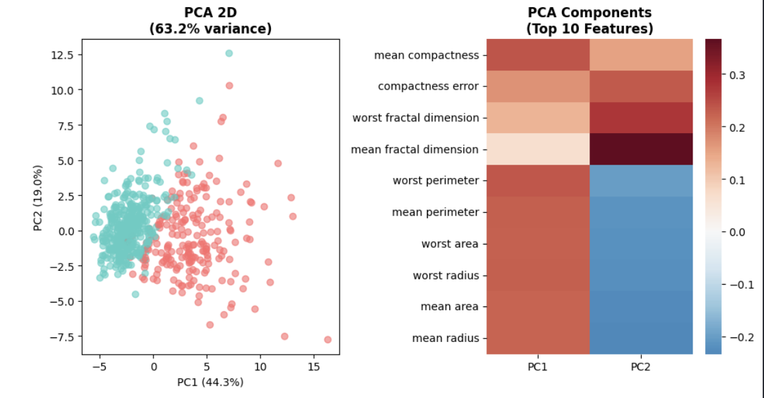

Results

Slide 7
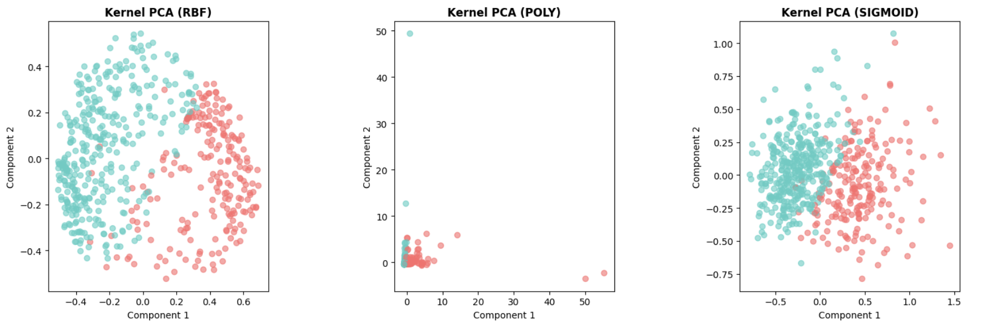
Results

Slide 8
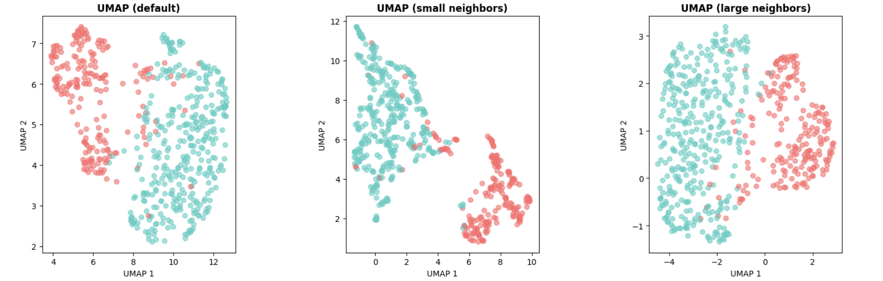
Results

Slide 9
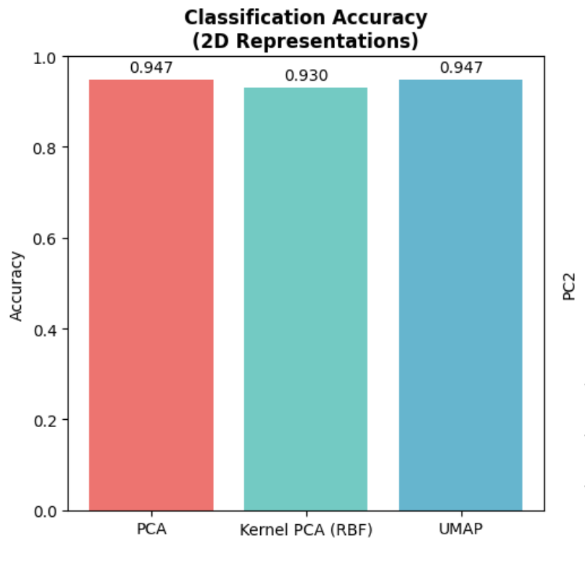
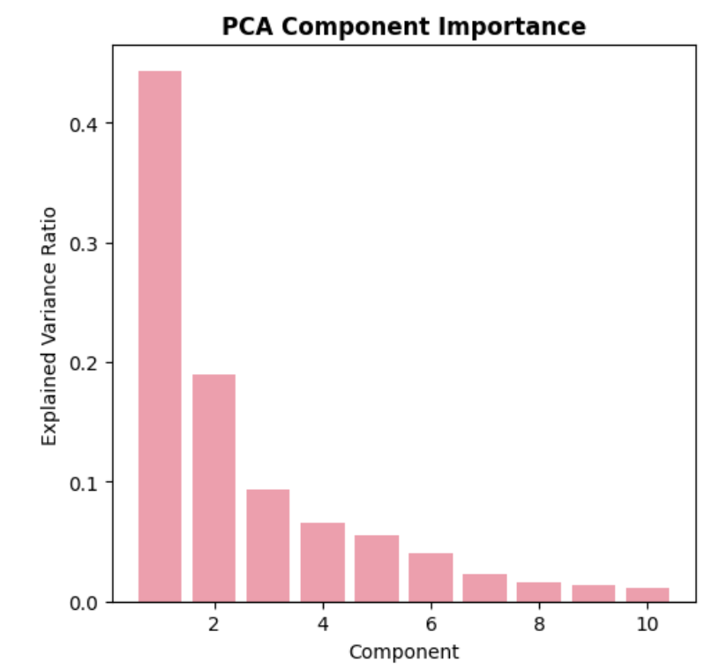
Results

