Slide 1

SETTLEUP
Bet your mates drinks. The app keeps score.
Built in a weekend. Tested at a pub. Finished at sunrise.
Hayden Tibbals × Charles Keenen

Slide 2
THE PROBLEM
Everyone says "bet you a beer." Nobody ever pays.
"Bet you a beer"
"I'll get the next one"
"Who won that bet?"
Said 47 times.
Settled 0 times.
The next one
never comes.
Nobody remembers.
Nobody pays.
You probably owe someone a drink right now.

Slide 3
WHAT WE BUILT
SettleUp is a night-out app for groups of mates who can't stop competing.
Bet anything
1v1 challenges
"Will Dave mention his ex?" Create it in a few taps. Everyone bets drinks. Winners split the lot. Pari-mutuel — like the horses, but for your mates.
Challenge someone directly. Pool, darts, whatever. Both put drinks on the line, the crew piles on side bets.
Beer Bomb
The ledger
Minesweeper but you're drinking. Tap tiles, one's the bomb. Most popular thing in the app.
Tracks every fraction of a drink owed. Carries across nights. The app never forgets.
The name evolved with the product: BeerScore → BeerToBeer → BeerScore → SettleUp. The last one stuck — it's what people actually say at the bar.

Slide 4
THE WEEKEND
How a bar napkin idea became a real app in 48 hours.
Friday PM
Inductions + pub brainstorm
Did the hackathon inductions. Went straight to the pub to figure out what we were actually building. Came back with a plan and a vision doc.
Saturday AM
Build the prototype
Fed the vision doc to Claude. By end of morning we had a working app — crews, nights, bets, the lot. But the database was slow and messy.
Saturday 6 PM
The hard call: full DB wipe
Poor initial planning was killing us. Wiped the entire database, designed v2 from scratch, and rebuilt. Painful but necessary.
Saturday 11 PM
Time to test it for real
Set up Claude Code remote dispatch. Went to the pub. Ordered a beer. Opened the app. Immediately started finding things to fix.

Slide 5
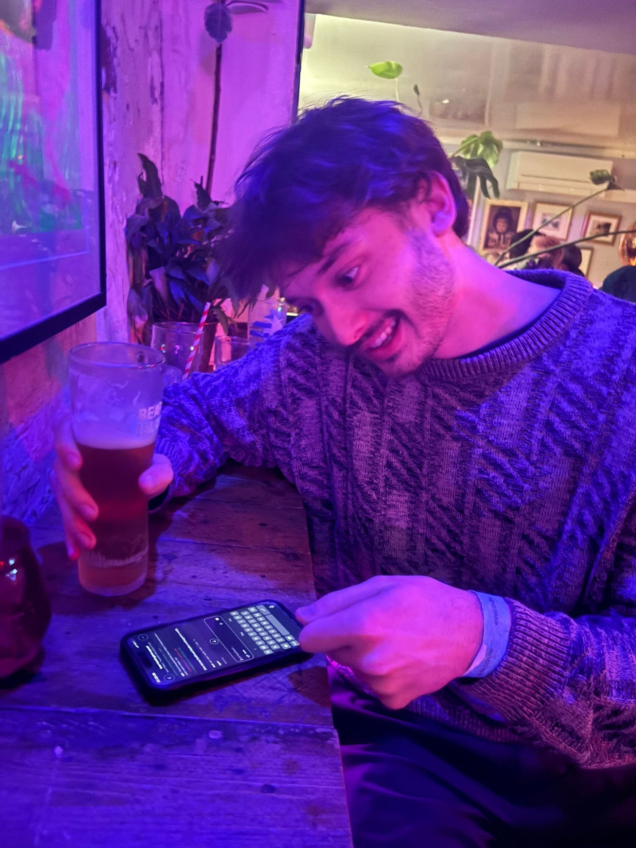
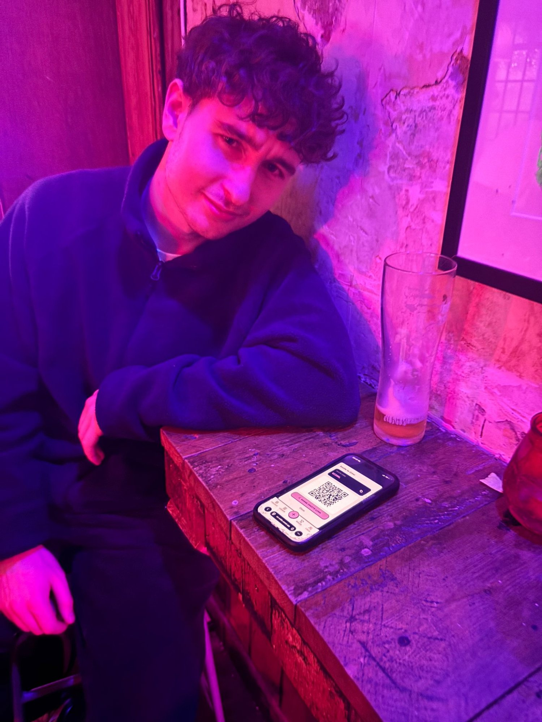
PUB-DRIVEN DEVELOPMENT
The pub wasn't just where we tested. It's where we built.
Beer Bomb got more play than every bet combined — mini-games get the night going, losses drive bigger bets
New players took too long to join - built QR codes on the spot so you scan and you're in
Shipped it all live from the bar via Claude Code

Slide 6
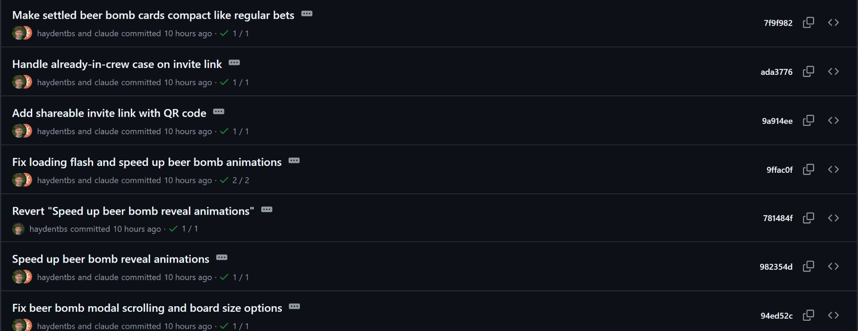
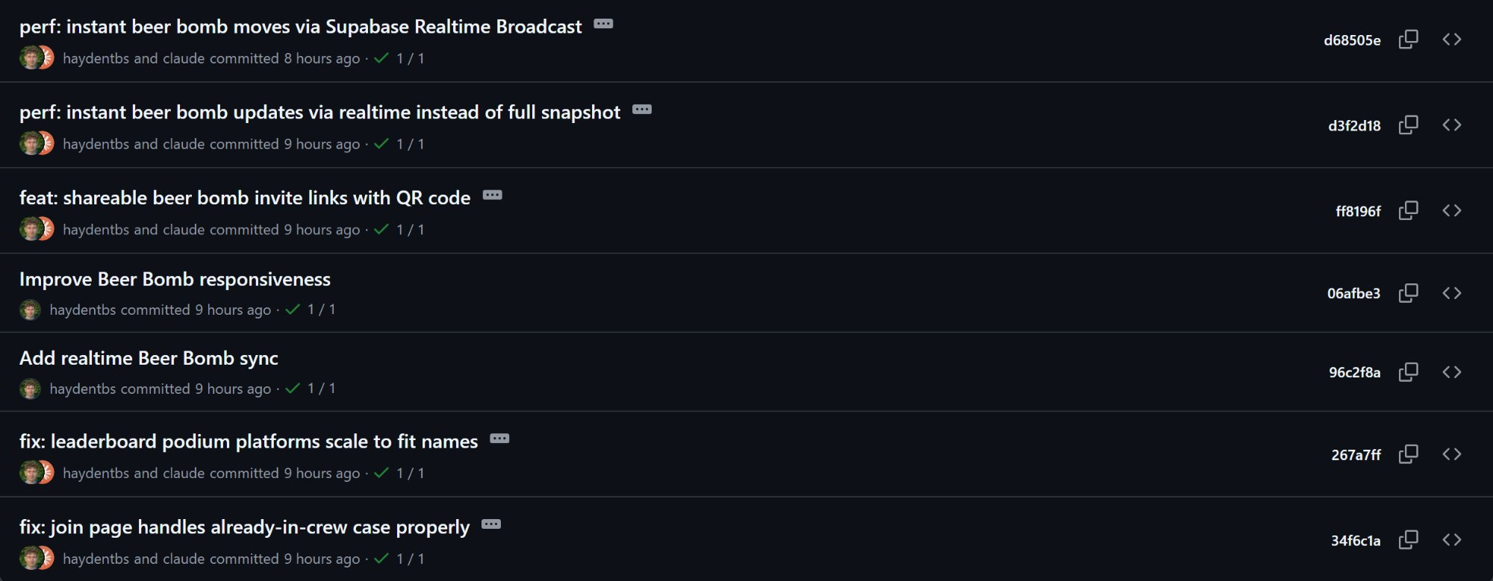
THE RECEIPTS
"haydentbs and claude committed" — pushes to main directly from the bar
QR codes, Beer Bomb realtime sync, invite link fixes, leaderboard polish, animation tuning — all shipped from the pub and through the night.

Slide 7
OUR AI STACK
We didn’t want to be restricted by one tool and one agent
v0 + Vercel
Design + deploy
Cursor
IDE + fast edits
Initial designs, rapid iteration on UI direction, instant deploys.
Our interface for everything. Composer for quick changes, terminal for git and localhost.
Claude Code
Architecture + remote
Codex
Heavy builds + testing
Big planning, complex bugs, code consistency. Remote dispatch from the pub.
Large refactors, agentic testing, bulk feature builds. Did the heavy lifting.
Each tool has a sweet spot. The trick was learning which one to reach for.

Slide 8
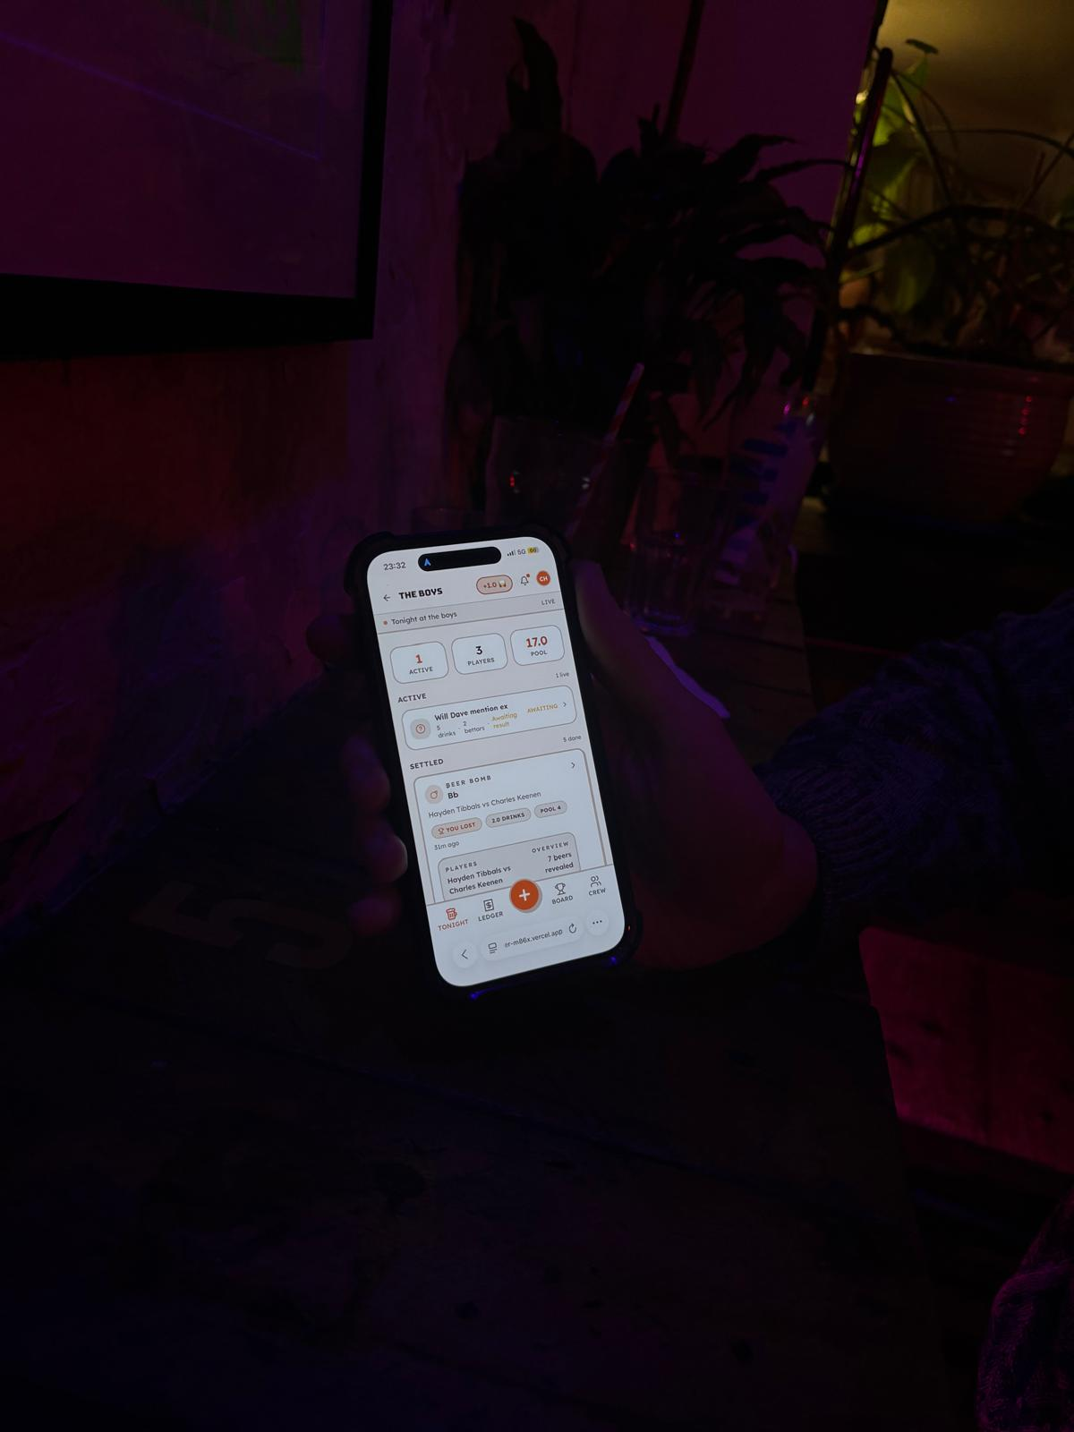
v0 + VERCEL
Design iteration and instant deploys.
v0 handled our design exploration. We went through several directions before landing on the look — dark with gold accents, neobrutalist cards, the trophy-pint icon. v0 let us try layouts and component ideas without writing CSS from scratch.
We'd generate a direction, screenshot it, tweak it, regenerate. The speed meant we could explore ideas that would've taken hours to prototype by hand.
Vercel hosts the whole thing. Auto-deploy on push to main, preview deployments on branches. With v0 Pro the deploys are near-instant — push a commit, it's live in seconds. During the all-nighter that meant we could ship a fix, pull it up on our phones, and test immediately.

Slide 9
CURSOR
Our IDE for when we actually need to read the code...
Cursor as home base
Composer v2 for speed
Our primary interface. Easy file navigation, inline diffs, and the terminal right there for localhost dev and git commands.
Lightning fast for simple stuff — renaming a component, changing a colour, finding a specific function, swapping a label. The fastest way to make small changes across multiple files.
Claude Code from Cursor's terminal
Creating Context For Agents
Ran Claude Code sessions directly from the Cursor terminal. The IDE gave us full context while Claude handled the complex work.
Being able to highlight code, reference files, and give Composer context about what you're looking at — that's what makes it fast. It's not just autocomplete, it's a conversation with your codebase.

Slide 10
CLAUDE CODE
The architect. The planner. The one we trusted to run unsupervised.
Opus was a workhorse fixing bugs and adding features, but the value came when we could dispatch Claude remotely. From the pub to the kebab shop and trust it to make the right changes without us watching every line.
Claude also did our planning. Before handing work to Codex, Claude would break it down into clear tasks, design the approach, and scope what needed to happen. That planning layer is what made the whole multi-agent workflow work.
Dispatching Claude Code from the bar, pint in hand.

Slide 11
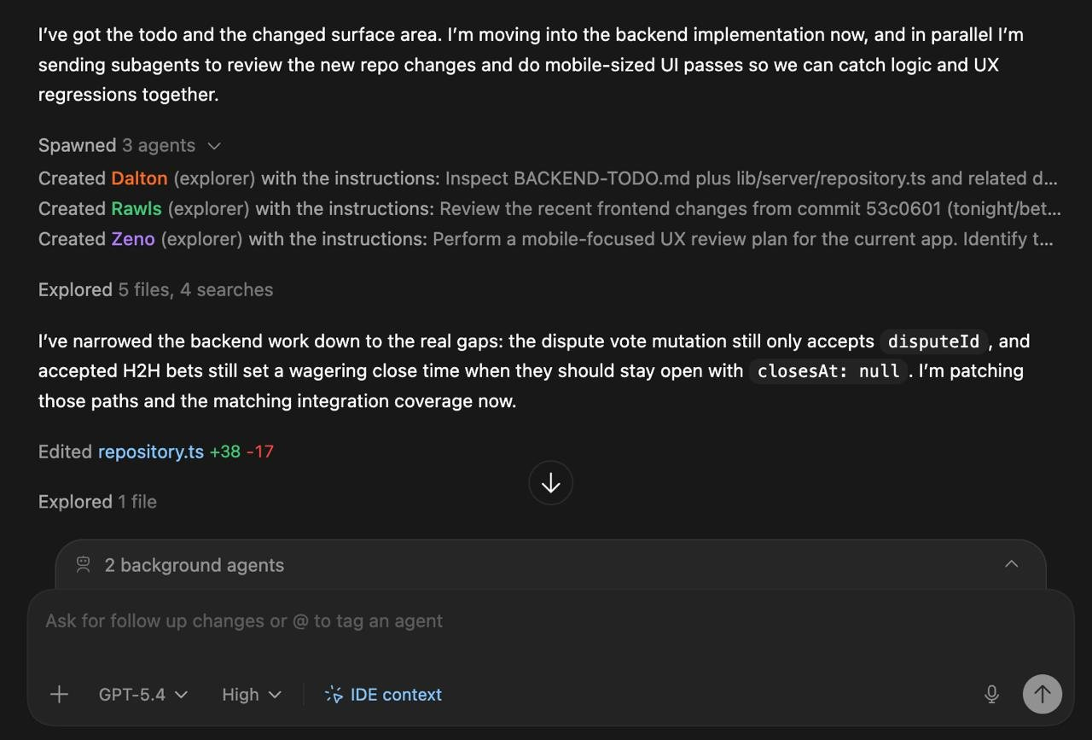
CODEX
The workforce. Large builds, agentic testing, and three agents we owe a drink.
Codex did a huge chunk of the heavy coding. The DB v2 migration, major feature builds, integration testing — anything that was clearly scoped and needed executing.
The workflow: Claude plans, we review the plan, Codex builds it. Clear handoff, clean results.
Codex also ran agentic testing — spawning sub-agents to explore the codebase, review changes, and do UX passes. On one run it created three explorer agents: Dalton, Rawls, and Zeno. They inspected the backend, reviewed frontend changes, and ran a mobile UX audit — all in parallel.
Shoutout to Dalton, Rawls, and Zeno. We owe them a pint.
Codex spawning Dalton, Rawls, and Zeno to review the codebase in parallel.

Slide 12
SKILLS & MCPs
Plugged in specialised capabilities on demand.
Skills
MCPs
Specialised instruction sets that give Claude deep expertise in specific domains.
Model Context Protocol servers — live connections to external tools and services.
frontend-design
Production-grade UI with high design quality
Supabase MCP
Direct database access, migrations, schema inspection
supabase
Database best practices, RLS, schema design
Vercel MCP
Deployment status, preview URLs, build logs
postgres
Query optimisation, indexing, performance
Playwright MCP
Rapid agentic testing of our interface to find bugs and improve user flows
webapp-testing
Integration tests, edge cases, coverage
algorithmic-art
Generated visual assets and patterns
Skills give AI expertise. MCPs give AI access. Together they turn a general-purpose model into a specialised dev partner.

Slide 13
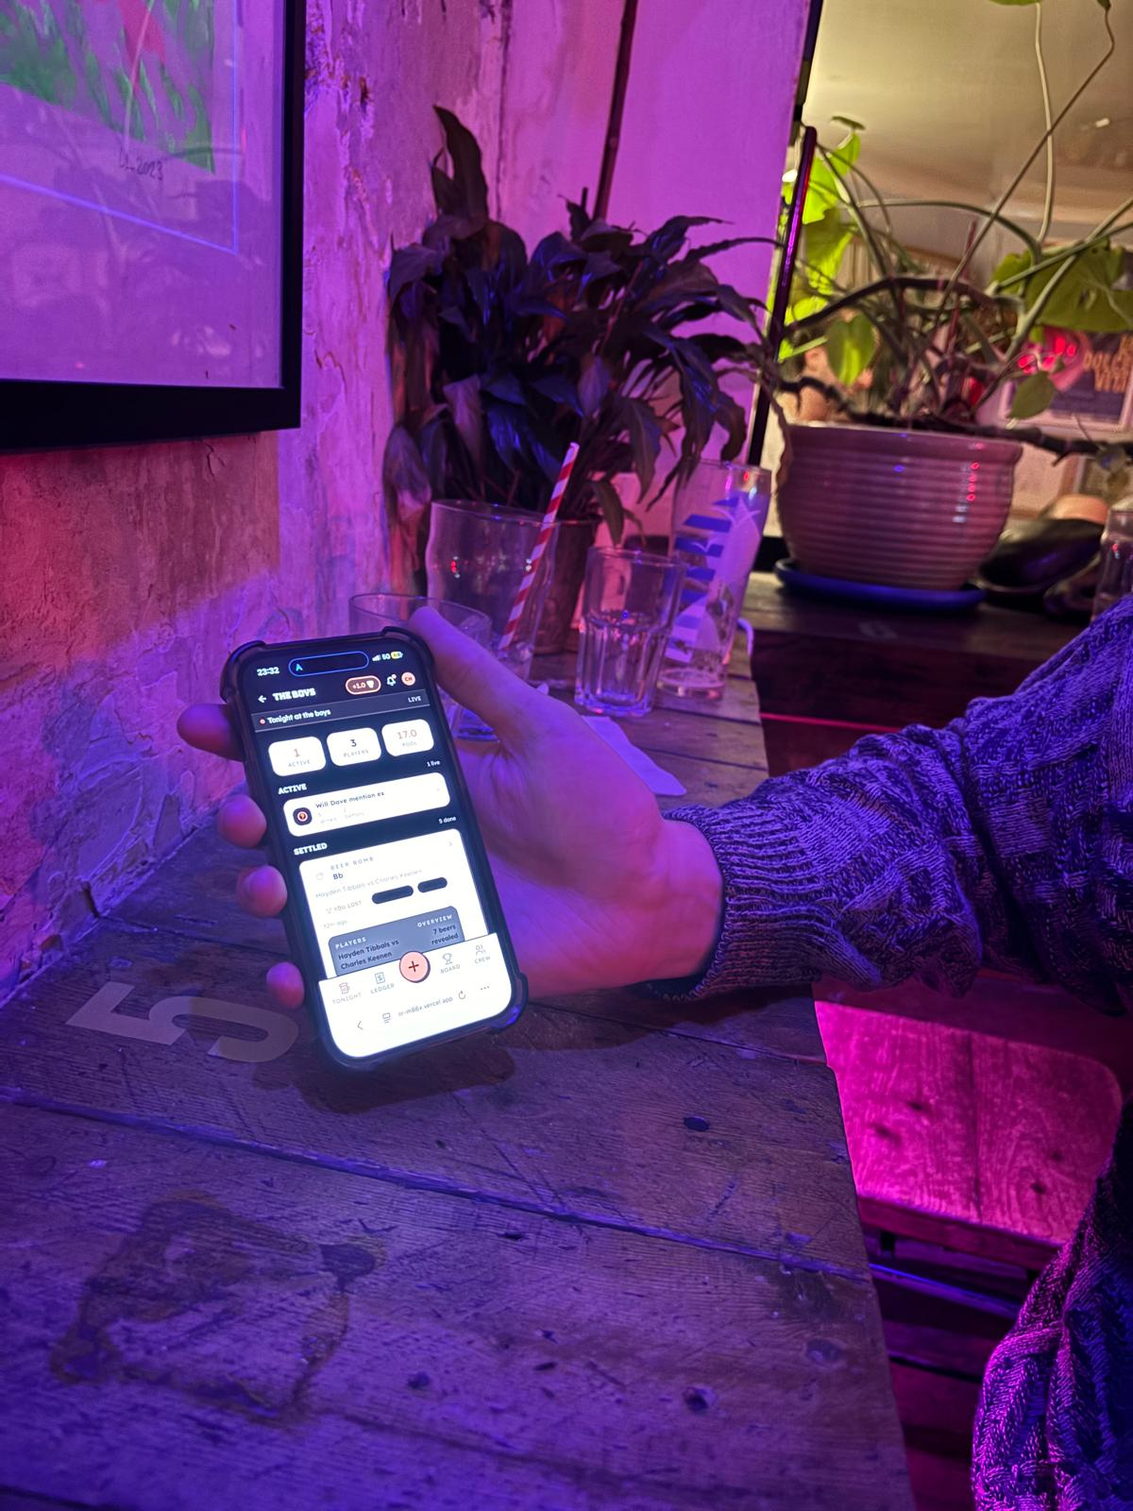
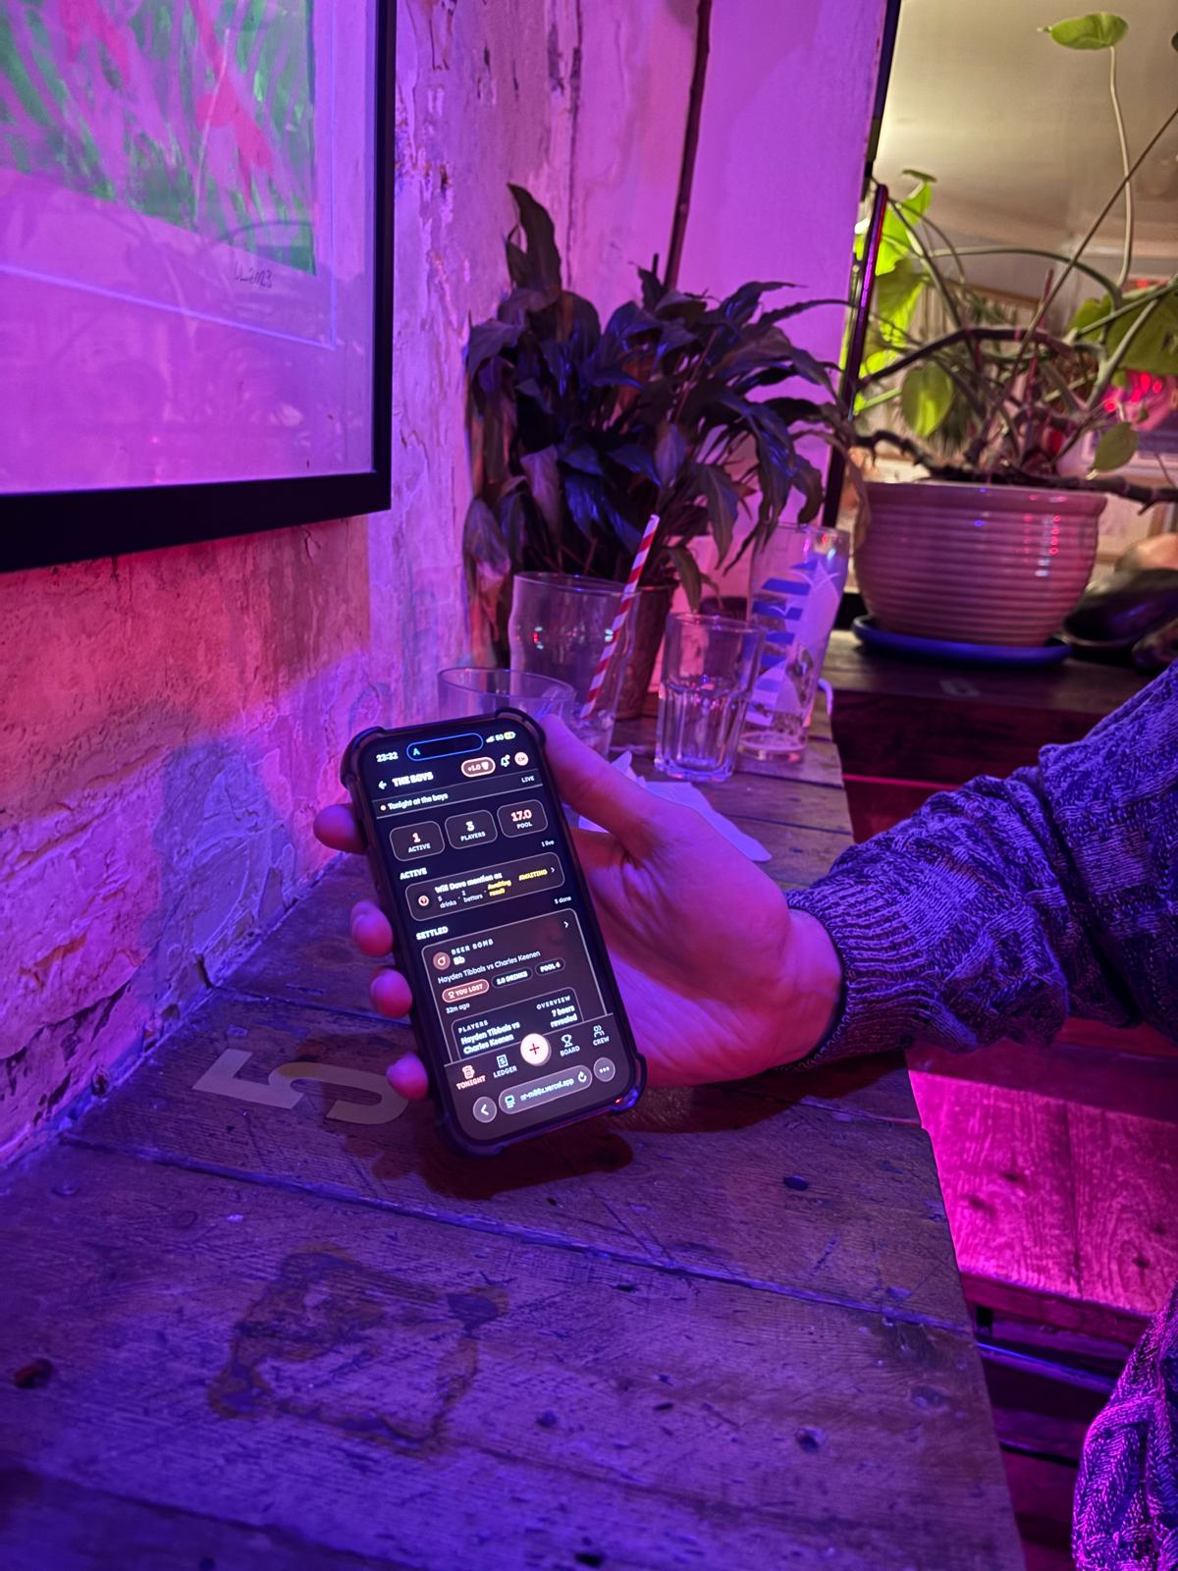
DESIGNED FOR THE PUB
Three modes. One goal: usable at night without blinding anyone.
Light Mode
Classic Mode
Dark Mode
Clean and readable.
Good in well-lit spaces.
Our default. Warm blend
of both — the sweet spot.
For the dim pub at midnight.
High contrast, easy on the eyes.

Slide 14
BY THE NUMBERS
4
18
5
AI Tools
Screens
Bet Types
v0 · Cursor · Claude · Codex
3 themes · 6 drink themes
Yes/No, O/U, Multi, 1v1, Beer Bomb
20+
~3
17.0
Database Tables
Hours of Sleep
Drinks in the Pool
Supabase + RLS
Give or take
Saturday night field test

Slide 15
WHAT'S NEXT
We're keeping this going. This is a product, not a project.
NOW
NEXT
LATER
What's working
What we're building
Where it goes
Group bets + 1v1 challenges
Beer Bomb mini-game
Drink ledger + settlement
Crew leaderboards
QR code instant join
3 display modes
Tournament brackets
with side betting
AI commentary + roasts
More mini-games
Native iOS + Android
Premium tier (stats, themes)
Bar + venue partnerships
Campus ambassador program
Sponsored tournaments

Slide 16
SETTLEUP
Competition is everything. We're just giving it a tab.
Hayden Tibbals × Charles Keenen
Now... who owes who a drink?

