Slide 1

DUKE AIPI 590 · ALTERNATIVE DATA · FINAL
Climate Impacts on
Futures Pricing
What free weather data can measure, what the market already knows,
and who can still use the difference
Haydn Stucker · November 2026
Notes:
0:20 · leave by 0:20
• Haydn Stucker · AIPI 590 final
• The whole project in one sentence: free weather data measures a real corn supply shock, and the futures market has already priced it
• Road map: what worked, what failed, why, and who can still use it

Slide 2


One project, two tests, one answer
The measurement worked and the trading signal failed — these are not in tension
MEASURE
PREDICT
Can public climate data identify real crop supply shocks?
Can those signals predict tradeable commodity returns?
Yes — in the seasons that matter
No — and now we know why
WHAT TO WATCH FOR
Every result that follows carries a second number: the same test with 2012 removed and every fold refitted. One drought season recurs in all of them, and how much each result depends on it is the honest measure of what this project established.
Both tests use the same point-in-time archive and the same publication-aware feature construction.
Notes:
1:00 · leave by 1:20
• Two tests from the proposal: MEASURE the physical shock, PREDICT tradeable returns
• Measurement worked, prediction did not — and that is not a contradiction, it is what an efficient market looks like
• Flag the second number now: every result has a "with 2012 removed" column
• Tell them to watch for it. It is the spine of the whole deck

Slide 3
What worked: measuring corn supply risk
County weather and drought beat a training-only trend forecast on held-out harvests
+0.748
+0.476
0.31
R² vs trend, 16 forward-validated harvests
the same test, 2012 removed and refitted
t/ha mean error, against the trend’s 0.58
Positive in both samples. Every fold trains only on earlier harvests and refits the yield trend inside itself, so no held-out year helped define what counts as normal for itself.
But this is post-harvest attribution, not an in-season forecast: county weather reached only 3 of 26 growing seasons in time to be used.
Metric: R² against each fold’s own trend forecast. Source: corn_yield_forward_validation_results.csv.
Notes:
1:25 · leave by 2:45
• County heat and drought beat a training-only trend forecast on held-out harvests
• Forward validation: train only on earlier years, refit the trend inside every fold
• 75% of trend error removed across 16 harvests; 48% with 2012 refitted out
• Both positive — that is the defensible claim, and it is narrower than it sounds
• The footnote matters: county data reached only 3 of 26 seasons in time to be used
IF ASKED — "why not just benchmark against USDA's own yield forecast?"
Fair, and it is the obvious next comparison. USDA condition ratings are in the
archive from 2012. The benchmark here is a trend forecast because that is what
someone with no weather data can always build; USDA's forecast would be a
stronger bar and is honest future work.

Slide 4
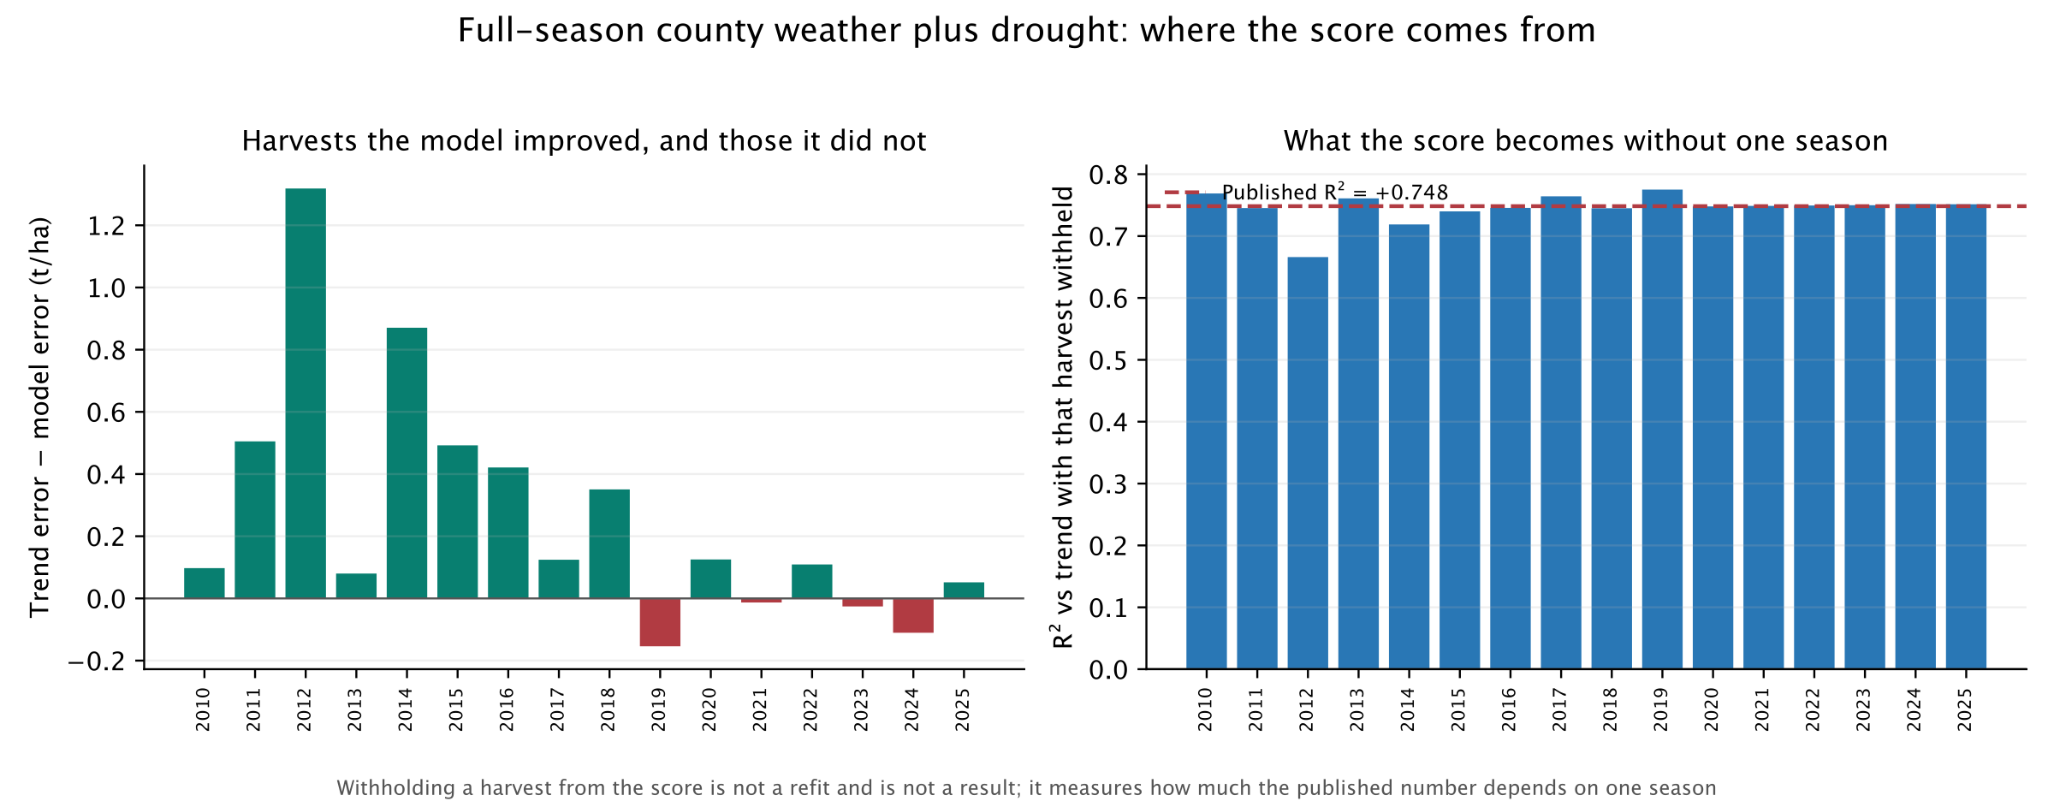
Where the result actually lives
Not a single-season artifact — but concentrated in the seasons that went wrong
+0.666 to +0.775
+0.815
−0.452
range when any single harvest is withheld from the score
in the third of seasons furthest from trend
in the calmest third, with 2012 refitted out
Withholding a harvest from a score is not the exclude-2012 sample, which also drops it from training and refits every fold.
Notes:
1:35 · leave by 4:20
• Withhold any single harvest and the score stays between +0.666 and +0.775
• No single removal flips the sign — so it is not one season's artifact
• But the skill is concentrated: +0.815 in the most extreme third of seasons
• In the calmest third without 2012: −0.452 — worse than doing nothing
• Land the characterisation: this is a damage function, and it works when the crop is failing
IF ASKED — "isn't 2012 just an outlier you should drop?"
Two different tests, both reported. Dropping it from the SCORE leaves +0.666.
Dropping it from TRAINING and refitting every fold leaves +0.476. Neither
removes the result. But it is the season doing the most work, and the strata
say where the rest of the work happens.

Slide 5
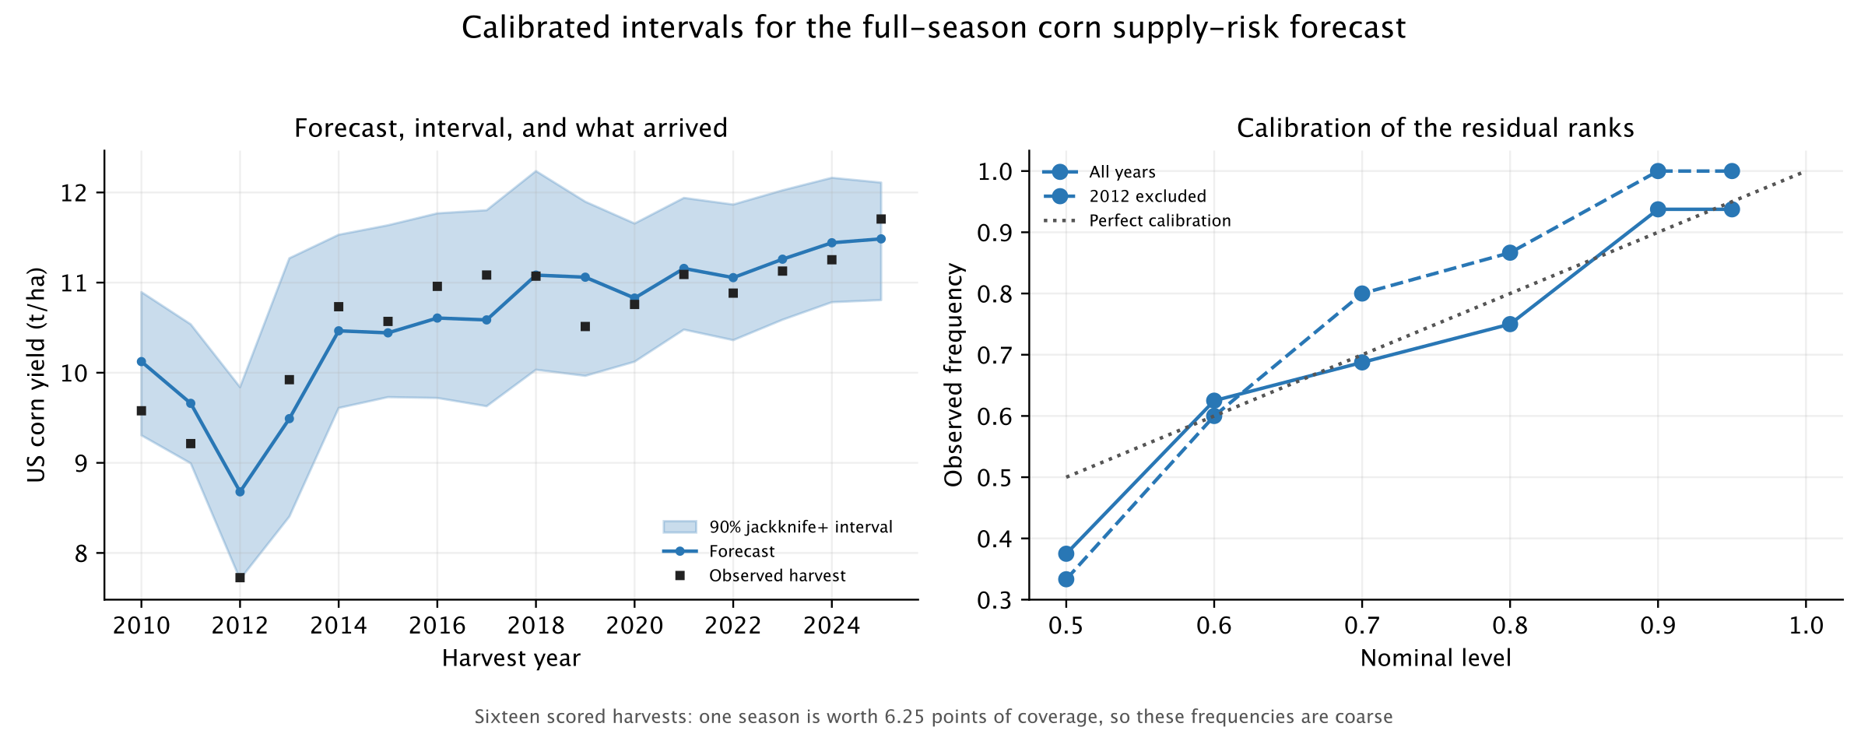
How precise is the estimate?
Calibrated intervals, with coverage measured rather than assumed
16/16
±8.7%
0.018 t/ha
covered at a nominal 90%; the guarantee is only 80%
of trend yield — the honest resolution of the estimate
the margin by which 2012 stays inside its interval
Jackknife+ on chronological folds; every narrower construction tested leaves 2012 outside.
Notes:
1:30 · leave by 5:50
• A point forecast is not a risk estimate — a buyer needs the spread
• Jackknife+, calibrated only on earlier harvests; coverage measured, not assumed
• 16/16 at a nominal 90% — but be honest that the guarantee is only 80%
• 2012 clears its bound by 0.018 t/ha; every narrower construction misses it
• The price of that coverage is ±8.7% of trend yield. That is the usable resolution
IF ASKED — "16 observations is too few to calibrate anything"
Agreed, and that is why the method is distribution-free rather than Gaussian,
and why coverage is reported with its resolution: one season is worth 6.25
points. Split conformal would have been cleaner still but cannot reach 90%
until 2019 on this sample — that trade-off is in the report.

Slide 6

What failed, and how we know
Every candidate was frozen before its final test — and none was retuned afterwards
GEFS forecast revisions
−7.3% net
Sharpe −0.98
14 sealed-holdout trades
USDA Crop Progress
−52.7% net
Sharpe −0.81
positive in 3 of 9 years
THE DISCIPLINE IS THE RESULT
Candidate identity, costs and gate checks were committed before each reveal.
Seven predeclared checks failed on the USDA model, so its 2026 holdout was never opened.
No specification was retuned after a gate failure — the avenue was closed instead.
Sources: gefs_corn_holdout_results.csv, nass_corn_progress_validation_results.csv.
Notes:
1:15 · leave by 7:05
• Now the other half. Every promoted candidate was frozen before its final test
• GEFS sealed holdout: −7.3% over 14 trades, Sharpe −0.98
• USDA Crop Progress: −52.7%, positive in 3 of 9 years
• Seven predeclared checks failed, so the 2026 holdout was never opened
• Say it plainly: nothing was retuned after a gate failed. The avenue was closed
• This is the result, not a setback — the next slide is why

Slide 7
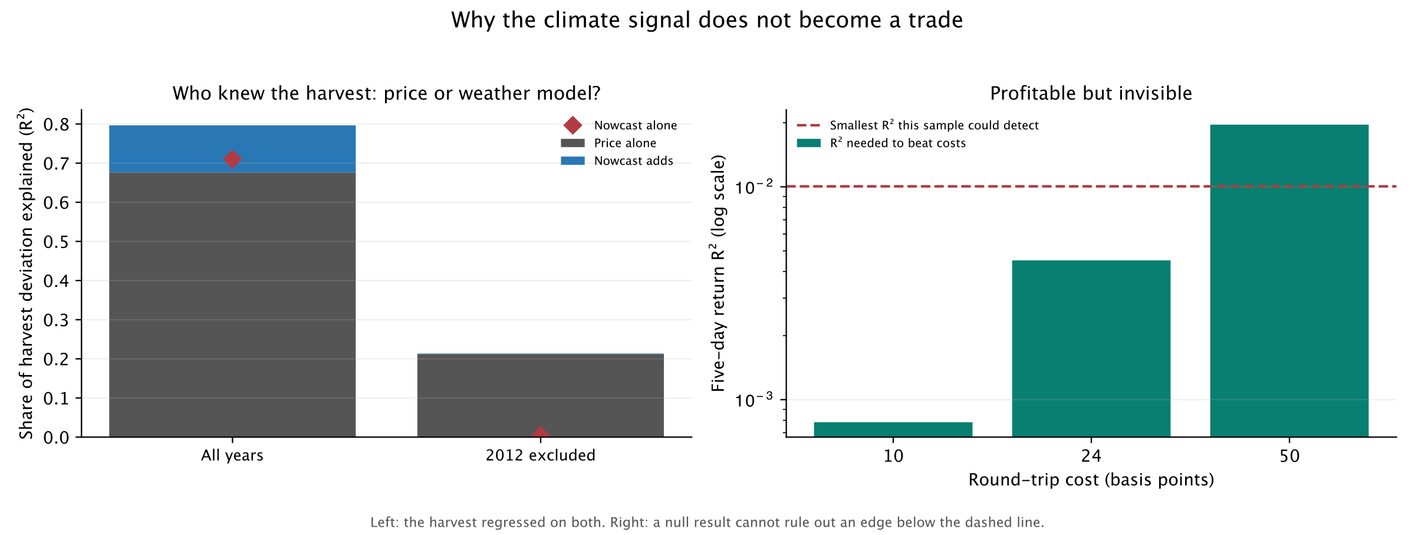



Why it does not become a trade
Three separate reasons for that result — not one excuse for it
ALREADY PRICED
BELOW RESOLUTION
AND IT LOST MONEY
The December contract explains 0.676 of the harvest on its own. The nowcast adds +0.120, and +0.001 without 2012.
Break-even is an R² of 0.00078; 781 independent returns can only detect 0.01005. A factor of 13.
The losses on the previous slide are the strongest sign. An edge too small to detect scatters near zero — it does not lose 52%.
The race is run on the harvest, not on returns: it asks who knew what, rather than whether the signal predicts the price.
Notes:
2:00 · leave by 9:05
• The most interesting slide. Three separate reasons, not one excuse
• ONE — already priced. Race run on the HARVEST, not returns: who knew what?
• December contract explains 0.676, nowcast 0.710, together only 0.797 — same information
• Nowcast adds +0.120 on top of the price; +0.001 without 2012
• TWO — below resolution. Break-even sits 13× under what 781 returns can detect
• THREE — and this is the honest part — it lost money, which an invisible edge would not do
IF ASKED — "so could a bigger sample find an edge?"
Possibly, and the deck says so rather than hiding it: at 10 bps you would need
about 10,019 independent returns against the 781 available. But that
cuts both ways. The losses are far too large to be a small positive edge, so
the power argument bounds the evidence, it does not rescue the model.

Slide 8
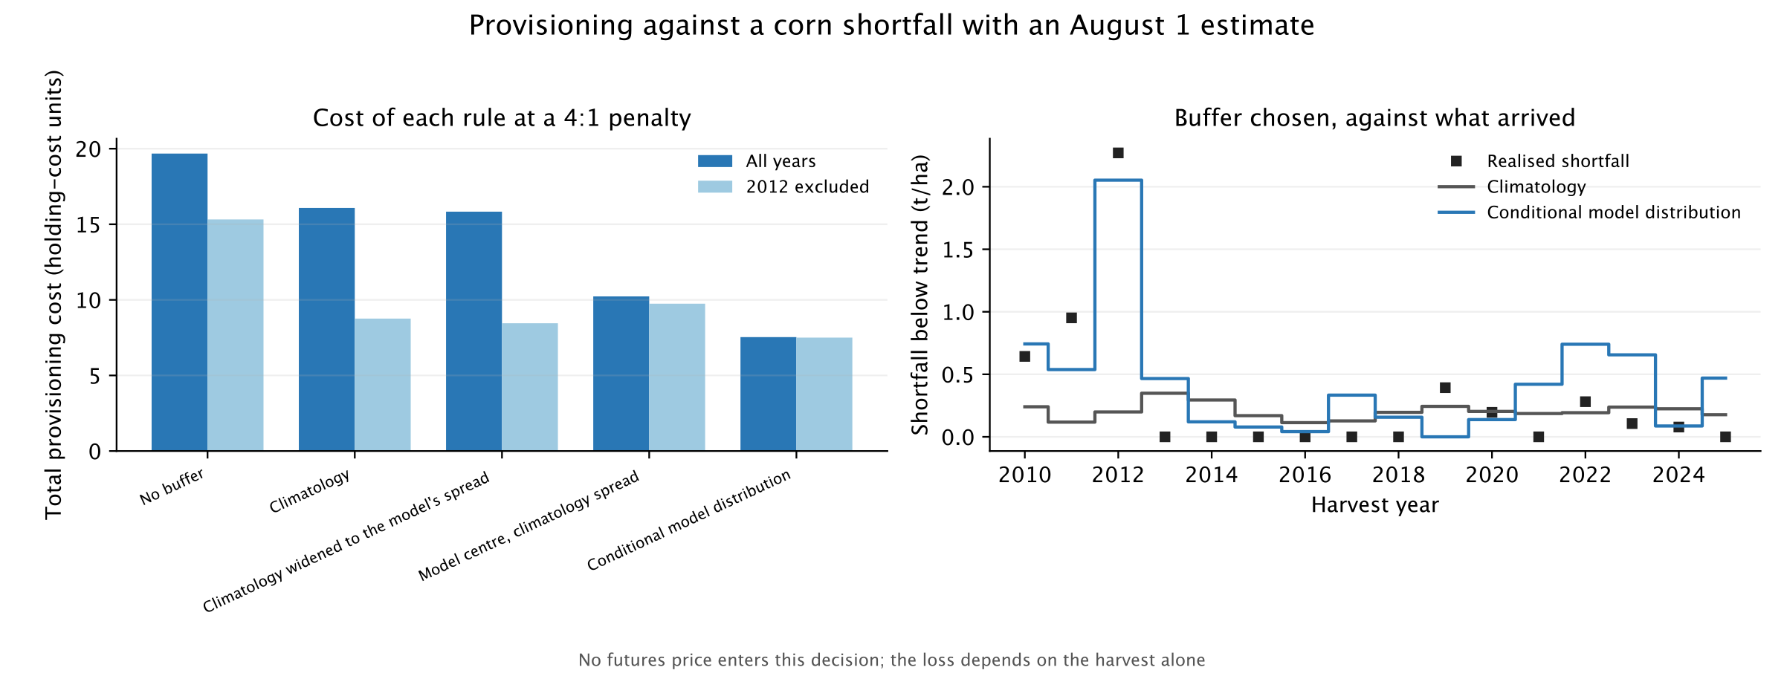
Who can still use it
Not a speculator — someone who already holds the risk, tested without any price
53%
0.76×
14%
provisioning cost saved against a no-weather baseline, at a 4:1 penalty
the model is the narrower distribution — so this is not over-provisioning
without 2012 — but the bootstrap straddles zero (P = 66%)
No futures price enters the decision, so it cannot restate the rejected trading signal as a profit.
Notes:
1:45 · leave by 10:50
• So who can use this? Not a speculator — a buyer who already holds the exposure
• Their payoff is a lower chance of being caught short, which survives in an efficient market
• Price-free by construction: no futures position anywhere in the test
• Saves 53% of provisioning cost against a no-weather baseline
• The control that matters: the model is the NARROWER distribution (0.76×), so this is not just over-provisioning
• Without 2012: 14%, but the bootstrap straddles zero. Insurance, not a planning tool
IF ASKED — "why not put a dollar figure on it?"
Because a dollar figure needs a price, and a price is how the rejected trading
signal would sneak back in. Costs are in holding-cost units; converting scales
every strategy identically and changes no ranking.

Slide 9


THE ANSWER
Free weather data measures a real
supply shock. The market already
knows about it.
Measurement
Validated forward, concentrated in extreme seasons
Efficiency
Priced in by the time the model can compute it
Use
Insurance for a buyer holding the risk — not an edge
Questions?
github.com/haydn-s/climate-futures-pricing
Notes:
0:40 · leave by 11:30
• Free climate data measures a real supply shock — in the seasons that matter
• The market has already priced it by the time the model can compute it
• The estimate is insurance for someone holding the risk, not an edge
• Everything is reproducible: locked protocols, committed outputs, sealed holdouts that stayed sealed
• Questions — and ~30 seconds of buffer if the earlier slides ran long

