Slide 1

E
COMPETITIVE LANDSCAPE ANALYSIS
F P
Focal
Technologies
T O Z
L P E D
Vision testing: competitors, positioning, SWOT, and Harvey ball analysis
“Creating simple and interpretable technology for wellness.”
P E C F D
Haydn Stucker, CEO · Burak Donbekci, CTO · Hadley McCormack, CFO · Fan, CCO · Qingyi, CPO
E D F C Z P
F E L O P Z D
D E F P O T E C
Notes:
Focal Technologies — competitive landscape analysis for vision testing. Mission (from our Lean Canvas): creating simple and interpretable technology for wellness. The deck follows the workbook: the problem and jobs to be done (Part 1), competitors and fact-checks (Part 2), the leaders quadrant (Part 3), SWOTs (Part 4), Harvey balls (Part 5), and our learning narrative, AI reflection, and updated Lean Canvas (Part 6).

Slide 2
Vision testing forces a tradeoff between convenience and depth
WHO HAS THE PROBLEM
JOBS TO BE DONE
Individuals, parents monitoring their children’s vision, and organizations — licensing agencies, airlines, schools — that need reliable screening.
See how well I can see without a clinic visit, travel, or an appointment.
Functional
HOW IT’S SOLVED TODAY
Monitoring
Compare results over time so I notice problems early.
Clinic exams are comprehensive but need appointments, trained professionals, and equipment. Charts and remote tests are easier, but mostly check basic acuity.
Qualification
Prove I meet a vision standard with a result the organization will accept.
WHAT’S MISSING
More complete assessment
Broader assessment, repeated tracking over time, testing standards for different use cases, and consistent results organizations can rely on.
Understand parts of my vision beyond basic acuity.
Emotional
A simple check to decide whether I need professional care.
Notes:
Part 1A and 1B. Problem: vision testing can be inconvenient, expensive, and limited — people may need a clinic visit even when they only need basic screening, regular monitoring, or an initial indication of whether they need professional care. Who: individuals, parents monitoring children's vision, and organizations such as licensing agencies, airlines, and schools that need reliable screening. Today: clinic exams are comprehensive but require appointments, trained professionals, and equipment; simple charts and many remote tests are easier but focus mainly on basic visual acuity. Gap: current options force a tradeoff between convenience and depth, and may not support broader assessment, longitudinal tracking, different testing standards for different use cases, or consistent testing that organizations can rely on. Jobs to be done: functional (check vision without a clinic visit), monitoring (compare results over time), qualification (a trustworthy result an organization can accept), more complete assessment (beyond basic acuity), and emotional (a simple way to decide whether I need professional care).

Slide 3
Eleven competitors: six from our own research, four from the AI, one it missed
CLINICAL & IN-PERSON
AT-HOME & DIGITAL
INSTITUTIONAL SCREENING
Comprehensive eye exam
OUR LIST
Visibly
OUR LIST
School screening programs
FROM AI
Remote acuity test for Rx renewal
In-person, multi-test clinical exam
Screening delivered in schools
EyeQue
OUR LIST
Snellen chart
OUR LIST
Phone tests plus optical add-ons
Licensing-agency tests
FROM AI
Wall chart in clinics, DMVs, schools
Vision checks for driver licensing
Peek Acuity
OUR LIST
Spot Vision Screener
AI MISSED
Smartphone acuity screening
Employer / work qualification
FROM AI
Handheld automated screening device
WHOeyes
Occupational vision screening
OUR LIST
Free WHO acuity self-check app
Airline qualification tests
FROM AI
Aviation vision screening
Notes:
Part 2A plus our pre-work. OUR LIST = competitors we listed before using any AI: Snellen chart, the traditional comprehensive eye exam, Visibly, EyeQue, Peek Acuity, and WHOeyes. FROM AI = new names the AI's Stage-1 list surfaced: school screening programs, licensing-agency vision tests, employer/work qualification testing, and airline vision qualification testing. AI MISSED = Spot Vision Screener, a handheld automated screener used by clinics and schools that we added during fact-checking (2B). The AI's expanded view described product, segment, and approach for each; business models were not specified in the workbook.

Slide 4
Fact-checking the AI: what it missed
Visibly
Can’t replace a comprehensive exam or diagnose ocular disease (e.g., glaucoma, macular degeneration) — strictly routine prescription renewals for eligible patients.
HOW WELL DO THEY SOLVE THE PROBLEM?
CORRECTED
No diagnostic replacement
EyeQue
Needs specialized optical hardware mounted on the phone — higher cost and more friction than pure software or telehealth.
Results are a point of reference, not something more meaningful.
CORRECTED
Hardware erodes convenience
Peek Acuity
EyeQue’s add-on optics mean users need more assets at their disposal.
Strictly a screening and referral tool — not diagnostic, and it can’t issue corrective-lens prescriptions.
CORRECTED
Nobody personalizes the test
Each tool mimics a conventional exam. Focal’s opening: AI-personalized testing plus eye-health predictions and trajectory.
Spot Vision Screener
Handheld automated screener for amblyopia, myopia, and astigmatism risk factors — but it needs expensive clinical hardware and trained staff, with no direct-to-consumer access.
AI MISSED
Notes:
Part 2B, feeds Slide 1. We fact-checked the AI's descriptions against company websites and recent news. Visibly: offers an FDA-cleared digital vision test by phone or computer so eye-care professionals can remotely review results and renew prescriptions — the AI missed that it cannot replace a comprehensive clinical exam or diagnose ocular disease such as glaucoma or macular degeneration, and is limited to routine renewals for eligible patients. EyeQue: smartphone-attached optical hardware (refractometers) and apps for at-home refractive testing — the AI omitted that the hardware accessories add cost and friction compared with pure software or telehealth. Peek Acuity: a mobile app for rapid acuity screening in low-resource communities and schools — the AI failed to say it is strictly a screening and referral tool that cannot issue prescriptions. Spot Vision Screener (added): a handheld device clinics and schools use to screen for risk factors like amblyopia, myopia, and astigmatism — it requires expensive hardware and trained staff and lacks direct-to-consumer accessibility. Summary: none of these can replace a true diagnostic tool; required hardware strips away convenience; and none offers personalized testing with AI — Focal provides personalized testing and eye-health predictions, giving users a custom examination and a personal measure of their optical health and its trajectory.

Slide 5
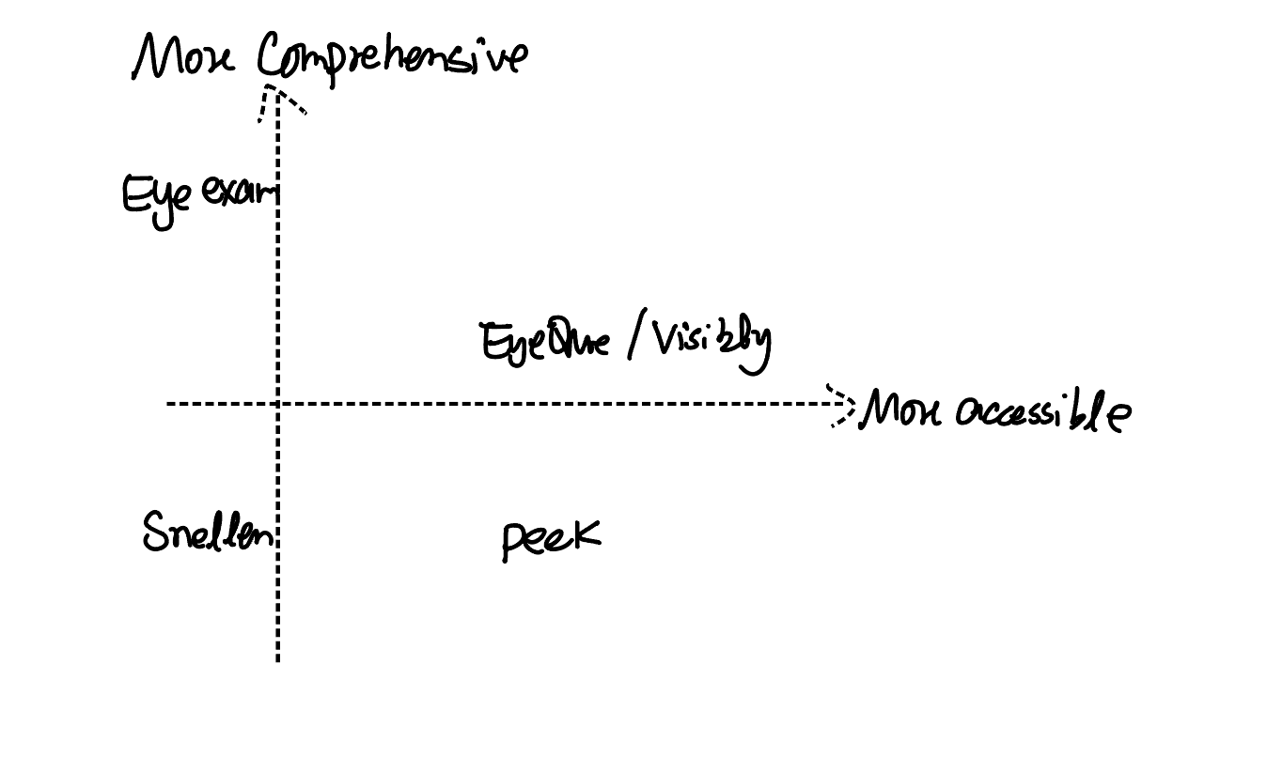
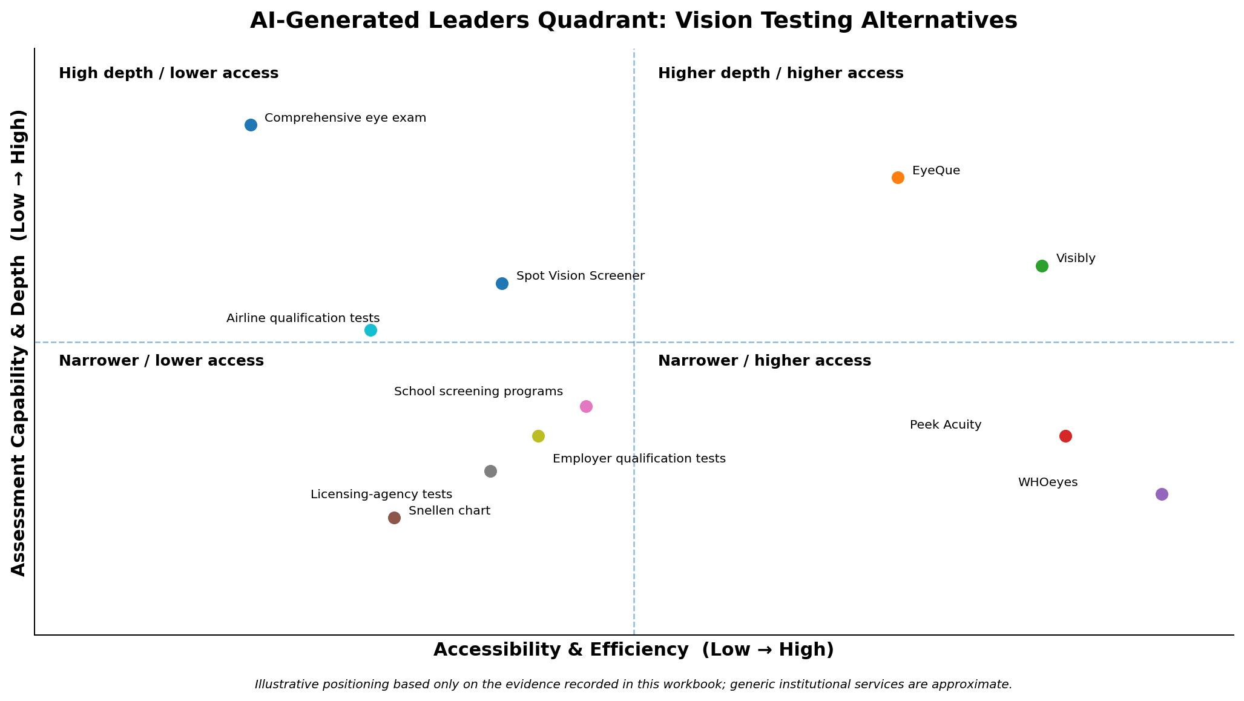
Our quadrant began as a sketch, then became an AI draft
3A · OUR SKETCH, BEFORE ANY AI
3B · THE AI’S DRAFT
Accessibility × comprehensiveness. Even our rough placements showed the tradeoff: nothing was both highly accessible and comprehensive.
Same two dimensions, all 11 competitors. The AI put EyeQue closest to the upper-right. We kept its axes — they match our pre-work dimensions.
Notes:
Part 3A and 3B. Our starting point (no AI): we placed competitors on accessibility (cost, time, equipment, need for a professional, ability to test remotely) and comprehensiveness (how many aspects of vision the test measures beyond basic acuity). The traditional exam sat top-left: most comprehensive, can detect eye disease, but needs an appointment, a professional, and clinic equipment. EyeQue and Visibly sat mid upper-right: at-home and slightly beyond a basic chart. Peek Acuity sat lower-right: free and quick but acuity-only. Snellen sat lower-left: acuity-only and usually in person. The AI's draft used Accessibility and Efficiency (x) and Assessment Capability and Depth (y), positioned all 11 competitors, and called EyeQue the closest consumer option to the upper-right.

Slide 6
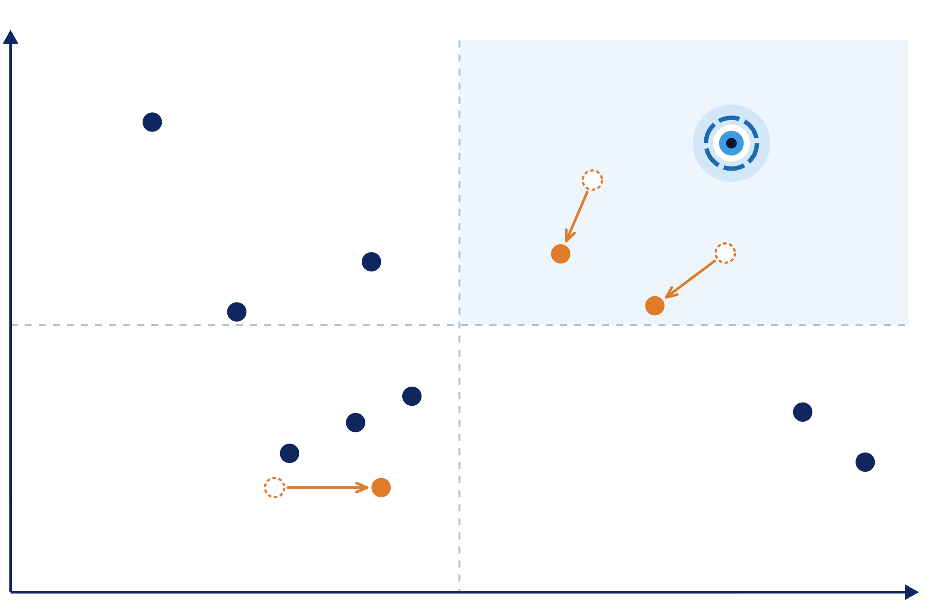




Final quadrant: the upper-right is still open
Assessment capability & depth
WHAT WE CHANGED FROM THE AI
High depth · lower access
High depth · high access
EyeQue: moved down and left
Per EyeQue, no eye-health exam; FDA Class I (510(k)-exempt); users must buy phone-mounted hardware.
Comprehensive eye exam
Focal — our target
Visibly: moved left and down
FDA-cleared (2022) only for ages 22–40 and existing-prescription renewals; some states restrict online exams.
Spot Vision Screener
EyeQue
Visibly
Airline qualification
tests
Snellen chart: moved right
School screening
programs
Printed charts are cheap and widely available — no appointment or equipment. Depth stays low: acuity only.
Peek Acuity
Licensing-agency tests
Employer qualification tests
WHOeyes
Focal: added, upper-right
Snellen chart
Accessible and comprehensive, with standardized, organization-ready testing for agencies, airlines, and rentals.
Narrower · lower access
Narrower · high access
Accessibility & efficiency
Kept
Moved
AI’s original
Notes:
Part 3C, feeds Slide 2 (graded version). We kept the AI's axes — Accessibility and Efficiency (x) and Assessment Capability and Depth (y) — because they match the dimensions we drafted in pre-work and reflect the convenience-versus-depth tradeoff from 3A. We kept all 10 AI-identified competitors plus Spot Vision Screener, and made three moves. EyeQue moved down and slightly left: EyeQue states its products do not include any form of eye health exam, and it is registered with the FDA as a Class I device exempt from 510(k) review rather than cleared through it; it measures only acuity and refractive error, and the phone-mounted hardware users must buy lowers accessibility. Visibly moved left and down a little: it received FDA 510(k) clearance in 2022 as the first online visual acuity test, but that clearance limits it to adults 22 to 40, it is meant for renewing existing prescriptions, and some states restrict online eye exams; we placed it below EyeQue on depth because it only offers a self-administered acuity test. The Snellen chart moved right: printed charts are inexpensive, widely available, and need no appointment or special equipment, while depth stays low because it only measures acuity. Finally, we added Focal's target position in the top right. No current competitor is both highly accessible and comprehensive — the gap Focal aims to fill through app-based, dynamic testing — and most at-home tools aren't designed for the standardized, organization-ready testing that licensing agencies, airlines, and rental companies need.

Slide 7
The AI’s SWOT: EyeQue as the leader
S
Strengths
W
Weaknesses
WHERE WE CORRECTED THE AI
At-home access plus acuity testing and refractive-error estimation
More depth than basic smartphone tools like WHOeyes and Peek Acuity
Self-administered — avoids clinic visits for routine checks
Phone-mounted optical hardware adds cost and setup friction
Less comprehensive than an in-person exam; no disease diagnosis
Weaker evidence of institutional or regulatory acceptance
1
Different leader
We ran our own SWOT on Visibly instead of EyeQue.
2
FDA clearance isn’t an umbrella
Visibly’s clearance covers only adults 22–40 — the range where eye problems are least common. Less groundbreaking than it sounds.
O
Opportunities
T
Threats
Add vision measures beyond acuity and refractive error
Stronger longitudinal tracking for early detection of change
Standardized workflows for organizations that repeat screening
Visibly: remote convenience plus clinician review and stronger regulatory credibility (corrected →)
Comprehensive eye exams remain the reference for breadth
Spot and institutional programs where hardware and control matter
3
Optometry pushback, unmentioned
The AI never flagged the opposition Visibly and EyeQue face from optometry specialists and lobbyists.
Notes:
Part 4A — the AI-generated SWOT (unedited content, condensed for the slide). The AI chose EyeQue as the leader. Strengths: combines at-home access with acuity testing and refractive-error estimation; more depth than WHOeyes and Peek Acuity; self-administered testing addresses unnecessary clinic visits. Weaknesses: specialized phone-mounted hardware adds cost and setup friction; less comprehensive than an in-person exam and doesn't solve the disease-diagnosis gap; less evidence of institutional or regulatory acceptance than Visibly or traditional qualification testing. Opportunities: broader measures beyond acuity and refractive error; stronger longitudinal tracking; standardized workflows for organizations. Threats: Visibly can compete on remote convenience with clinician review and stronger regulatory credibility; comprehensive exams remain the reference; Spot and institutional programs may be preferred where organizations value dedicated hardware and controlled workflows. AI's view: EyeQue reduces access friction without collapsing to acuity alone, but its depth comes from added hardware rather than a fully software-based, institution-ready workflow. Our corrections (4B): we chose Visibly for our own SWOT; FDA approval is not an all-encompassing umbrella — Visibly's clearance is limited to ages 22 to 40, a sweet spot where eye-related issues are least common, so it is less groundbreaking than total clearance; and the AI did not mention the pushback services like Visibly and EyeQue are getting from optometry specialists around the country.

Slide 8
Our SWOT puts Visibly to the test
S
Strengths
W
Weaknesses
Remote, convenient, FDA-cleared acuity test
Nationwide network of licensed eye-care providers
Limited scope: mainly acuity and prescription renewal
Needs clinician review
FDA-cleared only for adults 22–40 · AI missed
At-home conditions vary from test to test
Relies on retail and licensed-provider partners
O
Opportunities
T
Threats
Broader vision testing
Tracking over time
Regulated screening
Partnerships with retailers, contact-lens sellers, employers, and insurers
In-store testing that doesn’t require professional staff
Visibly expands into broader vision testing
Large eye-care companies build similar digital tools
Clinics or regulators don’t trust remote results
Privacy or cybersecurity issues with stored health data
Opposition from optometry specialists and lobbyists (“BigOpto”) · AI missed
Notes:
Part 4B — our own SWOT (no AI for the judgments), competitor: Visibly. Strengths: a remote, convenient, FDA-cleared acuity test and a nationwide network of licensed eye-care providers. Weaknesses: test scope limited mainly to acuity and prescription renewal; needs clinician review; FDA-cleared only for adults in the 22 to 40 range; at-home conditions may differ from test to test; reliant on retail and licensed-provider partners. Opportunities: broader vision testing, tracking over time, regulated screening; partnerships with retailers, contact-lens sellers, employers, and insurers; expansion of in-store testing that does not require professional staff. Threats: Visibly expands into broader testing; large eye-care companies build similar digital tools; clinics or regulators don't trust remote results; privacy or cybersecurity issues with stored sensitive healthcare data; opposition from optometry specialists and lobbyists (BigOpto). Items marked 'AI missed' are the two corrections we called out against the AI's SWOT.

Slide 9
Visibly today vs. Focal’s plan
 | Visibly · today | Focal · our plan
Core job | Remote acuity test plus clinician-reviewed prescription renewal | Routine testing plus dynamic, personalized testing with curated predictions of visual health
Who it serves | Adults 22–40 with an existing prescription (its FDA-cleared range) | Early adopters: insurers, individual users, vehicle-rental agencies, pediatric development
Assessment depth | Acuity only — doesn’t screen for or diagnose eye disease | Broader vision testing and tracking over time
For organizations | Relies on retail and licensed-provider partners | Compliance checks and standardized testing for licensing agencies and their constituents
How it reaches users | Nationwide network of licensed eye-care providers | Pilot medical examiners, school nurses, insurer apps, a DMV-test checker, rental-app check-in
Sources: our SWOT (4B), FDA 510(k) summary cited in 5C, and our updated Lean Canvas (6B)
Notes:
Strategic direction from the SWOT, assembled from our own materials. Visibly today: a remote acuity test with clinician-reviewed prescription renewal, cleared for adults 22 to 40 with an existing prescription, acuity-only (the FDA states it does not screen for or diagnose eye disease), reliant on retail and licensed-provider partners, with a nationwide provider network. Focal's plan (Lean Canvas and SWOT opportunities): accessible routine testing, dynamic testing to reduce false positives, and personalized testing with curated predictions of visual health; early adopters are insurance providers, individual users, vehicle-renting agencies, and pediatric development; broader vision testing and tracking over time; a testing pipeline with compliance checks for licensing agencies and their constituents; channels through pilot medical examiners and airline safety teams, school nurses and pediatric offices, insurer member apps and auto telematics programs, a free 'Will I pass my DMV eye test?' checker, and rental-app check-in.

Slide 10
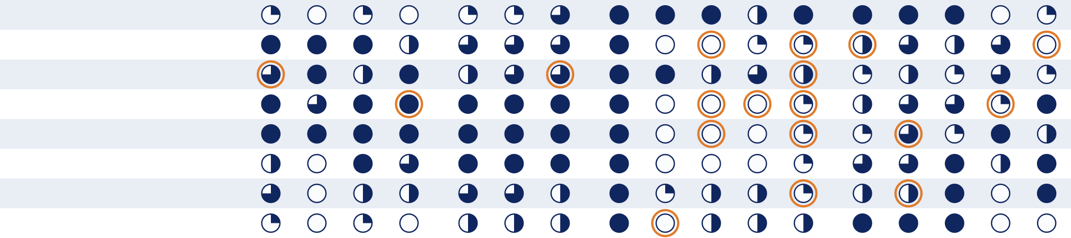






Harvey balls: 8 competitors, 17 criteria
Access & service
delivery
Cost & time
new category
Assessment & monitoring
Institutional &
market fit
Accessibility
Remote use
Low equipment
burden
Low professional
involvement
Affordability
Speed /
convenience
Turnaround time
Visual-acuity
capability
Refractive-error
capability
Broader vision
screening
Longitudinal
tracking
Comprehensive
assessment depth
Regulatory
readiness
Standardization /
test integrity
Organizational
acceptability
Direct-to-consumer
suitability
Removed from the AI’s matrix: licensing-agency and employer/work tests — testing contexts, not distinct products.
School / community
scalability
Comprehensive eye exam
Visibly
EyeQue
Peek Acuity
WHOeyes
Snellen chart
School screening programs
Airline qualification tests
Strong
Moderate-high
Moderate-low
Low
None
Changed from the AI’s score
Notes:
Part 5C, feeds Slide 6 (graded version). Four categories: Access and service delivery, Cost and time, Assessment and monitoring, and Institutional and market fit. Cost and time is new relative to the AI's matrix: Affordability and Turnaround time come from our own starting attributes (5A), and Speed/convenience moved there from the AI's access category. Orange rings mark the 18 scores we changed from the AI's draft — evidence on the next slide. Licensing-agency and employer/work-qualification tests were removed because they are testing contexts rather than distinct products or service providers, and their procedures commonly use tools already in the matrix, such as acuity charts or professionally administered exams. No criteria were removed. Affordability and turnaround time for school-screening and airline-certification programs vary by jurisdiction and implementation, so treat those scores as approximate, program-dependent judgments.

Slide 11







18 scores we overruled, with evidence
Visibly
AI → ours
EyeQue
AI → ours
Peek Acuity
AI → ours
Broader vision screening
Accessibility
Low professional involvement
Comprehensive depth
Turnaround time
Broader vision screening
Regulatory readiness
Comprehensive depth
Longitudinal tracking
School / community scalability
VERAI needs a phone, $129 hardware, and provider review before a prescription; it doesn’t evaluate ocular health.
Comprehensive depth
Only its acuity product is FDA-cleared (adults 22–40); it doesn’t screen for disease and needs a prior prescription.
Direct-to-consumer suitability
No professional needed, but not self-testable; distance acuity only; the app doesn’t record results; Android-only.
WHOeyes
AI → ours
School screening
AI → ours
Airline qualification
AI → ours
Standardization / integrity
Standardization / integrity
Refractive-error capability
Broader vision screening
Comprehensive depth
FAA testing checks acuity thresholds; it doesn’t perform refraction or calculate a prescription.
Comprehensive depth
Varies by jurisdiction, equipment, and training (WHO flags false results); built for referral, not diagnosis.
Standardized tumbling-E test evaluated against ETDRS; acuity only — no peripheral defects, no refraction.
Notes:
Part 5C — what we changed from the AI, with sources. Visibly: its FDA-cleared product assesses visual acuity and categorizes each eye as consistent or not with normal vision; the FDA states it does not screen for or diagnose eye disease (broader screening to none; depth to low). Regulatory readiness is scored for the overall platform: only the Visibly Digital Acuity Product is clinically tested and FDA-cleared, other products are not, and full refraction is still 'coming soon'. VDAP is intended for adults 22–40 and the consumer service requires an existing prescription, so it is unsuitable for school screening. Sources: FDA 510(k) summary, Visibly product information. EyeQue: VERAI requires a compatible smartphone and proprietary hardware and costs $129; measurement takes about 15 minutes, but a licensed provider must review before a prescription is issued; it measures refraction, acuity, pupillary distance, color vision, and contrast sensitivity, but does not evaluate glaucoma, cataracts, retinal disease, or ocular health. Sources: EyeQue VERAI and product overview. Peek Acuity: no licensed professional needed, but another person must administer it; the standalone app measures distance acuity only, displays but does not record results (Peek's separate organizational platform can collect data), is Android-only, and does not replace assessment by an eye-care professional. Sources: Peek Acuity, Peek validation evidence. WHOeyes: standardized tumbling-E test evaluated in three accuracy studies against ETDRS; distance control is automated on iOS but manual on Android; it does not detect peripheral defects or replace professional care. Sources: WHOeyes and its information sheet. School screening programs: vary by jurisdiction, equipment, screener training, and referral process; WHO flags false positives and negatives when training or equipment is inadequate; screening identifies children for referral, not diagnosis. Source: WHO vision-screening handbook. Airline qualification: FAA testing checks corrected or uncorrected acuity thresholds and does not perform refraction; it does include distance, near, intermediate, and color-vision standards. Source: FAA medical standards.

Slide 12

What we learned: convenience alone won’t win
01
The market is more competitive and fragmented than we thought — each solution solves a different part of the problem.
BEFORE THE ANALYSIS
Make vision testing easier to access remotely.
02
The tradeoff between accessibility and assessment depth still holds across the market.
03
When the customer is an organization, reliability and standardization matter more.
AFTER
04
The AI’s descriptions were too general: it glossed over EyeQue’s hardware and missed Spot Vision Screener entirely.
Combine accessibility with broader assessment and longitudinal monitoring — under standardized testing conditions.
Notes:
Part 6A — our learning and critical analysis (no AI). The vision-testing market is much more competitive and fragmented than we initially thought: traditional tests provide the greatest depth, while digital tools such as WHOeyes, Peek Acuity, Visibly, and EyeQue improve accessibility but vary significantly in capability, hardware requirements, and intended use. Some AI descriptions were too general — for example, EyeQue requires additional optical hardware rather than being purely software-based — and the AI initially missed Spot Vision Screener, an important hardware competitor. Insights: the market still involves a clear tradeoff between accessibility and assessment depth; reliability and standardization become more important when the customer is an organization; and a future product cannot compete only on convenience — it needs broader assessment, repeatable testing, and evidence that results are trustworthy. Before, we viewed the opportunity mainly as making vision testing easier to access remotely; now the stronger opportunity may be combining accessibility with broader assessment and longitudinal monitoring while maintaining standardized testing conditions. That changed how we think about differentiation and the target customer.

Slide 13
Working with the AI: fast breadth, missing context
Where it fell short
Where it helped
What changed in our Lean Canvas
It lacked context. It surfaced competitors but not their significance — and missed the backlash they face from optometrists. The full story took digging into the nuances.
It uncovered the broader scope of our competition and expedited initial research, so we could vet competitors and make market-entry decisions faster, with manual review.
It now reflects competitors’ hangups, so we can follow a path already cleared — an easier barrier to entry — plus customers and channels no competitor is pursuing yet.
Notes:
Part 6C — reflection on AI collaboration (no AI). What the AI lacked most is context: it brought up interesting points about competitors but didn't always recognize their significance — the primary example is that it didn't recognize the backlash competitors face from optometrists. Our Lean Canvas now identifies some of the hangups competitors have faced; instead of facing those head on, we can navigate a path that has already been cleared, so we have an easier barrier to entry. We also identified customers and channels competitors have not yet targeted, where we can claim share because no competitor is pursuing them. Using AI helped uncover the broader scope of our competition; with manual review, AI agents expedite initial research, letting us vet competitors and make market-entry decisions in a much more timely manner.

Slide 14

THE GAP
No current option is both highly accessible and comprehensive.
That’s the gap Focal aims to fill through app-based, dynamic testing — built for the standardized, organization-ready testing that licensing agencies, airlines, and rental companies need.
Notes:
From Parts 3A and 3C: our final quadrant shows that no current competitor is both highly accessible and comprehensive, which is the gap Focal aims to fill through app-based, dynamic testing. Most existing at-home tools aren't designed for the standardized, organization-ready testing that customers like licensing agencies, airlines, and rental companies need — a central part of our value proposition.

Slide 15

Focal Technologies · updated Lean Canvas
PROBLEM
SOLUTION
UNIQUE VALUE PROPOSITION
UNFAIR ADVANTAGE
CUSTOMER SEGMENTS
1. Accessibility to vision testing is difficult and outdated.
1. App to Test Vision
1. AI enhancements to allow for personalized testing and evaluation.
1. Healthcare Providers
1. Accessibility to more routine vision testing.
2. FAA/Airlines
2. AI enhanced vision testing.
3. Pediatric Development
2. The existing models to measure eyesight performance are poor and are not predictive.
2. Dynamic eyesight testing to reduce false positives.
2. Testing pipeline to provide compliance checks for licensing agencies and their constituents.
4. Vehicle Renting Agencies
5. Insurance Providers
KEY METRICS
6. Licensing Agencies
[Not yet filled in]
3. Testing compliance and standardization.
3. Optical telehealth is not accessible for routine health checks.
CHANNELS
7. Lens Providers
4. Streamlined operations and management for licensing agencies.
1. Pilot medical examiners and airline safety teams.
EARLY ADOPTERS
2. School nurses and pediatric offices.
1. Insurance Providers
EXISTING ALTERNATIVES
5. Personalized testing for the individual and curated predictions of their visual health.
2. Individual Users
3. Insurer member apps and auto telematics programs.
3. Vehicle Renting Agencies
Visibly · EyeQue · Peek Acuity · WHOeyes · Licensing Agencies
4. Pediatric Development
4. Free “Will I pass my DMV eye test?” checker.
5. Rental app check-in.
COST STRUCTURE
REVENUE STREAMS
[Not yet filled in]
[Not yet filled in]
Notes:
Part 6B — our updated Lean Canvas (no AI), submitted as a separate file and reproduced here as written. Key metrics, cost structure, and revenue streams are still blank in the source file.

