Slide 1
An investigation of PPR protein binding in plant chloroplasts
Haydn King
Jesus College
hjk38
Supervisors:
Jorge Gonçalves (internal)
Jim Haseloff (external)
Reference: F-JMG77-type(b)

Slide 2
Synthetic Biology
Applying Engineering Principals to Biology
  Encapsulation, Standardisation, Characterisation, etc...
Synthetic Biology is not Genetic Engineering

Slide 3
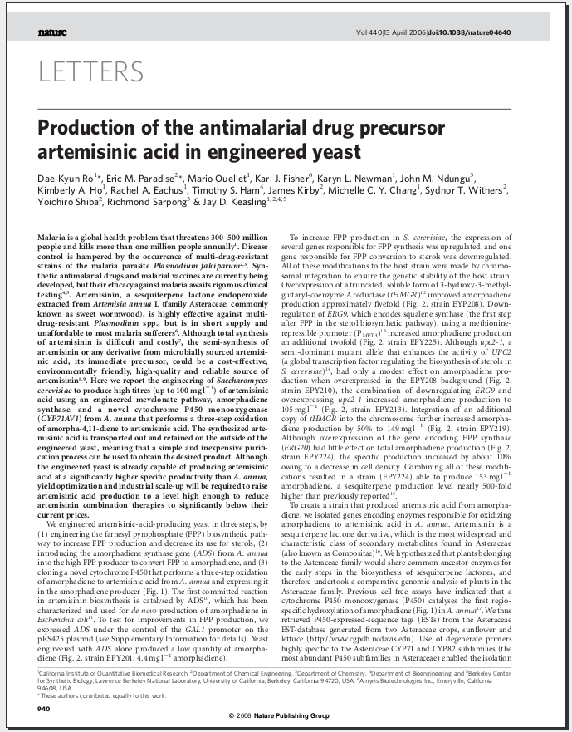
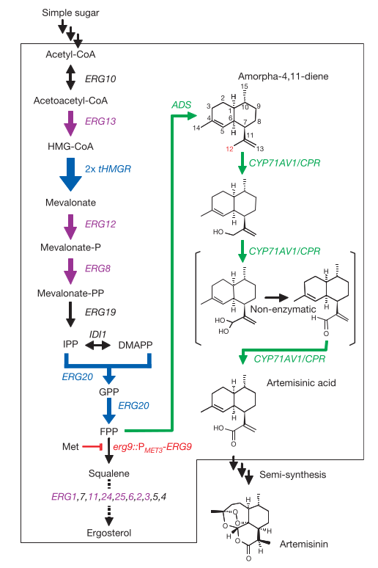

Slide 4
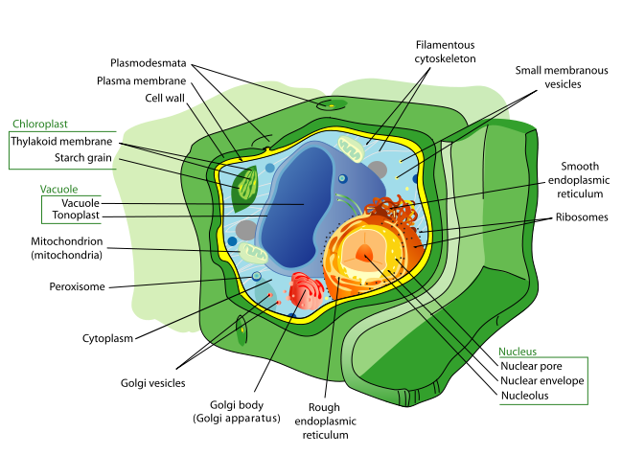
Chloroplasts
A cell within a cell
Where photosynthesis takes place
RuBisCo is the most abundant protein on earth
Image: Wikimedia commons

Slide 5
A 30 second introduction to information flow within the cell
DNA
Transcription
RNA
Translation
Protein
Long Term Storage
(521 year half life)
Short Term Message
(minutes to hours)
End Product
Control is usually achieved by up or down-regulating transcription or by modifying the mature protein

Slide 6
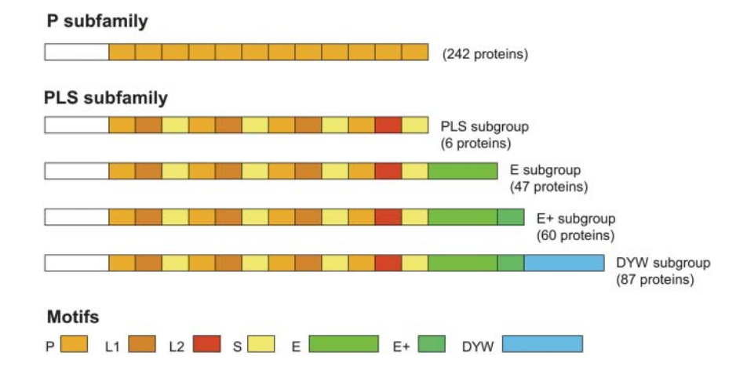
PPR Proteins
A class of proteinaceous message sent from nucleus to chloroplast
Binds to a specific RNA sequence in the chloroplast (~17bp long)
Genome-wide analysis of Arabidopsis pentatricopeptide repeat proteins reveals their essential role in organelle biogenesis.
Lurin et al., The Plant Cell, 2004

Slide 7
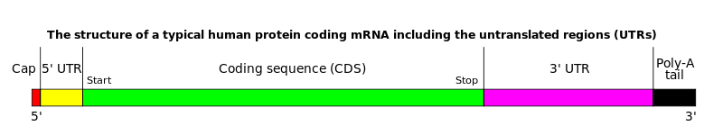
Influencing Protein Levels in the Chloroplasts
PPRs can bind to the 5' and 3' UTRs and increase lifespan of the mRNA
PPRs can bind to the Ribosome Binding Site (RBS), preventing translation

Slide 8
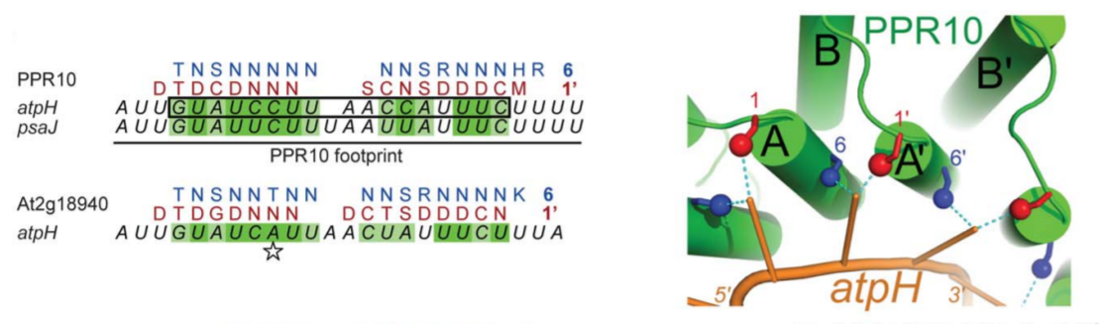
PPR Binding Rules
Recently published paper discovered a strong correlation between PPR domains and RNA target sequence
A combinatorial amino Acid code for RNA recognition by pentatricopeptide repeat proteins.
A. Barkan, M. Rojas, S. Fujii, PLoS Genetics, 2012

Slide 9
Goal 1: Automatic Construction of a Library of putative PPR/RNA Pairs
Discover PPR domains in 6-frame translations of the genome using Hidden Markov Model (HMM) search
  Python wrapper for the HMMER library written
Extract proteins from chains of sequential domains
Use the binding rules to create a HMM representing the target sequence
Find highly scoring matches in the chloroplast genome
Compare matches across plant species and find homologies

Slide 10
Goal 2: Demonstration of PPR based expression control in E. Coli
Useful to discover whether PPR proteins can be used for control in other organisms
Attempt to control the expression of Green Fluorescent Protein (GFP) in E.Coli using an inducible PPR generator
Wet-work planned for next term

Slide 11
Questions

Slide 12
Hidden Markov Models
A Markov Model where each state emits a symbol from an alphabet, with probability distribution defined by the state
The sequence of symbols is known, but not the sequence of states
Transition and Emission probabilities can be learnt with Expectation Maximisation
Network topology is a “dark art”

Slide 13
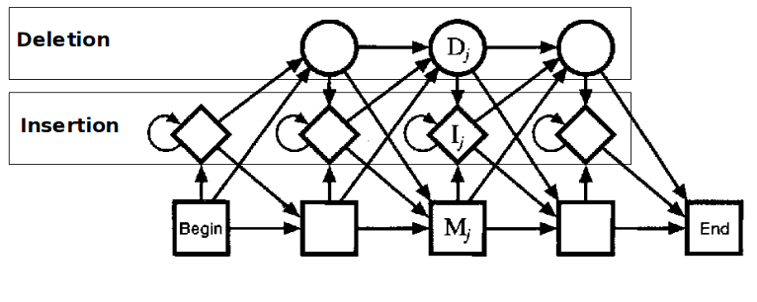
Profile HMMs
HMMs which have a set network topology

