Slide 1

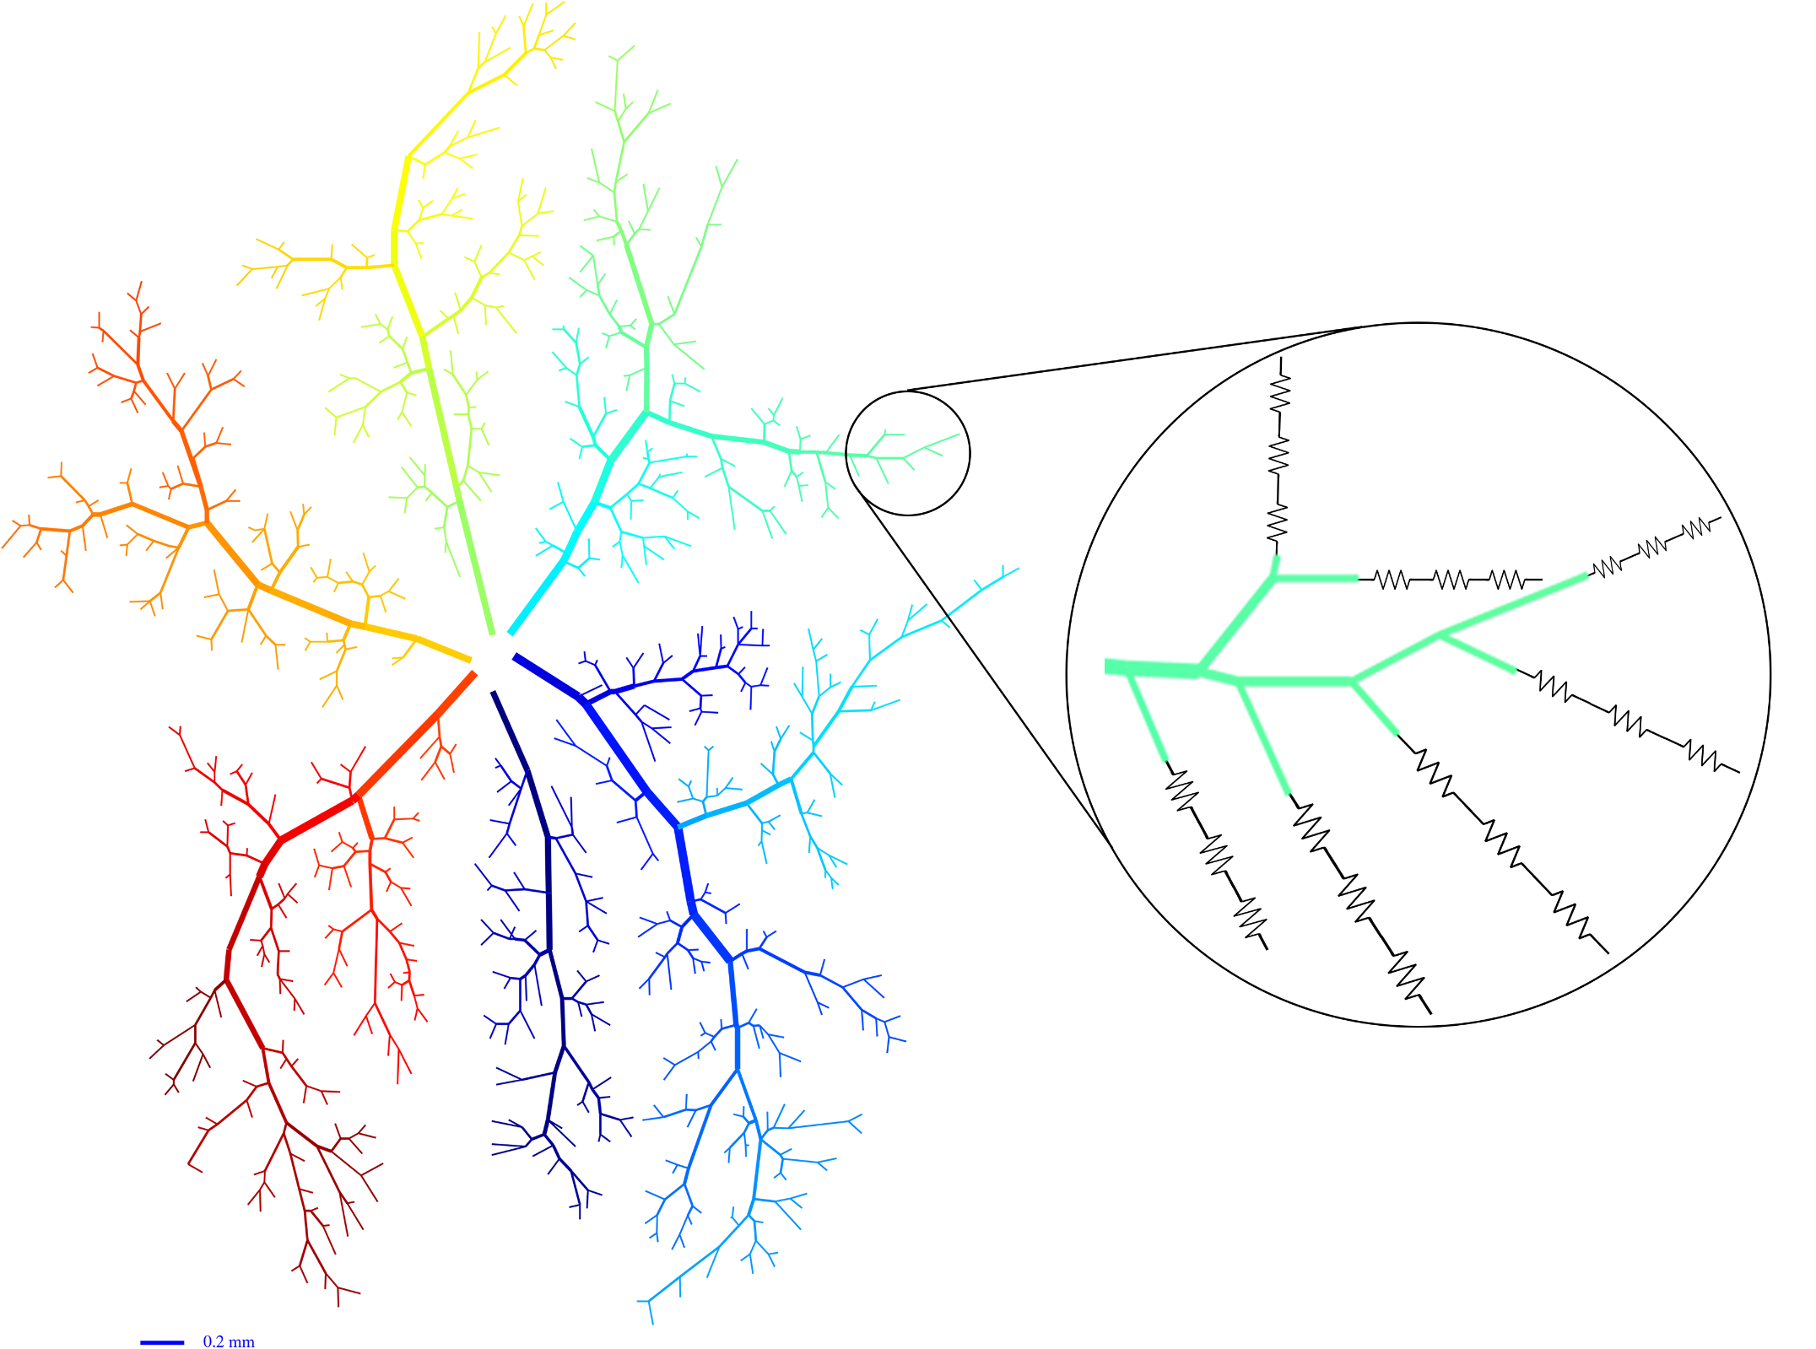
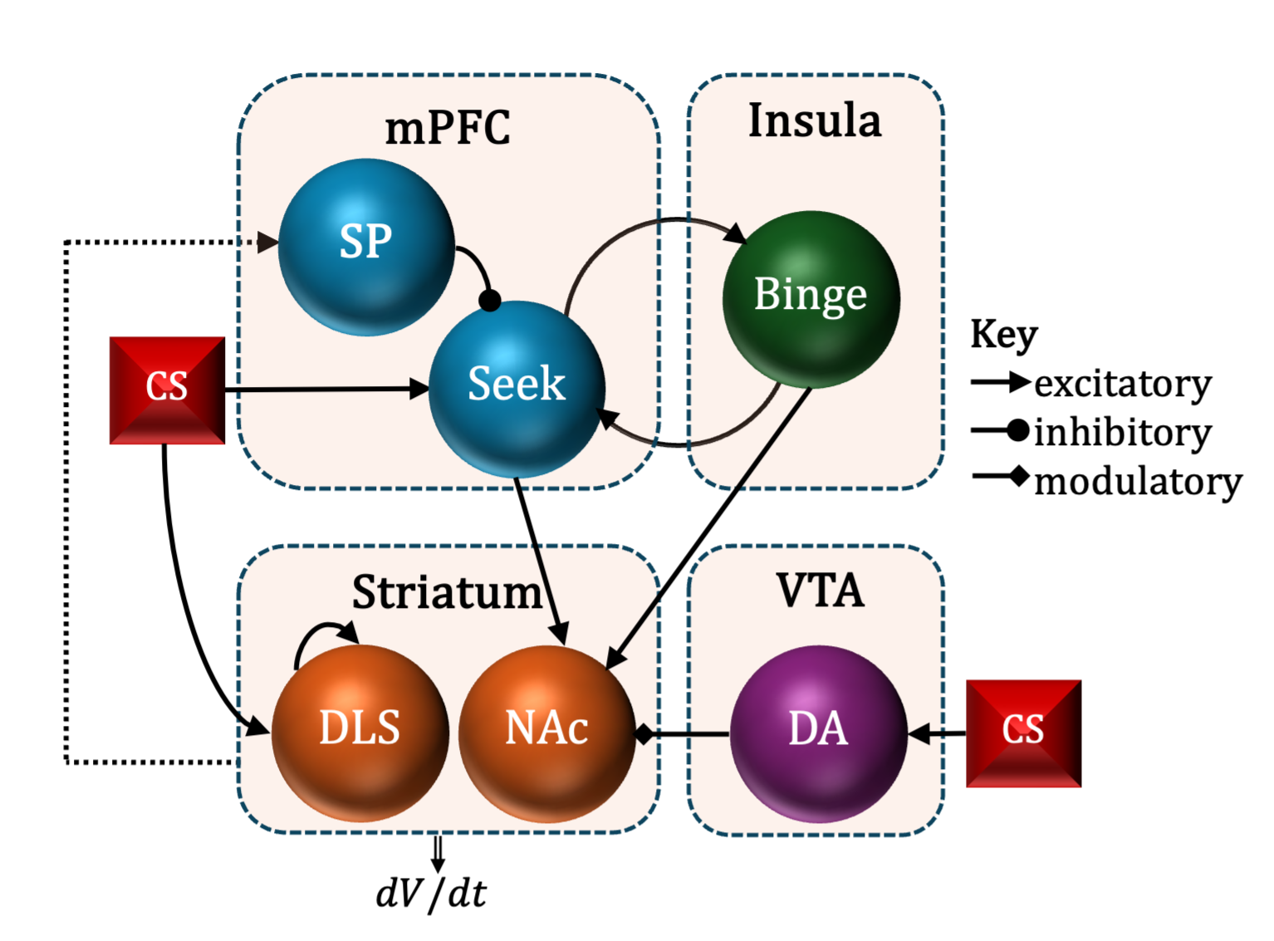
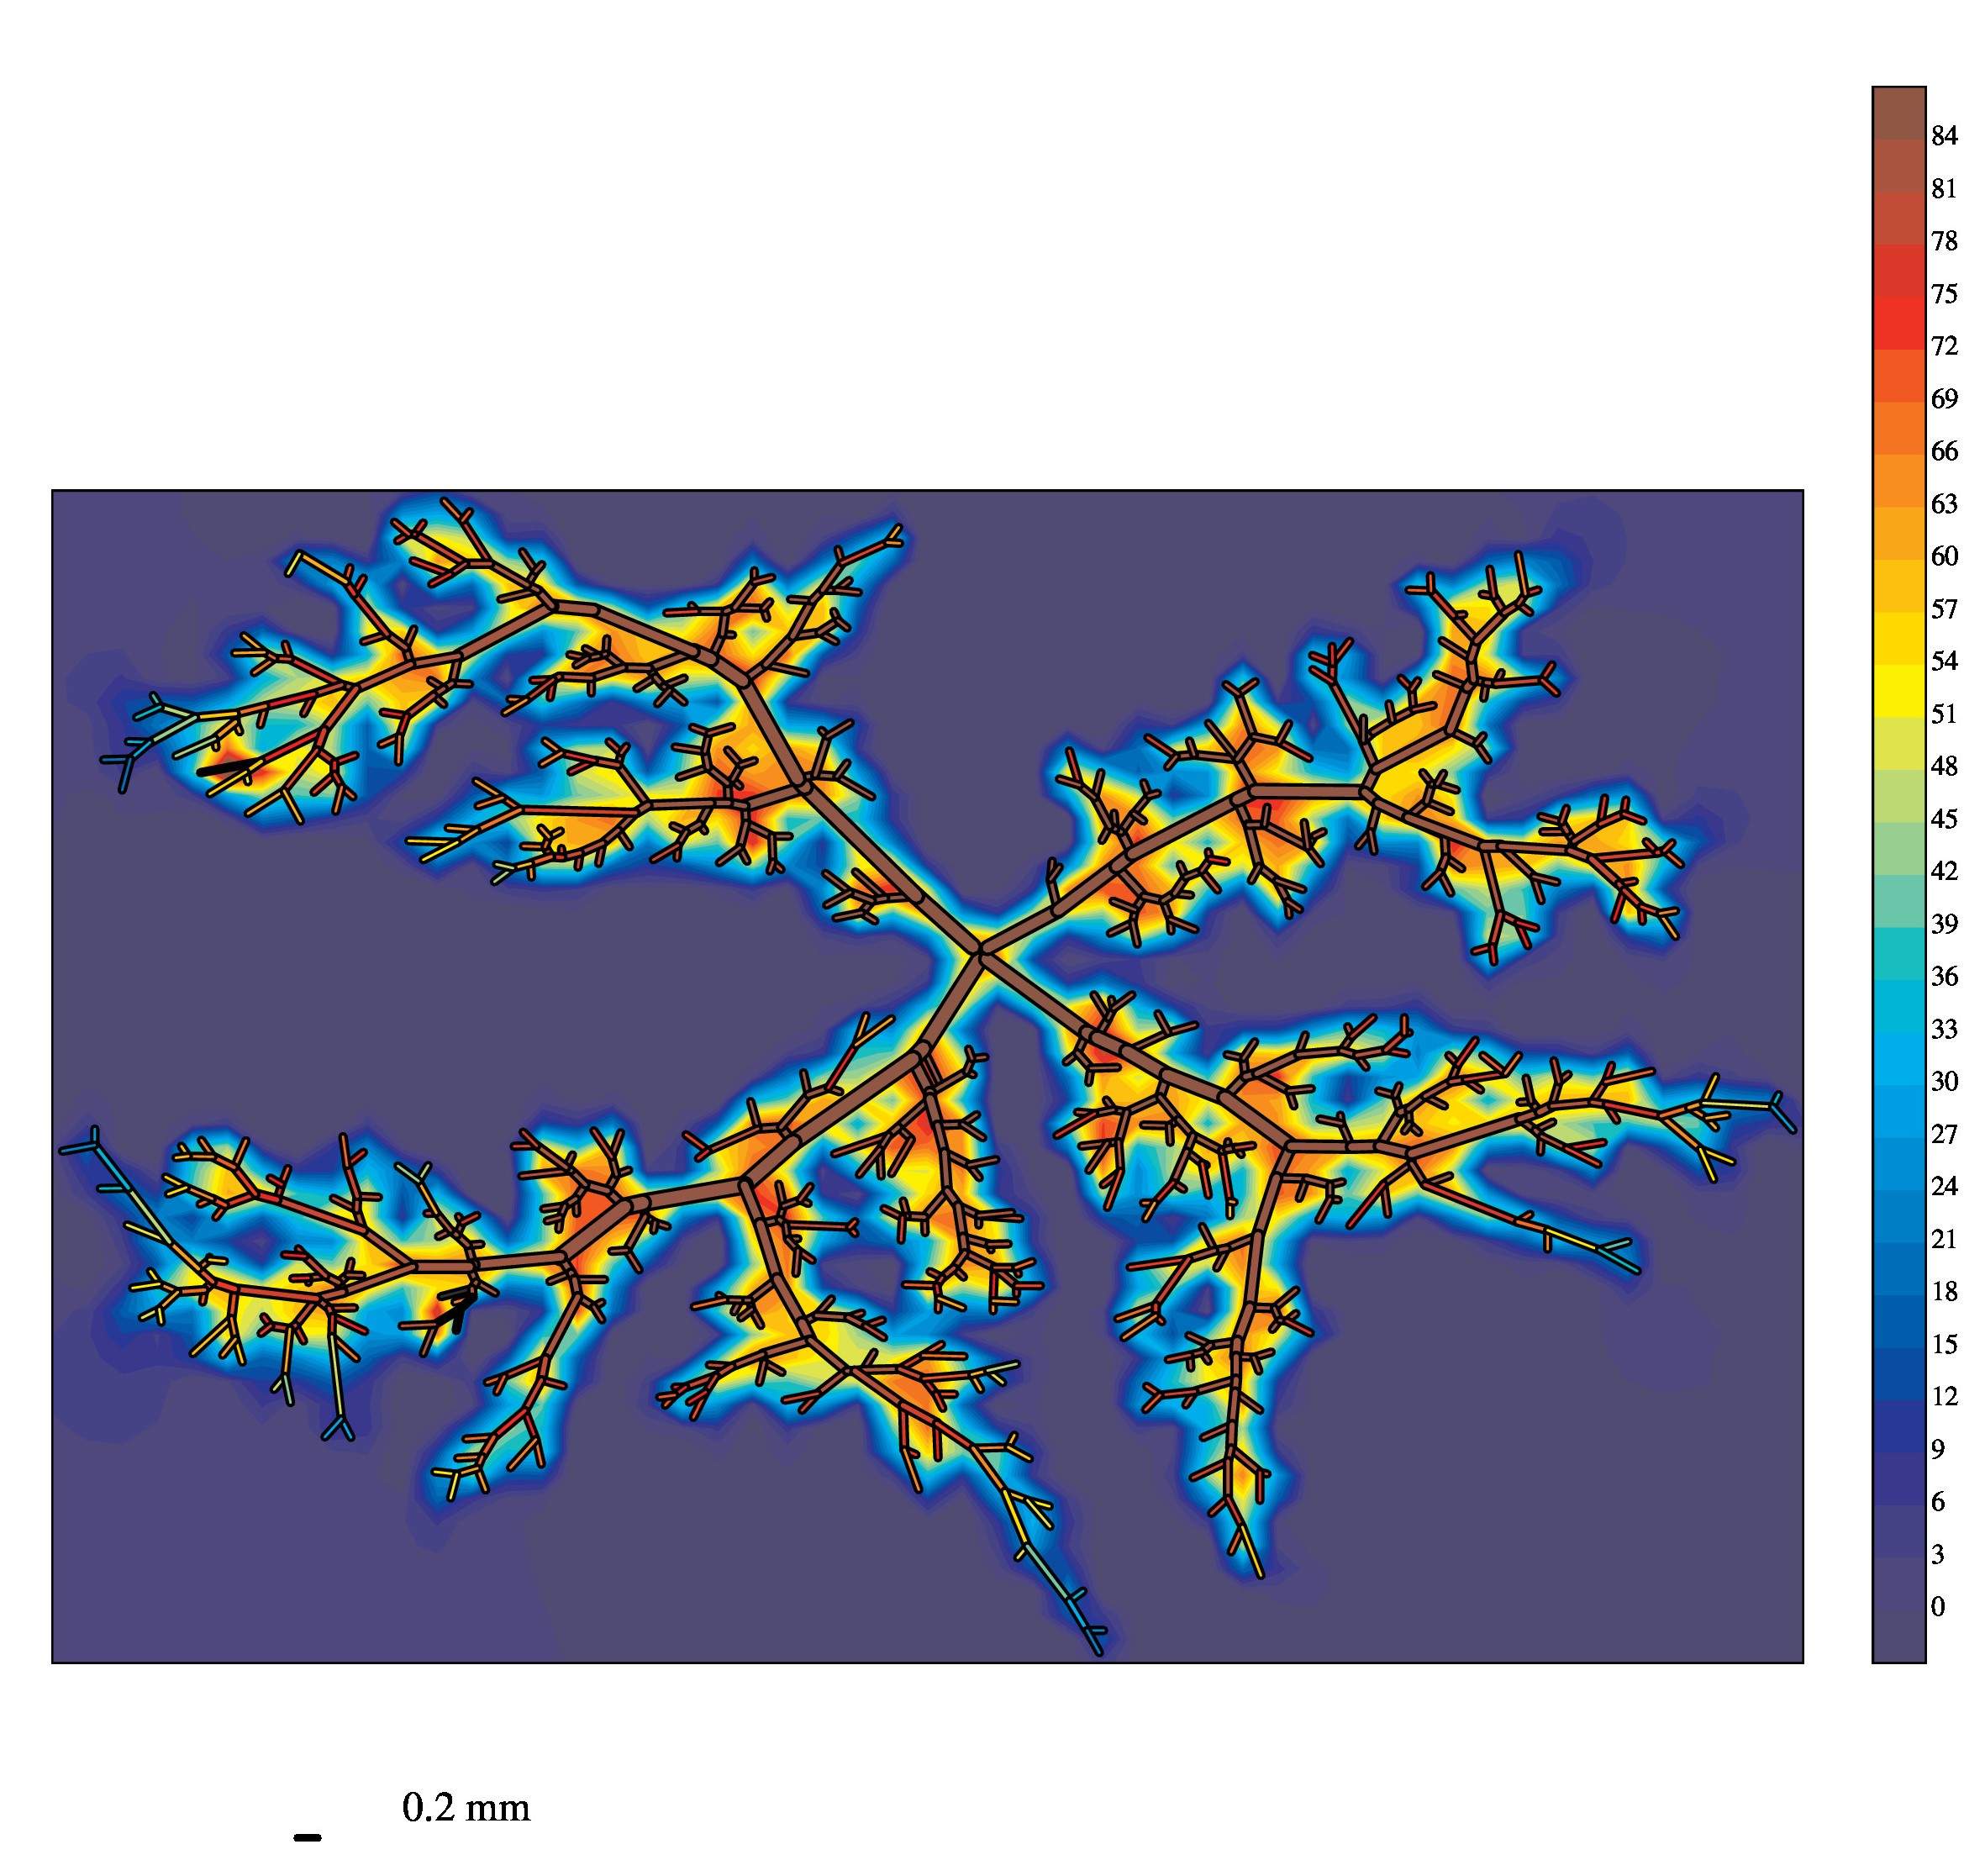
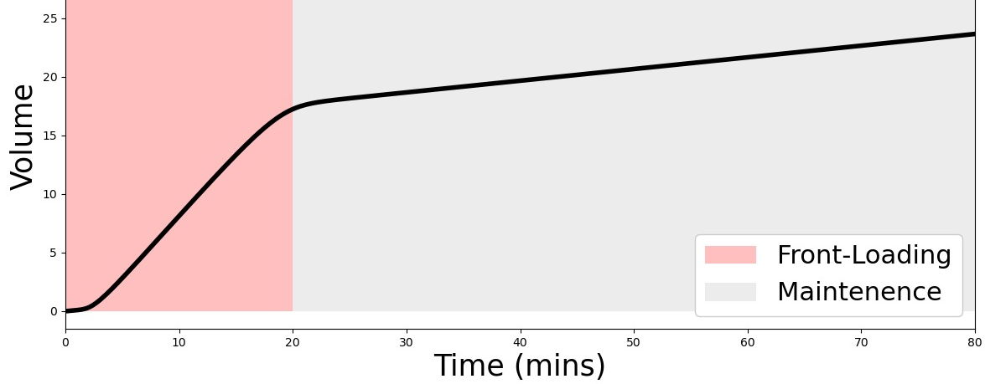
Summer Undergraduate Mathematics Research
Indiana University Indianapolis
Modeling Blood Flow Regulation and Tissue Oxygenation in the Retina
Numerical Stability of a Star-Shaped Model
Hannah Scanlon¹, Brendan Fry², Julia Arciero³
¹Department of Mathematics, Wake Forest University
²Deparment of Mathematical and Computational Sciences, Metropolitan State University of Denver
³Department of Mathematical Sciences, Indiana University-Purdue University Indianapolis
Mary Petersen¹, Jared Barber²
¹Department of Mathematics, Rose-Hulman Institute of Technology
²Department of Mathematical Sciences, IUPUI
High intraocular pressure is a primary risk factor for glaucoma, but impaired tissue perfusion has also been identified as a significant contributing factor
Objectives: (1) To include a wall-derived metabolic signal in a compartmental model of the retinal vasculature (2) To build a hybrid model of the retinal vasculature that includes a spatial representation of the arterioles and downstream effects of a metabolic response
The incorporation of a realistic metabolic response mechanism in this human compartmental model allows for basic analysis of the effects of pressure, shear stress, and oxygen demand on vessel diameter, tissue oxygenation, and tissue perfusion
Our hybrid model allows system regulation to be combined with accurate physical arterial data to produce more specific, realistic predictions of tissue oxygenation
A two-dimensional mathematical model of cancer cell motion has been constructed, but can experience slower run times due to non-physiological star-shaped numerical instabilities.
To better understand this issue, a star-shaped model shown in the Figure was modeled as a system of viscoelastic elements.
Rotational symmetry of this system of damped springs produces a system of two ODEs.
Stability analysis found that the maximum step size that can be taken when modeling cancer cell motion using improved Euler’s method is dt = 0.0359.
A sensitivity analysis (Table) was also performed that determines the effect on maximum time step (dt_{max}) of changing each of the parameters by 1%.
Figure. The star-shaped model.
 | Value | Δ dt_{max}% | Description
l_{ref} | 1.96 | 0.003 | Reference length
R_{l,ref} | 6.2 | 0.007 | Reference radius l
R_{r,ref} | 6.2 | 0.007 | Reference radius r
A_{ref} | 120.76 | 0.002 | Reference area
θ₀ | 0.314 | -0.004 | Angle between two radii
μ_{ext} | 200 | 4.668e-11 | External element viscosity
μ_{int} | 100 | 2.203e-11 | Internal element viscosity
k_{p} | 100 | 1.414e-5 | Interior pressure constant
k_{b} | 90 | 4.766e-11 | Bending modulus
k_{t,ext} | 1200 | 2.014e-5 | External element elasticity
k_{t,int} | 1200 | -3.414e-5 | Internal element elasticity
Figure. Top: Metabolic response values for the compartmental model. Bottom: Hybrid model schematic
Table. The effect of parameters on dt.
Developing a Heterogeneous Model of the Arteries in the Retina
Modeling Neurocircuitry Involved in Binge Drinking
Mandy Abernathy¹, Brendan Fry², Alon Harris³, Brent Siesky³, Alice Verticchio³, Julia Arciero⁴
¹Department of Mathematical Sciences, Wisconsin Lutheran College
²Department of Mathematical and Computer Sciences, Metropolitan State University of Denver
³Department of Ophthalmology, Indiana University School of Medicine
⁴Department of Mathematical Sciences, IUPUI
Nicholas Hayek¹, Amy Rude², Christopher C. Lapish³, Alexey Kuznetsov⁴
¹Department of Mathematics and Statistics, McGill University
²Department of Applied Mathematics and Department of Neuroscience, University of Washington
³Addiction Neuroscience Program IUPUI
⁴Department of Mathematical Sciences, Indiana University Indianapolis
Glaucoma is a serious ocular disease that results in irreversible vision loss; impaired oxygenation of retinal tissue has been identified as a factor that may contribute to glaucoma.
Objective: To develop a theoretical model of the human retinal vasculature based on oximetry data to predict retinal blood and tissue oxygenation.
A previous heterogeneous model of retinal oxygenation in the mouse was adapted to model the human retina. Vessel lengths and diameters were rescaled, and arteriolar branch number and position were altered.
The heterogeneous arrangement of blood vessels in this model accounts for the diffusion of oxygen from multiple sources into one tissue point, and the model predicts a large range in PO₂
Binge drinking occurs when one vigorously seeks alcohol intoxication. It is characterized by two successive phases: high-rate “front-loading” and low-rate “maintenance.”
Objectives: (1) Develop a literature-based computational model of the neuropathways involved in binge drinking and (2) better understand how irregular neuron behavior impacts front-loading.
Model Design: Cortical structures mediate seeking behavior by tracking one’s consumption patterns. Conditioned stimulus mediates dopamine (DA) release and activates long-term, low-level drinking signals in the dorsal-lateral striatum. Projections of glutamate and DA to the nucleus accumbens drive the vigor at which one drinks.
Results: (1) The steepness, but not duration, of front-loading is dependent on DA release. (2) Bidirectional cortical projections determine whether binging is two-phased. (3) The efficiency of striatal-cortical feedback determines the duration of front-loading.
Figure. Predicted contour of map of oxygenation in the human network. In contrast to the mouse eye, the human eye has four arterial branches and an avascular zone around the fovea.
Figure. Top: Hypothesized model. Bottom: Two-phased consumption pattern

