Slide 1

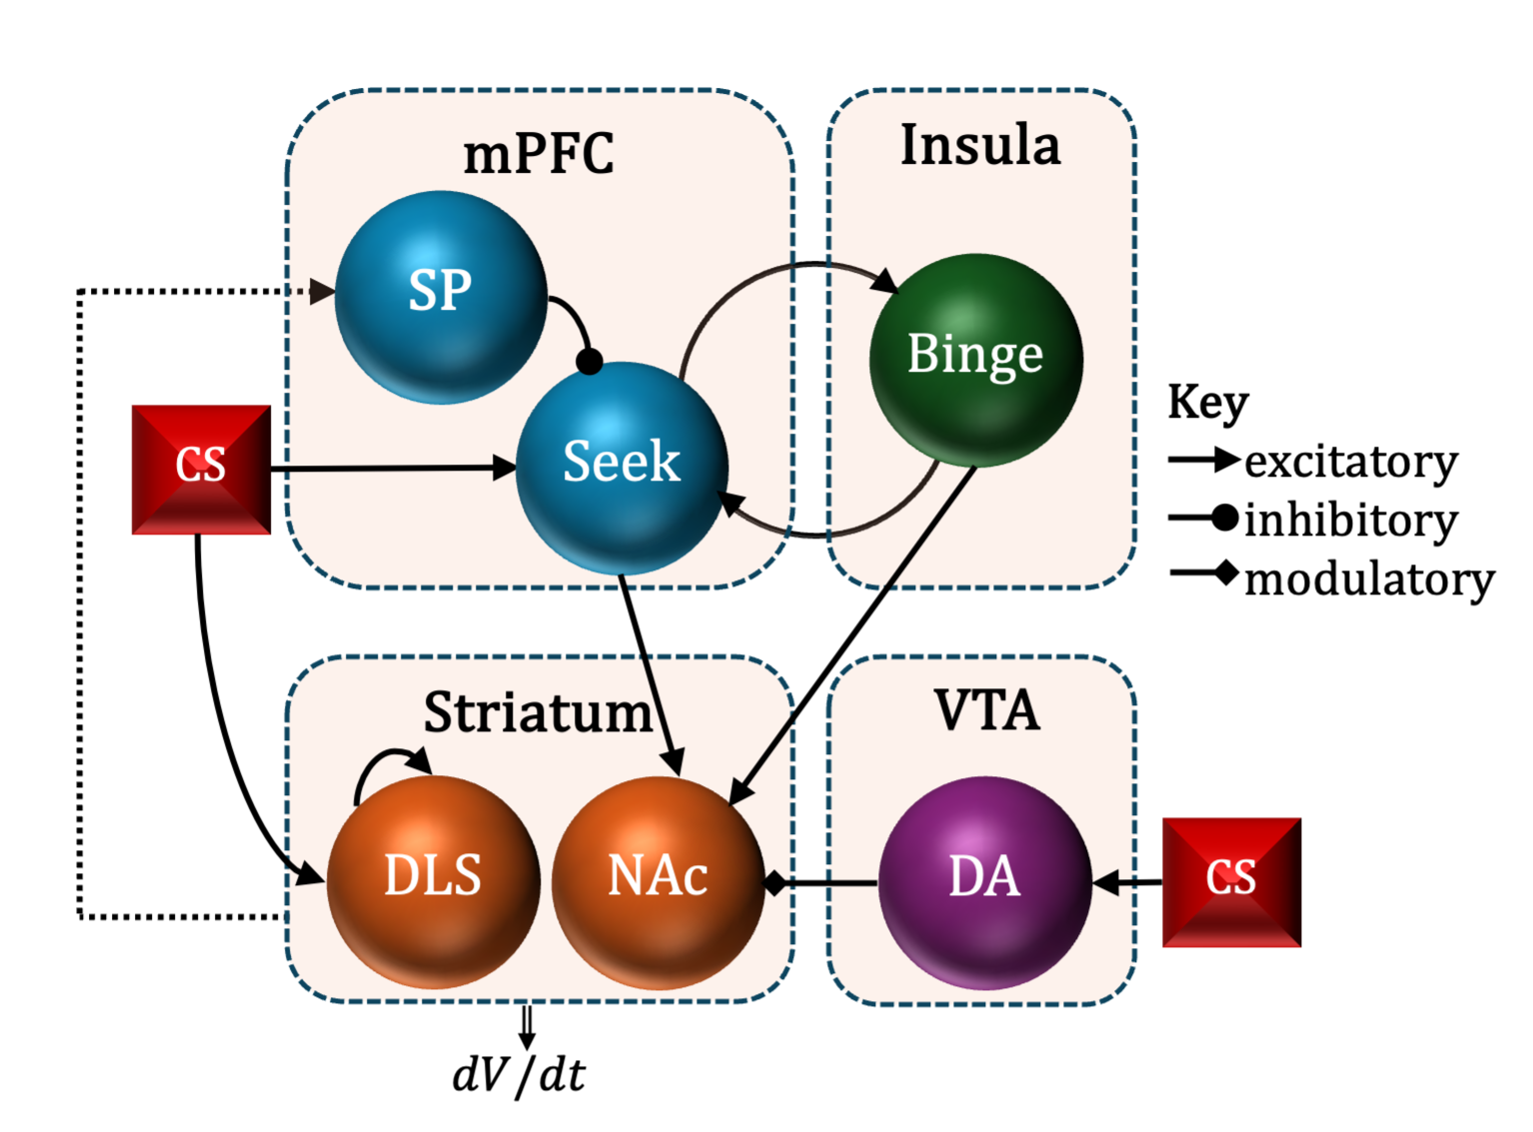
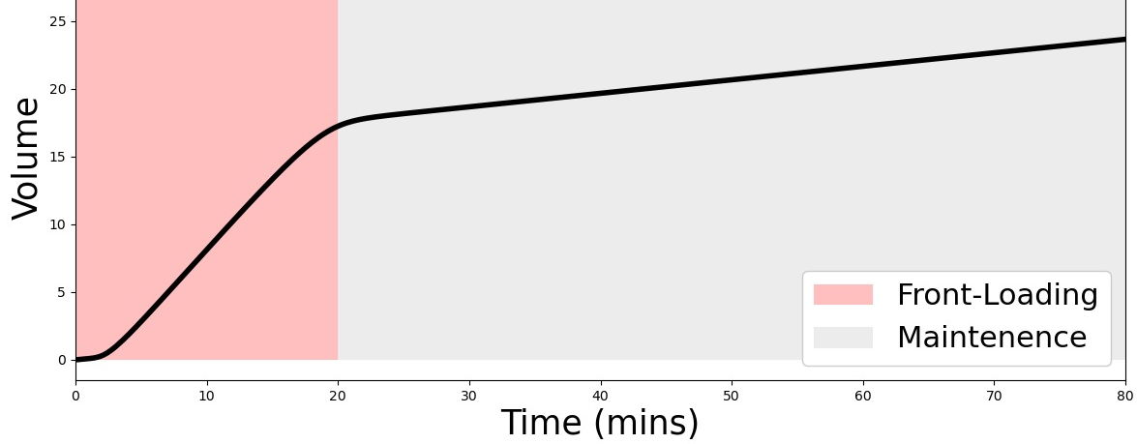
Summer Undergraduate Mathematics Research
Indiana University Indianapolis
Modeling the Neurocircuitry Involved in Binge Drinking
Nicholas Hayek¹, Amy Rude², Christopher C. Lapish³, Woody Hopf⁴, Alexey Kuznetsov⁵
¹Department of Mathematics and Statistics, McGill University
²Department of Applied Mathematics and Department of Neuroscience, University of Washington
³Department of Anatomy, Cell Biology, and Physiology, Indiana University School of Medicine
⁴Department of Psychiatry, Indiana University School of Medicine
⁵Department of Mathematical Sciences, Indiana University Indianapolis
Binge drinking occurs when one vigorously seeks alcohol intoxication. It is characterized by two successive phases: high-rate “front-loading” and low-rate “maintenance.”
Objectives: (1) Develop a literature-based computational model of the neuropathways involved in binge drinking and (2) better understand how interactions of neurons determine the dynamics of behavioral patterns.
Model Design: Cortical structures mediate seeking behavior by tracking one’s consumption patterns. Conditioned stimulus mediates dopamine (DA) release and activates long-term, low-level drinking signals in the dorsal-lateral striatum. Projections of glutamate and DA to the nucleus accumbens drive the vigor at which one drinks.
Results: (1) The steepness and duration of front-loading are affected by DA release. (2) Bidirectional cortical projections determine whether binging is two-phased. (3) The efficiency of striatal-cortical feedback determines the duration of front-loading.
Figure. Top: Hypothesized model. Bottom: Two-phased consumption pattern

