Slide 1
Noise2Noise: Learning Image Restoration without Clean Data
Multimedia Processing Technique
201811300 Son Hayeon

Slide 2
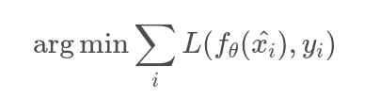
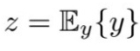
Theoretical background

Slide 3
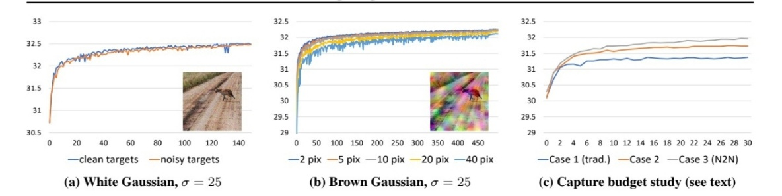
Contents of the study

Slide 4
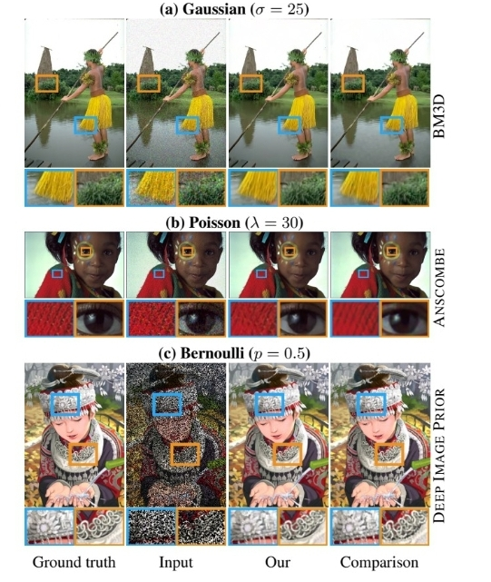
Contents of the study

Slide 5
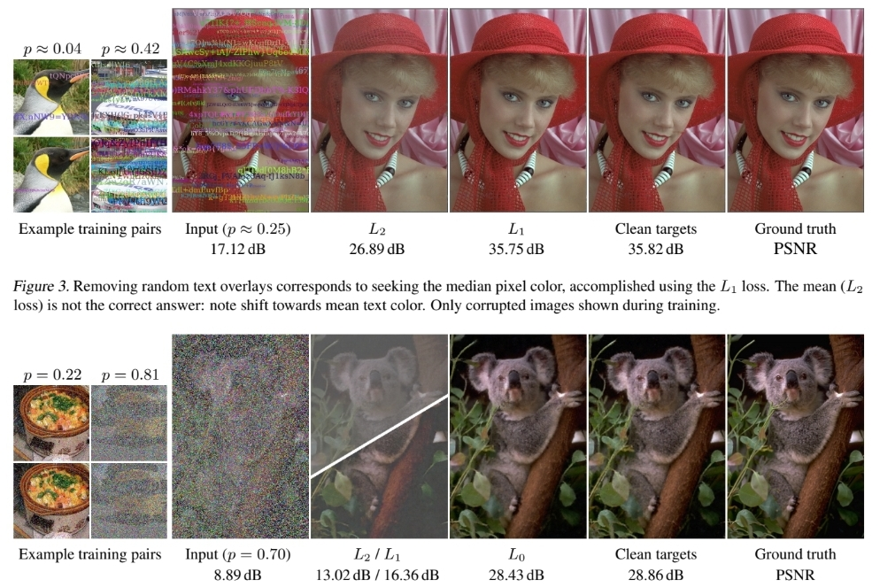
Contents of the study

Slide 6
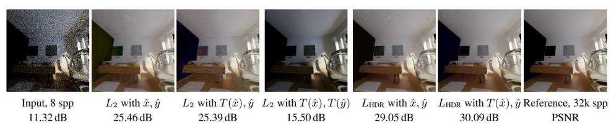
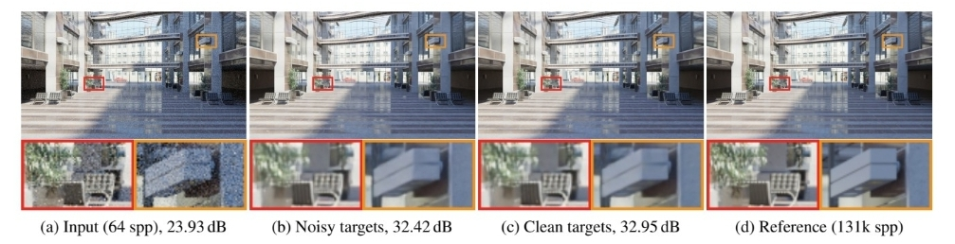
Contents of the study

Slide 7
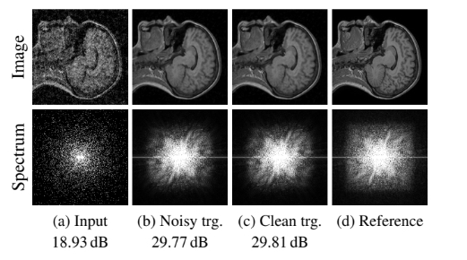
Contents of the study

Slide 8
Thank you

