Slide 1

“Operational Excellence”
NFL EverGame Program
2026 Program Committee Meeting January 2026
TECHNOLOGY

Slide 2
Agenda
CONFIDENTIAL | 2
>
Objective
>
Organizational Structure
>
Program Structure
>
Scorecard
>
Milestones

Slide 3
EverGame Monthly Committee Meeting
CONFIDENTIAL | 3
Objective: Decision making, approval, and alignment.
Meeting Frequency: Monthly, third week of the month on Thursday;1 Hour.
Key Participants:
NFL: Gary Brantley, Aaron Amendolia, Rama Ravindranathan, Tim Davidson, Sandra Manigault
N-Ovate: Tye Hayes, Knox Phillips, Erin Greene, Asia Lewis, Tionna Taylor
Meeting Host:
Sandra Manigault (Primary)
Victoria Donten (Alternative)
Notes:
Objective: Decision making, approval and alignment
Meeting host sandi tori

Slide 4
EverGame Program Organization Structure
Steering Committee
Gary
Brantley
Aaron Amendolia
Sandra
Manigault
Rama
Ravindranathan
Tim
Davidson
Tye
Hayes
Knox
Phillips
NFL Approvers
Gary
Brantley
Rama
Ravindranathan
Aaron Amendolia
EverGame Advisory Board
Program Lead (NFL)
Project Management
Program Lead (N-Ovate)
Sandra
Manigault
Victoria Donten
Kathryn
Rodriguez-Barry
Jacqueline Navarro
Asia
Lewis
Erin
Greene
Tionna
Taylor
Knox
Phillips
Workstream Leads
Stadium Certification
GDA Module
Integrations
IT Infrastructure Module
IT Events
Nik
Stamatakis
Mike Katzenoff
David
Ng
Tim
Davidson
Nick
Annucci

Slide 5
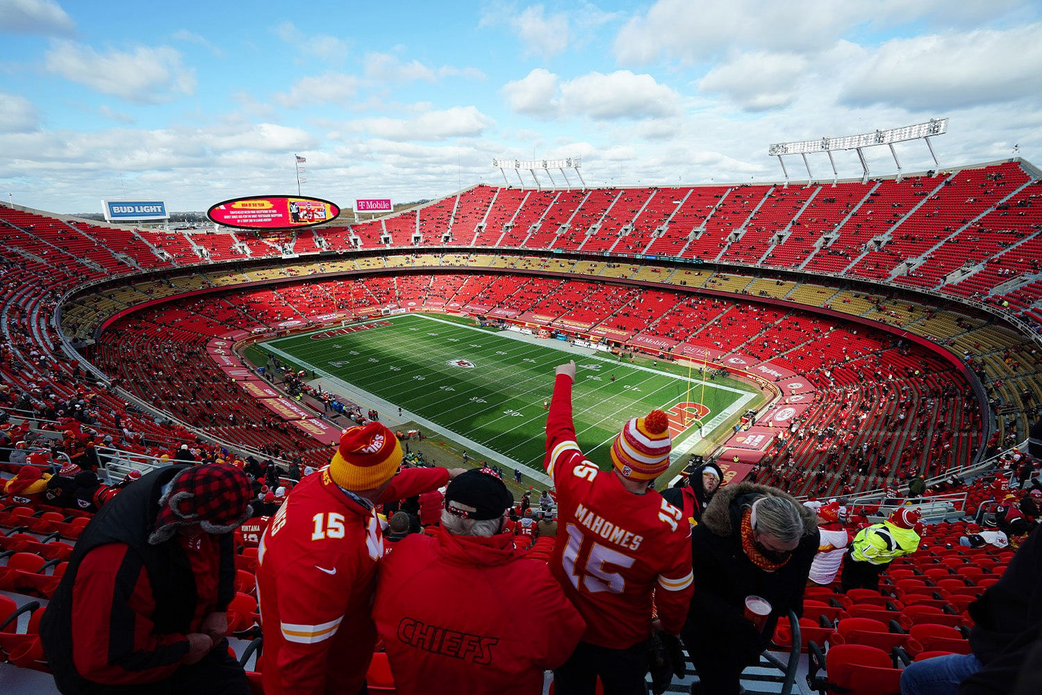
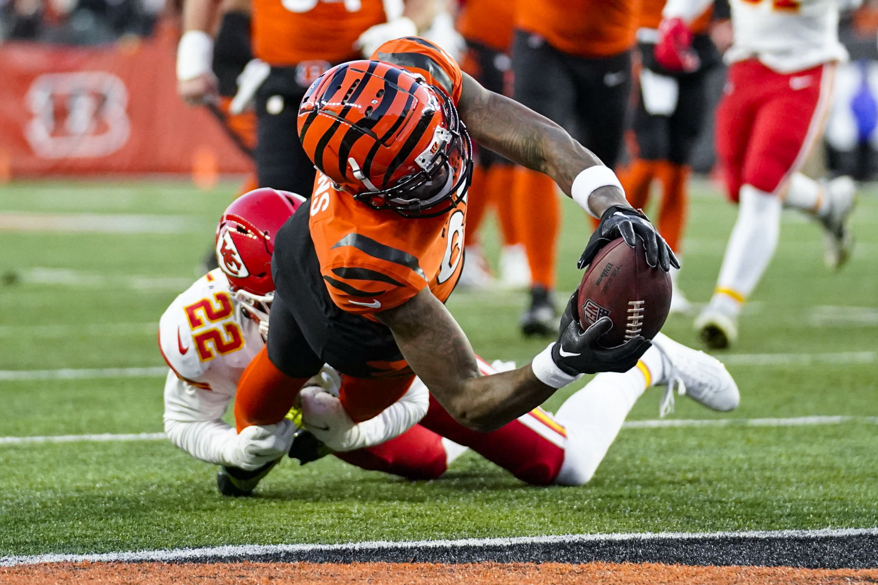
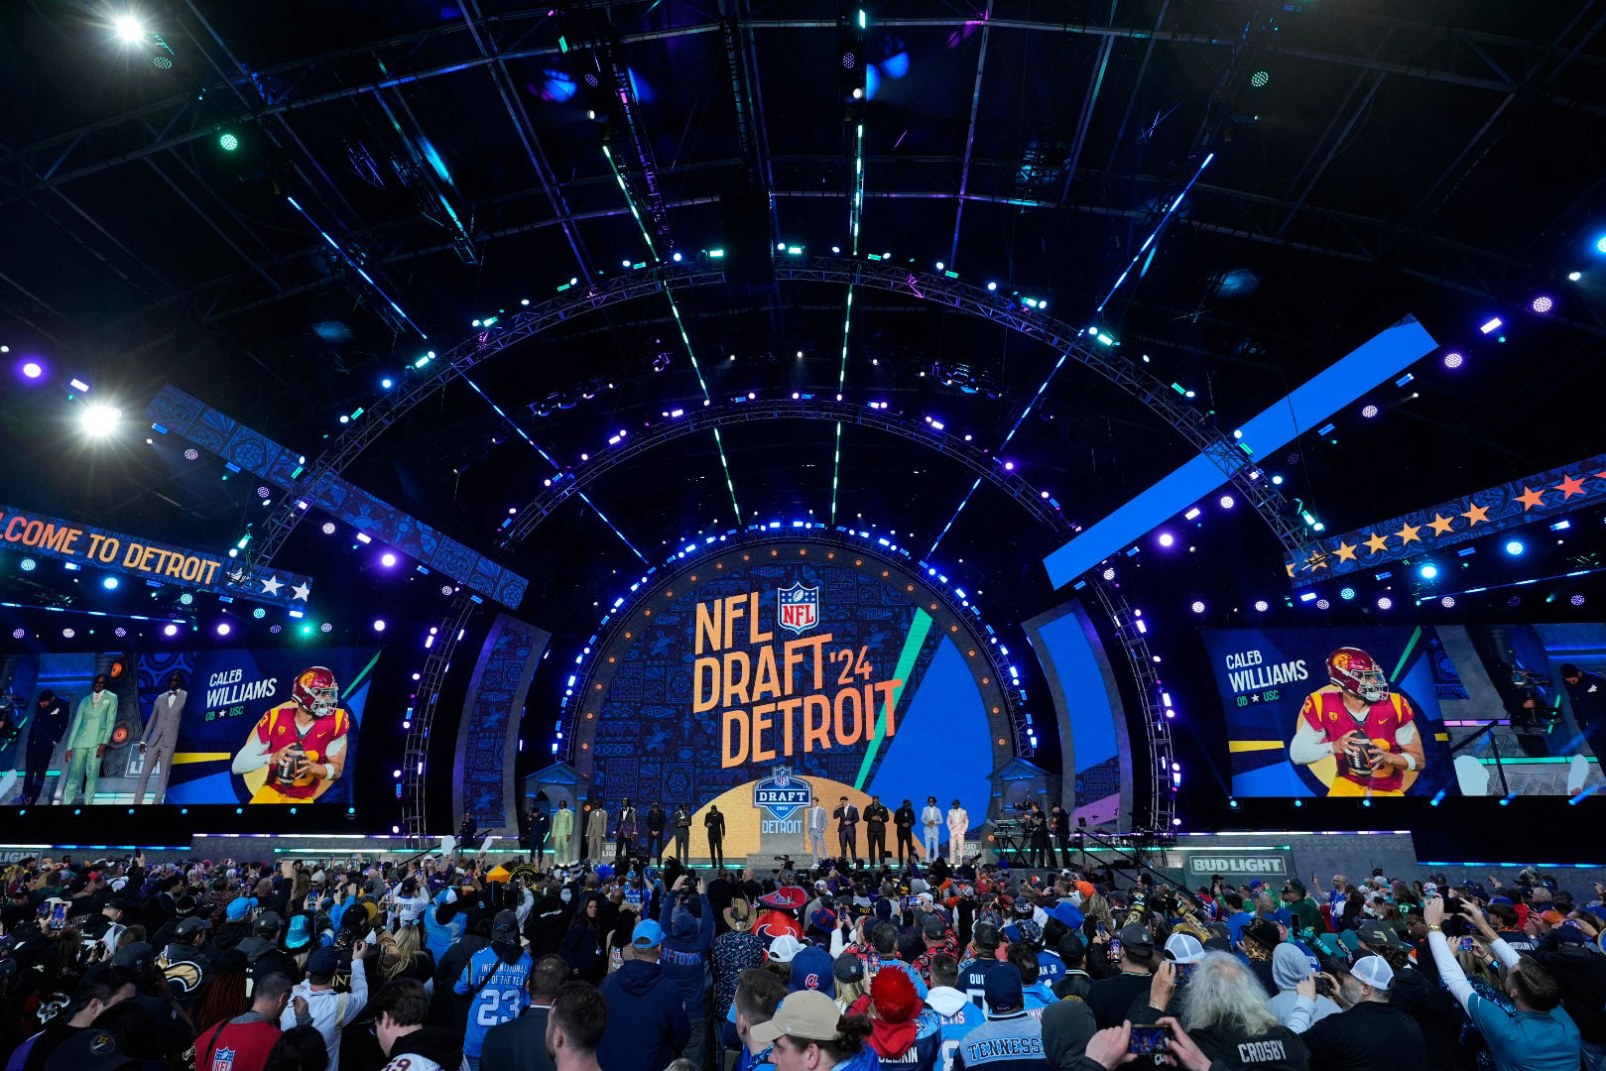
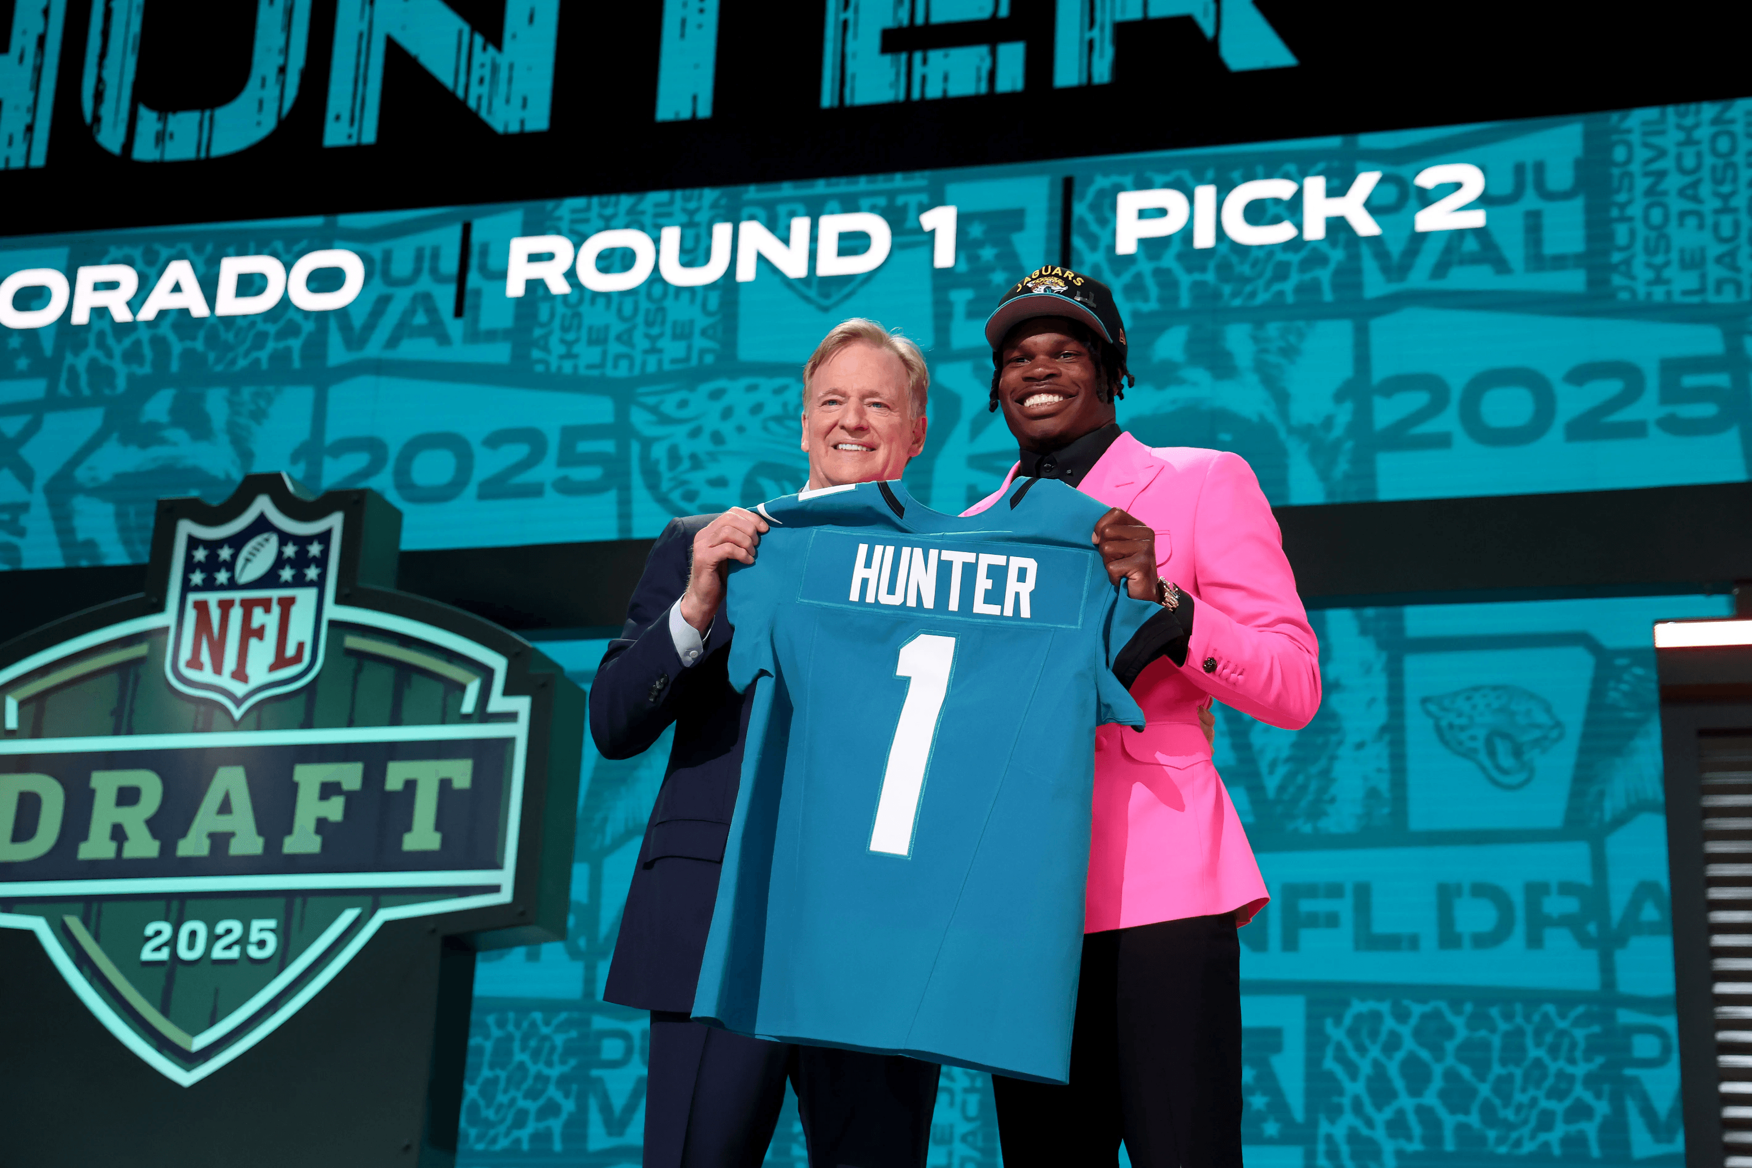
EverGame Program Structure
EverGame Program – 3 Tracks | 4 Projects
STADIUM CERTIFICATION TRACK
Stadium Certification Project
GAMEDAY TRACK
GDA Module Project
IT Infrastructure Module Project
IT EVENTS READINESS TRACK
IT Events Readiness Project
Stadium Certification Project
Support NFL IT with annual certification of 30 stadiums plus Hall of Fame (HOF) and international stadiums during the offseason in preparation for the upcoming year.
GDA Module & IT Infrastructure Projects
Support NFL GDAs and NFL Infrastructure team with the set of game readiness activities IT is responsible for during game day as well as tentpole events.
IT Events Readiness Project
Support the IT Events team with build out and set up of technology readiness for all tentpole events.

Slide 6
EverGame Program Scorecard as of January 22nd
Stadium Certification – 68 Days to Go-Live Date March 31st
GDA – 159 Days to Go-Live Date June 30th
Project | BRD | Business Approved | Design | Business and Vendor Signoff | Build | Go-Live
Stadium Certification
GDA Module
IT Infrastructure Module
IT Events Readiness
Not started | On Track | At Risk | Off Track | Complete
Status reflects likelihood of meeting target date
Notes:
Another color for days

Slide 7
EverGame Program Milestones
Complete
In Progress
Not Started
Note, IT Infrastructure Module and IT Events Projects have not started.
Today
Dec 2025
Jan 2026
Feb 2026
Mar 2026
Apr 2026
May 2026
Jun 2026
BRD
BRD Business Approval
BRD N-Ovate Review
BRD Workshop
BRD All Team Sign-Off
Stadium Certification
Design Phase
ARB Review
Feb 2026
Build Phase
Integrations
QA
UAT & Testing
Go-Live
Mar 31
BRD
BRD Business Approval
Simulation Testing
BRD N-Ovate Review
BRD All Team Sign-Off
GDA Module
Design Phase
ARB Review
Mar 2026
Build Phase
Integrations
Internal Testing
User Acceptance Testing
Go-Live
Jun 30

Slide 8
Questions?

