Slide 1
NFL Goals Innovation HUB

Slide 2
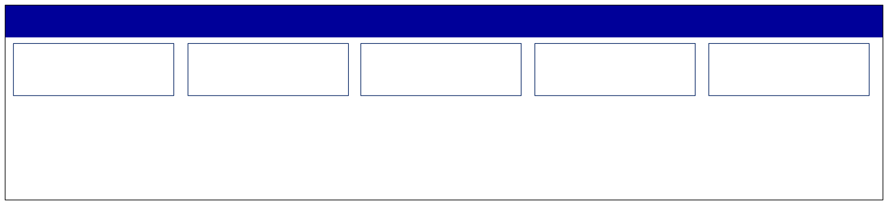
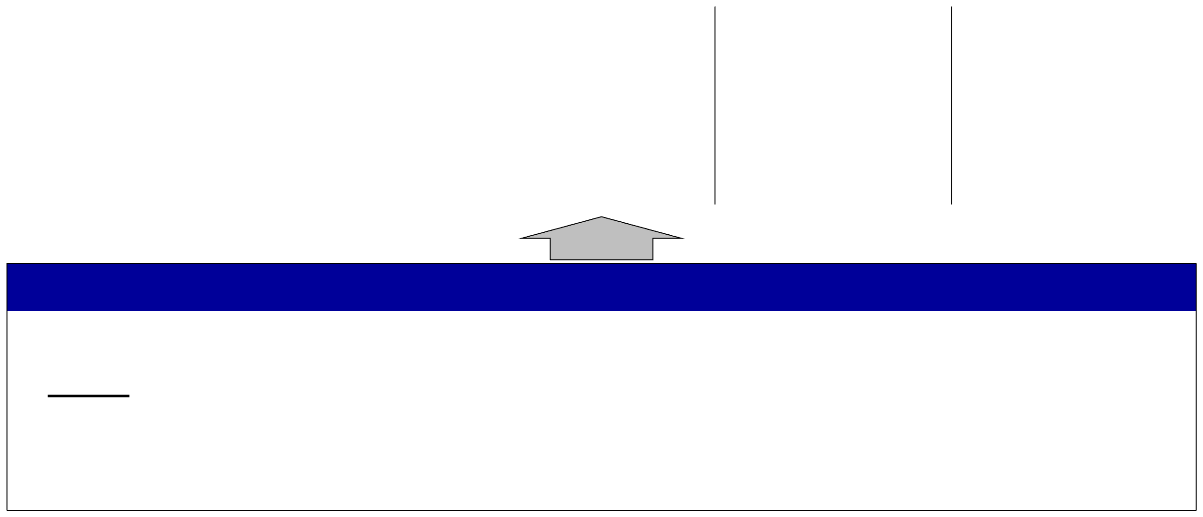

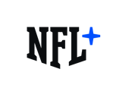



















STRATEGIC PLANNING FOCUS
League Goals: Increase Consumption | Fan Growth | Grow Key Demographics
Focus Areas
Direct-to-
International
Legalized
Non-Game
New
Consumer
Sports Betting
Media Content
Technology
Blockchain
Foundational Investments
Game Youth
Fan Development
Avid Youth / Latinx
Business Operations
DEI Data/Tech
Quality
PH&S
Digital Athlete
Fan 1:1
*League goals in no particular order

Slide 3


Stage 1: Evaluation
Initial Screening
Engage
Suggested topics for categories against which ideas can be collected:
Player Health & Safety
Game Integrity
Game Quality
Reputation / Brand
Fan Engagement
Cyber-Security / Data Privacy
Youth Markets / Football
Legalized Sports-Betting
International Markets
Natural Disaster/ Unforeseen Event
Talent Management (Diversity / Succession)
League-Club Support
Third-Party Management
Event Management
Economy / Geo-Politics
PLAYERS
PROGRAM EXECUTION COMMITTEE
TOP 15 NFL RISKS
“Next 5”
Media Fragmentation / Behavioral Shift
NFLPA Relations
Collective Bargaining
Internal Communications
Regulatory Compliance

