Slide 1
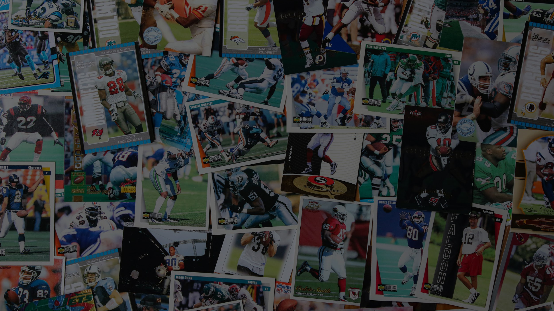
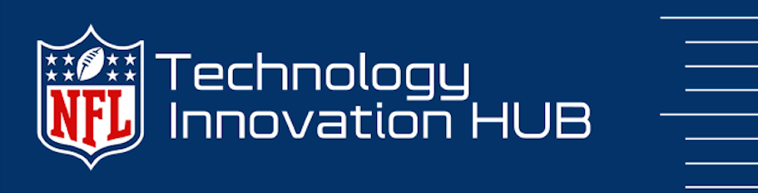



Slide 2

Why an Innovation Framework?
Having an innovation framework is crucial in the digital transformation process as it allows an organization to discover, cultivate, and execute innovative and inventive concepts to drive strategic success.
Benefits the discovery of new and imaginative approaches
Reviews the positive and negative aspects of each option
Makes decisions based on accurate and reliable information
Develops strategies to translate ideas into business opportunities

Slide 3

Why is a framework needed at the NFL?
To address the lack of monitoring and measuring of technology innovation projects and ideas
Eliminate siloed pockets of innovation and redundant projects
Leverage ideas from all levels of the organization
Strengthen brain power through increased collaboration
Foster creativity by working as a connected NFL (networked, flexible, and learning) organization
Solve complex business problems collectively to enhance the game.

Slide 4

NFL Strategic Goals
+
NFL Tech Innovation Framework designed based on

Slide 5
NFL Tech Innovation Framework:
NFL Goals &
Focus Area
Transformation Zone
Performance Zone
Make a big change
Leverage technology to exceed goals
Enabling
Investments
Incubation Zone
Productivity Zone
Create options for the future
Enable efficiency and scale
Sustaining innovation:
Disruptive innovation:
focuses on extension and improvements to already existing innovations inside the incumbent organizations
new business models and operating models

Slide 6
Sustaining Innovatio﻿n:
Modernizing Today
Performance Zone
Increase Consumption | Fan Growth | Grow Key Demographics
Technology that drives the execution of League Strategic Goals
Productivity Zone
Shared service investments and programs that serve to optimize the core business.
Maintains efficiency and compliance and delivers optimization

Slide 7
Disrupt﻿ive Innovatio﻿n:
Planning for the Future
The goal is to undertake a transformational initiative to put the NFL on a significantly different trajectory
Allows the NFL to manage change and transformation of the business
Transformation Zone
Increase Consumption | Fan Growth | Grow Key Demographics
New offers and products in emerging and/or fast-growing markets that could someday be a game changer for the business.
The enterprise science lab, where new ideas are hatched that could someday transform the business
Incubation Zone

Slide 8
Innovation Categories
Disruptive Innovation Characteristics
Opportunity Not Clearly Understood
New Market Opportunity
Disruptive Impact to Existing Models
Requires Change Management and Governance Models to Implement
Sustaining Innovation Characteristics
Existing Market
Innovation Improves Performance
Lower Cost
Incremental Changes
Market is Predictable

Slide 9
Next Steps
Phase 1:
Identify cross-functional working group
Define goals and objectives
Define intake process
Develop evaluation criteria for each category
Develop communication strategy
Inventory all proof of concepts project currently in scope or planned
Establish metrics
Implement program
Target Teams:
Football operations
Player Health & Safety
Information technology (IT)

Slide 10











Data Driven Project Prioritization
Resource Prioritization
Rapid Development
Leverage Partner Expertise
Technology Interoperability

Slide 11




















Brands that have leveraged this framework

Slide 12
THANK YOU

