Slide 1
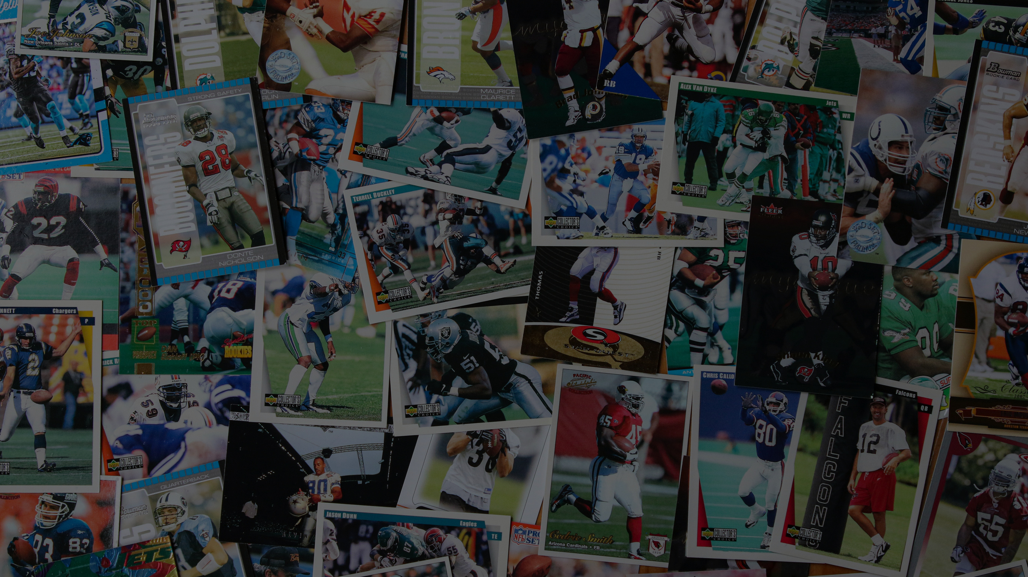
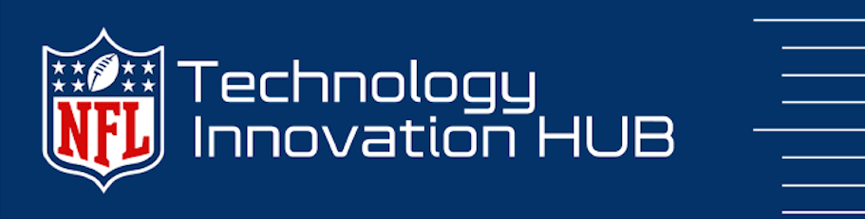



Slide 2

Why an Innovation Framework?
Having an innovation framework is crucial in the digital transformation process as it allows an organization to discover, cultivate, and execute innovative and inventive concepts to drive strategic success.
Benefits the discovery of new and imaginative approaches
Reviews the positive and negative aspects of each option
Makes decisions based on accurate and reliable information
Develops strategies to translate ideas into business opportunities

Slide 3

Why is a framework needed at the NFL?
To address the lack of monitoring and measuring of technology innovation projects and ideas
Eliminate siloed pockets of innovation and redundant projects
Leverage ideas from all levels of the organization
Strengthen brain power through increased collaboration
Foster creativity by working as a connected NFL (networked, flexible, and learning) organization
Solve complex business problems collectively to enhance the game.

Slide 4

NFL Strategic Goals
+
NFL Tech Innovation Framework designed based on

Slide 5
4 Zones Model: Business Value Creation
Transformation Zone
Performance Zone
NFL Goals &
Focus Area
Develop & deploy systems of engagement to increase customer experience value
Utilize systems of intelligence to better understand and deliver new customer value
Scale material net new lines of business
Utilize digital technologies to enter adjacent markets
Enabling
Investments
Incubation Zone
Productivity Zone
Utilize Agile, Lean & DevOps to increase time to value
Identify, test & validate next generation products, services and new business ideas
Recover trapped value by consolidating, replacing or eliminating systems of record
Optimize SOR maintenance costs and reduce technical debt
Sustaining innovation:
Disruptive innovation:
focuses on extension and improvements to already existing innovations inside the organizations
new business models and operating models

Slide 6
The Zone Management Dialogue
How long can our current business model deliver our desired growth goals and financial results?
How sustainable is our current growth model?
How vulnerable is our business model to being digitally disrupted?
How quickly could we respond to this disruption?
How well can we leverage digital technology for increased competitive advantage?
How robust is our digital technology pipeline?
How open is our culture to changing the way we do business?
How capable are we at competing as a digital enterprise?

Slide 7
Sustaining Innovation:
Run the Business
Technology that drives the execution of League Strategic Goals
Charged with serving the organization’s customers and creating near-term financial returns. It represents the revenue generation arm of your business today. It provides the operating income to fund both your current and future operations
Performance Zone
Increase Consumption | Fan Growth | Grow Key Demographics
Shared service investments and programs that serve to optimize the core business.
Maintains efficiency and compliance and delivers optimization
Charged with making the performance zone more efficient and more effective as well as insuring it complies with all regulations. It consists of all the cost-center functions that provide these services, an expense that is subtracted from your performance zone revenue, along with the latter’s cost of goods, to produce your operating income.
Productivity Zone

Slide 8
Disruptive Innovation:
Grow the Business
Transformation Zone
Increase Consumption | Fan Growth | Grow Key Demographics
The goal is to undertake a transformational initiative to put the NFL on a significantly different trajectory
New offers and products in emerging and/or fast-growing markets that could someday be a game changer for the business.
Charged with exploring new products, services and businesses that can leverage new digital technologies and potentially have a significant impact on future business growth opportunities. It also serves as the staging area for all major projects and includes project prioritization, demand management and resource allocation governance processes.
Incubation Zone

Slide 9
Next Steps
Phase 1:
Identify cross-functional working group
Define goals and objectives
Define intake process
Develop evaluation criteria for each category
Develop communication strategy
Inventory all proof of concepts project currently in scope or planned
Establish metrics
Implement program
Target Teams:
Football operations
Player Health & Safety
Information technology (IT)

Slide 10
Desired Outcomes
Higher percentage of the organization’s resources & budget allocated to grow-the business activities
2. Strong alignment between future investment priorities and critical business outcomes
3. Significant increase in time-to-value and throughput for all new product & service development projects
A culture that prioritizes progress over perfection
Identify, test and validate next generation product, service and business ideas and leverage digital technology enabled innovation to deploy them
Recover trapped value by modernizing consolidating, or retiring legacy systems
Reduce technical debt

Slide 11




















Brands that have leveraged this framework

Slide 12
THANK YOU

