Slide 1

Technology Innovation HUB
Program Update
For the National Football League
January 8, 2024
Program Update
Tye Hayes, CEO, N-Ovate Solutions
Jeff Cratty, CTO, N-Ovate Solutions
Brad Boim, Sr. Director, Post Production-Media
Notes:
Meeting Agenda:
Introduction (2 slides)
a. Recap of Previous Presentation
b. Overview of Today's Update
Program Overview (3 slides)
a. Introduction to the Innovation Hub Program
b. Program Design Highlights
c. Execution Model and Phase Gates
Project Placement Simulation (2 slides)
a. Selection of Sponsor Projects
b. Placement on Maturity Model and Governance Structure
Project Pitch Simulation (3 slides)
a. Introduction of Multimodal AI Project
b. Business and Technological Value
c. Request for Funding
Backup Slides (1 slide)
a. Project Evaluation Criteria
Meeting Agenda Slide Details:
Slide 1: Introduction
Slide 1: Title: "Introduction"
Briefly mention the previous presentation and its purpose.
Slide 2: Title: "Today's Update"
Highlight the focus of today's presentation.
Slide 2: Program Overview
Slide 3: Title: "Innovation Hub Program"
Briefly introduce the Innovation Hub Program.
Slide 4: Title: "Program Design"
Highlight key elements of the program's design.
Slide 5: Title: "Execution Model"
Explain the execution model and mention phase gates.
Slide 3: Project Placement Simulation
Slide 6: Title: "Sponsor Projects Selection"
Explain the selection of three sponsor projects for the simulation.
Slide 7: Title: "Maturity Model & Governance"
Display a visual representation of project placement on the maturity model and governance structure.
Slide 4: Project Pitch Simulation
Slide 8: Title: "Multimodal AI Project"
Introduce the Multimodal AI project.
Slide 9: Title: "Business & Technological Value"
Present the business and technological value of the project.
Slide 10: Title: "Funding Request"
Outline the project's request for funding.
Slide 5: Backup Slides
Slide 11: Title: "Project Evaluation Criteria"
Mention the criteria used for project evaluation as backup slides.
Remember to use visuals, charts, and minimal text to convey the key points effectively during the presentation. Keep the slides concise and visually engaging to maintain the audience's interest and understanding.

Slide 2
Meeting Agenda
Background
Recap of Previous Presentation
Explanation of Value Zone
Operating Model of the Innovation Hub
Execution Phase Gates
Innovation HUB
Program Design and Criteria Governance Structure
Pilot Project Updates
Optical Tracking Progress
NFL Player View Project Developments
NLP / Multi-modal AI Milestones
NLP / Multi-modal AI Pitch
Introduction
Business Value
1
3
2
4
5
Notes:
Background (2 slides) a. Recap of Previous Presentation b. Introduction to the Innovation Hub Program Innovation Hub Program Design (3 slides) a. Program Objectives and Goals b. Governance Structure and Phase Gates c. Operating Model of the Innovation Hub Zone Value Creation (2 slides) a. Explanation of Value Zones b. Demonstrating Value Creation Strategies Pilot Project Updates (4 slides) a. Optical Tracking Project Progress b. NFL Player View Project Developments c. NLP / Multi-modal AI Project Milestones d. Project Evaluation Criteria and Updates NLP / Multi-modal AI Pitch (2 slides) a. Introduction of the NLP / Multi-modal AI Project b. Business Value, Technological Significance, and Funding Request

Slide 3

4 Zones Model: Business Value Creation
DISRUPTION INNOVATIONS
SUSTAINING INNOVATIONS
NFL Goals &
Focus Area
Transformation Zone
Performance Zone
Enabling
Investments
Incubation Zone
Productivity Zone
Disruptive Innovations: New business models and operating models
Sustaining Innovations: Extension and improvements to already existing innovations inside the organizations

Slide 4
Program Design & Criteria
Program Design
VC Model of Investment​
Full visibility on objectives and progress of each project
Centralized decision making on which projects to fund
Established Success Criteria
Funding decision based on rigorous screening and evaluation process
Funding linked to stage gates or milestones
Control of funding based on milestone-based success criteria
Multiple exit options for sponsors based on process success

Slide 5
Governance Structure
The Governance Committee's mission is to steer the Innovation Hub program through collaborative design, guiding league-wide decisions for maximum impact.
Executive Steering Committee
EVPs
Program Execution Committee
SVPs - Information Technology, Player Health and Safety, Football Operations, NFL Media, Data & Analytics, Finance, and Sponsorship
Innovation Tech Advisory Committee
NFL Technical Working Group
Innovation HUB PMO
Intake, Prioritization, & Program Management
Notes:
Alok Bhatt: Players for each Committee to be updated
PMO office will be managed by Novate

Slide 6
HUB Execution Gates or Operation Model
Intake
Concept
Business Case
MVP
ROI
Grow
Internal/External Idea Submission
NFL Business Value
Zone Placement
Depth Evaluation
Technical Feasibility
Product/Service definition
Business Justification
Development Plan
Develop prototype to verify and validate
Test market fit
Several iterations
Financial viability
Implementation strategy
Total Cost of Ownership
Transition to funded operational project
Stage 1
Stage 2
Stage 3
Stage 4
Stage 5
HUB Funded Projects

Slide 7
POC Projects
1
Optical Tracking
NFL Player View
Multi-Modal AI
2
3

Slide 8
Project Stage Placements
Intake
Concept
Business Case
MVP
ROI
Grow
Multi-modal AI
Brad Boim
NFL VIEW
Marc Hodakowski
Optical Tracking
Aaron Amendola
Stage 1
Stage 2
Stage 3
Stage 4
Stage 5
HUB Funded Projects

Slide 9

Optical Tracking
ROI
Overall Scope: The optical tracking scope aims to identify an innovative solution for line-to-gain detection and other officiating use cases. Optical tracking will be able to inform real-time officiating.
Current State:
Conducting 3 POCs to determine the accuracy of each demo. Vendors: HawkEye, ChyronHego, Genius/Second Spectrum.
Stadium Evaluations: Each vendor is undergoing evaluations and testing in stadiums upon approval
Vendor Scorecard & Partner Screening: A vendor scorecard has been developed to assess compatibility and are actively screening potential partners during the Proof of Concept (POC) phase.

Slide 10
Optical Tracking, Cont.
Use Case
Line-to-Gain: Utilize optical tracking technology to improve the accuracy of line-to-gain detection.
Game Presentation: Optimized data utilization for all games (Including in-stadium and broadcast executions).
Next Steps
Data accuracy comparison among vendors, aiming for consistently achieving ½ inch accuracy or better ( ½ or less).
Identify the vendor that best aligns with the goals identified through RFI Vendor Evaluation Scorecard.

Slide 11
Optical Tracking
Vendor Assessment
 | HawkEye Current Vendor | Genius/Second Spectrum Current Vendor | ChyronHego New Vendor
Overview | Technology is currently deployed in 3 stadiums (LV, MIA, NY) | SoFi Stadium (LA) | Technology has been deployed at 5 stadiums for MLS soccer (ATL, CAR, CHI, NE, SEA)
Update | Data from testing has been analyzed | Installation has been completed in SoFi Stadium (LA) | NDA has been signed
Next Steps | A review with the Competition Committee and the Future of Football Committee scheduled during Combine (Feb 27 - Mar 1) | Tech evaluation scheduled for the January 7th game | Validating solution internally before enabling system for January 7th
Notes:
ChyronHego Stadiums
Mercedes Benz Stadium - Atlanta
T- Mobile Park - Seattle
Bank of America in North Carolina
Soldier Field in Chicago

Slide 12
Optical Tracking
ROI
Overall Scope: The optical tracking scope aims to identify an innovative solution for line-to-gain detection and other officiating use cases. Optical tracking will be able to inform real-time officiating.
Current State:
Conducting 3 POCs to determine the accuracy of each demo. Vendors: HawkEye, ChyronHego, Genius/Second Spectrum.
Stadium Evaluations: Each vendor is undergoing evaluations and testing in stadiums upon approval
Vendor Scorecard & Partner Screening: A vendor scorecard has been developed to assess compatibility and are actively screening potential partners during the Proof of Concept (POC) phase.

Slide 13
NFL View
Concept
Overall Scope: NFL View's primary emphasis is player health and safety. Their concentration encompasses player-related elements such as player speed, impact force and injury prevention.
Current State:
Enhance data collection for player health and safety.
Three years of testing and utilizing original Intel cameras for player movement tracking.

Slide 14
NFL View
Concept
Use Case
Player Health and Safety: Proactively preventing injuries by identifying game events that enhance player safety.
Identifying Game events: Identifying game events can help improve player engagement and enhance the overall gaming experience.
Skeletal tracking: This is implemented to proactively enhance player safety and performance.
Next Steps
Collaborating with the PHS team to create a comprehensive plan for business testing, cost analysis, and project timeline development.

Slide 15
NFL View
Overall Scope: NFL View's primary emphasis is player health and safety. Their concentration encompasses player-related elements such as player speed, impact force and injury prevention.
Strategic Alignment
→ New Technology → Non-Game Media → International Expansion
POC already completed – June thru October​
100 hours of NFL content indexed, 10 taxonomies fine-tuned​
​
Phase One Goals – April 2024​
Direct integration of TwelveLabs API with Vidispine MAM ​
Build, test and refine integration and validate results​
Identify and engage power users to test and provide feedback​

Slide 16
MutliModal AI
Meloni Boatswain
12/12/2023
1.1
Current media search process is inefficient and time consuming
Most content is not logged, buried deep in the archive, and impossible to find.
Human logging process is antiquated, costly and error prone ($25K / year)
Develop an automated solution leveraging Multi-Modal AI via the TwelveLabs API to allow Natural Language search across our content library at a scale.
Develop a natural language (AI/ML) search tool for media assets within the NFL to unlocking previously unavailable content
Train model for a customized taxonomy for exclusive use by the NFL
Faster search efficiency
Improved discovery of our media archive, uncovering assets previously buried in the archive
Quick adoption, as it utilizes UI tools already in use
Internal Content Creators
NFL Media Producers
Complience
Manual asset tagging
Not logging content at all
Traditional AI methods
Accuracy of search results
Search time reduced from minutes/hours to seconds
Is the indexing pipeline sustainable?
Faster user adoption
TwelveLabs multi-modal AI extracts multiple features from video such as time, objects, text in video, conversation, faces, and actions, synthesizing this information into vectors.
Vectors enable fast, semantic and scalable search using natural language.
Direct integration into the NFL's existing MAM system
Develop indexing and search pipeline
Fine-Tune NFL Taxonomies
Deployment and testing during 2023 Playoffs to determine capabilities and benefits
NFL Media Teams (L.A., NJ, NY)
NFL Game Operations
Integration, development, testing, and initial deployment:
ARVATO SYSTEMS NORTH AMERICA $15,000
TwelveLabs $36,300
Total: $51,300
Cost savings from increased efficiency and accuracy.
Exploration of Gen AI technology targeting potential applications within the NFL.
Gaining leverage from existing investments in our media asset library utilizing emerging Gen AI technology.
Draft By: Meloni Boatswain – N-Ovate Solutions

Slide 17
Multimodal AI Video Pitch

Slide 18
Pitch Feedback

Slide 19

Next Steps

Slide 20
Disruptive Innovation Zone Placements
Incubation Zone | Transformation Zone
Develop an MVP: Focus on developing a minimum viable product (MVP) quickly and efficiently to gain early feedback and validate the core concept. Milestones: MVP Prototype completed within X weeks/months. User testing conducted with Y participants. Key learnings and insights documented. Success Criteria: MVP demonstrates core functionality and potential value. User feedback validates the problem and need for the solution. Clear path identified for further development based on testing results. | Conduct a pilot project: Implement the idea on a smaller scale to test its feasibility and impact within a controlled environment. Milestones: Pilot project plan established within X weeks/months. Pilot launched and executed successfully for Y timeframe. Data and metrics collected to measure impact on KPIs and other critical areas. Success Criteria: Pilot proves the idea's scalability and ability to generate desired outcomes. Financial modeling demonstrates strong ROI potential. Clear plan for full-scale launch developed based on pilot learnings.

Slide 21
Sustaining Innovation Zone Placements
Performance Zone | Productivity Zone
Integrate and deploy: Seamlessly integrate the idea into existing NFL operations and performance metrics. Milestones: Implementation plan developed within X weeks/months. Idea integration completed with minimal disruption to existing systems. Training and support provided to relevant stakeholders. Success Criteria: Measurable improvement in target KPIs (e.g., increased fan engagement, revenue growth, contribution margins). Positive user feedback and adoption from internal stakeholders. Successful integration with existing systems and infrastructure. | Implement and optimize: Implement the idea to automate tasks, streamline processes, and optimize resource allocation. Milestones: Implementation plan developed within X weeks/months. Key processes identified for optimization. Technology infrastructure established to support automation. Success Criteria: Demonstrated cost savings or resource optimization based on implemented changes. Improved efficiency and reduced waste in target processes. Positive feedback from stakeholders impacted by the changes.

Slide 22
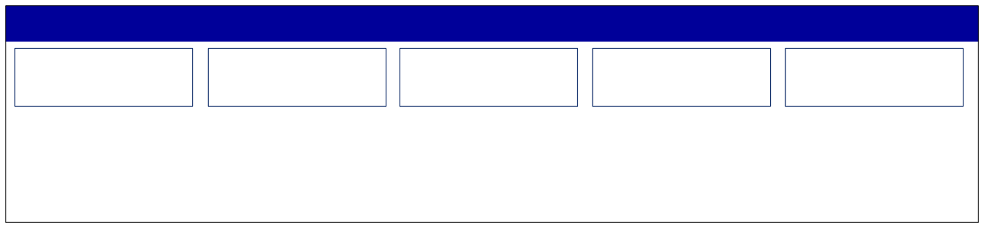
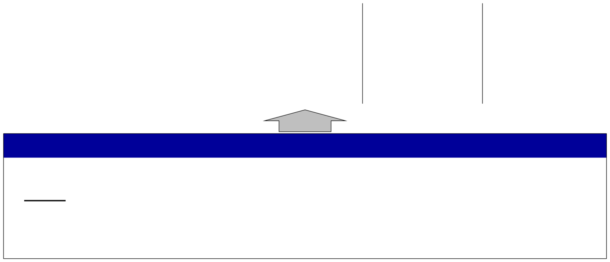

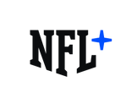



















STRATEGIC PLANNING FOCUS
League Goals: Increase Consumption | Fan Growth | Grow Key Demographics
Focus Areas
Direct-to-
International
Legalized
Non-Game
New
Consumer
Sports Betting
Media Content
Technology
Blockchain
Foundational Investments
Game Youth
Fan Development
Avid Youth / Latinx
Business Operations
DEI Data/Tech
Quality
PH&S
Digital Athlete
Fan 1:1
*League goals in no particular order

