Slide 1
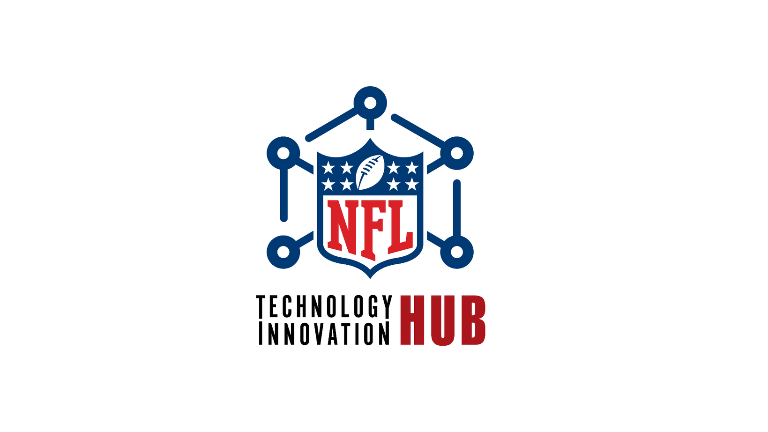
Gary Brantley | SVP Information Technology
July 24, 2023

Slide 2
The Foundation
NFL Strategic Business Outcomes
+
NFL Tech Innovation Framework

Slide 3




NFL Technology Innovation Hub
Mission & Goals
 | Strategic Alignment | Align the NFL’s portfolio of innovation investments with its critical business outcomes
 | Consistency | Provide a consistent, enterprise-wide approach to identify, prioritize, measure, and successfully deliver major innovation initiatives and projects
 | Accountability | Utilize venture investment metrics to measure innovation project performance and delivery timetable
 | Repeatability | Create a standardized and repeatable demand management, capacity planning and project prioritization management framework, vocabulary, and toolset

Slide 4
Why an Innovation Framework?
Having an innovation framework is crucial in the digital transformation process as it allows an organization to discover, cultivate, and execute innovative and inventive concepts to drive strategic success.
Benefits the discovery of new and imaginative approaches
Reviews the positive and negative aspects of each option
Makes decisions based on accurate and reliable information
Develops strategies to translate ideas into business opportunities

Slide 5

Why is a framework needed at the NFL?
To address the lack of monitoring and measuring of technology innovation projects and ideas
Eliminate siloed pockets of innovation and redundant projects
Leverage ideas from all levels of the organization
Strengthen brain power through increased collaboration
Foster creativity by working as a connected NFL (networked, flexible, and learning) organization
Solve complex business problems collectively to enhance the game.

Slide 6
4 Zones Model: Business Value Creation
Transformation Zone
Performance Zone
NFL Goals &
Focus Area
Scale material net new lines of business
Utilize digital technologies to enter adjacent markets
Develop & deploy systems of engagement to increase customer experience value
Utilize systems of intelligence to better understand and deliver new customer value
Enabling
Investments
Incubation Zone
Productivity Zone
Utilize Agile, Lean & DevOps to increase time to value
Identify, test & validate next generation products, services and new business ideas
Recover trapped value by consolidating, replacing or eliminating systems of record
Optimize SOR maintenance costs and reduce technical debt
Sustaining innovation: extension and improvements to already existing innovations inside the organizations
Disruptive innovation: new business models and operating models

Slide 7
Sustaining Innovation: Run the Business
Performance Zone
Technology that drives the execution of League Strategic Goals
Charged with serving the organization’s customers and creating near-term financial returns. It represents the revenue generation arm of your business today. It provides the operating income to fund both your current and future operations
Increase Consumption | Fan Growth | Grow Key Demographics
Shared service investments and programs that serve to optimize the core business.
Maintains efficiency and compliance and delivers optimization
Charged with making the performance zone more efficient and more effective as well as insuring it complies with all regulations. It consists of all the cost-center functions that provide these services, an expense that is subtracted from your performance zone revenue, along with the latter’s cost of goods, to produce your operating income.
Productivity Zone

Slide 8
Disruptive Innovation: Grow the Business
Transformation Zone
The goal is to undertake a transformational initiative to put the NFL on a significantly different trajectory
Increase Consumption | Fan Growth | Grow Key Demographics
New offers and products in emerging and/or fast-growing markets that could someday be a game changer for the business.
Charged with exploring new products, services and businesses that can leverage new digital technologies and potentially have a significant impact on future business growth opportunities. It also serves as the staging area for all innovation projects. Includes: project prioritization, demand management and governance processes.
Incubation Zone

Slide 9
NFL Tech Innovation Framework - Incubation Zone
The NFL Tech Innovation HUB is charged with exploring new products, services and businesses that can leverage new digital technologies and potentially have an significant impact on future business growth opportunities. It also serves as the staging area for all major projects and includes project prioritization, demand management and resource allocation governance processes.
Accelerate the organization’s ability to identify, test and validate next generation product and service ideas and leverage digital technology enabled innovation to develop and deliver them
Learning faster for sustainable competitive advantage
9

Slide 10

NFL Tech Innovation HUB - The Next Big Wave
In the rapidly evolving technological landscape, businesses need a nucleus of innovation to drive competitive advantage. The NFL Tech Innovation HUB is conceived as a cutting-edge initiative integrating disruptive technology with business strategy, offering an environment for incubating future business ideas while ensuring robust governance (NFL Innovation Framework) and a collaborative approach.
9

Slide 11
NFL Tech Innovation HUB - Strategic Outcomes
1. Alignment of Technology and Business Strategy: The hub ensures that technological advancements are congruent with business goals, offering a seamless path for businesses to adopt, adapt, and scale new technologies effectively.
2. Incubation of Future Business Strategies: By serving as a birthplace for innovative ideas, the hub fosters an environment where fledgling business strategies can be tested, refined, and matured, using technology as a driving force.
3. Collaborative Ecosystem for Innovation: The introduction of an innovation steering committee guarantees that stakeholders, including tech innovation partners, are aligned, have a voice, and work collaboratively towards shared objectives.
4. Robust Governance Model: The hub's customized framework ensures that the adoption and adaptation of disruptive technologies are executed within a structured, risk-mitigated environment, ensuring compliance, security, and optimal utilization.
9

Slide 12
NFL Tech Innovation HUB - The Next Big Wave
The NFL Tech Innovation HUB can be leveraged to develop new value propositions and take them from concept to thriving startup. The goal is for the framework/HUB is to act as a catalyst tool to stimulate innovation and create a pipeline of successful new ventures.
New ventures are developed strategically using existing corporate assets, including internal
expertise, infrastructure, networks, funding and other resources.
The new ventures provide a wide range of return on investment, including:
Access to new markets and technologies
New revenue streams
The opportunity to try out new business models
Expansion beyond core business offerings
Valuable insights into sponsor and vendor roadmaps
9

Slide 13
NFL Tech Innovation HUB - Growth Strategies
Enhanced Market Positioning: By fostering technological innovations that resonate with market demands, the NFL can secure a leading edge in their respective sectors, ensuring increased market share and brand loyalty.
Revenue Growth: The continuous incubation of novel business strategies means that the NFL always has a pipeline of new products, services, or solutions, ensuring diversified revenue streams and reduced reliance on singular income sources.
Operational Efficiency: As technology is leveraged and streamlined with business goals, operational redundancies are reduced, and processes become more agile, leading to cost savings and improved profitability.
Partner and Stakeholder Engagement: The collaborative nature of the hub ensures that tech innovation partners, vendors, and other stakeholders are deeply engaged, opening avenues for joint ventures, co-creation opportunities, and shared profits.
Long-Term Sustainability: In an era where technological redundancy is a significant concern, the hub's proactive approach ensures businesses stay relevant, adaptable, and sustainable, offering long-term profit horizons.
9

Slide 14
NFL Tech Innovation HUB - Investments
Each entity in the NFL Tech Innovation HUB operates as an Independent Opportunity Unit (IOU) with its own dedicated resources for business and product development.​
The incubation zone as a whole is governed by a “venture board” made up of steering committee members that determine what areas of innovation to invest in, which business plans get funded, which IOUs get follow-on funding.​
The entire portfolio of IOUs in the incubation zone is supported by a small cross-functional team from various shared services in the productivity zone.​
Each IOU is subject to a venture-funding discipline that requires meeting specific milestones in order to secure the next round, typically along the following lines: ​
Initial seed round: Validate the technology, outline potential market opportunity ​
Series A round: Build a minimum viable product, confirm market opportunity​
Series B round: Mature product for release at scale and production support​
Series C round: Meet performance metrics set by venture board (revenue, impact, value)​
9

Slide 15
NFL Technology Innovation Hub Governance Structure
EXECUTIVE STEERING COMMITTEE
PROGRAM STEERING COMMITTEE
Strategic Planning (Zone to Win) | Project Management Office | Project Management Office | Enterprise Architecture | Service Delivery
PLAN Do the right things. | PLAN Do the right things. | BUILD Do things right. | BUILD Do things right. | RUN Measure and Improve.
Business Outcomes Driven Decisions | Business Outcomes Driven Decisions | Business Outcomes Driven Decisions | Business Outcomes Driven Decisions | Business Outcomes Driven Decisions
Continuous Improvement Cycle
Notes:
10

Slide 16
TECH INNOVATION HUB PROGRAM STRUCTURE
EXECUTIVE STEERING COMMITTEE
STEERING COMMITTEE
Information Technology, Player Health and Safety, Football Operations, NFL Media, Data & Analytics, Finance, Sponsorship
WORKING GROUP
IT​
ISO​
Broadcast ​
Player Health and Safety
Football Tech​
NGS​
Digital Media​
Football Business Strategy & Ops
PHASE I PROJECTS
OPTICAL TRACKING
NFL VIEW
NATURAL LANGUAGE PROCESSING, MEDIA INDEXING

Slide 17


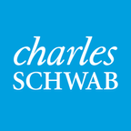
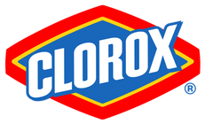

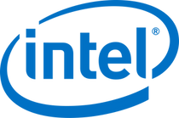
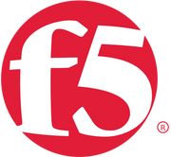













Brands that have leveraged innovation framework

Slide 18
Next Steps
Phase 1:
Identify cross-functional working group
Define program goals and objectives
Identify proof of concepts projects
Working group workshop (training, POC project review)
Develop communication strategy
Establish evaluation metrics

Slide 19
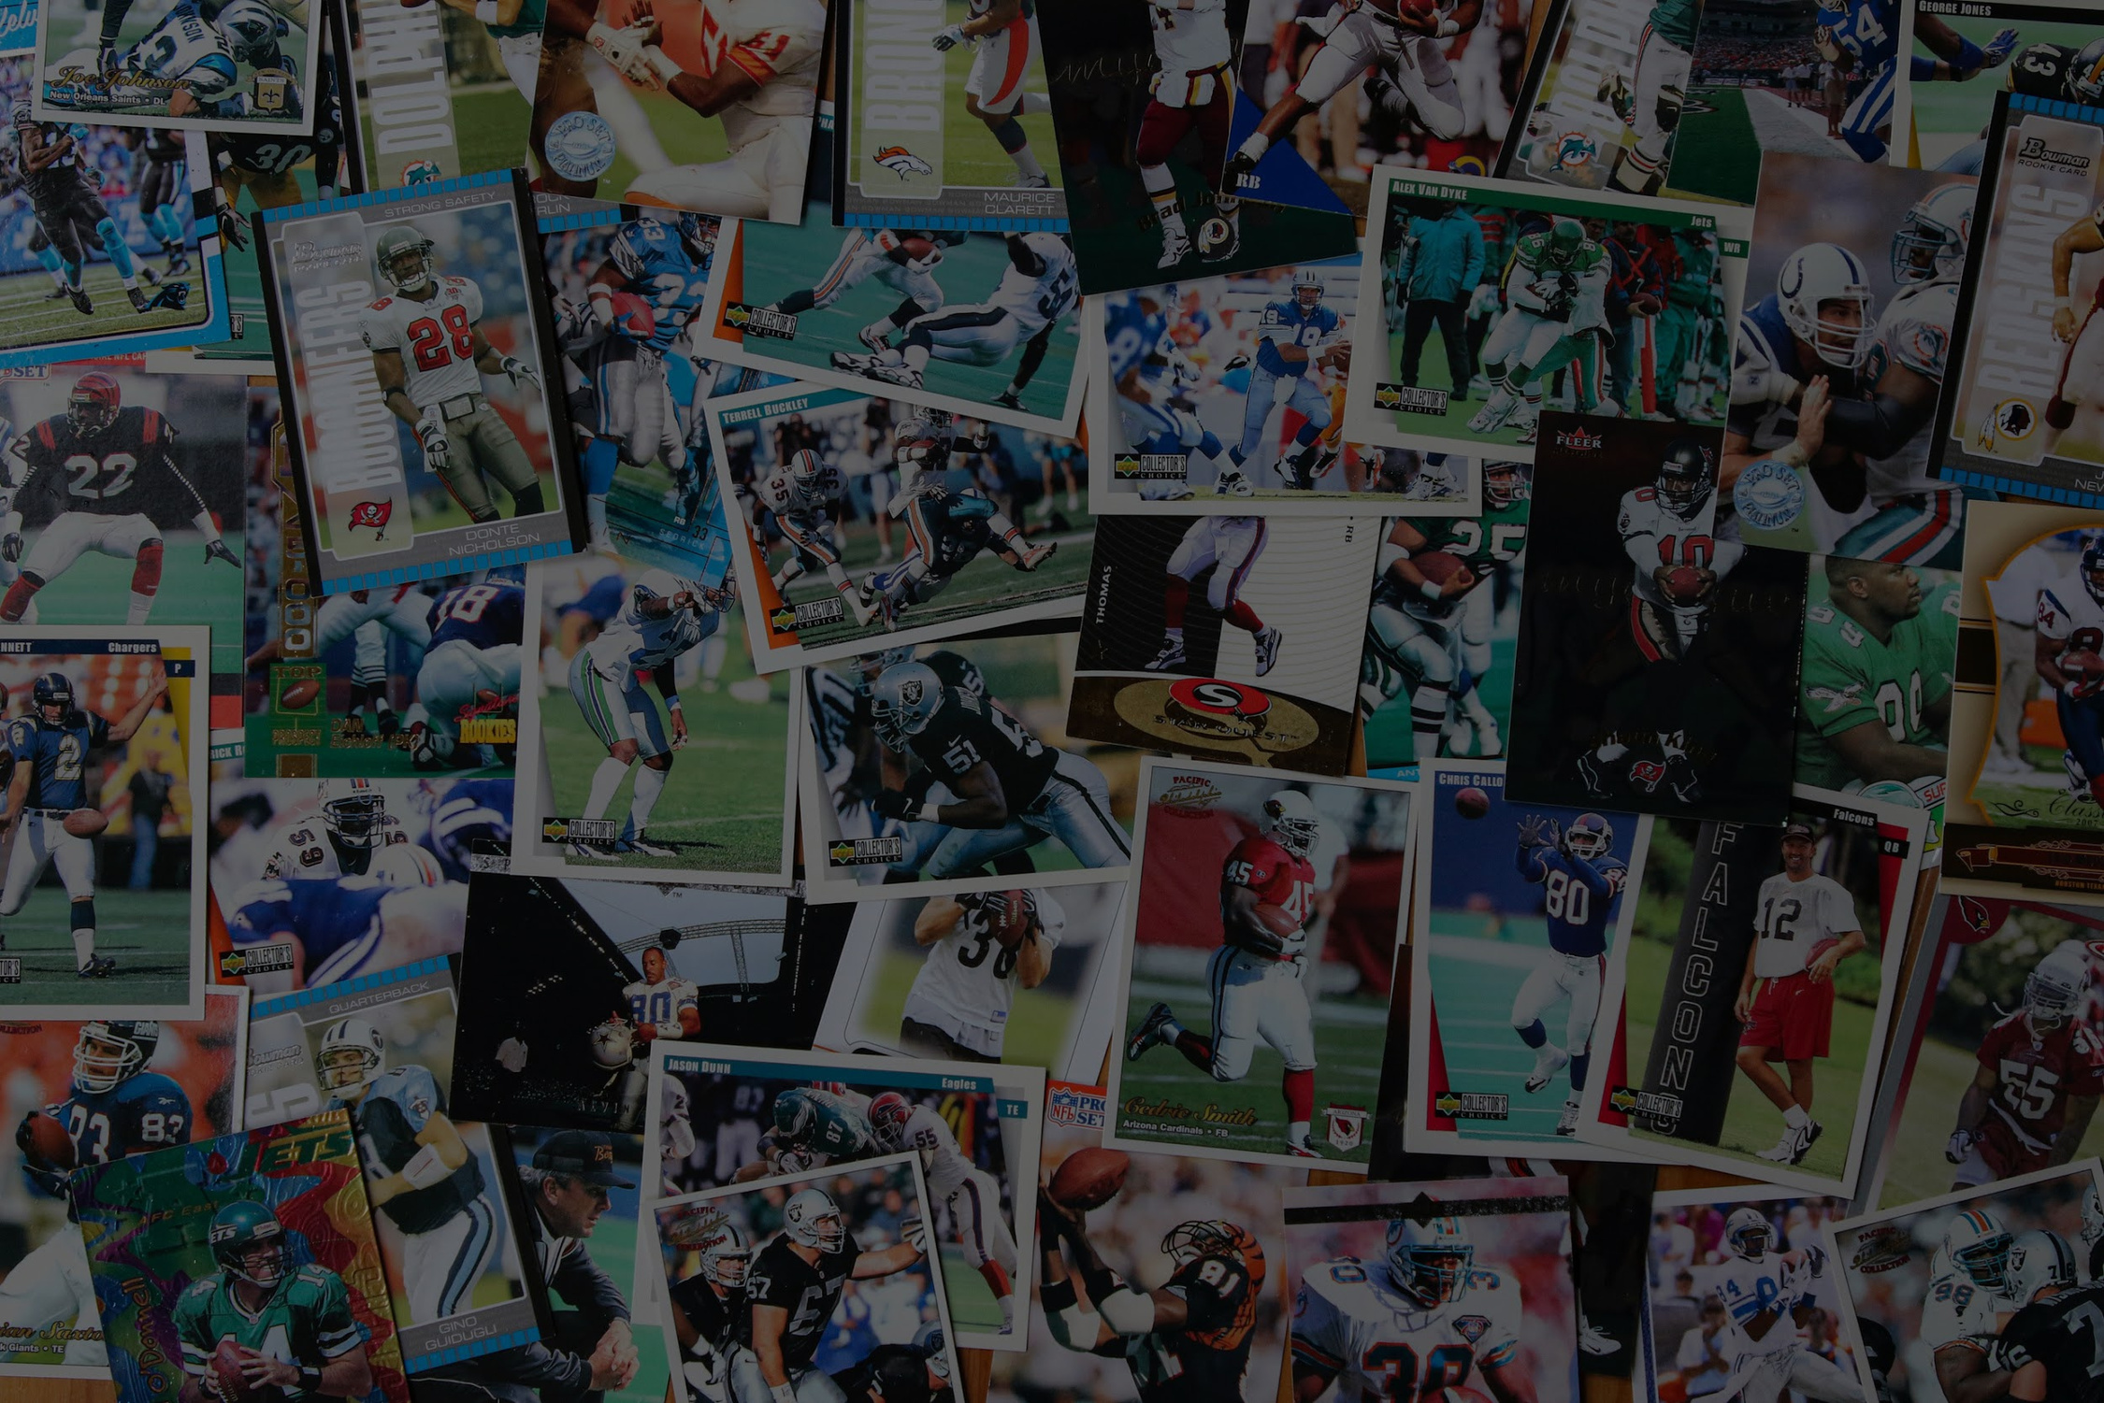
THANK YOU

