Slide 1


Tye Hayes - N-Ovate Solutions, CEO
Jeff Cratty - N-Ovate Solutions, Solutions Architect

Slide 2
Implementing Zone Management
Workshop Agenda
Competing in the Age of Digital Technology Disruption
Zone To Management Framework & Toolset – Maximizing Business Value
Performance Zone
Productivity Zone
Group Exercise
Incubation Zone
Transformation Zone
Zone to Win - Attacking, Defending, Maintaining
Use Case Discussion (SalesForce and Microsoft)
NFL Innovation HUB Group Exercise (NFL View, Optical Tracking)

Slide 3

An Age of Disruption
From industrial products to digital services
The Industrial Product Era
The Digital Services Era
Demand exceeds supply
Focus on the supply chain
Six sigma quality programs
Internet changes everything
B2B enables B2C
Systems of Record
License & maintenance business model
Customer support
SAP, Oracle, Cisco, Intel
Supply exceeds demand
Focus on the customer
User experience design
Cloud + Mobile changes everything
B2C enables B2B
Systems of Engagement & Systems of Intelligence
Subscription & ARR business model
Customer success
Salesforce, Amazon, Apple, Microsoft
‹#›
This is the next wave. The challenge is to catch it.
Notes:
‹#›

Slide 4
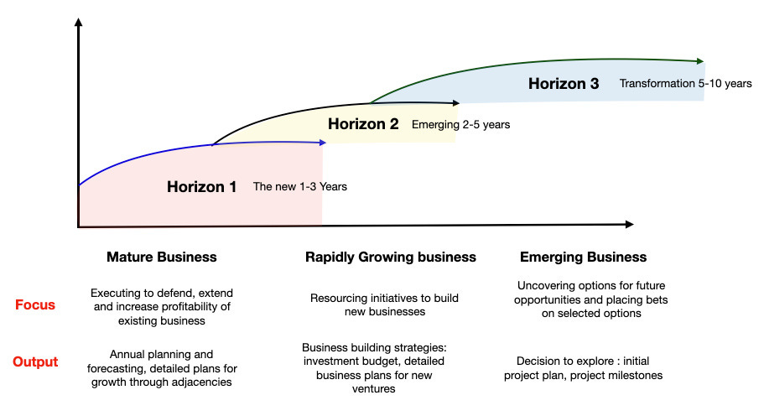
Manage innovation - Now, New, and Next
McKinsey’s Three Horizons Model
Notes:
‹#›

Slide 5
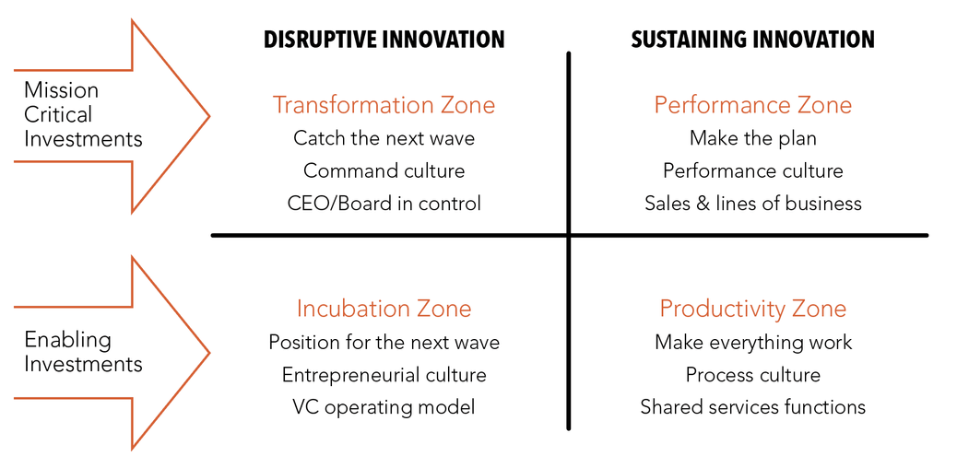
The Zone To Win Framework
A process to allocate resources between running the business and growing the business
Performance & Productivity Zones = Run the Business
Incubation & Transformation Zones = Growth the Business
Notes:
‹#›

Slide 6
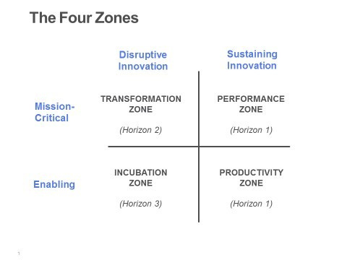
Manage innovation - Now, New, and Next
Three Investment Horizons

Slide 7
Breaking Down The Zones
Performance Zone
The Performance Zone is charged with serving the organization’s customers and creating near-term financial returns. It represents the revenue generation arm of your business today. It provides the operating income to fund both your current and future operations.

Slide 8
Breaking Down The Zones
Productivity Zone
The Productivity Zone is charged with making the performance zone more efficient and more effective as well as insuring it complies with all regulations. It consists of all the cost-center functions that provide these services, an expense that is subtracted from your performance zone revenue, along with the latter’s cost of goods, to produce your operating income.
Effectiveness
Efficient
Compliance

Slide 9
Group Exercise

Slide 10
Breaking Down The Zones
Incubation Zone
The Incubation Zone is charged with exploring new products, services and businesses that can leverage new digital technologies and potentially have a significant impact on future business growth opportunities. It also serves as the staging area for all major projects and includes project prioritization, demand management and resource allocation governance processes. (Invent the future)
Accelerate your organization’s ability to identify, test and validate next generation product and service ideas and leverage digital technology enabled innovation to develop and deliver them
Learning faster that the competition is the only sustainable competitive advantage
**Labs don’t work. (Create great technology..but is it mature enough, Does it provide business value?, Are there proven customers for it?)**

Slide 11
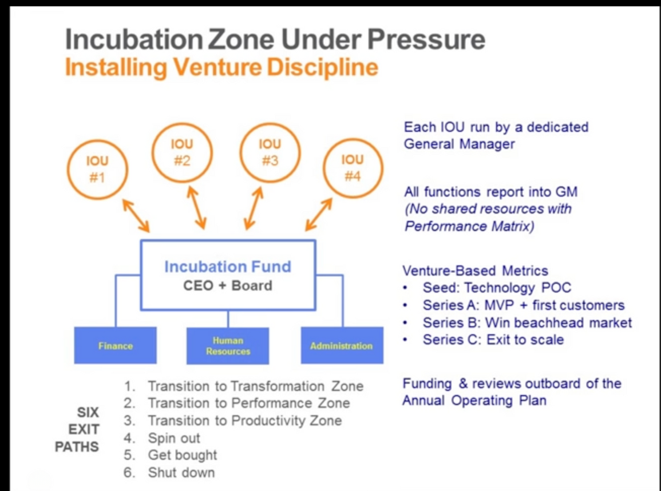
Incubation Zone
Installing Venture Discipline - Shark Tank
IOU Governance:
GM, sales, marketing,
engineering, services
and support resources
Venture Board
Funded during
Annual Plan
Funds deployed by
milestones
Zone-wide:
Shared Services
dedicated to the
Incubation Zone
Venture-style Funding

Slide 12
Breaking Down The Zones
Transformation Zone
The Transformation Zone is charged with driving an enterprise-wide change at scale, creating a net new source of earnings.
Expenses to fund, staff, and accelerate this effort are met by extracting sacrifices from the other three zones. This necessarily puts a big dent in your short-term operating income and is only worth pursuing if it can generate a 10% or greater increase in revenues over the company’s total current revenues.
Amazon Services retail -> Amazon Web Services
Apple PC company -> Music -> smart phone -> tablet

Slide 13
Zone to Win
Attacking, Defending, & Maintaining

Slide 14
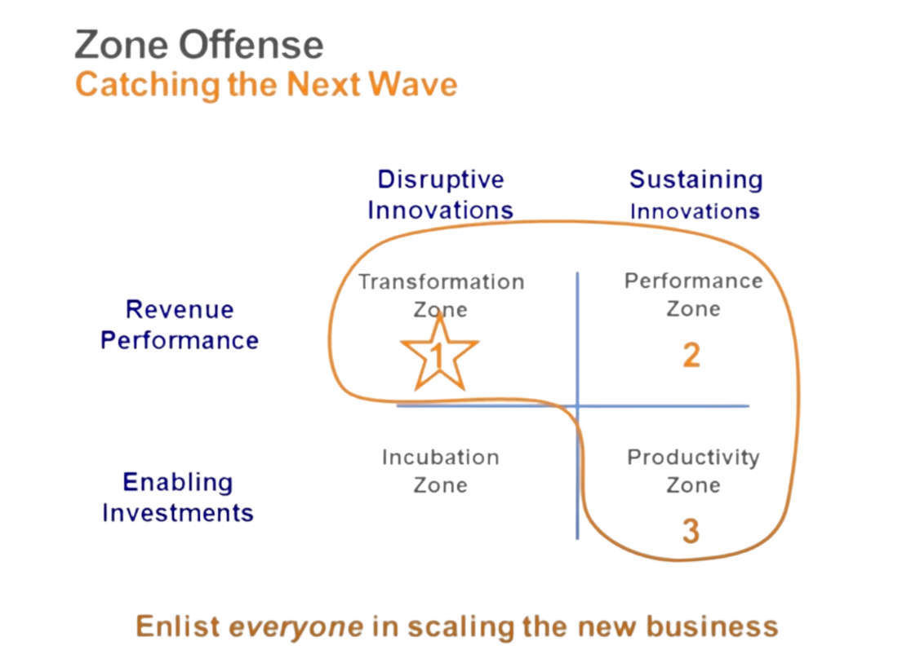
SalesForce - Zone Offense (proactive)
Force.com
Marketing Cloud
Communities, iOT
Analytics

Slide 15
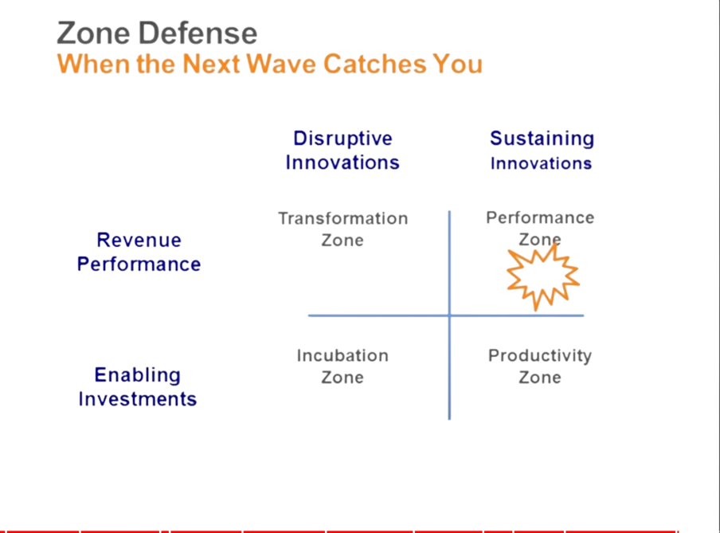
Microsoft - Zone Defense - Next Wave Catches You
Performance Zone
Windows
Office (Productivity)
Backoffice, SQL
On-Premise
Performance Zone under attack
Mobile Device displaced Windows
Google Apps (free, collaborative)
Cloud v/s on-Premise

Slide 16
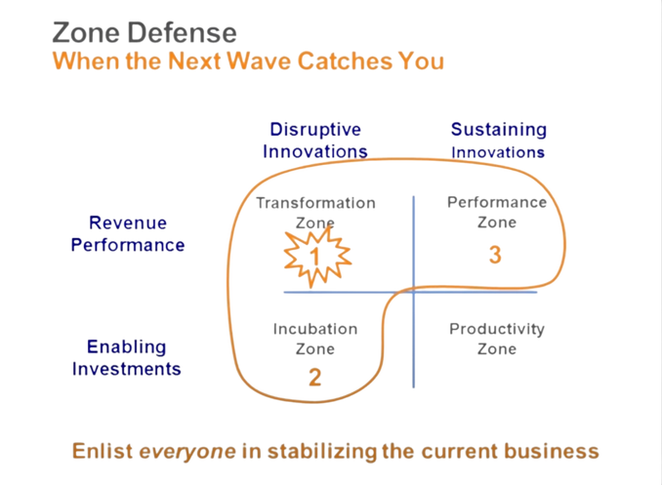
Microsoft - Zone Defense - Next Wave Catches You
Azure pushed forward - Cloud first
O365 - Office - Mobile first/Cloud
Windows next

Slide 17
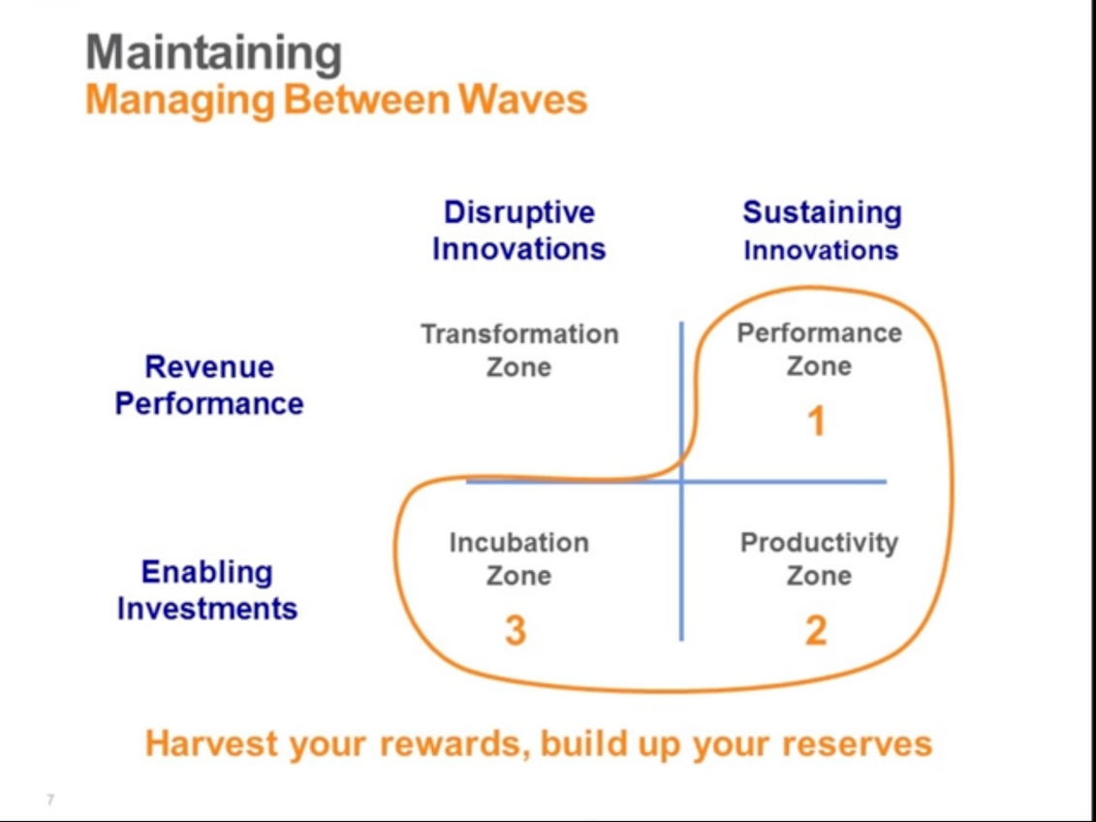
Maintaining - Managing Between Waves

Slide 18
Project Prioritization Process
NFL Technology Innovation HUB
Core Questions
Are they sustaining innovations or disruptive innovations?
Are they enabling systems productivity and cost optimization?
Are they increasing business unit performance and revenue growth?
Are they enabling business model transformation?

Slide 19
Demand Management Process
NFL Technology Innovation HUB
Core Questions
Should we do it? Does it align with and support critical business outcomes?
Can we do it? Do we have the relevant skills, capabilities and capacity to achieve the outcome?
Did we do it? Do we have the right metrics to measure the achieved outcome vs. the desired outcome?

Slide 20
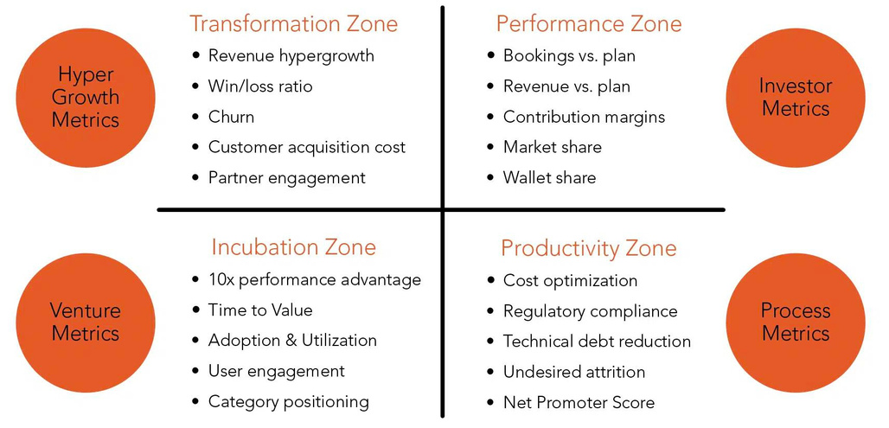
Specific Metrics for Each Zone
4 Zones Model: Business Value Creation Metrics
Key Takeaway
Don’t use the metrics of one zone to measure the performance of another zone
Notes:
‹#›

Slide 21
4 Zones Model: Metrics Exercise
Identify & agree upon metrics for NFL Technology Innovation Hub
Transformation Zone
Performance Zone
Hypergrowth
Metrics
Investor
Metrics
Incubation Zone
Productivity Zone
Venture
Metrics
Process
Metrics
Key Takeaway
Don’t use the metrics of one zone to measure the performance of another zone
Notes:
‹#›

Slide 22
Part II

Slide 23
Workshop Agenda - Part 2
Project Exercise
NFL Strategic Goals
Top NFL Risks
NFL View Overview
Map to Zone
Optical Tracking
Map to Zone
Next Steps

Slide 24
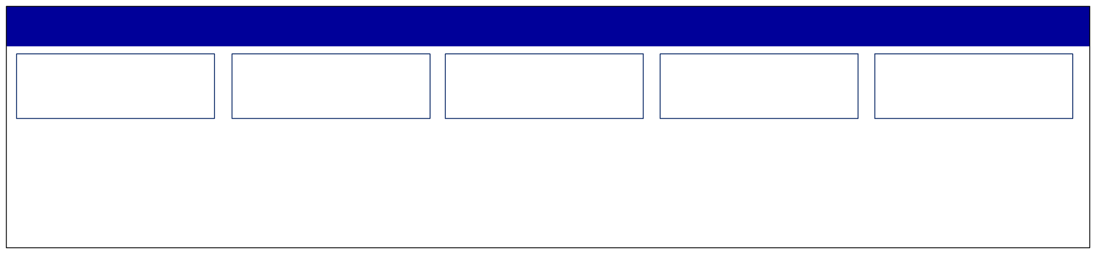
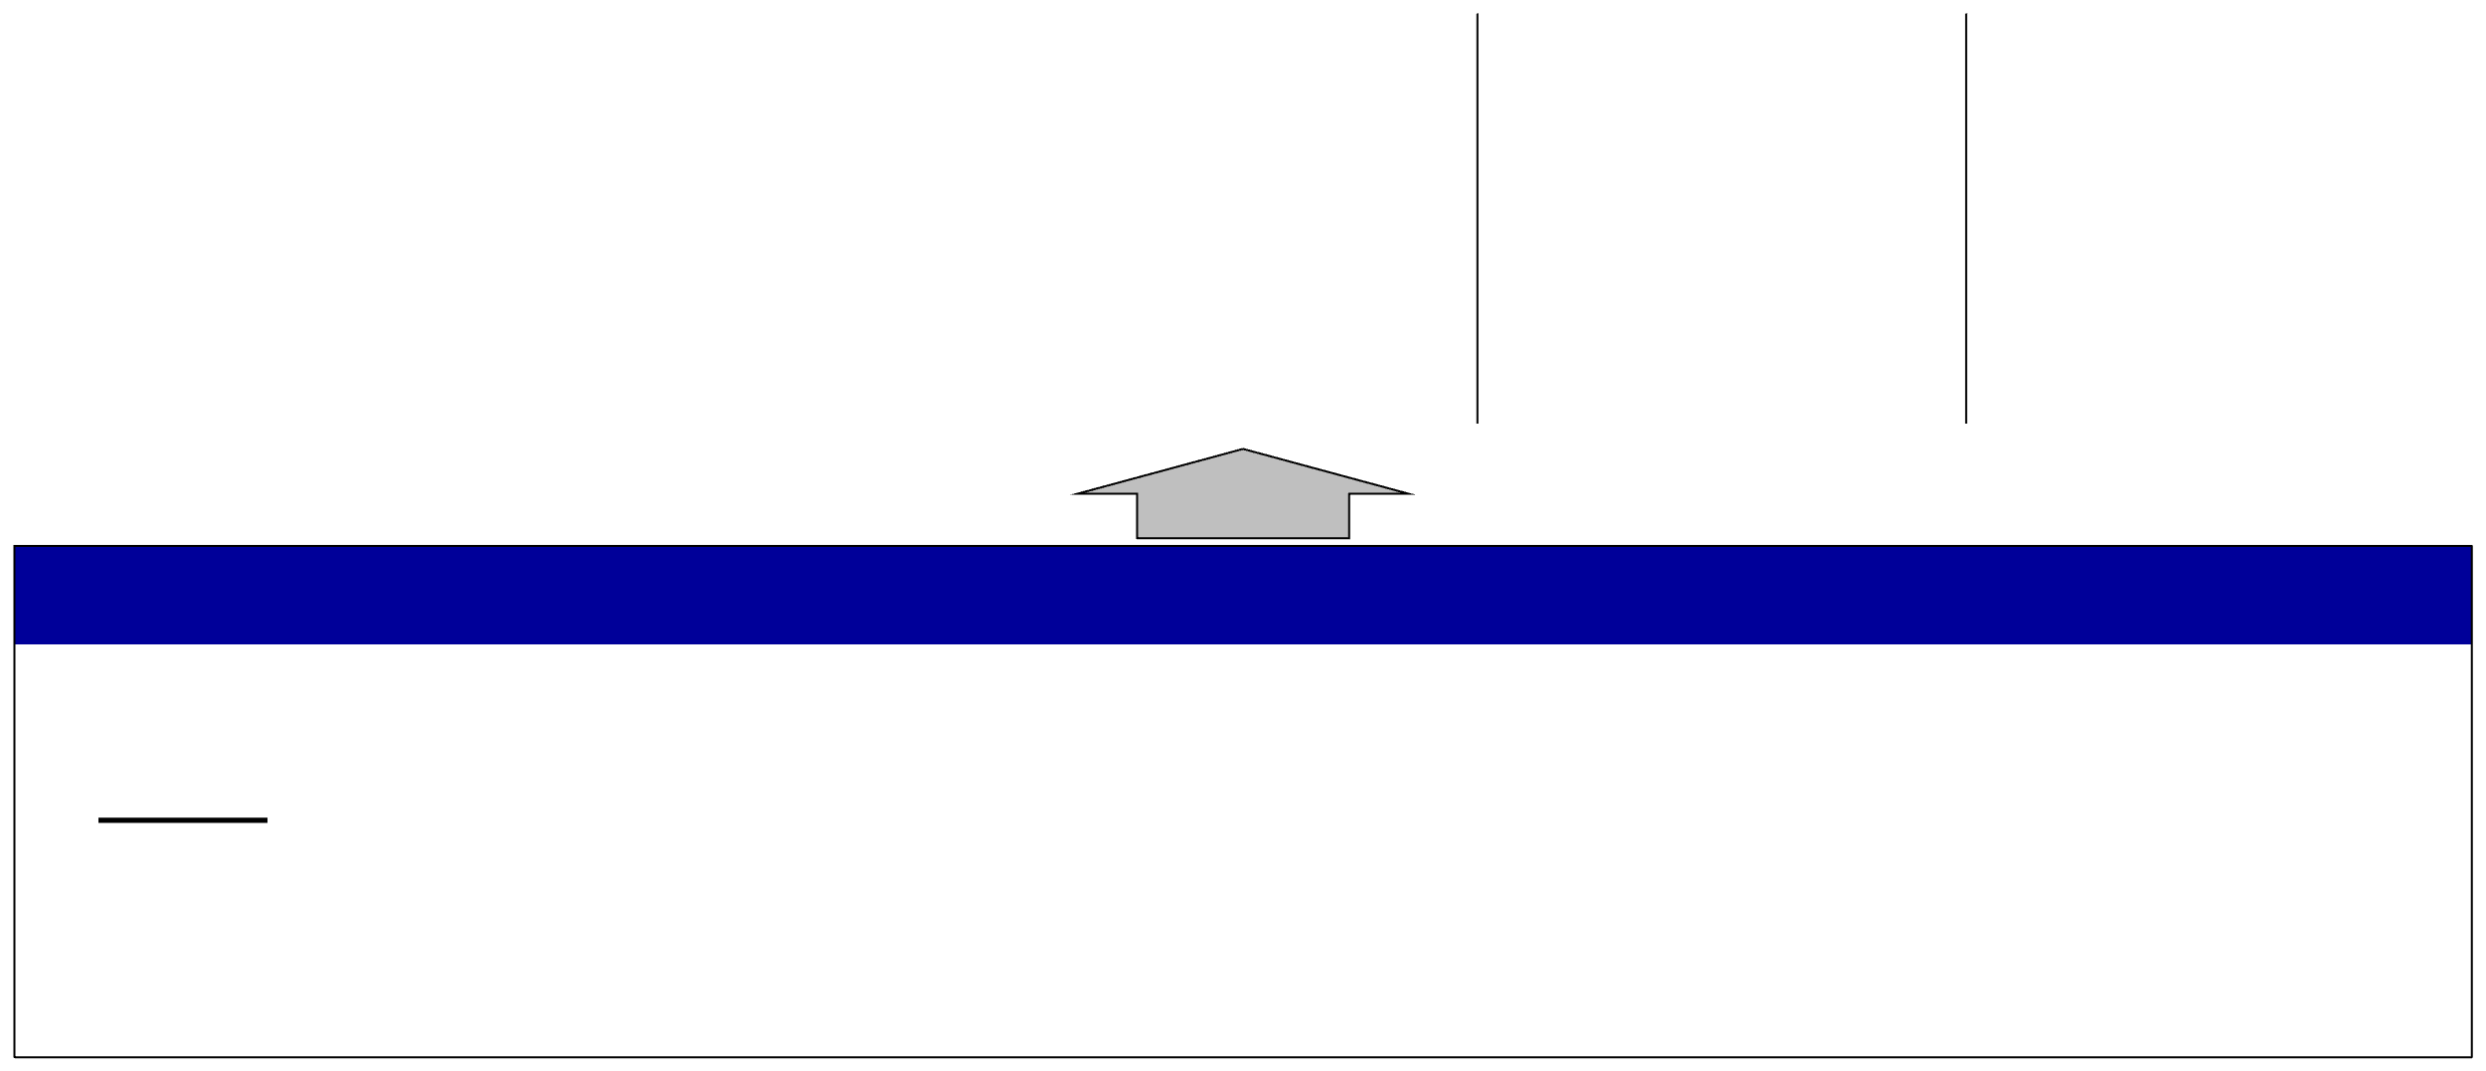





















STRATEGIC PLANNING FOCUS
League Goals: Increase Consumption | Fan Growth | Grow Key Demographics
Focus Areas
Direct-to-
International
Legalized
Non-Game
New
Consumer
Sports Betting
Media Content
Technology
Blockchain
Foundational Investments
Game Youth
Fan Development
Avid Youth / Latinx
Business Operations
DEI Data/Tech
Quality
PH&S
Digital Athlete
Fan 1:1
66
*League goals in no particular order

Slide 25


2023 NFL KEY RISK ASSESSMENT
TOP 15 NFL RISKS
“Next 5”
1.PlayerHealth & Safety
2.Game Integrity
3.Game Quality
4.Reputation / Brand
5.Fan Engagement
6.Cyber-Security / Data Privacy
7.Youth Markets / Football
8.Legalized Sports-Betting
9.International Markets
10.Natural Disaster/ Unforeseen Event
11.Talent Management (Diversity /
Succession)
12.League-Club Support
13.Third-Party Management
14.Event Management
15.Economy / Geo-Politics
Media Fragmentation / Behavioral Shift
NFLPA Relations
Collective Bargaining
Internal Communications
Regulatory Compliance

Slide 26
Project Overview
NFL Technology Innovation HUB
Optical Tracking
Player View)
* Problem - What problem are we trying to address?
* Criteria - Why should this project be selected?
* Timing - When is this need going to be most acute?
* Impact - What will change as a result of this project?
* Process - How do we get there?

Slide 27
Project Zone Mapping
NFL Technology Innovation HUB
Optical Tracking
Player View)
* Group Discussion
* Solicit brainstorming / discussion on did we place it in the right zone & why
* Now that we have it placed in the zone, what is the impact? (does this require something else to come out of incubation?, is there an impact on transformation?, are there any lessons / shared technologies that can be leveraged in productivity or performance... etc.)

Slide 28
Next Steps

