Slide 1

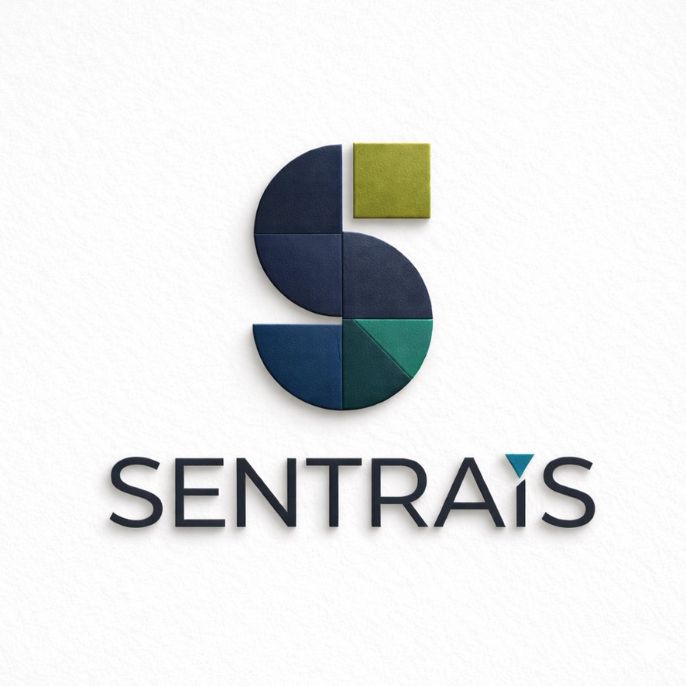
90-DAY POC STRATEGY
15 Venues by March 31, 2026
5
5
5
NFL Stadiums
AEG Venues
Live Nation Venues
Google Sports
Microsoft Venues
AWS Federal
SENTRAIS CORPORATION TEAM BRIEFING JANUARY 2026

Slide 2

WHAT IS SENTRAIS?
The Intelligence Operating System for High-Stakes Environments
THE CORE IDEA
THE SENTRAIS ECOSYSTEM
Sentrais digitizes an organization's DNA—processes, playbooks, systems—into a unified core model that powers every project and platform.
SENTRAIS OS
Intelligence Operating System
WHAT SENTRAIS DOES
EVERGAME
eVenu
CiviGrid
Federal
Unifies fragmented systems into one intelligence layer
Accelerates commercialization through shared blueprints
Embeds resilience, governance, and security
"Calm during chaos. Making the complex simple."
Compounds intelligence with every deployment
Sentrais is the living intelligence core that translates organizational DNA into unified, resilient frameworks.

Slide 3

THE NIN METHODOLOGY
Gartner-Recognized Framework Systematic Approach to Resilience
1
2
3
4
5
DISCOVER
DIAGNOSE
DESIGN
DEPLOY
DEBRIEF
NIN Forensics, current state, operational mapping
Root cause analysis, risk prioritization, impact
Solution architecture, future-state blueprints
Implementation, training, Sentrais activation
Continuous improvement, AAR automation
OUTCOME-FOCUSED
RAPID DELIVERY
BATTLE-TESTED
Not just technology—measurable resilience, accuracy, and speed to innovation.
90-day POCs deliver results, not PowerPoints. Outcomes in months, not years.
Born from Atlanta cyber crisis, Super Bowl delivery, NFL production deployment.
NIN = NOVATE Intelligence Network Each POC follows this exact methodology

Slide 4

WHERE WE ARE TODAY
NFL-Validated Production-Proven Ready to Scale
LIVE
NFL ANCHOR CONTRACT
CORPORATE STRUCTURE
Sentrais Corp — C-Corp, all IP, platform, advisory
32
clubs deployed with EVERGAME360
NOVATELabs — 501(c)(3), research, workforce
Partners Network — Certified delivery
$1.9M
committed ARR (76% of Y1 target)
4 yrs
R&D, $5M founder investment
LEADERSHIP TEAM
Tye Hayes
Knox
Founder & CEO
Chief Product Officer
Tionna
WHY NFL MATTERS
Director, Labs
Most complex sports operation in the world
Production-proven technology at scale
Unassailable reference for all verticals
FOUNDER CREDENTIALS
Gartner Market Guide recognition
Service-Disabled Navy Veteran Former CIO, City of Atlanta Cyber crisis commander Super Bowl LIII delivery Hartsfield-Jackson innovation lead
Transitioning from NOVATE Solutions (S-Corp) to Sentrais Corporation (C-Corp) for institutional investment readiness

Slide 5
THE 15-POC TARGET
Three Categories 90 Days Market-Defining Traction
5
NFL STADIUMS
5
AEG VENUES
5
LIVE NATION
Google Partner
Microsoft Partner
Microsoft Partner
Mercedes-Benz Stadium
Crypto.com Arena
The Fillmore Network
Atlanta SB 2029 Host
LA Flagship 20K
Multi-venue proof
SoFi Stadium
The O2
Hollywood Bowl
LA Olympics 2028
London International
LA Iconic 17.5K
Allegiant Stadium
Dignity Health Sports Park
Red Rocks
Vegas Tech-Forward
LA FIFA Training
Denver Unique Ops
AT&T Stadium
Microsoft Theater
Bridgestone Arena
Dallas Largest NFL
LA Partner Alignment
Nashville 20K
MetLife Stadium
T-Mobile Arena
House of Blues
NY/NJ FIFA 2026 Final
Vegas Major Events
Artist integration
$1.35M
$4M+
3-4x
POC Investment
Y1 Pipeline
Expected ROI

Slide 6
CLOUD PARTNERSHIP STRATEGY
Three Partners Three Markets One Intelligence Layer
Google
SPORTS
Microsoft
VENUES
AWS
FEDERAL
FOCUS
FOCUS
FOCUS
Sports leagues, entertainment, AI-native innovation
Venue operators, enterprise deployments
Federal agencies, airports, critical infrastructure
SERVICES
SERVICES
SERVICES
Vertex AI BigQuery Chronicle
Azure AI Dynamics 365 Teams
GovCloud Bedrock Lambda
TARGETS
TARGETS
TARGETS
NFL MLS NBA NCAA
AEG Live Nation ASM Global
FEMA DHS TSA Airports
Q1: Partnership signed, NFL case study
Q1: Azure marketplace listing
Q1: FedRAMP pathway initiated
JAN: Google
→
FEB: Microsoft
→
MAR: AWS

Slide 7
90-DAY EXECUTION CALENDAR
Week-by-Week Milestones January 6 March 31, 2026
JANUARY
FEBRUARY
MARCH
Foundation & NFL
AEG & Live Nation
Acceleration
Week 1-2
Week 5-6
Week 9-10
Finalize POC materials
AEG venue meetings
Rapid POC velocity
NFL stadium meetings
Live Nation approach
AWS federal partnership
Week 3
Week 7
Week 11
Google partnership signed
Microsoft partnership
Case study documentation
Week 4
Week 8
Week 12
First 2 NFL POCs launched
AEG + LN POCs launch
Series A prep complete
END: 2 POCs Active
END: 8 POCs Active
END: 15 POCs ✓
Weekly tracking: POCs Initiated POCs in Discovery POCs in Deploy POCs Complete Pipeline Value

Slide 8
TEAM ROLES & RESPONSIBILITIES
Who Does What 15 POCs Require All Hands
TH
Tye Hayes
K
Knox
KJ
Mikalina/Free
T
Tionna
CEO 80%
CPO 70%
CRO 100%
Labs Dir 60%
Executive relationships
NIN methodology
POC sales & pipeline
Fellow deployment
Cloud partnerships
Product customization
Agent coordination
SIPE configuration
Strategic selling
Technical leadership
Weekly tracking
Technical delivery
LABS FELLOWS (5-8)
COMMISSION AGENTS (8-15%)
CERTIFIED PARTNERS
Implementation, configuration. Each supports 2-3 POCs.
Mid-market venues. Zero fixed cost. Target 30-50 agents.
Implementation delivery. Revenue share model.
Lean Core: 8 FTEs only
Automation First: AI before headcount
Partner Before Build: Certify capacity

Slide 9
SUCCESS METRICS & CALL TO ACTION
What We're Measuring What We Need From You
IMMEDIATE ACTIONS
KEY MILESTONES
Week 4 (Jan 31)
3 POCs $500K
THIS WEEK
Finalize POC pricing
Week 8 (Feb 28)
8 POCs $2M
Draft Google proposal
Week 12 (Mar 31)
15 POCs $6M+
NEXT 2 WEEKS
NFL stadium intros
MARCH 31 END STATE
Pre-recruit 3 Fellows
15
10+
8
3
BY JAN 31
2 NFL POCs launched
POCs
Complete
Proposals
Cloud
Google partnership signed
15 active POCs = market validation for Series A ($12-15M at $50-80M). NFL + venues + cloud = category leadership.
THE ASK
Full commitment for 90 days. Every POC strengthens Sentrais. This is how we win.
SENTRAIS CORPORATION Q1 2026 LET'S BUILD

