Slide 1
Chapter 6:
Memory

Slide 2
Team Introduction
Group 3 Roles:
Thuy Hoang- Team Leader & Virtual Memory
Michael Toronto- Cache Memory
Elise Kurtz- Memory Hierarchy
Abifatah Kedirp- Types of Memory
Samantha Larsen- Java Stack Heap Memory

Slide 3
Project Introduction
The scope of this project will include what memory is used for, how it is used, and the usefulness of different variations of memory along with the following topics:
-Types of Memory
-Memory Hierarchy
-Cache Memory
-Virtual Memory
-Java Stack Heap Memory

Slide 4
Types Of Memory

Slide 5
What is Computer Memory ?

Slide 6
Computer memory is physical device capable of storing information temporarily like RAM (Random Access Memory), or permanently, like ROM (Read-Only Memory).
Memory devices utilize integrated circuits and are used by operating systems, software, and hardware.
Memory is primarily of three types
Cache Memory
Primary Memory/Main Memory
Secondary Memory

Slide 7
.
TYPES OF MAIN MEMORY
RAM
ROM
SRAM
DRAM
PROM
EPROM
EEPROM

Slide 8
Random Access Memory (RAM)
RAM also called
Read Write Memory.
Is a Volatile Memory(erases the data if the system is turned off or interrupted).
It is a high-speed memory.
RAM is subdivided into DRAM and SRAM.

Slide 9
DRAM
Stores a bit using a single paired capacitor and transistor.
Requires a recharger every few milliseconds to maintain the data.
Slower than SRAM.
can hold more data than an SRAM chip, but it requires more power.
Generates less heat.
Used for main Memory.

Slide 10
SRAM
stores a bit using a six-transistor circuit and latch
Faster than DRAM.
Can not be stored many bits per chip and Uses More power.
retains data values without recharging cells.
Generates More heat.
Used for cache.

Slide 11
Random Only Memory (ROM)
It is not volatile (does not erases the data if the system is turned off or interrupted).
It is much slower than the RAM
Data stored in ROM can only be modified slowly, with difficulty, or not at all, so it is mainly used to store firmware or application software in plug-in cartridges.

Slide 12
PROM
Programmed by the user.
Data and Instruction cannot be changed.
EPROM
Data in this memory chip can be erased by exposing it to high-intensity UV light.
EEPROM
Data in this memory can be electrically erased using field electron emission.

Slide 13
Additional 5 minute video

Slide 14
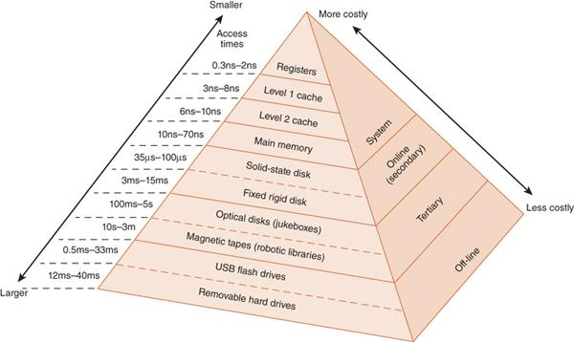
Memory Hierarchy

Slide 15
Memory Hierarchy - System Memory
Registers - Processor’s storage locations
Cache (L1 and L2) - Where frequently used data is temporarily stored (very high-speed)
Main Memory - Connected to the cache memory but slower.

Slide 16
Memory Hierarchy - Secondary Memory
Contains the data not directly accessed by the CPU - must me transferred to the main system memory for use.
Consists of hard disk drives (either solid state or magnetic)

Slide 17
Memory Hierarchy - Off-line Bulk Memory
Requires human or robotic involvement and must be transferred to secondary memory for the system to be able to use.
Tertiary memory - Such as optical jukeboxes and tape libraries (Robotic arm mounts and dismounts the discs and tapes)
Off-line Storage - Such as flash drives, external hard drives, optical discs, etc.

Slide 18
Memory Hierarchy - Locality of Reference
Clustering of the memory into groups. This is based on the idea that when information is requested and accessed, the information around it has a higher probability of being accessed in the near future. Therefore, blocks of information are transferred to higher memory in anticipation of this concept.
Temporal Locality - Recently accessed data will be used again
Spatial Locality - Data around the requested data will also be accessed
Sequential Locality - Data is accessed in a linear fashion

Slide 19
Cache Memory- What is it?
High-speed static random access memory (SRAM) that a computer can access faster than regular random access memory (RAM).
Typically integrated into the CPU chip.
Used to store program instructions and data that are used repeatedly in the operation of programs or information that the CPU might need next.
Loses data once power is no longer supplied.

Slide 20
Cache Memory History
Processor performance increased much faster than memory performance which created a bottleneck.
In 1980s, experiments with SRAM began to boost memory performance.
Cache memory was separate from the processor.
Newer processor included cache memory in the chip.
With the cache on the chip, clock rates synchronized and the system became more efficient.
More caches were added to boost the system (L1, L2, and L3)

Slide 21
Cache Differences
L1 cache- (Primary cache) extremely fast but relatively small. 32KB - 64KB
L2 cache- Larger capacity than the L1 cache. May be embedded on the CPU or on a separate chip or coprocessor. Connected by high-speed bus from the cache to the CPU. 256KB- 512KB
L3 cache - Developed to improve the performance of the L1 and L2 cache. Slower than previous caches but 2x as fast as RAM. In multicore processors, the L3 cache is shared. 8MB - 32MB

Slide 22
How Cache Memory Works
When the processor needs to execute an instruction, it looks in it’s own registers first.
If the data is not there, it moves to the L1 cache, then the L2 cache or L3 cache
If the data is not in a cache, it goes to the main memory.
If the data is located in the cache it's called a “hit.”
If the data is not located in the cache it’s a “miss.”
Every “miss” slows the computer as it moves to a deeper level.

Slide 23
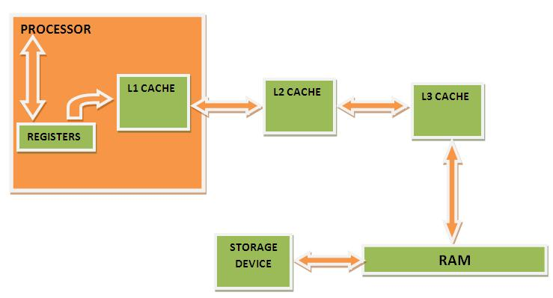
How Cache Memory Works

Slide 24
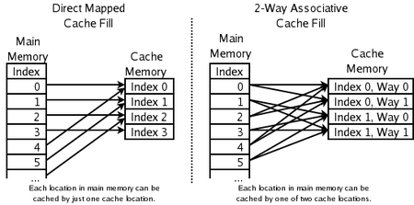

Slide 25
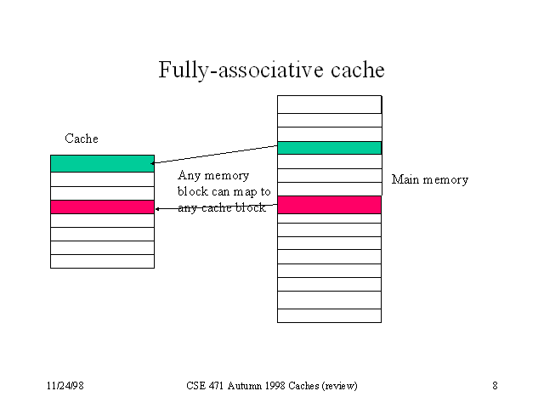

Slide 26
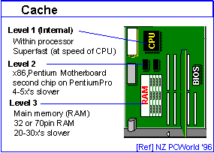

Slide 27
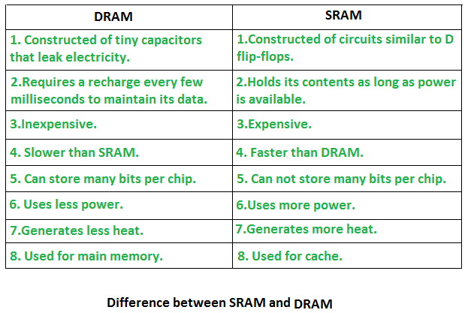

Slide 28
Future of Cache Memory
Bigger sized caches
Bigger is not always better - Bigger caches require more power to run, produce much more heat, and complicate production.
Better algorithms to manage data in the cache.
Hybrid cache memory
Wafer Scale Integration

Slide 29
Virtual Memory
What is it?
A technique that allows the execution of processes that are not completely in main memory.
Works just like cache memory, in terms of mapping main memory address to a logical address.
Not easy to implement and can slow down performance if used carelessly.
A way to extend main memory using a secondary disk as a storage place (in most cases, the hard drive). *Note* Main memory and physical memory will be used interchangeably. Virtual memory and logical memory will be used interchangeably.

Slide 30
Terminology for Virtual Memory
Virtual Address: The program address that the process uses, generated by the CPU. (Also known as a logical address)
Physical Address: The real address in physical memory. Generated by the register.
Mapping: The mechanism by which virtual addresses are translated into physical ones.
Frames or Page Frames: Physical Memory broken into fixed size blocks.
Pages: Logical Memory broken into fixed size blocks (same size as Frames)
Paging: The process of copying a page to a page frame.
Fragmentation: Memory that becomes unusable.
Page Fault: An event when page is not in main memory and must be copied into main memory from disk.

Slide 31
How does it work?
Programs that are too large for main memory are often stored in virtual memory and are swapped into main memory when needed.
Entire programs do not need to be moved from virtual memory into main memory.
Virtual memory can be implemented using different techniques:
Paging (most popular)
Segmentation
Combination of both
A virtual memory address is mapped to a physical memory address by using a page table or a TLB (Translation lookaside Buffer).
A TLB is basically like a cache for the page table. It reduces the time it takes to access the virtual memory (most recent translation between virtual and physical)

Slide 32
Paging
Paging is used to copy pages that are in virtual memory into physical memory.
Many different types of Paging methods, but ‘Demand Paging’ is most common.
Demand Paging only loads the pages needed into physical memory.
When paging for a process that is already in physical memory, we arrive at something called a “page-hit”.
When trying to access a page marked invalid, we arrive at a “page-fault”, and the process is interrupted.
This can occur when the reference page was invalid, which then we terminate the process.
If page is valid, but not yet brought in, we now bring that page in.
Bringing in a new page requires a free frame. If there are no free frames we arrive at a process called “Page Replacement”.
Once disk read is complete, the interrupted process is restarted, and can now access the page though it had always been in memory.

Slide 33
Page Replacement
A way to find the ‘victim’ if page frames are full.
All page replacements require an algorithm to decide the ‘victim’
3 Types:
FIFO page replacement- replaces the oldest page with the demanded page.
Optimal page replacement- replaces the page not used for the longest time.
LRU (Least recently Used) page replacement- replaces the page that is used the least within the process. This require foresight and is often not applicable.
The lowest fault page replacement algorithm: Optimal Page Replacement.
Would be LRU if we need exactly which pages would be accessed.

Slide 34
Java Stack Heap Memory

Slide 35
Project Summary
Memory is constantly evolving due to new technologies.
There are different memory hierarchies based on speed and storage capabilities.
Generic overview of memory includes cache, main memory, and virtual memory.
The further the “distance” from the CPU, the longer the process time.
Memory is overall very dynamic and is always changing and moving.
Generally the bigger memory, the faster the system, as there is no need to create as much virtual memory. Where the need for swapping/paging is involved.

Slide 36
Questions?

