Slide 1
Codes comparison
Tunes versus energy for large & small dipole radius
Machine :
SOLEIL lattice : Standart synchrotron machine, large dipole radius
2750 GeV / Rdipole=5.36 m / circ=352 m
ThomX lattice : Compact ring, small dipole radius
50 MeV / Rdipole =0.352 m / circ=14.47 m
Codes :
BETA : Scaling method, find COD by iteration and resize dipole geometry, 4D tracking
AT : Ruth&Forest 6D symplectic integrator order 4, as TRACYII
MADX : Ruth&Forest 6D symplectic integrator order 4 + small radius terms
CODE : Exact geometrical dipole (or L. Nadolski Hamiltonian) resolution (limited to pure sector)
Perfect hard edge element
Sextupole as kick
Optimisations and Chromaticites set to 0
With BETA

Slide 2
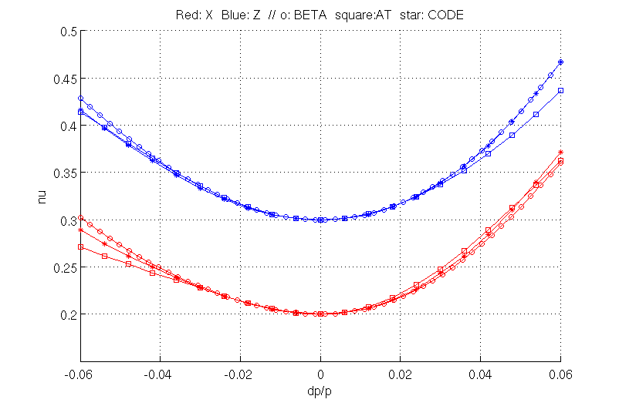
SOLEIL
All codes agree for linear chromatic terms
Small divergence for large dP/P

Slide 3
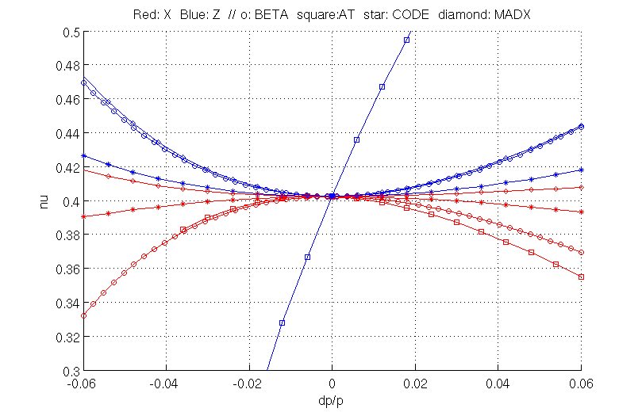
ThomX
All codes agree for linear chromatic terms except AT in Z (dipole edge effect !)
All codes disagree for higher order chromatic terms, except BETA and MADX in Z ?

