Slide 1
Positron temperature data analysis
Data taken during channeling experiment at KEK in October 2015

Slide 2
Data taking timeline
Date | Data | Sweeper Magnet | Repetition rate | Target | Nfiles | File of event | Start time | End Time
11/10/15 | 1011_2015_020733_158
11/10/15 | 1011_2015_022305_386
11/10/15 | 1011_2015_023857_916
11/10/15 | 1011_2015_033606_054 | ON | 25 Hz | 6 layers | 18 | 11
11/10/15 | 1011_2015_140445_225
11/10/15 | 1011_2015_141130_656 | ON | 1 Hz | 4 layers | 4
11/10/15 | 1011_2015_141728_516
11/10/15 | 1011_2015_142315_509
11/10/15 | 1011_2015_142754_352 | OFF | 1 Hz | 4 layers |  |  | 14h27 | 14h38
11/10/15 | 1011_2015_150320_719
11/10/15 | 1011_2015_150551_346 |  | 5 Hz | 4 layers | 1 | 1
11/10/15 | 1011_2015_151611_189
11/10/15 | 1011_2015_151851_330
11/10/15 | 1011_2015_152310_751
11/10/15 | 1011_2015_154358_726
11/10/15 | 1011_2015_154609_177
11/10/15 | 1011_2015_155109_994
11/10/15 | 1011_2015_160455_206 |  | 5Hz Pattern |  | 1
11/10/15 | 1011_2015_160624_897 |  |  |  | 5
11/10/15 | 1011_2015_161117_745 |  |  |  | 26
11/10/15 | 1011_2015_163654_997 |  |  |  | 2
11/10/15 | 1011_2015_163832_298 |  |  |  | 4
11/10/15 | 1011_2015_164237_235 |  |  |  | 22
11/10/15 | 1011_2015_170522_551 |  |  |  | 17
11/10/15 | 1011_2015_172156_299 |  |  |  | 2
11/10/15 | 1011_2015_172518_794 |  |  |  | 14
11/10/15 | 1011_2015_173951_145 |  |  |  | 17
12/10/15 | 1012_2015_105158_603
12/10/15 | 1012_2015_110026_278
12/10/15 | 1012_2015_110628_422
12/10/15 | 1012_2015_111225_955
12/10/15 | 1012_2015_142003_093
12/10/15 | 1012_2015_145552_089
12/10/15 | 1012_2015_145918_750
12/10/15 | 1012_2015_151251_305
12/10/15 | 1012_2015_182609_051
12/10/15 | 1012_2015_193103_878
12/10/15 | 1012_2015_193443_977 |  | All patterns | 4 Layer | 108

Slide 3
Setup
6
2
9
5
1
3
7
4
8

Slide 4
Panorama of beam conditions and structures

Slide 5
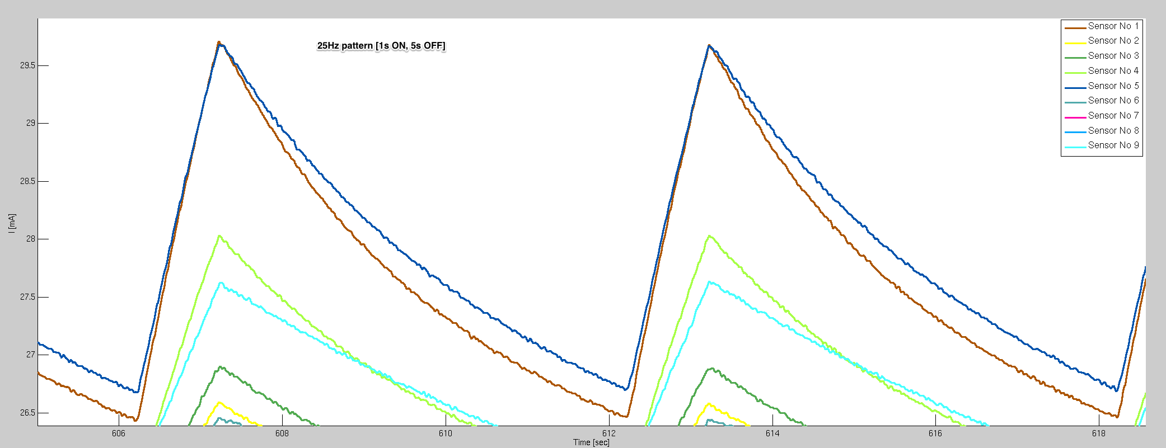
25 Hz Pattern

Slide 6
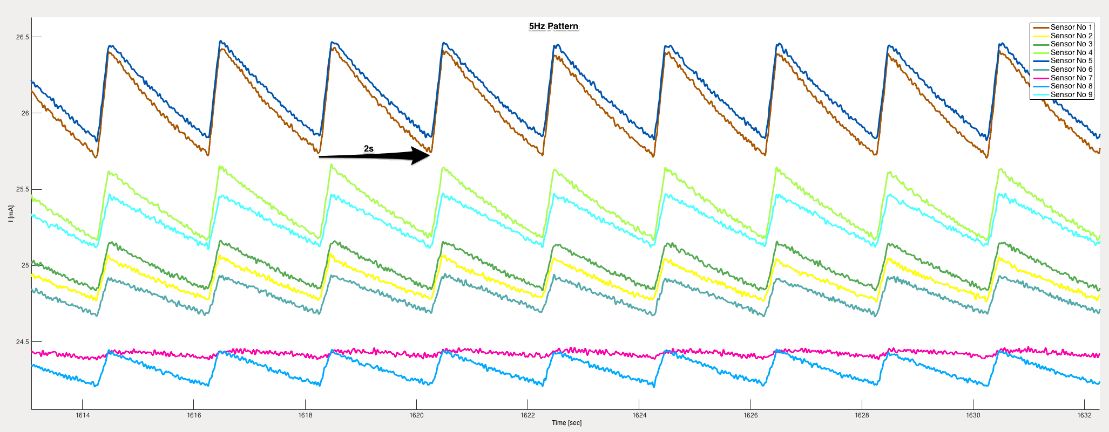
5 Hz Pattern

Slide 7
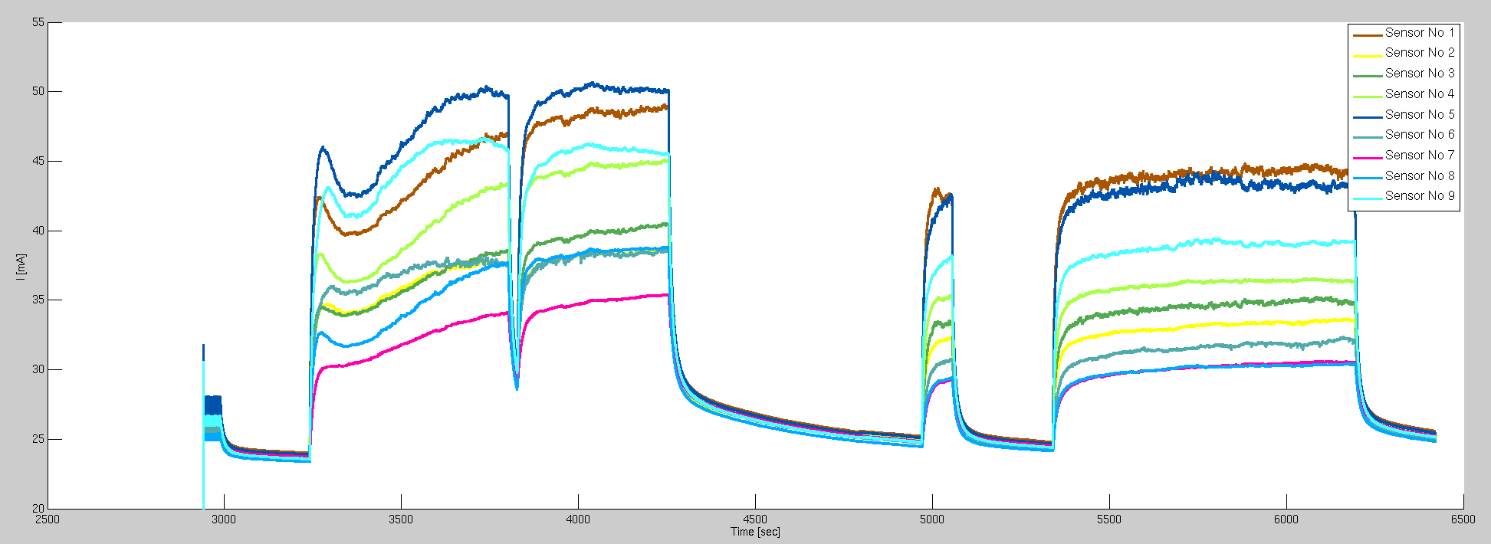
Continuous 25 Hz mode

