Slide 1
LogAnalyzer Intro
Wei Han
09/18/2019

Slide 2
AGENDA
Demo
Log Parsing
Log Pre-processing
Analyzing (Anomaly detection, ML way)
Analyzing (the old school way)

Slide 3
Demo

Slide 4
Demo
Analyzing (Anomaly detection, ML way)
Analyzing (the old school way)

Slide 5
Demo: Running Environment and Code Repo
>= Python 3.6
Packages needed
numpy, pandas, scipy, scikit-learn, skl2onnx, onnxruntime
OS independent and suppose it works on RGLinux too.
Get the code from Beijing server:
git clone your_unix_usrname@10.149.6.68:/projects/stbdevH/cmrepos/loganalyzer.git loganalyzer
branch updates on 2020/0527:
Branch | Description | status
master | OSS & supervised learning system | deprecated
supervised_models | OSS & supervised learning system w/ incremental learning | normal, maintaining
develop | DeepLog | normal, developing

Slide 6
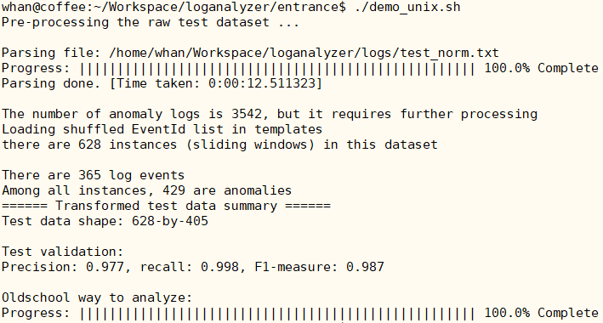
Demo: How to Use
Put the raw log file with timestamp to loganalyzer/logs/ folder.
loganalyzer/entrance/demo_unix.sh or demo_win.bat
The results are in loganalyzer/results/test/
One csv file is for the result of machine learning way
Another csv is for old school way
An example running the analyzer

Slide 7
Demo: Summary of Analyzing
anomaly_timestamp.csv
Timestamp tuples (Windows)
[start time] [end time]
Faults are in between start/end tuple
The window size can be pre-defined as well as the window step size. It depends if the detection algorithm works well
Need the user check the raw logs per the timestamp tuples
analysis_summary.csv
Timestamp, Description, Suggestion
Timestamp: The error location
Description: What is the error
Suggestion: What might be the cause and possible solutions

Slide 8
The Big Picture

Slide 9
The Big Picture
Anomaly Detection
Log
Pre-Processing
Log
Parsing
Old-School
Analyzing

Slide 10
Log Parsing

Slide 11
What is Log Parsing & Why is it Required
Raw log data are usually unstructured
Data mining models/techniques require structured input, e.g.
A matrix (required by anomaly detection w/ machine learning)
An event list (required by traditional method, I call it the old school way)
Log Parsing Overview
[20190719-08:58:34.233] RNG-RSP UsChanId= 149 Adj: freq= 278 Stat= Continue
[20190719-08:58:35.227] RNG-RSP UsChanId= 149 Adj: power= -1 Stat= Continue
[20190719-08:58:36.220] RNG-RSP UsChanId= 149 Stat= Continue
[20190719-08:58:37.718] RNG-RSP UsChanId= 149 Stat= Success
Log template 1
[20190719-08:58:34.233] RNG-RSP UsChanId= <*> Adj: freq= <*> Stat= <*>
[20190719-08:58:35.227] RNG-RSP UsChanId= <*> Adj: power= <*> Stat= <*>
[20190719-08:58:36.220] RNG-RSP UsChanId= <*> Stat= <*>
[20190719-08:58:37.718] RNG-RSP UsChanId= <*> Stat= <*>
Log template 2
Log template 3

Slide 12
Parsing Algorithm Overview
Traditional method w/ regular expression
Need domain knowledge and developer’s maintenance
It is tedious and error prone for a large system
Need manual update if system evolves
Data driven, also called clustering
Do not need domain knowledge
Extract log template directly from raw log messages based on some features
E.g.
[20190719-08:58:34.233] RNG-RSP UsChanId= 149 Adj: freq= 278 Stat= Continue
[20190719-08:58:35.227] RNG-RSP UsChanId= 149 Adj: power= -1 Stat= Continue
[20190719-08:58:36.220] RNG-RSP UsChanId= 149 Stat= Continue
[20190719-08:58:37.718] RNG-RSP UsChanId= 149 Stat= Success
sprintf(message, “RNG-RSP UsChanId= %d Stat= %s”, ucid, currstat)
Basic features of log message
Log contents: Constant part and variable part
The Constant appears always the same
The variable appears w/ changing values

Slide 13

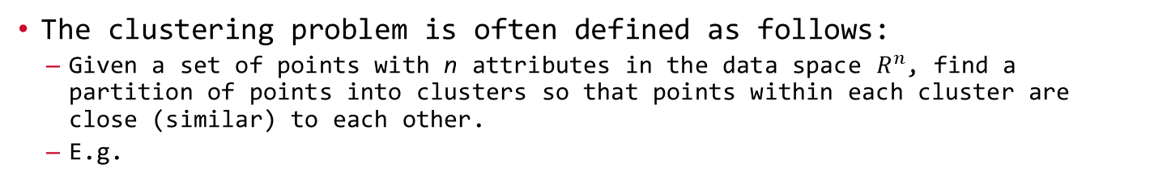
Parsing Algorithm Overview, cont.
The clustering problem is often defined as follows:
Given a set of points with n attributes in the data space $R^{n}$, find a partition of points into clusters so that points within each cluster are close (similar) to each other.
E.g.
[20190719-09:41:24.192] CM cfg file: 172.16.0.1 cm.bin
Above one line log is represented by one point with dimension size 5, or with 5 attributes
X = (‘CM’, ‘cfg’, ‘file:’, ‘172.16.0.1’, ‘cm.bin’)
If we have another log line that is represented by point below
Y = (‘CM’, ‘cfg’, ‘file:’, ‘172.16.1.1’, ‘simple.cfg’)
Then we can use formula below for clustering (n=5, p=2)

Slide 14
Parsing Algorithm, Drain
Many clustering algorithm were studied over last two decades
SLCT, IPLoM, LenMa, etc…
When log lines are more than 100M, time/space complexities are big issues.
I selected one developed by CUHK, called Drain. Fast, but it still has some issues when using it, need workarounds.
Drain: fixed Depth tree based online log parsing method

Slide 15
Parsing Algorithm, Drain, cont.
template 1
[20190719-08:58:34.233] RNG-RSP UsChanId= 149 Adj: freq= 278 Stat= Continue
[20190719-08:58:35.227] RNG-RSP UsChanId= 149 Adj: power= -1 Stat= Continue
[20190719-08:58:36.220] RNG-RSP UsChanId= 149 Stat= Continue
[20190719-08:58:37.718] RNG-RSP UsChanId= 149 Stat= Success
[20190719-09:41:24.192] CM cfg file: 172.16.0.1 cm.bin
template 2
template 3
template 4
Tree depth is 4
Root
Length: 5
Length: 8
RNG-RSP
CM
RNG-RSP
UsChanId=
cfg
UsChanId=
Template 4
Log Event: CM cfg file: <*> <*>
Log IDs: 102, 511, 1083
A List of Templates
A List of Templates
A List of Templates
…
…
…
Template 3
Template 1
Template 2
Log Event: RNG-RSP UsChanId= <*> Stat = <*>
Log IDs: 20, 21, 36
Log Event: RNG-RSP UsChanId= <*> Adj: freq= <*> Stat= <*>
Log IDs: 18, 51, 52
Log Event: RNG-RSP UsChanId= <*> Adj: power= <*> Stat= <*>
Log IDs: 19, 55, 56

Slide 16
Parsing Results
templates.csv
All the templates that extracted from raw logs file
Template IDs
Log count for each Template
structured.csv
Log ID, aka. Line ID for each log
Timestamp
Original log
Template ID of current log
Template for current log

Slide 17
Log Pre-processing

Slide 18
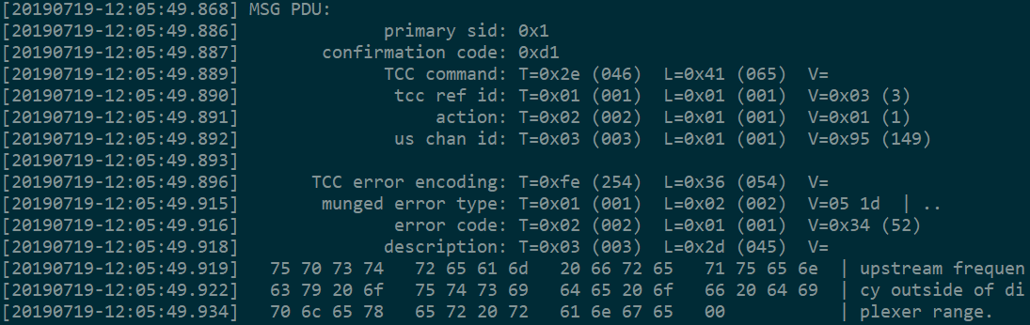
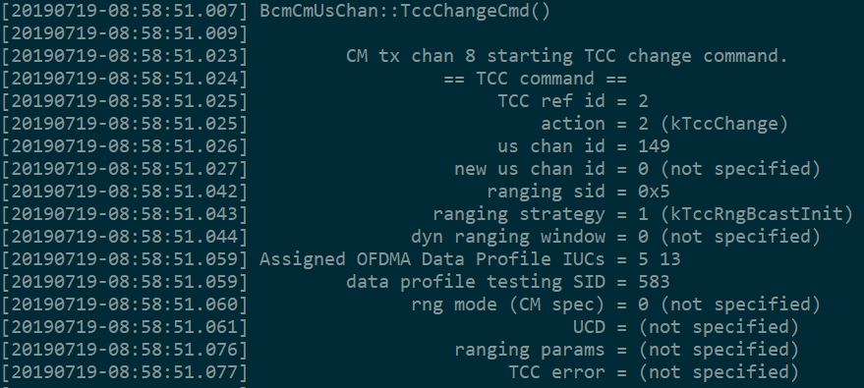
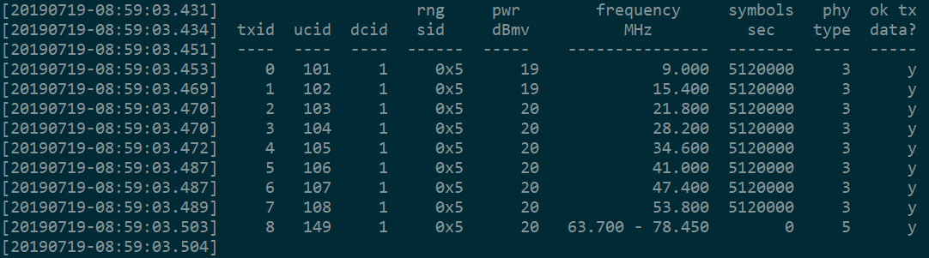
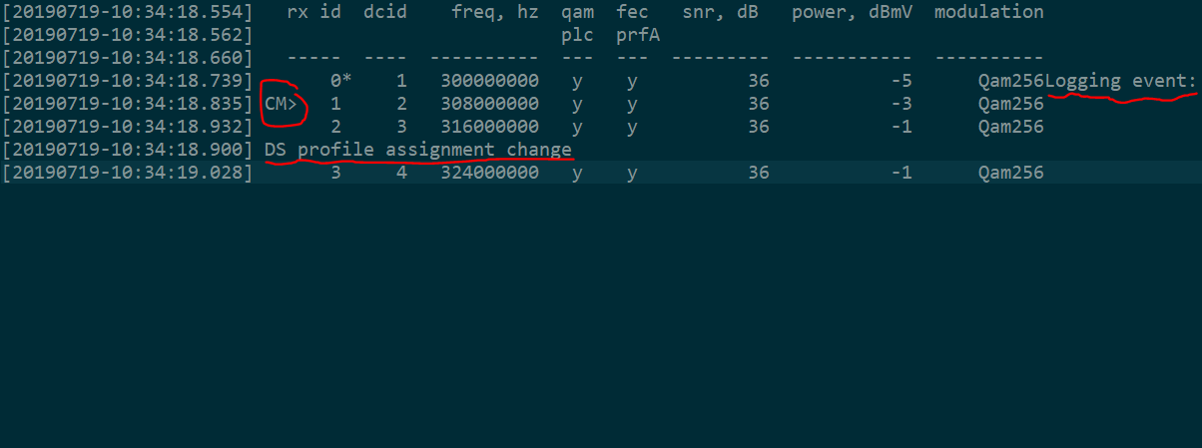
Why Pre-process the Raw Logs
Not all logs have expected formats as right. See below.
[20190719-08:58:34.233] RNG-RSP UsChanId= 149 Adj: freq= 278 Stat= Continue
[20190719-08:58:35.227] RNG-RSP UsChanId= 149 Adj: power= -1 Stat= Continue
[20190719-08:58:36.220] RNG-RSP UsChanId= 149 Stat= Continue
[20190719-08:58:37.718] RNG-RSP UsChanId= 149 Stat= Success
[20190719-09:41:24.192] CM cfg file: 172.16.0.1 cm.bin
Tables, timestamp from code
MAC Management message packet mixed with HEX
Code defect wherein developer lost ‘\n’ at the end of printf
Multi threads that mess up the logs
……

Slide 19
Why Pre-process the Raw Logs, cont.
Facilitate parsing process, e.g. replacing digits, ip/mac addresses with <*> ahead.
[20190719-08:58:34.233] RNG-RSP UsChanId= 149 Adj: freq= 278 Stat= Continue
[20190719-08:58:35.227] RNG-RSP UsChanId= 149 Adj: power= -1 Stat= Continue
[20190719-08:58:36.220] RNG-RSP UsChanId= 149 Stat= Continue
[20190719-08:58:37.718] RNG-RSP UsChanId= 149 Stat= Success
[20190719-09:41:24.192] CM cfg file: 172.16.0.1 cm.bin
[20190719-08:58:34.233] RNG-RSP UsChanId= <*> Adj: freq= <*> Stat= Continue
[20190719-08:58:35.227] RNG-RSP UsChanId= <*> Adj: power= <*> Stat= Continue
[20190719-08:58:36.220] RNG-RSP UsChanId= <*> Stat= Continue
[20190719-08:58:37.718] RNG-RSP UsChanId= <*> Stat= Success
[20190719-09:41:24.192] CM cfg file: <*> cm.bin
Facilitate the parameters mapping in the template. It is useful for the old way analyzer.
[20190719-09:27:07.379] Requested Spectrum = US:(0 MHz..204 MHz) DS:(258 MHz..1218 MHz)
[20190719-09:27:07.382] Best Match = 1: US:(5 MHz..85 MHz) DS:(108 MHz..1002 MHz)
[20190719-09:27:07.379] Requested Spectrum = US:( 0 MHz.. 204 MHz) DS:( 258 MHz.. 1218 MHz)
[20190719-09:27:07.382] Best Match = 1 : US:( 5 MHz.. 85 MHz) DS:( 108 MHz.. 1002 MHz)

Slide 20
Pre-processing Results
train_new.txt/test_new.txt
Multi-line log
It is used for labeling
train_norm.txt/test_norm.txt
One-line log
It is used for Parsing/Drain feeding.

Slide 21
Analyzing (Anomaly detection, ML way)

Slide 22
The Big Picture
Anomaly Detection
Log
Pre-Processing
Log
Parsing
Old-School
Analyzing

Slide 23
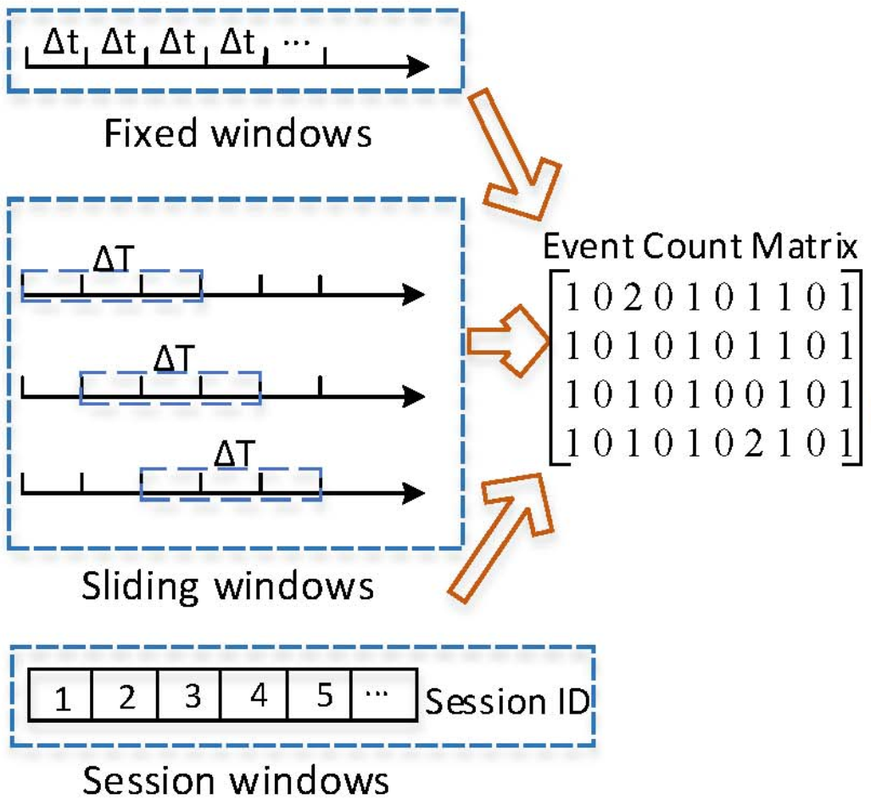
Anomaly Detection Overview
Log Parsing
Feature Extraction
Model Train and Predict
Train
Train Data (ECM)
Train Data (Logs)
Persist model para for further use
Test Data (Logs)
Predict
Test Data (ECM)
Output

Slide 24
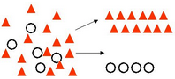
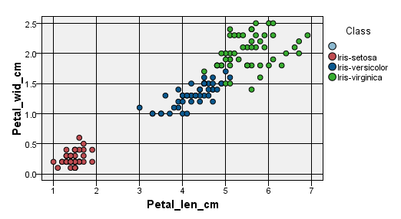
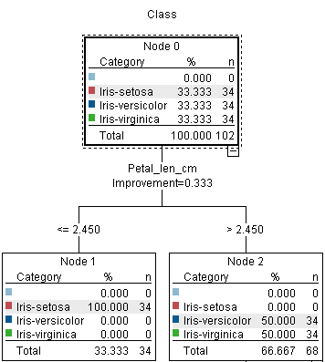
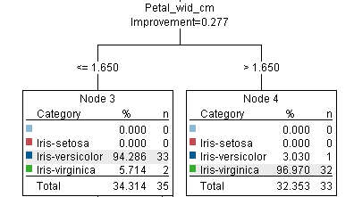
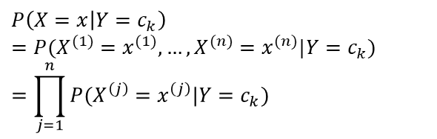
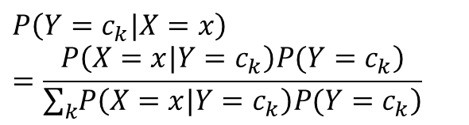
An Example of How ML (Bayes & DecisionTree) Works
Sepal_len_cm | Sepal_wid_cm | Petal_len_cm | Petal_wid_cm | Class
5.1 | 3.5 | 1.4 | 0.2 | Iris-setosa
4.9 | 3 | 1.4 | 0.2 | Iris-setosa
4.7 | 3.2 | 1.3 | 0.2 | Iris-setosa
4.6 | 3.1 | 1.5 | 0.2 | Iris-setosa
Classification
Iris Class: - Setosa - Versicolour - Virginica
$$P\left(Y=c_{k}|X=x\right)=\frac{\left.P\left(X=x|Y=c_{k}\right)P(Y=c_{k}\right)}{\sum_{k}{\left.P\left(X=x|Y=c_{k}\right)P(Y=c_{k}\right)}}$$
$$P\left(X=x | Y=c_{k}\right)$$
$$=P(X^{(1)}=x^{(1)},…,X^{(n)}=x^{(n)}|Y=c_{k})=\prod_{j=1}^{n}{P(X^{\left(j\right)}=x^{\left(j\right)}|Y=c_{k})}$$

Slide 25
Label the Train Dataset
For the train dataset, we need label the data ahead by human
Sepal_len_cm | Sepal_wid_cm | Petal_len_cm | Petal_wid_cm | Class
5.1 | 3.5 | 1.4 | 0.2 | Iris-setosa
4.9 | 3 | 1.4 | 0.2 | Iris-setosa
4.7 | 3.2 | 1.3 | 0.2 | Iris-setosa
4.6 | 3.1 | 1.5 | 0.2 | Iris-setosa
One of Log Parsing result is used. (The file before converting multi-line log to one-line. Just for convenience)
Instance | Template0 | Template1 | Template2 | Label
1 | 11 | 3 | 20 | 0
2 | 0 | 6 | 20 | 1
3 | 0 | 1 | 0 | 0
4 | 9 | 1 | 0 | 1
5 | 1 | 10 | 0 | 0
Convert this labeled log to one-line format then and extract the label vector finally.
After applying windowing, one instance contains ten or more logs. If one fault log appears in this instance, then label this instance as fault, say, 1.

Slide 26
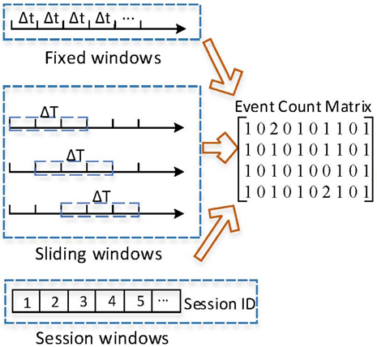
Log Feature Extraction (widowing, weighting)
Logs are strings line by line
We need some transformation to get some kind of matrix data like iris
Sepal_len_cm | Sepal_wid_cm | Petal_len_cm | Petal_wid_cm | Class
5.1 | 3.5 | 1.4 | 0.2 | Iris-setosa
4.9 | 3 | 1.4 | 0.2 | Iris-setosa
4.7 | 3.2 | 1.3 | 0.2 | Iris-setosa
4.6 | 3.1 | 1.5 | 0.2 | Iris-setosa
Instance | Template0 | Template1 | Template2 | Label
1 | 11 | 3 | 20 | 0
2 | 0 | 6 | 20 | 1
3 | 0 | 1 | 0 | 0
4 | 9 | 1 | 0 | 1
5 | 1 | 10 | 0 | 0
Instance | Template0 | Template1 | Template2 | Label
1 | 20.7216 | 17.0939 | 37.0737 | 0
2 | 0 | 19.9802 | 37.0737 | 1
3 | 0 | 7.9897 | 0 | 0
4 | 19.5621 | 7.9897 | 0 | 1
5 | 2.8136 | 20.7216 | 0 | 0
Weighting, e.g. tf-idf
tf: term frequency
idf: diminishes the weight of terms that occur very frequently

Slide 27
Train and Predict
Model Train and Predict
Instance | Template0 | Template1 | Template2 | Label
1 | 20.7216 | 17.0939 | 37.0737 | 0
2 | 0 | 19.9802 | 37.0737 | 1
3 | 0 | 7.9897 | 0 | 0
4 | 19.5621 | 7.9897 | 0 | 1
5 | 2.8136 | 20.7216 | 0 | 0
Train
Train Data
Persist model para for further use
Instance | Template0 | Template1 | Template2
1 | 20.7216 | 17.0939 | 37.0737
2 | 0 | 19.9802 | 37.0737
3 | 0 | 7.9897 | 0
4 | 19.5621 | 7.9897 | 0
5 | 2.8136 | 20.7216 | 0
Predict
Test Data
Output
We can use the Train/Predict models in sklearn/onnx or other frameworks instead of implementing from scratch.
Label
0
1
0
1
0

Slide 28
Locate Where the Errors are in Raw Log File
Predict result vector
Sliding window tuple list
Structured log file
The final results are list of window tuples

Slide 29
Analyzing (the old school way)

Slide 30
The Big Picture
Anomaly Detection
Log
Pre-Processing
Log
Parsing
Old-School
Analyzing

Slide 31
How it Works
knowledgebase
structured log
TemplateId
00000008 | No parameter log. If matched, it means the log is wrong anyway. | Error description | Suggestion to fix
00000009 | It has parameters. Analyzing them with domain knowledges. | Error description if something wrong | Suggestion to fix if something wrong
… | … | … | …
TemplateId | Content | Template | Timestamp
00000009 | ab= 1 | ab= <*> | 10:00
00000008 | xyz | xyz | 10:01
… | … | … | …
Extract the parameters of each log
Traverse each log to see if TemplateId is hit in knowledge base.

Slide 32
The Template and its Id
It’s done in Log Parsing stage. Train and Test logs all pass Parsing 1st.
Use MD5 HASH for each template.
Templates collection in knowledgebase and analyzing are independent because of the nature of HASH for each template.
EventId | EventTemplate | Occurrences
6b0ae484 | Ofdm0: profile0 LOCK in <*> ms! | 8
c481c3c2 | Telling application we lost lock on QAM channel <*> | 64
b4a1c2e6 | NumDsChans = <*>, NumUsChans = <*> | 39
69ab7cde | Clearing D31 PowerSave., DS: <*> SC-QAM ( <*> ), <*> OFDM ( <*> ), US: <*> SC-QAM ( <*> ), <*> OFDMA ( <*> ) | 1
594a8f8e | Restoring OFDM DS MAC settings | 2
a82bff10 | Initializing Quarantine D31 DS MAC structures to <*> | 2
22d6782b | BcmCmDsChan:: DsLockFail: ( BcmCmDsChan <*> ) hwRxId= <*> dcid= <*> -> enter kDsOperLockToRescueCmts state | 64
82f74f80 | BcmCmDsChan:: RecoverChan: ( BcmCmDsChan <*> ) retry -> hwRxId= <*> freq= <*> dcid= <*> | 48
db028621 | BcmCmDsChan:: DsLockOk: ( BcmCmDsChan <*> ) hwRxId= <*> freq= <*> dcid= <*> | 97
79df295c | FirstRngRsp success - adjustment was <*> | 1
bee48b02 | BcmCmMultiUsHelper:: UsTimeRefFail: ( Cm Multi US Helper ) target hwTxId= <*> | 3

Slide 33
Parameter extracting
Get a mapping between each <*> and its original value.
Each log is bijective to its template.
Offset list of <*> in template can be applied to the log to get the real parameters list.
E.g.
The two <*> offsets are list[2, 5]
Get the real para values by log[list[2, 5]]
structured log
b4a1c2e6 | NumDsChans = 32 NumUsChans = 10 | NumDsChans = <*>, NumUsChans = <*>

Slide 34
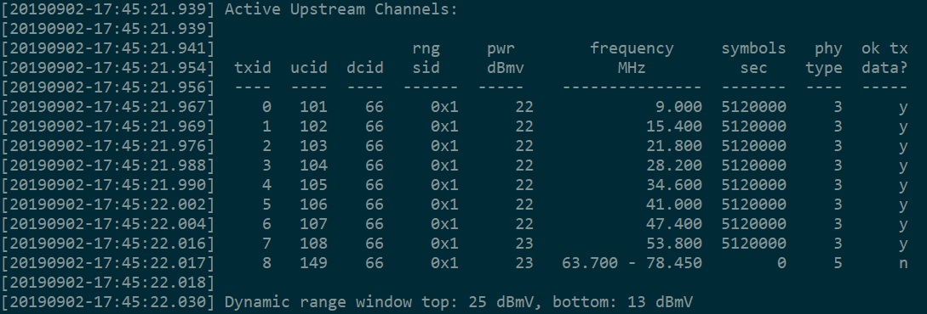
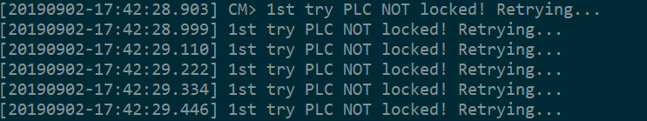
The Knowledgebase
Domain knowledge.
DOCSIS SW system might have several hundreds or even thousands
No need store all templates in knowledgebase
Store the no param templates that indicate wrong
Store the templates that have meaningful parameters
Time & space complexities are not problems
Log Examples the knowledgebase can analyze:

Slide 35
ML vs. Old School
ML method
Pro
No need domain knowledge
It less depends on system changes.
Con
Need manually label currently
Can only fault detection
Old School way
Pro
Know what the errors are and give suggestion
Con
Need domain knowledge to update and maintain the base

Slide 36
Improvement works
Update Drain algorithm to the new version
Incrementally updating templates w/ Drain based on old ones.
This can fix the issue that some templates cannot be generated because of too few logs.
Prepare for the incremental learning for analyzer
Incremental learning.
Current method needs one big training set and the model cannot learn incrementally.
Because of the feature of logging, we should use incremental learning.
Restructure the code to adapt NON-CM/NON-DOCSIS system logs
-------------------------------
Long term improvement
Unsupervised learning feasibility. Need investigate.

Slide 37
References
[1] Pinjia He, Jieming Zhu, Zibin Zheng, Michael R. Lyu. Drain: An Online Log Parsing Approach with Fixed Depth Tree, [ICWS’17]
[2] Pinjia He, Jieming Zhu, Hongyu Zhang, Pengcheng Xu, Zibin Zheng, Michael R. Lyu. A Directed Acyclic Graph Approach to Online Log Parsing, [Arxiv’18]
[3] Shilin He, Jieming Zhu, Pinjia He, Michael R. Lyu. Experience Report: System Log Analysis for Anomaly Detection, IEEE International Symposium on Software Reliability Engineering (ISSRE), 2016.
[4] https://en.wikipedia.org/wiki/Tf-idf
[5] https://archive.ics.uci.edu/ml/datasets/Iris
[6] https://datasciencecentral.com/profiles/blogs/introduction-to-classification- regression-trees-cart

