Slide 1
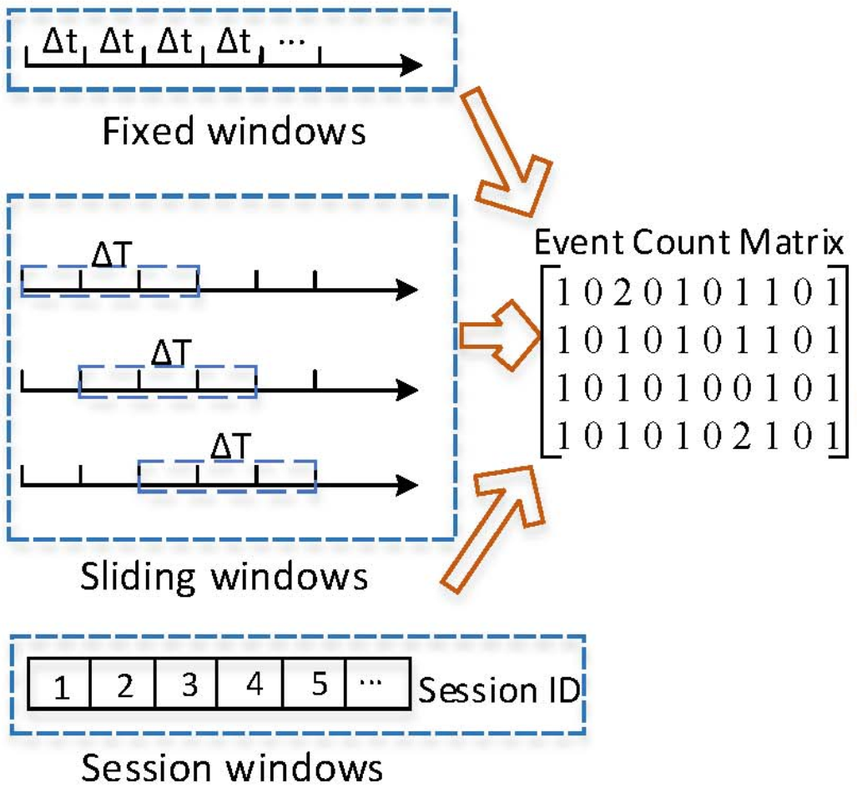
Pre Processing
Clustering
Feature Extraction
Model Train and Predict
Post Processing
Train Data
(Templates,
Structured logs)
Train
Train Data (raw logs with labels)
Train Data (norm logs)
Train Data (ECM)
Persist model para for further use
Map the anomaly to the timestamp window, etc.
Train Data (Labels vector)
Test Data
(Templates,
Structured logs)
Predict
Test Data (raw logs)
Test Data (norm logs)
Test Data (ECM)
Predict Output

Slide 2
A Batch of Logs
Drain Tree
Template Library

Slide 3
Pre Processing
Clustering
Knowledgebase build & retrieve
Post Processing
Extract the useful templates from library manually
Knowledge base
Train Data (raw logs)
Train Data (norm logs)
Train Data
(Templates,
Structured logs)
Build the knowledge
Retrieve Result
Collect the wrong logs info, etc.
Test Data (raw logs)
Test Data (norm logs)
Test Data
(Templates, Structured logs)

Slide 4
Log Generator
Console Tool
Log File
Sampler
Pre Processing
Clustering
Predict or Process in OSS
Log Producing System
Logs
Sampler
Pre Processing
Clustering
Predict or Process in OSS

Slide 5
Feature Extraction
Vectoring and Matrixing
Model Train and Predict
Multi Classes
OSS / Loglizer / DeepLog
Train Data (raw logs with class labels)
Template IDs of error and its context
Train
Persist model para for further use
Class 1
Description
Potential fix
CSPs / JIRAs if exist
Error Context Matrix with Label Vector
Class Labels
Class 2
Class 3
Vectoring
Predict
Test Data (raw logs)
Template IDs of error and its context
Error Context Vector
Predict Output
Class N
Description
Potential fix
CSPs / JIRAs if exist

Slide 6
Pre Processing
Clustering
Knowledgebase retrieve & error set build
DRAIN
Knowledge base
Train Data
(structured logs)
Train Data (raw logs)
Train Data (norm logs)
Event IDs of a Train sample
Class Label
Class Label
Class Label
Windowing
around
Typical Templates
Event IDs of Test Data
Test Data (raw logs)
Test Data (norm logs)
Test Data
(structured logs)

Slide 7
Knowledgebase retrieve & error set build
Multi Classes
Knowledge base
Train Data
(structured logs)
Class 1
Description
Potential fix
CSPs / JIRAs if exist
Pass through to specific target
Class Label
Class 2
Windowing
around
Typical Templates
Class 3
Event IDs of Test Data
Test Data
(structured logs)
Class N
Description
Potential fix
CSPs / JIRAs if exist

Slide 8
Knowledgebase update
Check if the typical event ID is in library
Update Template Lib if necessary
Knowledge base
Extract the new typical templates from library manually
Run Drain
Typical logs
Update the knowledge

