Slide 1
LogAnalyzer Intro
Wei Han
09/18/2019

Slide 2
AGENDA
Demo
Log Parsing
Log Pre-processing
Analyzing (Anomaly detection, ML way)
Analyzing (the old school way)

Slide 3
Demo

Slide 4
Demo
Analyzing (Anomaly detection, ML way)
Analyzing (the old school way)

Slide 5
Demo: Running Environment and Code Repo
>= Python 3.6
Packages needed
numpy, scipy, scikit-learn, pandas, skl2onnx, onnxruntime
OS independent and suppose it works on RGLinux too.
Get the code from Beijing server:
git clone your_unix_usrname@10.149.6.68:/projects/stbdevH/cmrepos/loganalyzer.git loganalyzer

Slide 6
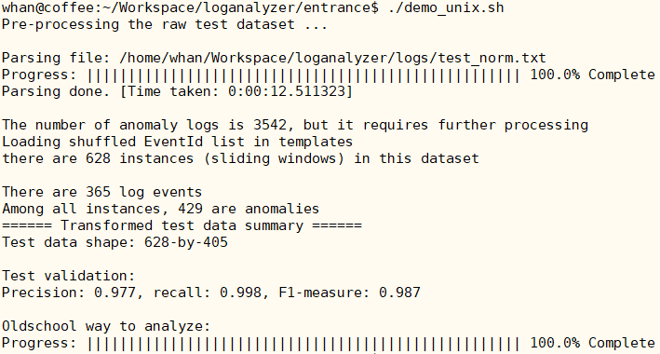
Demo: How to Use
Put the raw log file with timestamp to loganalyzer/logs/ folder.
loganalyzer/entrance/demo_unix.sh & demo_win.bat
The results are in loganalyzer/results/test/
One csv file is the result of machine learning way
Another csv is old school way
An example running the analyzer

Slide 7
Demo: Summary of Analyzing
anomaly_timestamp.csv
Timestamp tuples (Windows)
[start time] [end time]
Faults are in between start/end tuple
The window size can be pre-defined as well as the window step size. It depends if the detection algorithm works good
Need the user check the raw logs per the timestamp tuples
analysis_summary.csv
Timestamp, Description, Suggestion
Timestamp: The fault location
Description: What is the fault
Suggestion: What might be the cause
Possible solutions

Slide 8
The Big Picture

Slide 9
The Big Picture
Anomaly Detection
Log
Pre-Processing
Log
Parsing
Old-School
Analyzing

Slide 10
Log Parsing

Slide 11
What is Log Parsing & Why is it Required
Raw log data are usually unstructured
Data mining models/techniques require structured input, e.g.
A matrix (required by anomaly detection w/ machine learning)
An event list (required by traditional method, I call it the old school way)
Log Parsing Overview
[20190719-08:58:34.233] RNG-RSP UsChanId= 149 Adj: freq= 278 Stat= Continue
[20190719-08:58:35.227] RNG-RSP UsChanId= 149 Adj: power= -1 Stat= Continue
[20190719-08:58:36.220] RNG-RSP UsChanId= 149 Stat= Continue
[20190719-08:58:37.718] RNG-RSP UsChanId= 149 Stat= Success
Log template 1
[20190719-08:58:34.233] RNG-RSP UsChanId= <*> Adj: freq= <*> Stat= <*>
[20190719-08:58:35.227] RNG-RSP UsChanId= <*> Adj: power= <*> Stat= <*>
[20190719-08:58:36.220] RNG-RSP UsChanId= <*> Stat= <*>
[20190719-08:58:37.718] RNG-RSP UsChanId= <*> Stat= <*>
Log template 2
Log template 3

Slide 12
Parsing Algorithm
Traditional method w/ regular expression
Need domain knowledge and developer maintain
It is tedious and error prone for a large system
Need manual update if system evolves
Data driven, also called clustering
Extract log template directly from raw log messages based on some features
E.g.
[20190719-08:58:34.233] RNG-RSP UsChanId= 149 Adj: freq= 278 Stat= Continue
[20190719-08:58:35.227] RNG-RSP UsChanId= 149 Adj: power= -1 Stat= Continue
[20190719-08:58:36.220] RNG-RSP UsChanId= 149 Stat= Continue
[20190719-08:58:37.718] RNG-RSP UsChanId= 149 Stat= Success
sprintf(message, “RNG-RSP UsChanId= %d Stat= %s”, ucid, currstat)
Basic features of log message
Log contents: Constant part and variable part
The Constant appears always the same
The variable appears w/ changed values

Slide 13

Parsing Algorithm, cont.
The clustering problem is often defined as follows:
Given a set of points with n attributes in the data space Rn, find a partition of points into clusters so that points within each cluster are close (similar) to each other.
E.g.
[20190719-09:41:24.192] CM cfg file: 172.16.0.1 cm.bin
Above one line log is represented by one point with dimension size 5, or with 5 attributes
X = (‘CM’, ‘cfg’, ‘file:’, ‘172.16.0.1’, ‘cm.bin’)
If we have another log line that is represented by point below
Y = (‘CM’, ‘cfg’, ‘file:’, ‘172.16.1.1’, ‘simple.cfg’)
Then we can use formula below for clustering (n=5, p=2)

Slide 14
Parsing Algorithm, Drain
Many clustering algorithm were studied over last two decades
SLCT, IPLoM, LenMa, etc…
When log lines are more than 100M, time/space complexities are big issue.
I selected one developed by CUHK, called Drain. Fast, but still some issues when using it, need workarounds.
Drain: fixed Depth tree based online log parsing method

Slide 15
Parsing Algorithm, Drain, cont.
template 1
[20190719-08:58:34.233] RNG-RSP UsChanId= 149 Adj: freq= 278 Stat= Continue
[20190719-08:58:35.227] RNG-RSP UsChanId= 149 Adj: power= -1 Stat= Continue
[20190719-08:58:36.220] RNG-RSP UsChanId= 149 Stat= Continue
[20190719-08:58:37.718] RNG-RSP UsChanId= 149 Stat= Success
[20190719-09:41:24.192] CM cfg file: 172.16.0.1 cm.bin
template 2
template 3
template 4
Tree depth is 4
Root
Length: 5
Length: 8
RNG-RSP
CM
RNG-RSP
UsChanId=
cfg
UsChanId=
Template 4
Log Event: CM cfg file: <*> <*>
Log IDs: 102, 511, 1083
A List of Templates
A List of Templates
A List of Templates
…
…
…
Template 3
Template 1
Template 2
Log Event: RNG-RSP UsChanId= <*> Stat = <*>
Log IDs: 20, 21, 36
Log Event: RNG-RSP UsChanId= <*> Adj: freq= <*> Stat= <*>
Log IDs: 18, 51, 52
Log Event: RNG-RSP UsChanId= <*> Adj: power= <*> Stat= <*>
Log IDs: 19, 55, 56

Slide 16
Parsing Results
templates.csv
All the templates that extracted from raw logs file
Template IDs
Log count for each Template
structured.csv
Log ID, aka. Line ID for each log
Timestamp
Original log
Template ID of current log
Template for current log

Slide 17
Log Pre-processing

Slide 18
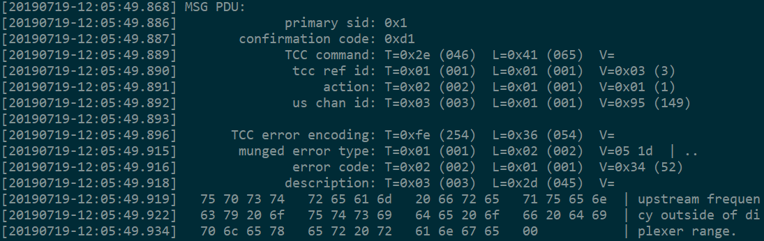
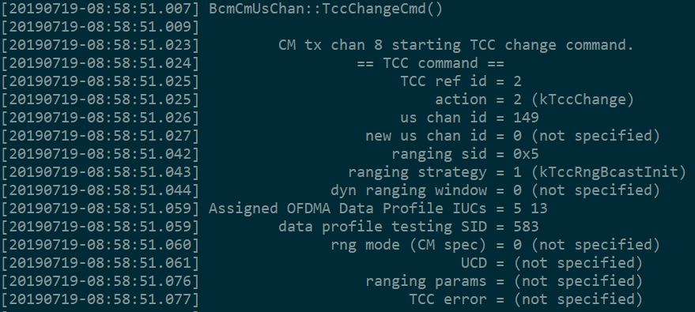
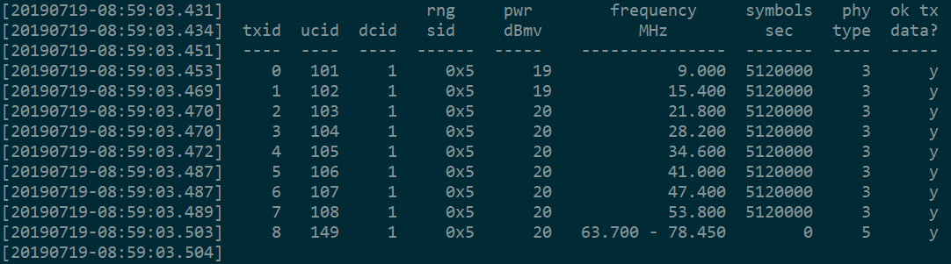
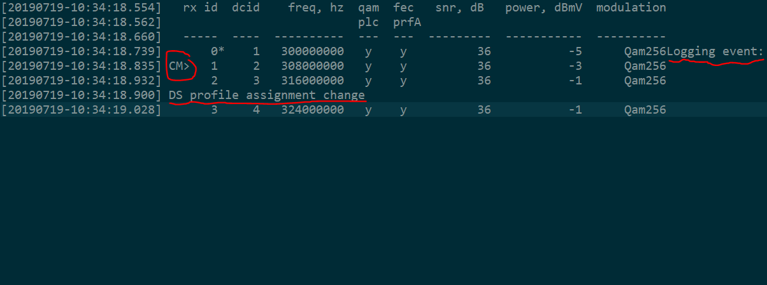
Why Pre-process the Raw Logs
Not all logs have expected formats as left. See below.
[20190719-08:58:34.233] RNG-RSP UsChanId= 149 Adj: freq= 278 Stat= Continue
[20190719-08:58:35.227] RNG-RSP UsChanId= 149 Adj: power= -1 Stat= Continue
[20190719-08:58:36.220] RNG-RSP UsChanId= 149 Stat= Continue
[20190719-08:58:37.718] RNG-RSP UsChanId= 149 Stat= Success
[20190719-09:41:24.192] CM cfg file: 172.16.0.1 cm.bin
Tables, timestamp from code
MAC Management message packet mixed with HEX
Code defect wherein developer lost ‘\n’ at the end of printf
Multi threads that mess up the logs
……

Slide 19
Why Pre-process the Raw Logs, cont.
Facilitate parsing process, e.g. replacing digits, ip/mac addresses with <*> ahead.
[20190719-08:58:34.233] RNG-RSP UsChanId= 149 Adj: freq= 278 Stat= Continue
[20190719-08:58:35.227] RNG-RSP UsChanId= 149 Adj: power= -1 Stat= Continue
[20190719-08:58:36.220] RNG-RSP UsChanId= 149 Stat= Continue
[20190719-08:58:37.718] RNG-RSP UsChanId= 149 Stat= Success
[20190719-09:41:24.192] CM cfg file: 172.16.0.1 cm.bin
[20190719-08:58:34.233] RNG-RSP UsChanId= <*> Adj: freq= <*> Stat= Continue
[20190719-08:58:35.227] RNG-RSP UsChanId= <*> Adj: power= <*> Stat= Continue
[20190719-08:58:36.220] RNG-RSP UsChanId= <*> Stat= Continue
[20190719-08:58:37.718] RNG-RSP UsChanId= <*> Stat= Success
[20190719-09:41:24.192] CM cfg file: <*> cm.bin
Facilitate the parameters mapping in the template. It is useful for the old way analyzer.
[20190719-09:27:07.379] Requested Spectrum = US:(0 MHz..204 MHz) DS:(258 MHz..1218 MHz)
[20190719-09:27:07.382] Best Match = 1: US:(5 MHz..85 MHz) DS:(108 MHz..1002 MHz)
[20190719-09:27:07.379] Requested Spectrum = US:( 0 MHz.. 204 MHz) DS:( 258 MHz.. 1218 MHz)
[20190719-09:27:07.382] Best Match = 1 : US:( 5 MHz.. 85 MHz) DS:( 108 MHz.. 1002 MHz)

Slide 20
Pre-processing Results
train_new.txt/test_new.txt
Multi-line log
It is used for labeling
train_norm.txt/test_norm.txt
One-line log
It is used for Parsing/Drain feeding.

Slide 21
Analyzing (Anomaly detection, ML way)

Slide 22
The Big Picture
Anomaly Detection
Log
Pre-Processing
Log
Parsing
Old-School
Analyzing

Slide 23
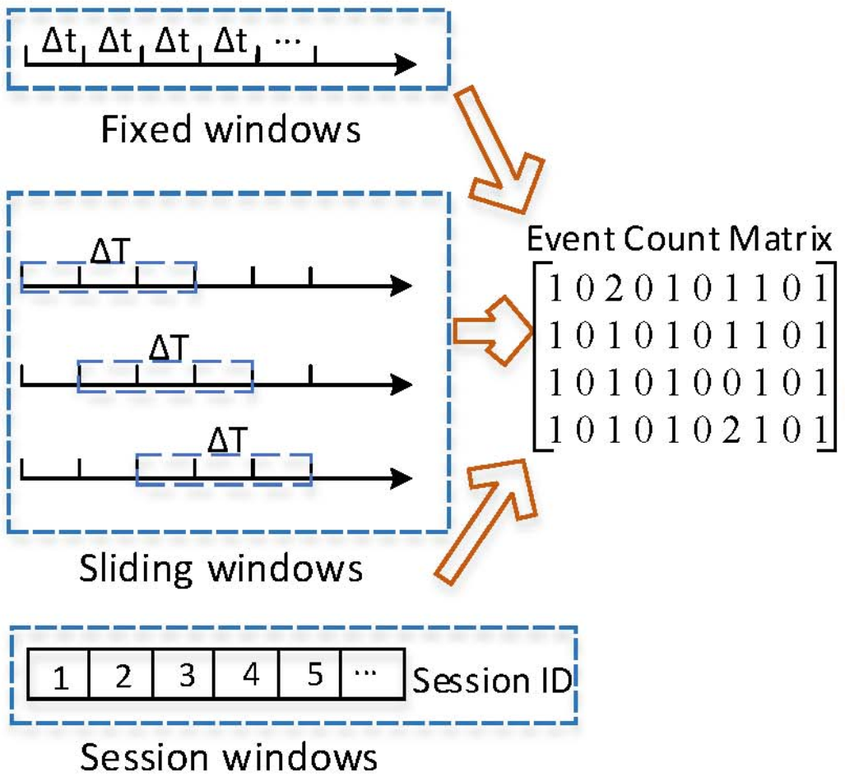
Anomaly Detection Overview
Log Parsing
Feature Extraction
Model Train and Predict
Train
Train Data (ECM)
Train Data (Logs)
Persist model para for further use
Test Data (Logs)
Predict
Test Data (ECM)
Output

Slide 24
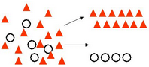
An Example of How ML (say, Decision Tree) Works
Classification
Iris class: -- Iris Setosa -- Iris Versicolour -- Iris Virginica
Sepal_len_cm | Sepal_wid_cm | Petal_len_cm | Petal_wid_cm | Class
5.1 | 3.5 | 1.4 | 0.2 | Iris-setosa
4.9 | 3 | 1.4 | 0.2 | Iris-setosa
4.7 | 3.2 | 1.3 | 0.2 | Iris-setosa
4.6 | 3.1 | 1.5 | 0.2 | Iris-setosa

Slide 25
Two Graphic Boxes Treatment
Subtitle
First level bullet
First level bullet
Second level Bullet
Third level Bullet
Subtitle
First level bullet
First level bullet
Second level Bullet
Third level Bullet

Slide 26
Three Graphic Boxes Treatment
Subtitle
First level bullet
First level bullet
Second level Bullet
Third level Bullet
Subtitle
First level bullet
First level bullet
Second level Bullet
Third level Bullet
Subtitle
First level bullet
First level bullet
Second level Bullet
Third level Bullet

Slide 27
Four Graphic Boxes Treatment
Subhead Line 1
Subhead Line 2
First level bullet
First level bullet
Second level Bullet
Third level Bullet
Subhead Line 1
Subhead Line 2
First level bullet
First level bullet
Second level Bullet
Third level Bullet
Subhead Line 1
Subhead Line 2
First level bullet
First level bullet
Second level Bullet
Third level Bullet
Subhead Line 1
Subhead Line 2
First level bullet
First level bullet
Second level Bullet
Third level Bullet

Slide 28

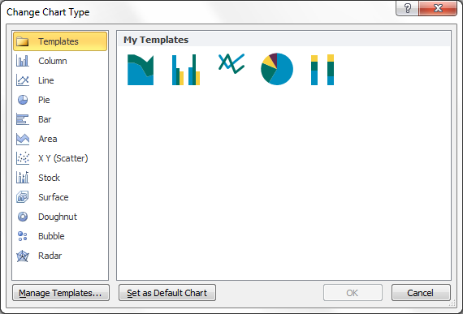
Pie Chart Example
Applying Broadcom Standard Chart Template
Click the chart that you want to apply template. This displays the Chart Tools, adding the Design, Layout, and Format tabs.
On the Design tab, in the Type group, click Change Chart Type.
In the Change Chart Type dialog box, click Template folder, and then select a chart template that you want to use.
Source: Xxxxxxx

Slide 29
Clustered Column Chart Example
Source: Xxxxxxx

Slide 30
Stacked Column Chart Example
Source: Xxxxxxx

Slide 31
Line Chart Example
Source: Xxxxxxx

Slide 32
Area Chart Example
Source: Xxxxxxx

Slide 33
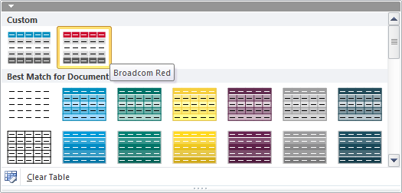

Table Example
Applying Broadcom Standard Table Template
Click the table that you want to apply template. This displays the Table Tools, adding the Design and Layout tabs.
On the Design tab, in the Table Styles group, click the Broadcom Red table style.
In the Table Style Options group, check (uncheck) the options to turn on (off) the following row styles.
1
Header Row
Description | 2011 | 2012 | 2013
Item 1 | xxx | xxx | xxx
Item 2 | xxx | xxx | xxx
Item 3 | xxx | xxx | xxx
Item 4 | xxx | xxx | xxx
Item 5 | xxx | xxx | xxx
Item 6 | xxx | xxx | xxx
Item 7 | xxx | xxx | xxx
Item 8 | xxx | xxx | xxx
Total | xxx | xxx | xxx
3
Banded Rows (Alternate Fill)
1
2
2
Total Row
3

Slide 34
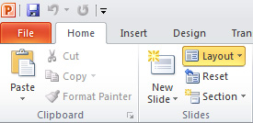
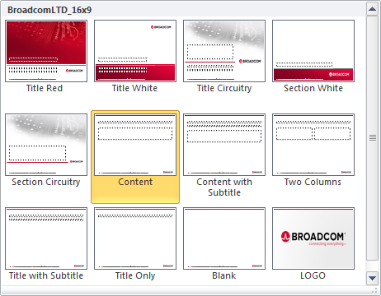

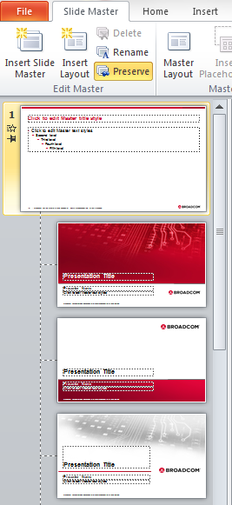

Adding Slides and Adjusting Layouts
Adding Existing Slides to the Template
Copy your slide(s) from your old presentation in Slide Sorter view.
Paste slide(s) into the new Broadcom template presentation.
Immediately after pasting the slide(s), look for the Paste Options button (located near the lower right corner of the pasted slide). Always select “Use Destination Theme.”
Applying Slide Layouts
Slides copied from another presentation may need to be adjusted by applying different slide layouts.
On the Home tab, choose Layout to view slide layout options. Or right-click anywhere on the slide and select Layout. Click on the most appropriate layout to apply formatting to the current or new slide.
Updating the Slide Footer
On the View tab, select Slide Master.
In the left task pane, scroll up to the first master slide. Select the text box to edit and retype. This change will affect all layouts.
Click on Close Master View to return to normal slide view.

Slide 35
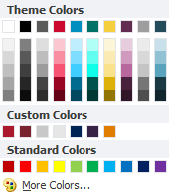
PowerPoint Color Palette Details
Theme/Primary Colors and variations for general usage in the presentation
White
Black
Gray
Red
Blue
Teal
Gold
Purple
Gray
Dark Teal
R G B
255
255
255
R G B
0
0
0
R G B
90 90 90
R G B
204 9 47
R G B
0
143191
R G B
0 113 103
R G B
246 207 63
R G B
98 45 80
R G B
158
158
159
R G B
36 76 90
Custom Brand Colors that may be used to augment Theme Colors
Red 187
Red 188
Gray 6
Gary 2
Secondary Colors
R G B
171 25 45
R G B
12136
47
R G B
200200 200
R G B
230
230 230
Secondary Colors
Blue 655
Purple 7448
Gold 138
Tertiary Colors
Tertiary Colors
R G B
0 37 84
R G B
56 34 70
R G B
255 125 0

Slide 36


Broadcom Chip Template
Use the Pulse Symbol Alone on Chip to Represent Corporate or Product Branding
Regular
Featured/Special Attention
BCM12345
BCM12345
Name
BCM12345
BCM12345
Name
BCM12345
BCM12345
Name
BCM12345
BCM12345
Name

Slide 37




Broadcom Logo Guidelines
The primary logo should be no smaller than 0.75 inches or 100 pixels wide
The primary logo should be no smaller than 0.75 inches or 100 pixels wide
The alternate logo with tagline should be no smaller than 1 inch
or 175 pixels wide
The alternate logo with tagline should be no smaller than 1 inch
or 175 pixels wide

Slide 38

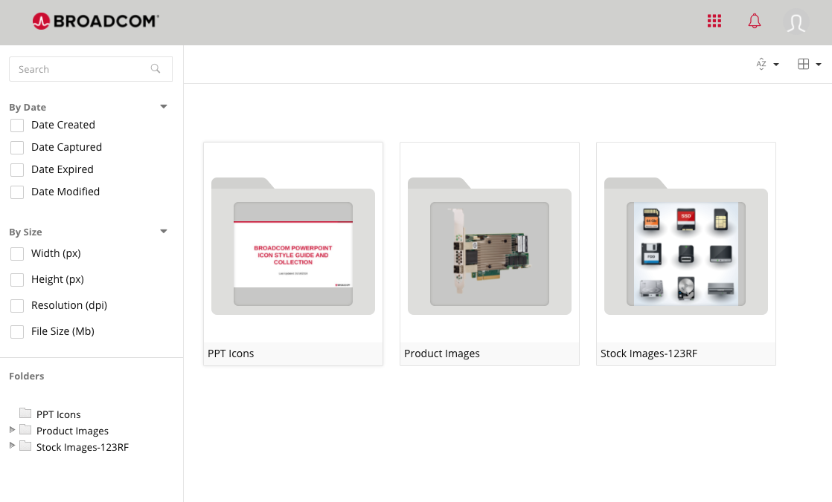
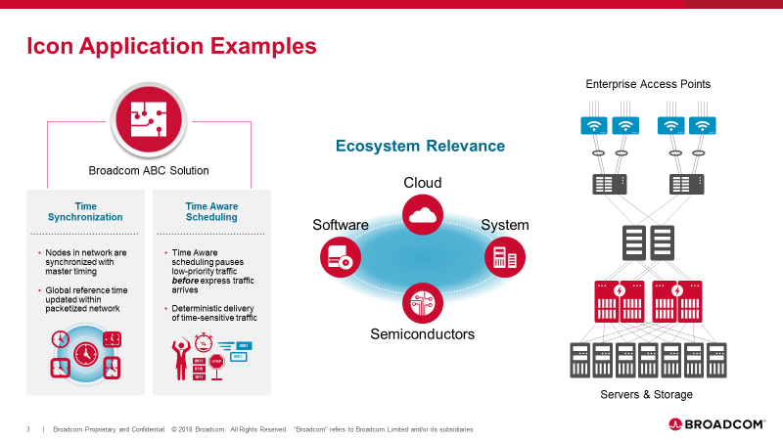
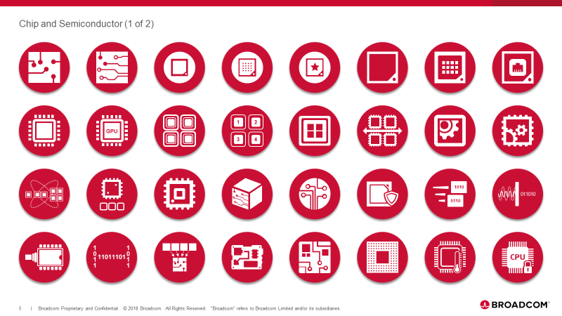
Broadcom PowerPoint Icon Library
Editable, Scalable and PowerPoint-Ready Icons
Okta > Broadcom Image Library > PPT Icons

