Slide 1
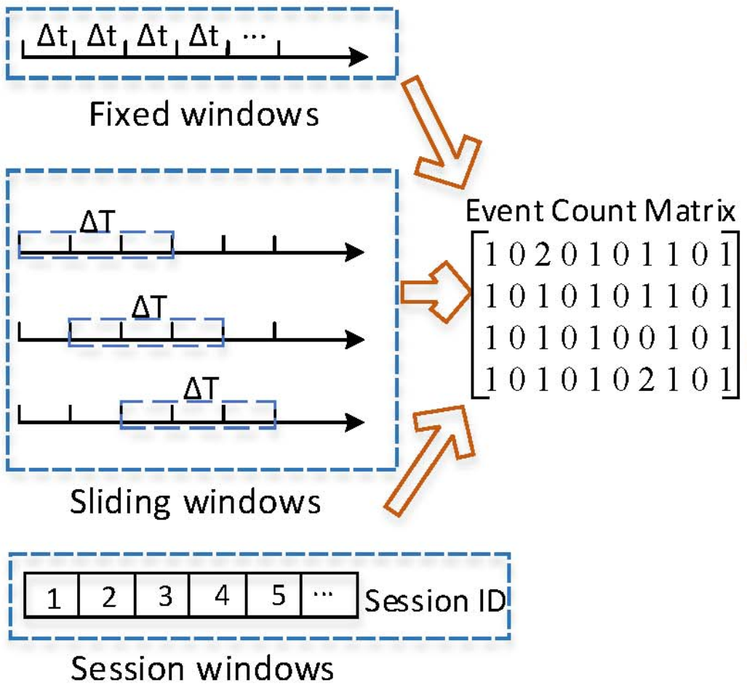
Pre Processing
Clustering
Feature Extraction
Model Train and Predict
Post Processing
Train Data
(Templates,
Structured logs)
Train
Train Data (raw logs with labels)
Train Data (norm logs)
Train Data (ECM)
Persist model para for further use
Map the anomaly to the timestamp window, etc.
Train Data (Labels vector)
Test Data
(Templates,
Structured logs)
Predict
Test Data (raw logs)
Test Data (norm logs)
Test Data (ECM)
Predict Output

Slide 2
A Batch of Logs
Drain Tree
Template Library

Slide 3
Pre Processing
Clustering
Knowledgebase build & retrieve
Post Processing
Extract the useful templates from library manually
Knowledge base
Train Data (raw logs)
Train Data (norm logs)
Train Data
(Templates,
Structured logs)
Build the knowledge
Retrieve Result
Collect the wrong logs info, etc.
Test Data (raw logs)
Test Data (norm logs)
Test Data
(Templates, Structured logs)

Slide 4
Log Generator
Console Tool
Log File
Sampler
Pre Processing
Clustering
Predict or Process in OSS
Log Producing System
Logs
Sampler
Pre Processing
Clustering
Predict or Process in OSS

