Slide 1
Features Shaping Attitudes Towards Covid-19
May 17, 2021
BUS288: Business Analytics
Hayk Mkhitaryan
Artur Aloyan
Instructor: Dr Hrant Davtyan

Slide 2
Overview
Illustrate the common features of individuals disregarding the seriousness of the recent pandemic, with the application of machine learning techniques
Recommend policies to raise awareness and combat the issues related with non-adherence of restrictions
Target Audience:
Governments; Policy Makers; Researchers; Psychologists

Slide 3



Main Hypotheses
Hypothesis 1
Hypothesis 2
Hypothesis 3
Education level: positive
Government Trust: Positive
Age: Positive

Slide 4
Data - Validation & Methodology
DataSet (8427 obs.) from CRRC Armenia
Data Cleansing; Comparison of the means
Proxy Dependent Variable - Public Response
Models : Logistics Regression; Decision Tree; Random Forest

Slide 5

Main Findings
Hypothesis
H:1 - Confirmed
H:2 - Confirmed
H:3 - Not Rejected
Best Model
Logistic Regression
Overfitting Test (Train-test split)
The test revealed almost no differences between performances (confusion matrix)
Probability Cut-Off
Optimal - 60%

Slide 6
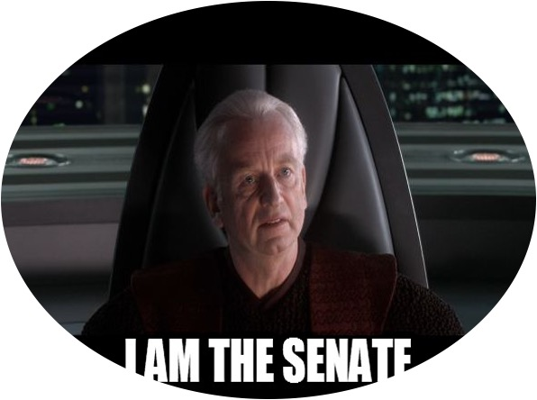


Policy Recommendation
Education
Governments
Economic Recessions
Educate people and stay away from trouble!
Honest, Transparent and Consistent Communication
Educate People about the Economic Side of the Pandemic to make them MORE Risk- Averse

Slide 7
THANK YOU

