Slide 1

The Impact of Growing Government Debt on Economic Growth
Special Topics in Economics
Student: Hayk Mkhitaryan
Instructor: Aleksandr Grigoryan

Slide 2
The Impact of Growing Government Debt on Economic Growth
Table of Contents
Introduction of the paper
Background Information & Data
Graphical Illustrations
Econometric Model & Methodology
Estimation
Discussion/Recommendation
Conclusion

Slide 3
The Impact of Growing Government Debt on Economic Growth
Introduction
Main research question: Are the short-term and long term impacts of increasing government debt significant on Armenian gross domestic product growth?
Hypothesis 1: The cumulative estimated short-term coefficient of lagged variables of debt is zero on level of confidence.
Hypothesis 2: The cumulative estimated long-term coefficient of lagged variables of debt is zero on level of confidence.
Hypothesis 3: There is statistically significant causality on Armenian economic growth and Russian economic growth.

Slide 4
The Impact of Growing Government Debt on Economic Growth
Data
Main data sources:
Financial Statistics of International Monetary Fund
Statistical Committee of Armenia
Data:
Quarterly time series data, from 2000 to 2019
Growth rate of Arm. GDP, Growth rate of Russian GDP, Growth rate of debt

Slide 5
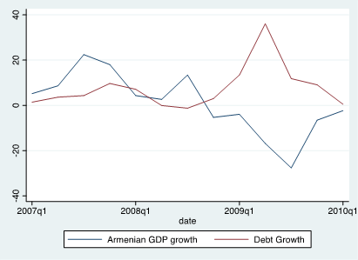
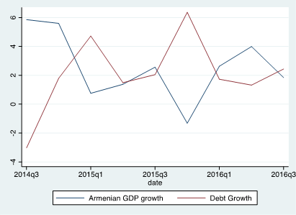
The Impact of Growing Government Debt on Economic Growth
Graphs

Slide 6
The Impact of Growing Government Debt on Economic Growth
Econometric Model and Methodology
Quarterly Percentage Growth forms
Dickey-Fuller Tests
ARDL Model

Slide 7
The Impact of Growing Government Debt on Economic Growth
Estimation
Table 4. | Model1 | Model 2 | Model 3 | Model 4 | Final Model
Lags | (4,0,0) | (8,3,1) | (8,8,1) | (3,12,0) | (4,12,0,0)
Adjuted R2 | 0.55 | 0.69 | 0.68 | 0.59 | 0.62
H:1 | Uncertain | Rejected | Rejected | Uncertain | Rejected
H:2 | Uncertain | Uncertain | Not Rejected | Not Rejected | Not Rejected
H:3 | Rejected | Rejected | Rejected | Rejected | Rejected

Slide 8
The Impact of Growing Government Debt on Economic Growth
Discussion/Recommendations
Hypothesis I (Short-Term): Rejected
Hypothesis II (Long-Term): Not Rejected
Hypothesis III (Zero Interdependence): Rejected
Data Limitation of 20 years/Bias

Slide 9
The Impact of Growing Government Debt on Economic Growth
Discussion/Recommendations (cont.)
Ministry of Finance projected debt/GDP ratio 0.67 by the end of 2021
$500 million dollars were raised through Eurobonds
Dependence on debt is inevitable

Slide 10
The Impact of Growing Government Debt on Economic Growth
Conclusion
Debt have effect on growth in short run, and no effect in long run
Optimized government spendings should trigger higher growth
Government spendings should be directed to economically productive projects

