Slide 1
Practical Assignment 5
By Hayley Dodkins, Jessica Bloem, Mihail Dicoski, Thando Dlamini, Tinotenda Gwanyanya, Precious Nhlapho and Kumbi Shonhiwa

Slide 2
Task 1: Research

Slide 3
History of Wine
Wine is made from fermented grape juice, however it is an alcoholic beverage that has been drunk and made in different parts of the world. The history of wine dates back to over 5000 years ago.
Its discovery is said to have been uncovered when grapes had been left for too long in amphorae or earthenware jugs. They would soon become tainted with wild yeast, eventually leading to their fermentation, brave individuals would then proceed to drink the tainted grapes leading to the creation of wine.

Slide 4
History of Wine
What is the 100-point scale?
The 100-point scale was popularized by Wine Spectator magazine and by Robert Parker in his Wine Advocate newsletter.
Getting a rating from this scale, has been said to either make or break a wine brand, due to the prestige that the scale holds. Most wines that are evaluated using this scale normally fall into he 85-100 points.
The scale is based on the American high-school marking system, so the scale will start at 50 and not 0, leading to additional criticism. There are other point scales such as the 5-point scale, the 20-point scale however the 100-point scale is the most popular.

Slide 5
Types of Wine
Red Wine
Made from black grapes fermented with the grape skin, seed and stems (Jordan, 2019). The red colour comes from the grape skin.
Red wine is high in tannins which is why it has a bitter and dry taste (Gillen, 2022).
Red wine is best had at or slightly below room temperature since if the wine is chilled the tannins in the wine can become bitter.
The darker or newer the wine the more tannins it contains so an older wine will taste less dry and bitter (Gillen, 2022).
Red wine is best paired with wholesome foods (Gillen, 2022) such as pizza, red meat and pasta.

Slide 6
Types of Wine
White Wine
Made from both white and black grapes that are fermented without the grape skins (Jordan, 2019) so only the clear grape juice is used.
White wine is low in tannins (Gillen, 2022) making it more acidic with a tart flavor. White wine is best has chilled to bring out its flavours.
White wine pairs best with light dishes (Gillen, 2022) such as chicken, seafood and salads.
Rose Wines
Made from black grapes that are fermented with the skins for a brief period before removing the skins to create its pink colour (Jordan, 2019). Rose is low in tannins but some rose can be dry (Jordan, 2019).
It has a light and sweet flavour. Rose is best paired with light dishes and appetizers such as seafood, fruit, cheese and poultry.

Slide 7
Types of Wine
Sparkling Wines
Sparkling wines are carbonated wines made from black and white grapes (Gillen, 2022) where the carbon dioxide creating the carbonated wine is naturally occurring due to the fermentation (Jordan, 2019). Best paired with light foods such as cheeses, seafood and fruit.
Desert Wines
Dessert wines are sweet wines that are had after a meal sometimes as a dessert. Best paired with a dessert such as a cheesecake, pudding or crème brulee.

Slide 8
Types of Wine
Fortified Wine
Fortified wines contain spirits which are added during the fermentation process (Jordan, 2019). These wines are sweetened by alcohol and can be used as dessert wines. Due to the added spirit these wines tend to have a higher alcohol percentage and are paired well with baked goods such as tarts, cheese and other desserts.
Orange Wine
Made with white grapes fermented with the skin on giving it an orange colour . This means that orange wine does have tannins but still maintains the crisp taste of a white wine. Served at a slightly warmer temperature than a white wine and pairs well with hearty dishes such as pork or beef (Gillen, 2022).

Slide 9
What Is a Wine Varietal?
A wine varietal is a wine made with one variety of grapes, such as pinot noir, chardonnay, and cabernet sauvignon (Wines, 2023).
Different types of wine such as red wine, white wine, sparkling wine, and dessert wine are not varietals, but varietals exist within these categories.
In some wine-producing regions, a varietal has the same name as the grape it's made from such as Syrah which is a varietal made from Syrah grapes. This is a common naming convention in North America, Australia, and South America.
In more traditional wine regions, such as France and Italy, varietals’ names come from where winemakers produce the drink instead of the grape variety. A Burgundy wine, made in the French wine region, contains Pinot Noir grapes.

Slide 10
Wine Varietals vs. Wine Blends
Wines that are made from two or more types of grapes that don't meet the varietal threshold are blends.
For example, a Bordeaux blend usually contains cabernet sauvignon, merlot, Malbec, and Petit Verdot.
There are an estimated 10,000 varieties of wine grapes grown around the world (Vineyard, 2023).

Slide 11
Red Wine Varietals
1. Cabernet sauvignon:
This varietal is high in tannins and has peppery and fruity notes (Puckette, n.a).
2. Malbec:
This varietal has hints of blackberry, plum, cloves, and pepper. Malbec grapes originated in France but are the predominant variety in Argentina (Critic, 2023).
3. Merlot:
Merlot wines have deep fruity flavors such as blackberry, plum, black cherry, and black currant. In warm climates like Chile, merlots tend to have a higher alcohol content (Critic, 2023).
4. Pinot noir:
This red wine has notes of red fruit, such as strawberry, cherry, and cranberry. Pinot noir is a versatile grape variety that winemakers also used to make white wine, rosé wine, and sparkling wine (Puckette, n.a).
5. Sangiovese:
Sangiovese varietals have hints of raspberry and licorice. Producers commonly blend the black Sangiovese grape with other varietals in Chianti, an Italian Tuscan wine blend (Critic, 2023).
6. Syrah:
This red grape goes by ”Syrah” in the French Rhône Valley and “Shiraz” in Australia. Due to regional differences, syrahs from Italy and France are more acidic and have earthy tones with herbaceous aromas. New World syrahs tend to be fruit-forward with hints of spice (Puckette, n.a).
7. Zinfandel:
Fruity and spicy with strawberry, raspberry, cherry, and blackberry notes, zinfandel is both a red wine and a sweet rosé. Some winemakers also produce white zinfandel (Puckette, n.a).

Slide 12
White Wine Varietals
1. Chardonnay:
This full-bodied varietal has hints of pear, apple, tropical fruit, and vanilla. Wine producers make chardonnay in many parts of the world, though its roots trace to Burgundy (Puckette, n.a).
2. Chenin blanc:
This grape variety originated in the Loire Valley in France and has citrus and floral notes. Producers also make Chenin blanc in South Africa and California (Zhang, 2023).
3. Muscat:
In Italian, the Muscat family of grapes goes by “Moscato.” Moscato is a fruity, sweet wine with notes of peach, nectarine, and orange. The Piedmont region in Italy produces Moscato wines (Zhang, 2023).
4. Pinot grigio:
Fresh and zesty, this varietal is also known as pinot gris. It originated in Burgundy and has pear, peach, and apricot notes (Puckette, n.a).
5. Riesling:
Highly acidic with fruit flavors such as nectarine, apple, and pear, this white grape originated in the Rhine region of Germany (Puckette, n.a).
6. Sauvignon blanc:
Fresh and crisp, with high levels of acidity, sauvignon blanc has notes of grapefruit, white peach, and passion fruit. In California, it's sometimes called fumé blanc because of oak aging in the winemaking process (Puckette, n.a).
7. Viognier:
This aromatic, full-bodied varietal has hints of rose petal, tangerine, and citrus. While Viognier is grown in North America and New Zealand, it originated in the Rhone Valley and is the only grape used in Condrieu wine (Zhang, 2023).

Slide 13
Wine Regions
South Africa is know to produce some of the most unique wines due to its soil resulting in bold red and white wines.
Most South African wines come from the Western Cape with the exception of Lower Orange River and Douglas in the Northern Cape (Folly, n.d).
The Western Cape has a hot climate making it a great location to produce bold red wines such as Syrah, Pinotage, and Cabernet.
The cooler climate found in the Cape South Coast is great for the production of Chardonnay and Sémillon.
Wine regions in the Western Cape include Stellenbosch, Paarl, and Swartland (Folly, n.d).

Slide 14
Information for A Wine Tourist
What is wine tourism?
Also known as enotourism and vinitourism, it is a branch of food tourism which is primarily focused on wine and its consumption.
It is all about getting to know about different types of wine around the world, learning about it as you are traveling.
There are a multitude of activities that a wine tourist would partake in, one of them being vineyard and winery tours, which are meant to show tourists the how wine is produced and to taste the wine.

Slide 15
Information for A Wine Tourist
The Benefits of wine tourism
Wine tourism has brought a massive positive impact on the wine industry, becoming a source of alternative income, helping winemakers and wineries to become more profitable.
It has also become a place to allow people who share their passion with people who will appreciate it.
It has become a place for people to experience new and different wines and provided a platform for people to visit different wineries from their regulars.
It has also provide the opportunity for people to learn more about wine, winemaking and wineries.

Slide 16
Bibliography for Research
Gillen, K. (2022, 07 26). 7 Types of Wine to Know (Even If You’re Just a Casual Drinker). Retrieved from Pure Wow: https://www.purewow.com/food/types-of-wine [Accessed 15 May 2023].
Jordan, D. (2019, 01 21). Wine 101: What Are the Different Types of Wine? Retrieved from corkbeard: https://corkbeard.com/blogs/news/wine-101-what-are-the-different-types-of-wine [Accessed 15 May 2023].
Virgin Wines. (n.d.). Quick Guide to Red Wine. Retrieved from Virgin Wines: https://www.virginwines.co.uk/hub/wine-guide/wine-basics/quick-guide-to-red-wine/ [Accessed 15 May 2023].
Critic, V. (n.d). Red Wine Types. Retrieved from Vino Critic: https://vinocritic.com/category/types-of-wine/red-wine-types/ [Accessed 15 May 2023].
Folly, W. (n.d). WINE REGIONS. Retrieved from Wine Folly: https://winefolly.com/wine-regions/south-africa/ [Accessed 15 May 2023].
Puckette, M. (n.d). Common Types of Wine (the top varieties). Retrieved from Wine Folly: https://winefolly.com/deep-dive/common-types-of-wine/ [Accessed 15 May 2023].
Vineyard, O. E. (n.d). Understanding the 10 most popular wine grape varieties. Retrieved from Oastbrook Estate Vineyard: https://oastbrook.com/blog/sharing-the-knowledge/understanding-the-10-most-popular-wine-grape-varieties/#:~:text=Wine%20grapes%20are%20one%20of,the%20most%20popular%20grape%20varieties. [Accessed 15 May 2023].
Wikipedia. (n.a). South African wine. Retrieved from Wikipedia: https://en.wikipedia.org/wiki/South_African_wine#:~:text=The%20seven%20wards%20of%20Stellenbosch,%2C%20Merlot%2C%20Pinotage%20and%20Shiraz [Accessed 15 May 2023].
Wines. (n.d). WINE VARIETALS A-Z. Retrieved from Wines: https://www.wines.com/wine-varietals/ [Accessed 15 May 2023].
Zhang, A. (n.d). 20 Most Popular White Wine Grapes in the World. Retrieved from Vino Vest: https://www.vinovest.co/blog/white-wine-grapes [Accessed 15 May 2023].
Wine Folly. (2016). Reality of Wine Prices (What You Get For What You Spend). [online] Available at: https://winefolly.com/lifestyle/reality-of-wine-prices-what-you-get-for-what-you-spend/ [Accessed 15 May 2023]. [Accessed 15 May 2023].
Wine-Searcher. (n.d.). What are Wine Scores? [online] Available at: https://www.wine-searcher.com/wine-scores [Accessed 15 May 2023].
Foodandroad (2021). What Is Wine Tourism: How To Travel To The World Of Wine. [online] Food’n Road. Available at: https://foodandroad.com/what-is-wine-tourism/ [Accessed 15 May 2023].
www.streetdirectory.com. (n.d.). An Overview Of Wine. [online] Available at: https://www.streetdirectory.com/food_editorials/beverages/wine/an_overview_of_wine.html [Accessed 15 May 2023].

Slide 17
Task 2: ER-Diagram

Slide 18
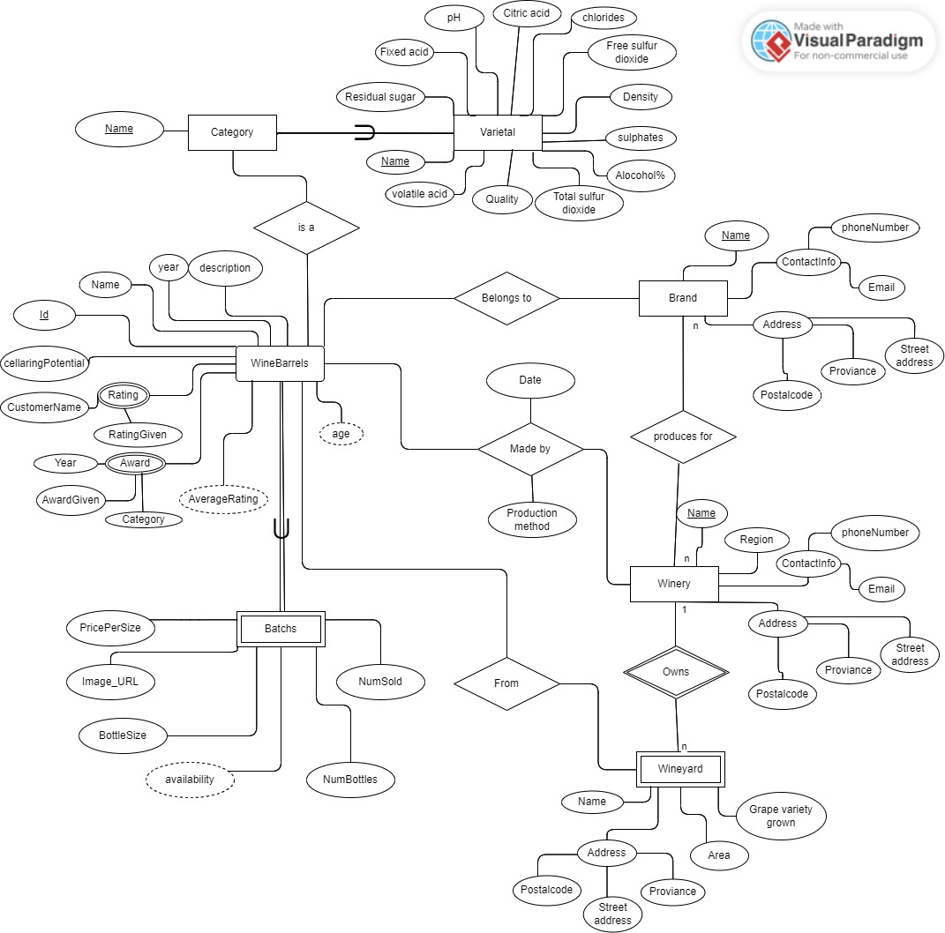

Slide 19
Task 3: ER-Diagram to Relational Mapping

Slide 20
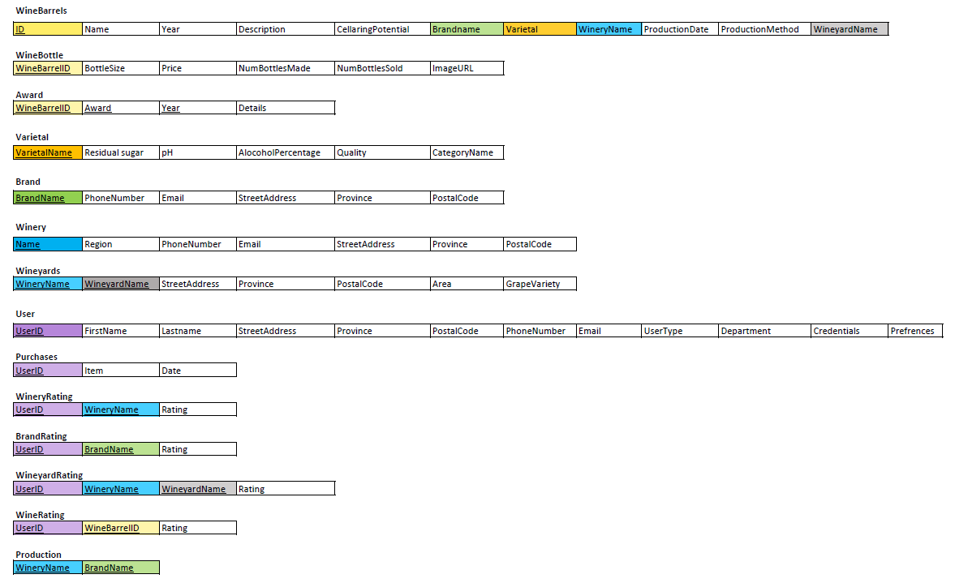

Slide 21
Task 4: Relational Schema

Slide 22
WineBarrels Table
CREATE TABLE WineBarrels(
ID int(11) UNSIGNED NOT NULL AUTO_INCREMENT,
Name VARCHAR(128) NOT NULL,
Year DATE NOT NULL,
Description VARCHAR(288) NOT NULL,
Cellaring_Potential DATE NOT NULL,
Brand_Name VARCHAR(128) NOT NULL,
Varietal VARCHAR(128) NOT NULL,
Winery_Name VARCHAR(128) NOT NULL,
Production_Date DATE NOT NULL,
Production_Method VARCHAR(128) NOT NULL,
Wineyard_Name VARCHAR(128) NOT NULL,
PRIMARY KEY (ID),
CONSTRAINT `fk_WineBarrels_Brand`FOREIGN KEY(Brand_Name) REFERENCES Brand(Name) ON DELETE RESTRICT ON UPDATE CASCADE,
CONSTRAINT `fk_WineBarrels_Varietal`FOREIGN KEY(Varietal) REFERENCES Varietal(Varietal_Name) ON DELETE RESTRICT ON UPDATE CASCADE,
CONSTRAINT `fk_WineBarrels_Winery`FOREIGN KEY(Winery_Name) REFERENCES Winery(Name) ON DELETE RESTRICT ON UPDATE CASCADE)
ENGINE=InnoDB DEFAULT CHARSET=utf8mb4;

Slide 23
Bottle Table
CREATE TABLE Bottle(
Wine_Barrel_ID INT(11) UNSIGNED NOT NULL,
Bottle_Size SET("500ml","750ml","1000ml") NOT NULL DEFAULT "750ml",
Price DECIMAL UNSIGNED NOT NULL DEFAULT 199.99,
Num_Bottles_Made INT UNSIGNED NOT NULL DEFAULT 0, Image_URL VARCHAR(128) NOT NULL DEFAULT "https://upload.wikimedia.org/wikipedia/commons/1/14/No_Image_Available.jpg?20200913095930",
PRIMARY KEY(Wine_Barrel_ID),
CONSTRAINT `fk_Bottle_WineBarrels` FOREIGN KEY(Wine_Barrel_ID) REFERENCES WineBarrels(ID) ON DELETE RESTRICT ON UPDATE CASCADE,
CONSTRAINT `check_Bottle_Size` CHECK(Bottle_Size IN("500ml","750ml","1000ml")),
CONSTRAINT `check_Price` CHECK(Price BETWEEN 100.00 AND 400.00).
CONSTRAINT`check_NumBottles_Made` CHECK(Num_Bottles_Made BETWEEN 0 AND 900000))
ENGINE=InnoDB DEFAULT CHARSET=utf8mb4;

Slide 24
Brand Table
CREATE TABLE Brand(
Name VARCHAR(128) NOT NULL,Phone_Number VARCHAR(9) NOT NULL UNIQUE,
Email VARCHAR(128) NOT NULL UNIQUE,
Street_Address VARCHAR(128) NOT NULL,
Province SET("Eastern Cape","Free State", "Gauteng","KwaZulu-Natal","Limpopo","Mpumalanga","Northern Cape","North West","Western Cape") NOT NULL,
Postal_Code VARCHAR(4) NOT NULL,
PRIMARY KEY(Name))
ENGINE=InnoDB DEFAULT CHARSET=utf8mb4;

Slide 25
Varietal Table
CREATE TABLE Varietal(
Varietal_Name VARCHAR(128) NOT NULL,
Residual_Sugar DECIMAL NOT NULL,
pH DECIMAL NOT NULL,
Alcohol_Percentage DECIMAL NOT NULL,Quality INT(2) NOT NULL DEFAULT 5,
Category_Name VARCHAR(128) NOT NULL,PRIMARY KEY(Varietal_Name),
CONSTRAINT `check_Quality` CHECK(Quality BETWEEN 0 AND 10))
ENGINE=InnoDB DEFAULT CHARSET=utf8mb4;

Slide 26
Winery Table
CREATE TABLE Winery(
Name VARCHAR(128) NOT NULL,
Region SET("Eastern Cape","Free State", "Gauteng","KwaZulu-Natal","Limpopo","Mpumalanga","Northern Cape","North West","Western Cape") NOT NULL,
Phone_Number VARCHAR(9) NOT NULL UNIQUE,
Email VARCHAR(128) NOT NULL UNIQUE,Street_Address VARCHAR(128) NOT NULL,
Province SET("Eastern Cape","Free State", "Gauteng","KwaZulu-Natal","Limpopo","Mpumalanga","Northern Cape","North West","Western Cape") NOT NULL,
Postal_Code VARCHAR(4) NOT NULL,PRIMARY KEY(Name),
CONSTRAINT `check_Province` CHECK(Province IN("Eastern Cape","Free State", "Gauteng","KwaZulu-Natal","Limpopo","Mpumalanga","Northern Cape","North West","Western Cape")),
CONSTRAINT `check_postal_code` CHECK(Postal_Code BETWEEN 0000 AND 9999),
CONSTRAINT `check_Region` CHECK(Region IN("Eastern Cape","Free State", "Gauteng","KwaZulu-Natal","Limpopo","Mpumalanga","Northern Cape","North West","Western Cape")))
ENGINE=InnoDB DEFAULT CHARSET=utf8mb4;

Slide 27
Award Table
CREATE TABLE Award(Wine_Barrel_ID INT(11) DEFAULT NULL,
Award VARCHAR(128) NOT NULL,
Year YEAR DEFAULT NULL,Details VARCHAR(288) NOT NULL,
PRIMARY KEY(Wine_Barrel_ID,Award,Year),
CONSTRAINT `fk_Award_WineBarrels`FOREIGN KEY(Wine_Barrel_ID) REFERENCES WineBarrels(ID) ON DELETE RESTRICT ON UPDATE CASCADE)
ENGINE=InnoDB DEFAULT CHARSET=utf8mb4;

Slide 28
Wineyards Table
CREATE TABLE Wineyards(
Winery_Name VARCHAR(128) NOT NULL,
Wineyard_Name VARCHAR(128) NOT NULL,
Street_Address VARCHAR(128) NOT NULL,
Province SET("Eastern Cape","Free State", "Gauteng","KwaZulu-Natal","Limpopo","Mpumalanga","Northern Cape","North West","Western Cape") NOT NULL,
Postal_Code VARCHAR(4) NOT NULL,
Area VARCHAR(128) NOT NULL,Grape_Variety VARCHAR(128) NOT NULL,
PRIMARY KEY(Winery_Name,Wineyard_Name),
CONSTRAINT `fk_Wineyard_Winery`FOREIGN KEY(Winery_Name) REFERENCES Winery(Name) ON DELETE RESTRICT ON UPDATE CASCADE,
CONSTRAINT `check_Province` CHECK(Province IN("Eastern Cape","Free State", "Gauteng","KwaZulu-Natal","Limpopo","Mpumalanga","Northern Cape","North West","Western Cape")),
CONSTRAINT `check_postal_code` CHECK(Postal_Code <= 9999))
ENGINE=InnoDB DEFAULT CHARSET=utf8mb4;

Slide 29
User Table
CREATE TABLE User(
User_ID int(11) AUTO_INCREMENT NOT NULL,
First_Name VARCHAR(128) NOT NULL,
Last_Name VARCHAR(128) NOT NULL,
Phone_Number VARCHAR(9) NOT NULL UNIQUE,
Email VARCHAR(128) NOT NULL UNIQUE,
Street_Address VARCHAR(128) NOT NULL,
Province SET("Eastern Cape","Free State", "Gauteng","KwaZulu-Natal","Limpopo","Mpumalanga","Northern Cape","North West","Western Cape") NOT NULL,Postal_Code VARCHAR(4) NOT NULL,
User_Type SET("Customer","Manager","Critic"),Department VARCHAR(128) DEFAULT NULL,Credentials VARCHAR(128) DEFAULT NULL,Preferences VARCHAR(128) DEFAULT NULL,
PRIMARY KEY(User_ID),
CONSTRAINT `check_Province` CHECK(Province IN("Eastern Cape","Free State", "Gauteng","KwaZulu-Natal","Limpopo","Mpumalanga","Northern Cape","North West","Western Cape")),
CONSTRAINT `check_postal_code` CHECK(Postal_Code <= 9999),
CONSTRAINT `check_user_type` CHECK(User_Type IN("Customer","Manager","Critic")))
ENGINE=InnoDB DEFAULT CHARSET=utf8mb4;

Slide 30
Purchases and WineryRating Tables
CREATE Purchases TABLE(
User_ID int(11) NOT NULL,
Item VARCHAR NOT NULL DEFAULT "WINE",
Date_of_Purchase DATE NOT NULL,
CONSTRAINT`fk_Purchases_User` FOREIGN KEY(User_ID) REFERENCES User(User_ID) ON DELETE RESTRICT ON UPDATE CASCADE)
ENGINE=InnoDB DEFAULT CHARSET=utf8mb4;
CREATE TABLE WineryRating(
User_ID int(11) NOT NULL,
Winery_Name VARCHAR(128) NOT NULL,
Rating int(2) NOT NULL DEFAULT 5,
PRIMARY KEY(User_ID,Winery_Name),
CONSTRAINT `fk_WineryRating_Winery`FOREIGN KEY(Winery_Name) REFERENCES Winery(Name) ON DELETE RESTRICT ON UPDATE CASCADE,
CONSTRAINT `fk_WineyRating_User`FOREIGN KEY(User_ID) REFERENCES User(User_ID) ON DELETE RESTRICT ON UPDATE CASCADE,
CONSTRAINT `check_rating` CHECK(Rating BETWEEN 0 AND 10))
ENGINE=InnoDB DEFAULT CHARSET=utf8mb4;

Slide 31
WineyardRating Table
CREATE TABLE WineyardRating(
User_ID int(11) NOT NULL,
Winery_Name VARCHAR(128) NOT NULL,
Wineyard_Name VARCHAR(128) NOT NULL,
Rating int(2) NOT NULL DEFAULT 5,
PRIMARY KEY(User_ID,Winery_Name),
CONSTRAINT `fk_WineyardRating_User`FOREIGN KEY(User_ID) REFERENCES User(User_ID) ON DELETE RESTRICT ON UPDATE CASCADE,
CONSTRAINT `fk_WineyardRating_Winery`FOREIGN KEY(Winery_Name) REFERENCES Winery(Name) ON DELETE RESTRICT ON UPDATE CASCADE,
CONSTRAINT `fk_WineyardRating_Wineyard`FOREIGN KEY(Wineyard_Name) REFERENCES Wineyards(Wineyard_Name) ON DELETE RESTRICT ON UPDATE CASCADE,
CONSTRAINT `check_rating` CHECK(Rating BETWEEN 0 AND 10))
ENGINE=InnoDB DEFAULT CHARSET=utf8mb4;

Slide 32
WineRating and Production Tables
CREATE TABLE WineRating(
User_ID int(11) NOT NULL,
WineBarrel_ID int(11) UNSIGNED NOT NULL AUTO_INCREMENT,
Rating int(2) NOT NULL DEFAULT 5,
PRIMARY KEY(User_ID,WineBarrel_ID),
CONSTRAINT `fk_WineRating_User`FOREIGN KEY(User_ID) REFERENCES User(User_ID) ON DELETE RESTRICT ON UPDATE CASCADE,
CONSTRAINT `fk_WineRating_WineBarrles`FOREIGN KEY(WineBarrel_ID) REFERENCES WineBarrels(ID) ON DELETE RESTRICT ON UPDATE CASCADE,
CONSTRAINT `check_rating` CHECK(Rating BETWEEN 0 AND 10))
ENGINE=InnoDB DEFAULT CHARSET=utf8mb4;
CREATE TABLE Production(
Winery_Name VARCHAR(128) NOT NULL,
Brand_Name VARCHAR(128) NOT NULL,
PRIMARY KEY(Winery_Name,Brand_Name),
CONSTRAINT `fk_Production_Winery`FOREIGN KEY(Winery_Name) REFERENCES Winery(Name) ON DELETE RESTRICT ON UPDATE CASCADE,
CONSTRAINT `fk_Production_Brand`FOREIGN KEY(Brand_Name) REFERENCES Brand(Name) ON DELETE RESTRICT ON UPDATE CASCADE)
ENGINE=InnoDB DEFAULT CHARSET=utf8mb4;

Slide 33
Task 5: Web-based Application

Slide 34
Login

Slide 35
Manage Users

Slide 36
Manage Wines

Slide 37
Manage Wineries

Slide 38
Manage Sites

Slide 39
Manage Addresses

Slide 40
Manage Locations

Slide 41
Sort Wines

Slide 42
Update Database

Slide 43
Suggest based on Location

Slide 44
Task 6: Data

Slide 45
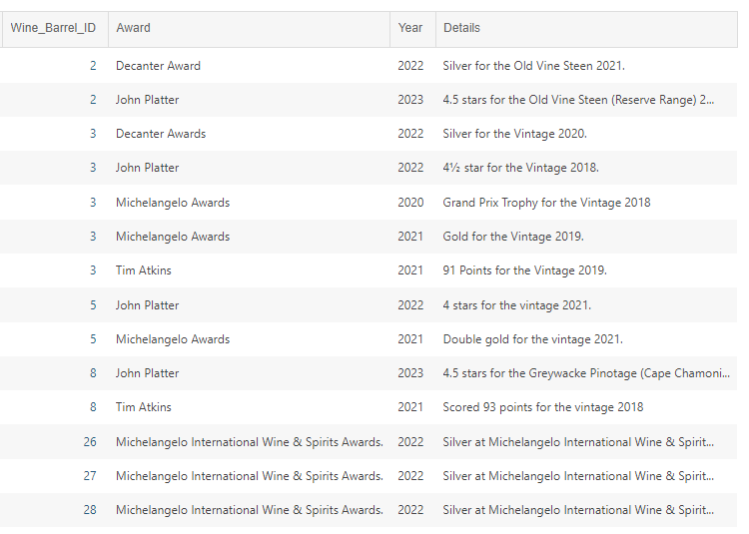
Award Table

Slide 46
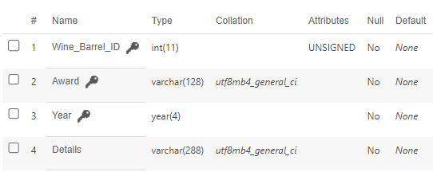
Award Table
Structure
Relationships

Slide 47
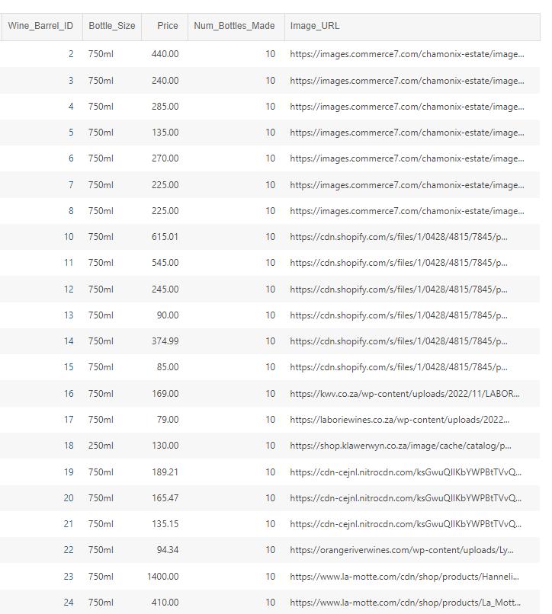
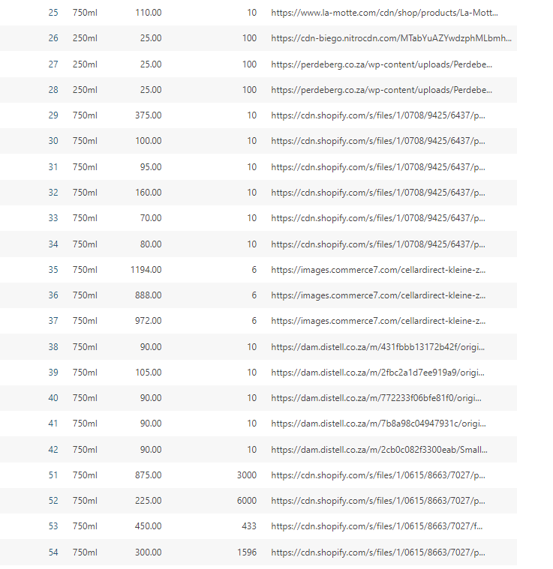
Bottle Table

Slide 48
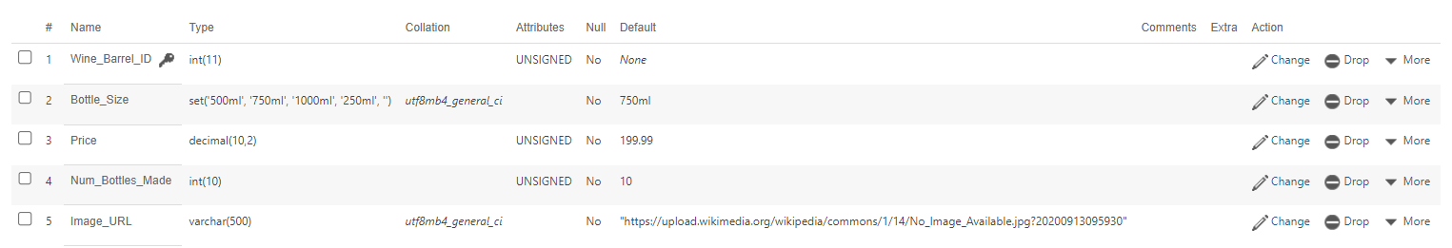
Bottle Table
Structure
Relationships

Slide 49
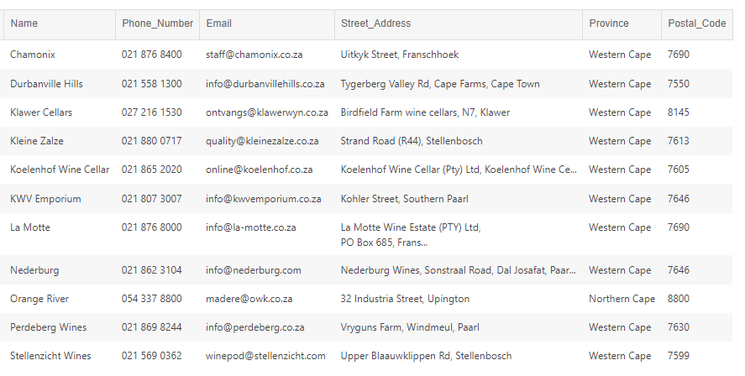
Brand Table

Slide 50
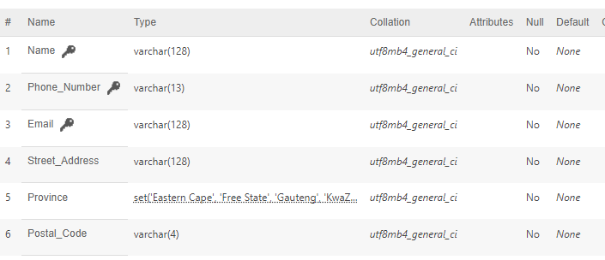
Brand Table
Structure

Slide 51
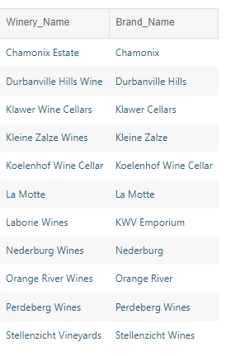
Production Table

Slide 52
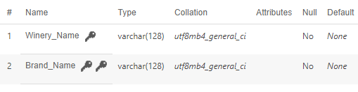
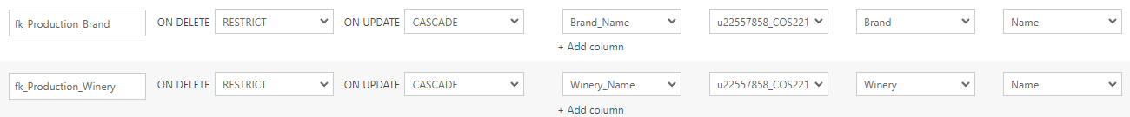
Production Table
Structure
Relationships

Slide 53
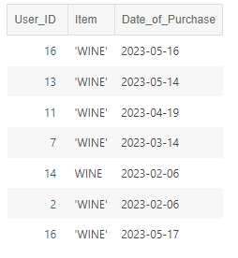
Purchases Table

Slide 54
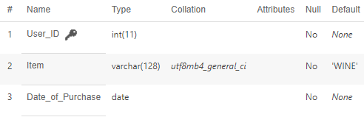
Purchases Table
Structure
Relationships

Slide 55
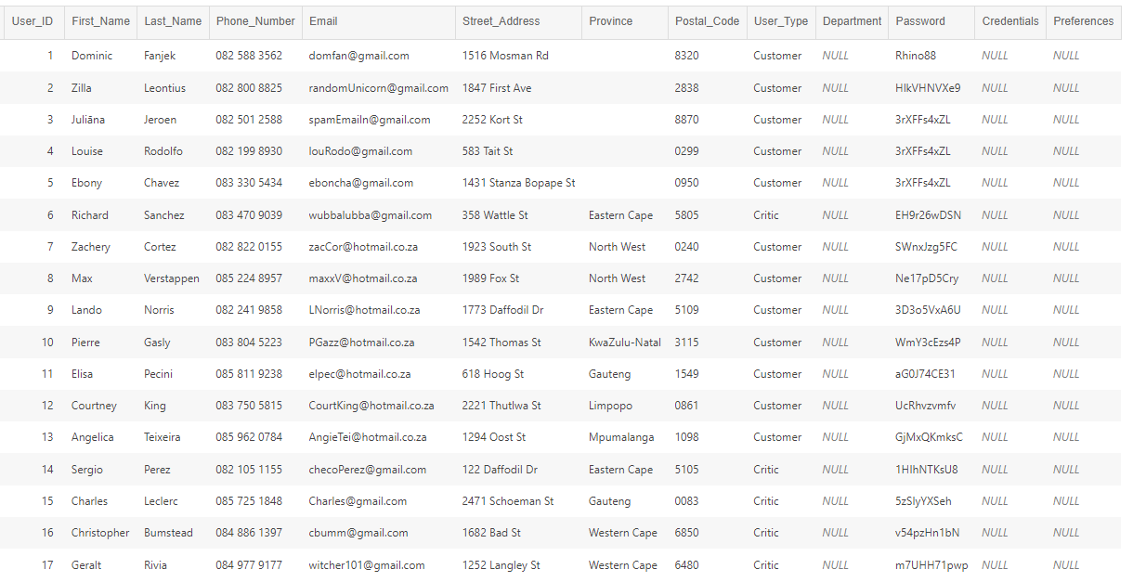
Users Table

Slide 56
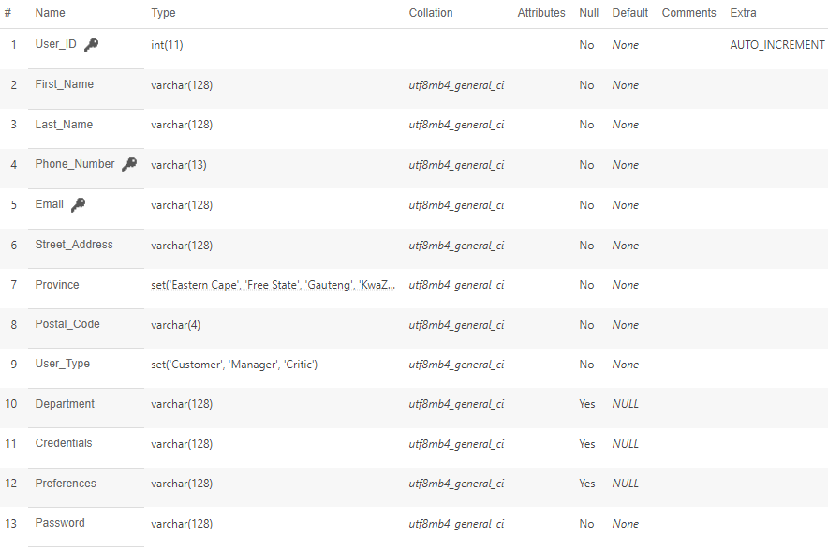
Users Table
Structure

Slide 57
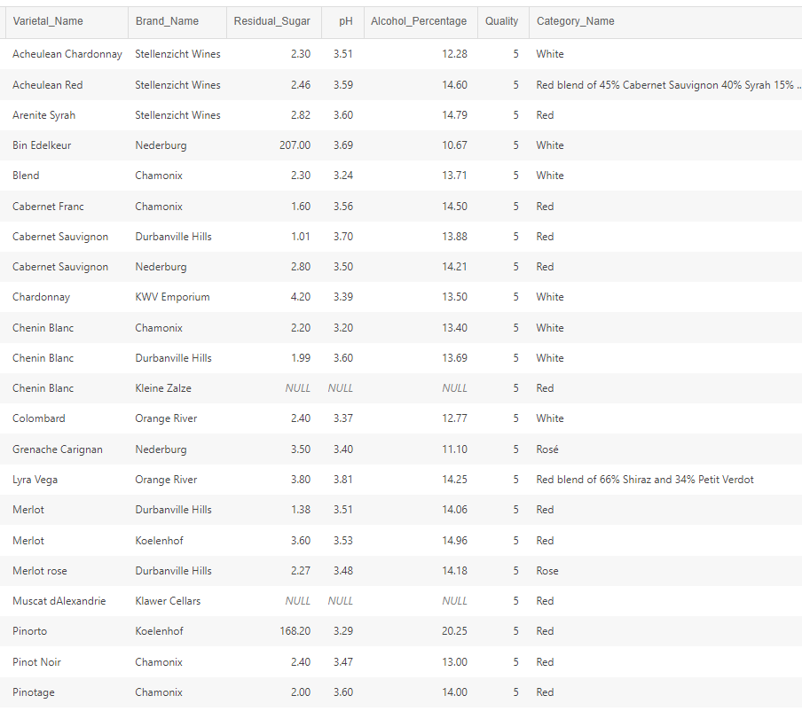
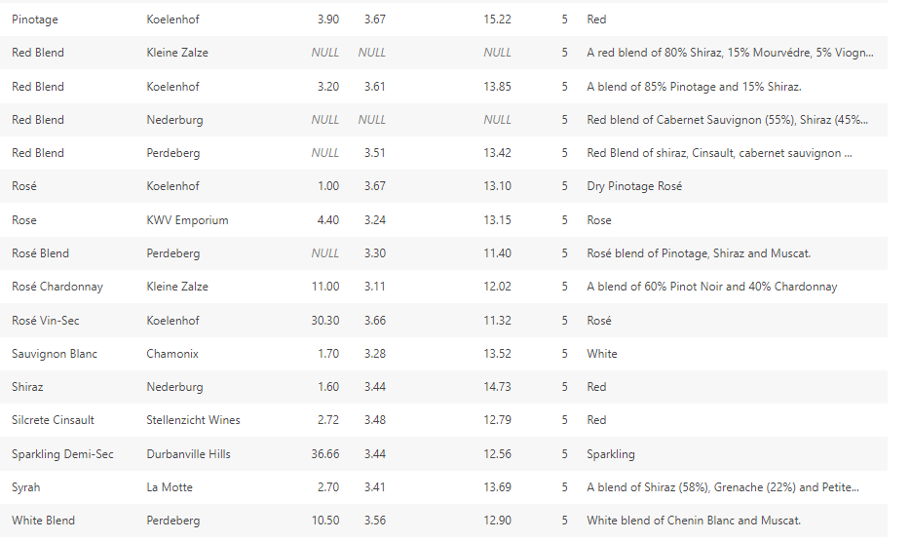
Varietal Table

Slide 58
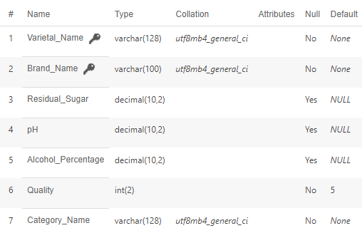
Varietal Table
Structure

Slide 59
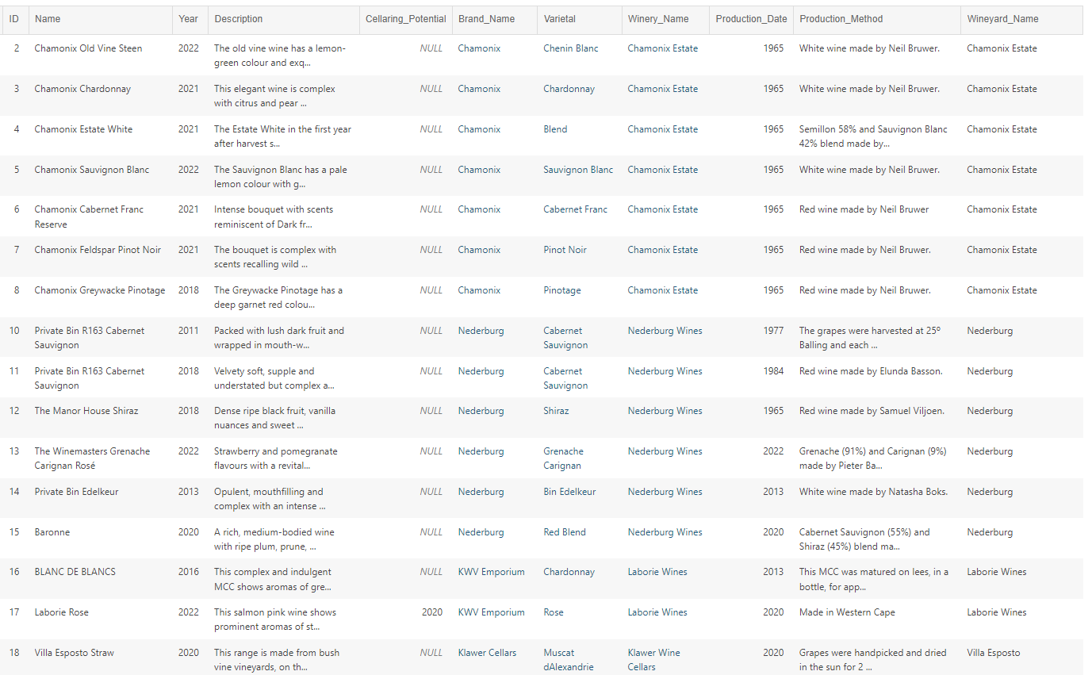
WineBarrels Table

Slide 60
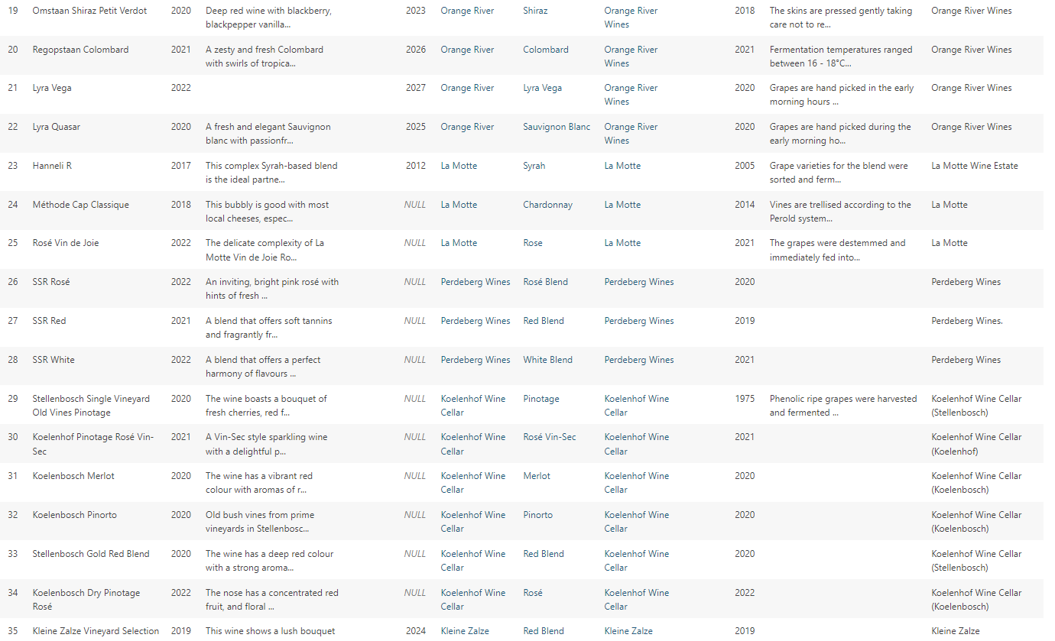
WineBarrels Table

Slide 61
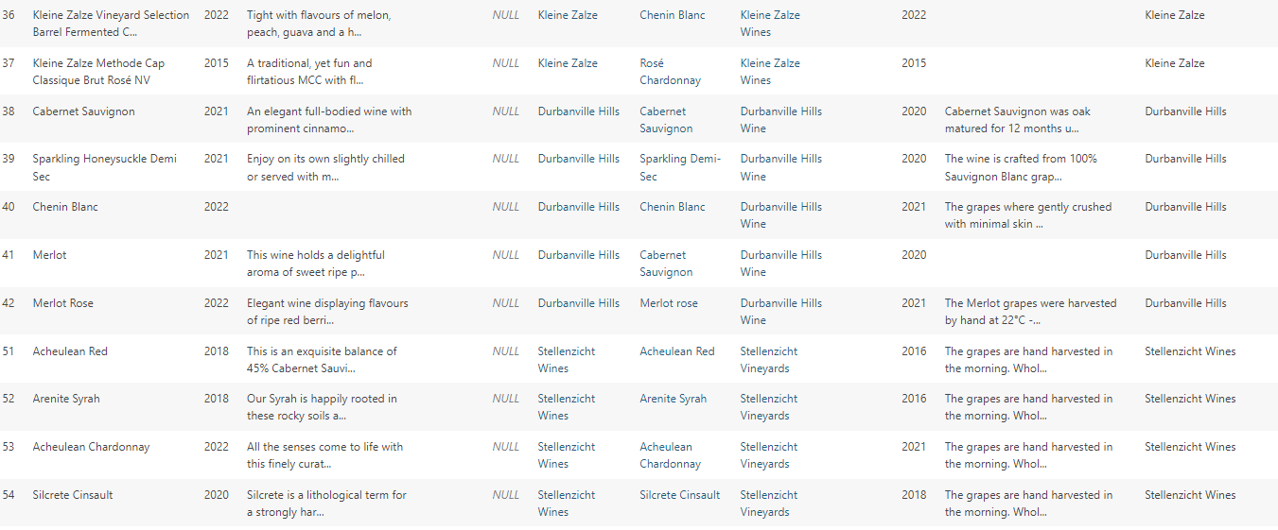
WineBarrels Table

Slide 62
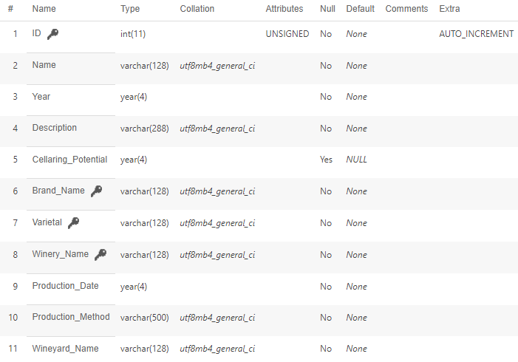
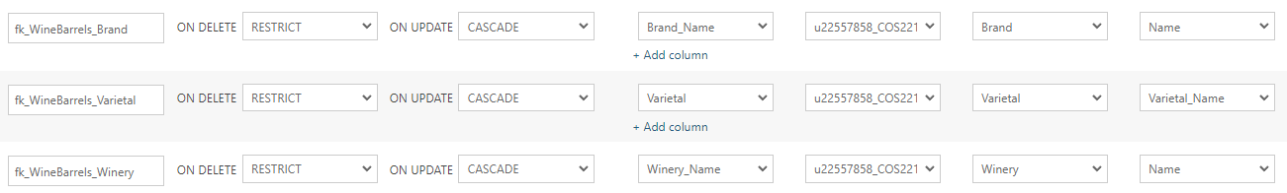
WineBarrels Table
Structure
Relationships

Slide 63
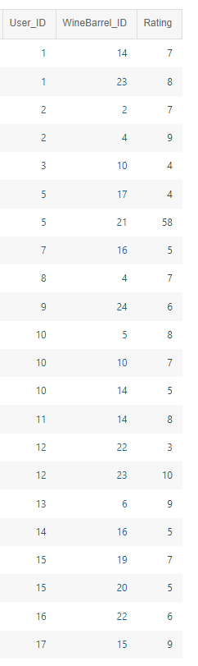
WineRating Table

Slide 64
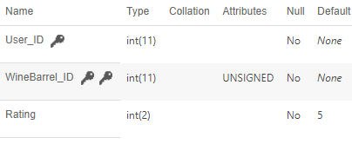
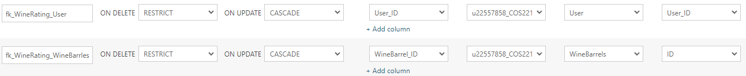
WineRating Table
Structure
Relationships

Slide 65
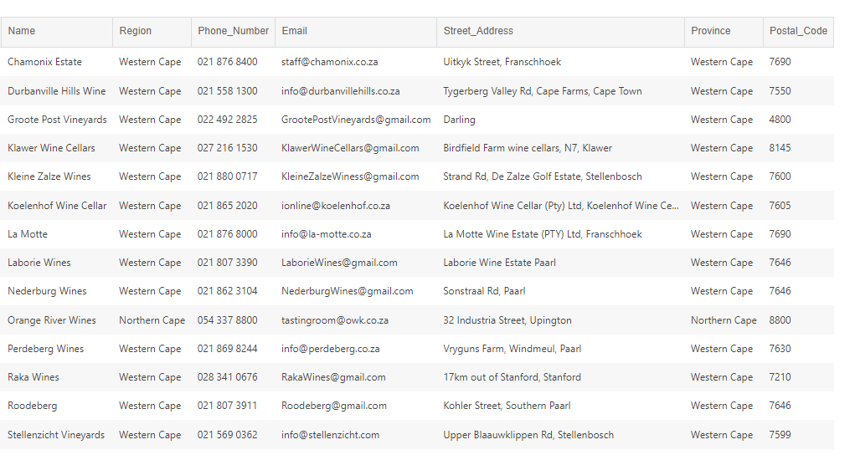
Winery Table

Slide 66
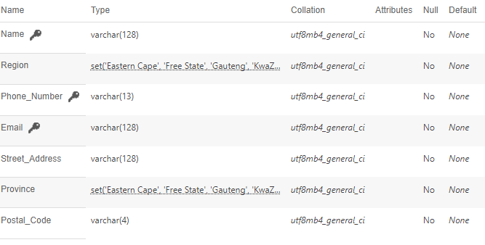
Winery Table
Structure

Slide 67
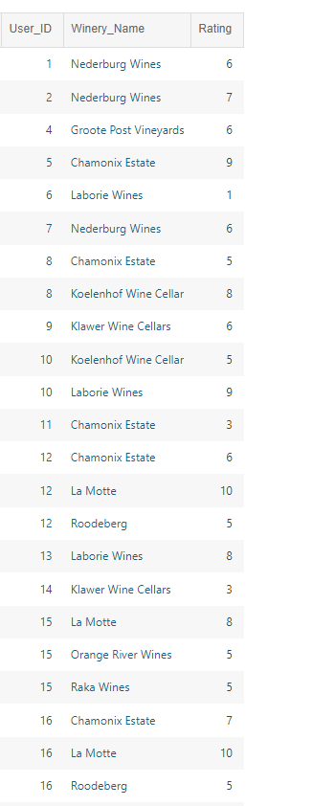
WineryRating Table

Slide 68
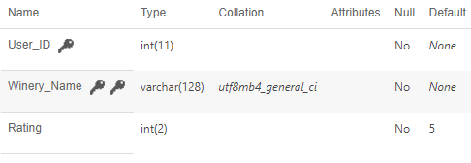
WineryRating Table
Structure
Relationships

Slide 69
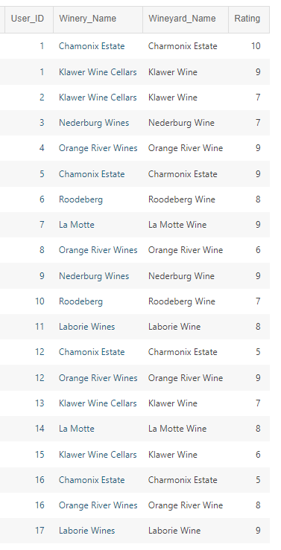
WineyardRating Table

Slide 70
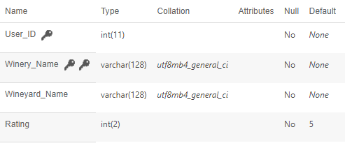
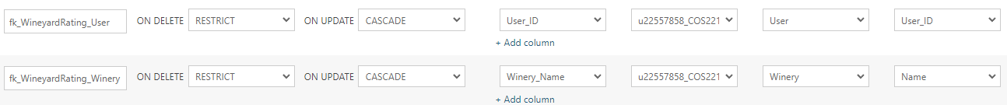
WineyardRating Table
Structure
Relationships

Slide 71
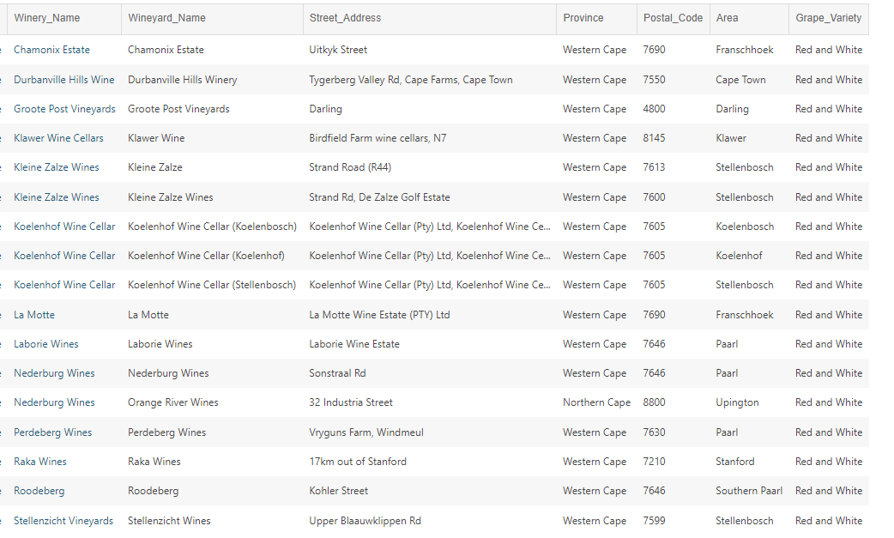
Wineyards Table

Slide 72
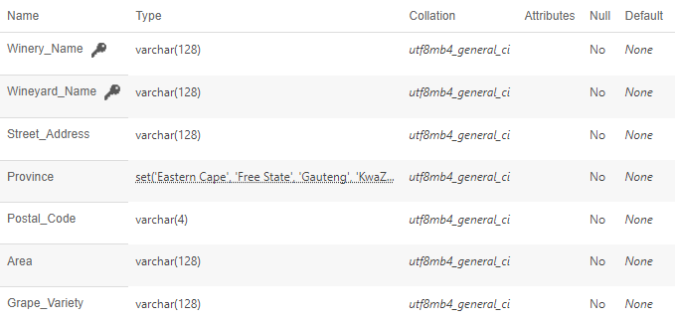
Wineyards Table
Structure
Relationships

Slide 73
Task 6: Development
Git Usage

Slide 74
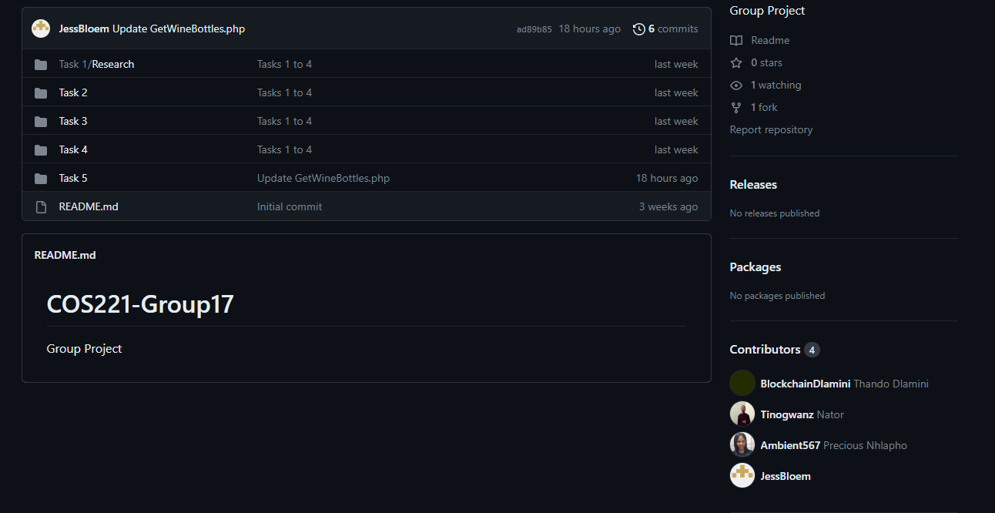
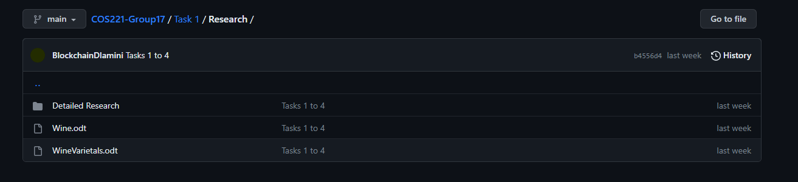
Git Usage Home page and task 1

Slide 75
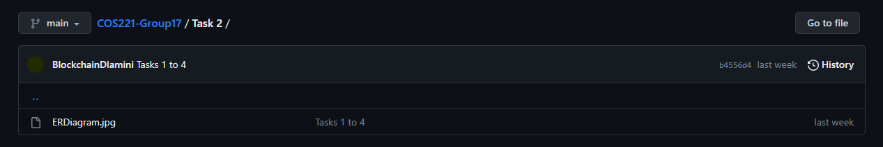
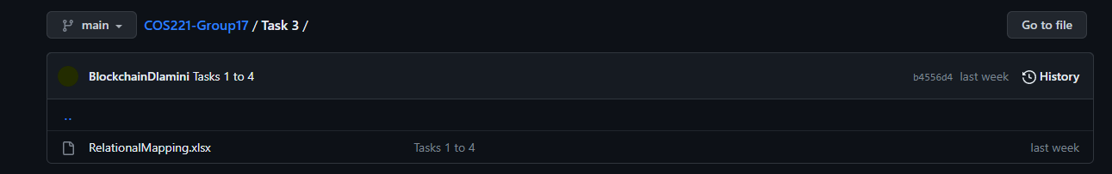
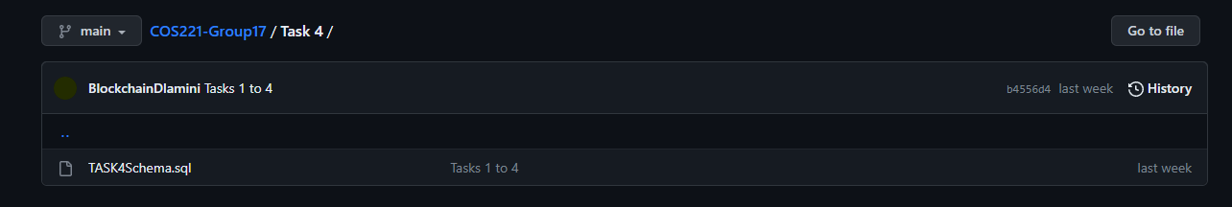
Git Usage for tasks 2-4

Slide 76
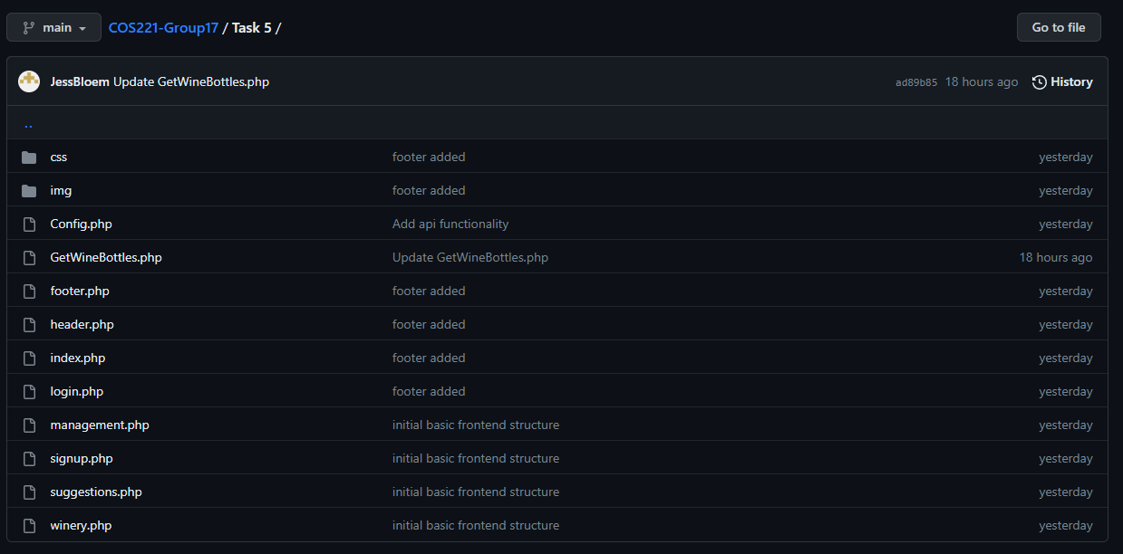
Git Usage for task 5

Slide 77
Task 6: Development
Data Validation

Slide 78
Task 6: Development
Code

Slide 79
Task 6: Development
Ease of Understanding

