Slide 1
eyeSee: A Multimodal Lookup Tool
Hayley Guillou and Jan Pilzer

Slide 2
Motivation
Situation
Reading research papers in PDF form on desktop
Problem
Figures, tables, and bibliography are separated from their references in the text
Readers are required to scroll and search
Context is lost on scrolling – reader might forget where they were in the text

Slide 3
Our Idea
Use eye tracking to recognize linked materials in a document
Enable user to quickly navigate to referenced content
Preserve the “last looked at” position for easy resumption

Slide 4
Eye Tracking
Reader is already interacting with the document with their eyes
Currently unused input of information
Gaze fixation provides point of focus

Slide 5
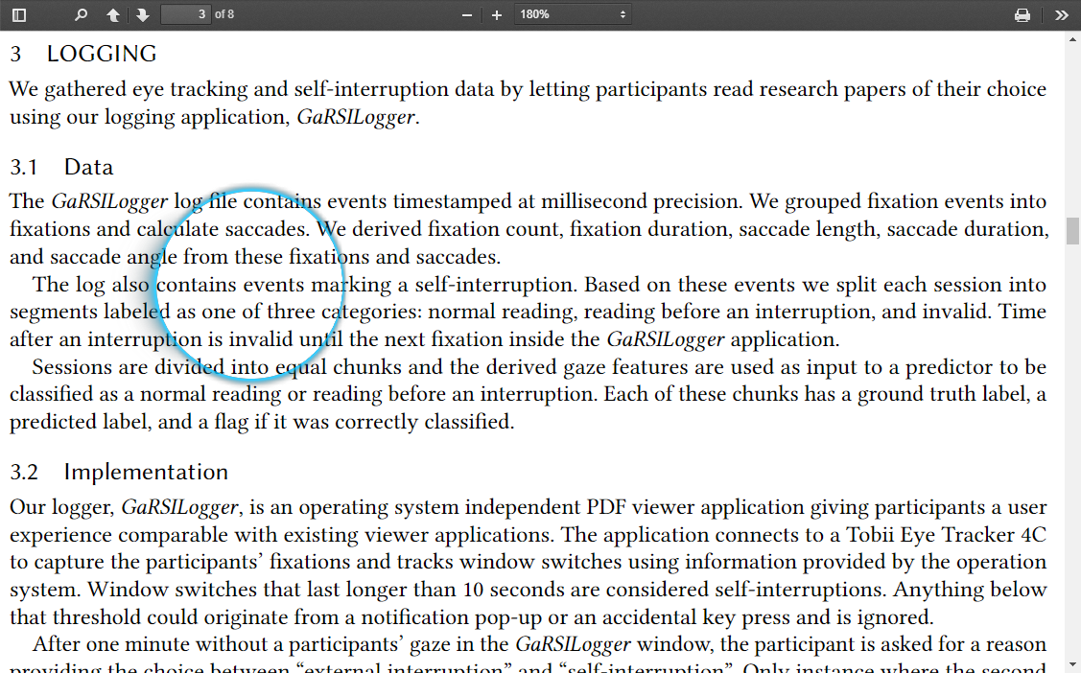
Solution
Use eye tracking to record read lines

Slide 6
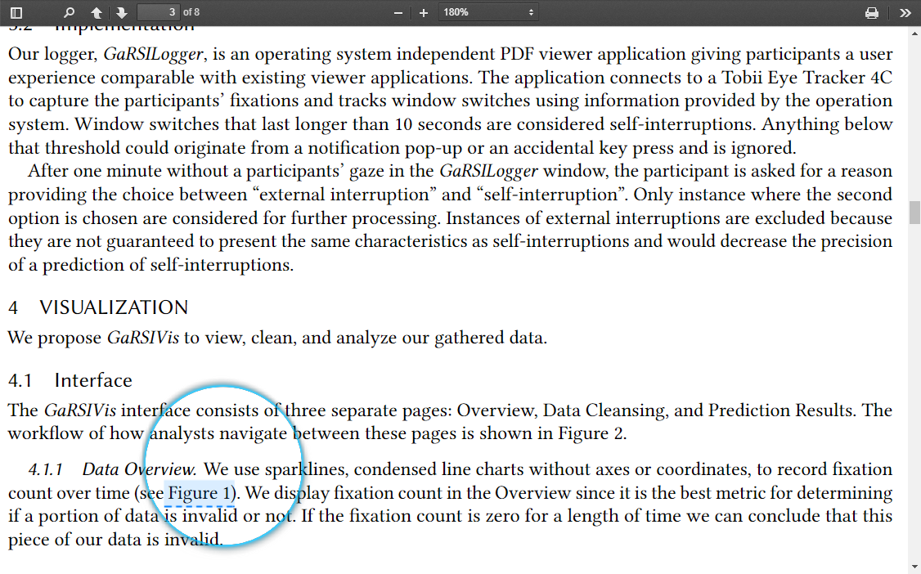
Solution
Highlight references (to figures, tables, and citations) on fixation

Slide 7
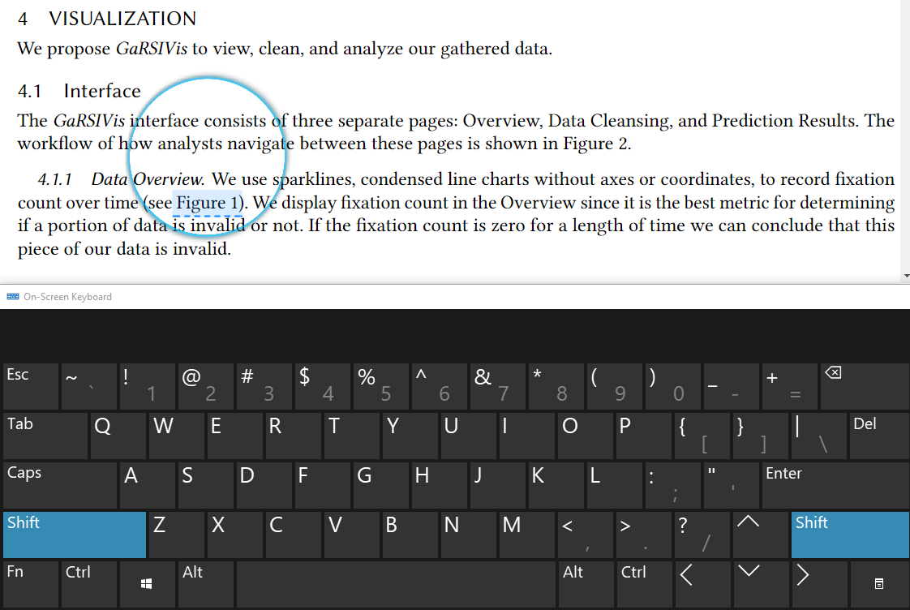
Solution
Pressing and holding down the shift key jumps to referenced target

Slide 8
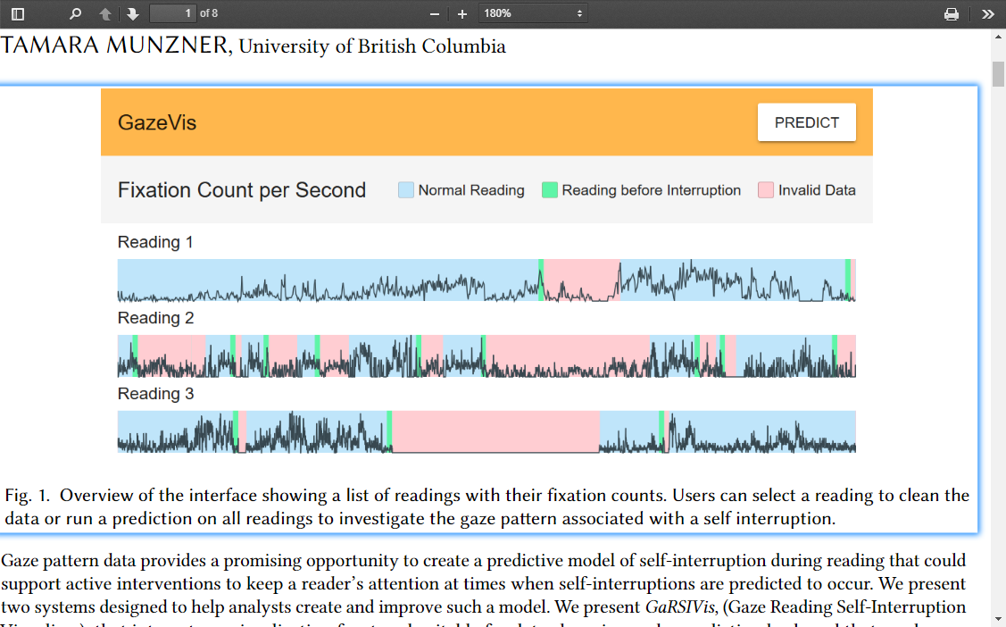
Solution
Highlight target to direct focus

Slide 9
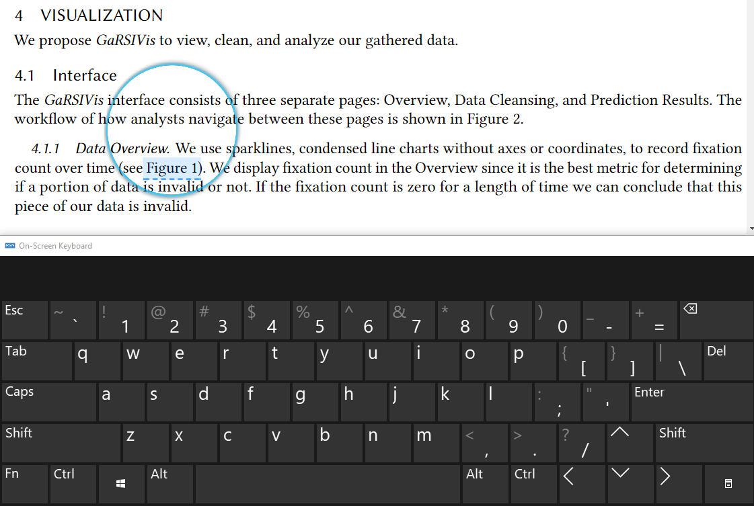
Solution
Releasing the shift key returns to the reference origin

Slide 10
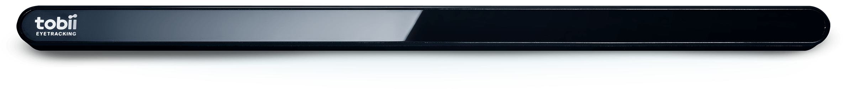


Technical Approach
Using the Tobii Eye Tracker 4C to capture participants' gaze
Using Electron and PDF.js, a Portable Document Format (PDF) viewer, for eyeSee

Slide 11
Design Approach and Pilot Study
Built tool using preliminary design
Conducted pilot study
3 participants
Surveyed reading habits and needs for tool support
Got initial feedback on our tool and design
Adjusted direction based on results of study
Participants only look at citations for related work searches
Shift focus to support natural reading tasks
Refined highlighting design to be less distracting

Slide 12
Evaluation
Task based analysis
Natural reading and discussion tasks simulating reading PDF research papers for a reading group
Compare our tool against standard viewer
6 Participants
2 reading tasks per participant (within subject design)
Variables
NASA-TLX
Criteria
Lower cognitive load using our tool
Failure if the user struggles to use the system or has a higher cognitive load

Slide 13
Results – the good news
Most participants found the tool useful and would use it (avg. 4/5)
Participants who normally read on paper rated it lower (avg. 3/5)
Participants mentioned eye tracking accuracy
Participants tend to skip figures when there is no easy way to jump to them

Slide 14
Results – the less good news
Participants rated the task of reading with our tool to have a higher cognitive load
Failure????
Maybe not
We severely underestimated the difficulty of comprehending our second paper
Possible the evaluation was flawed and not the tool itself

Slide 15
Lessons Learned
Task Selection
Natural reading tasks in a lab study are still staged, unable to attain external validity
Participants were uninterested in the papers
Difficult to simulate actual discussion and understanding
Limited reading time
Hardware Limitations
Lab environment
Physical eye tracker can be distracting
Paper difficulty and participant individuality
Different papers are more difficult for different people
NASA TLX captured the cognitive load of comprehension rather than reading with our tool

Slide 16
Project Limitations
Eye Tracking
Accuracy
Consistent positioning
External hardware
Need an eye tracker
Social implications
Difficult to talk to others and use eyes for navigation simultaneously

Slide 17
Future Work
Field Study
Increase usage time for participants to reduce novelty and distraction
Gain subjective feedback
Use larger control group
Compare with professional eye trackers

Slide 18
Contributions
Building the eyeSee multimodal lookup tool
Utilize eye tracking to record readers’ gaze
Highlight references and enable quick navigation
Validate solution in user study
Use NASA-TLX to asses cognitive load
User survey to solicit participants’ comments

Slide 19
Questions

Slide 20
Thank you

