Slide 1


Introducing Apache Giraph for Large Scale Graph Processing

Slide 2
outline
Graph recap
Google Pregel
What is Apache Giraph?
Setting Up
How does it work ?
What’s more?
See also

Slide 3
Graph recap

Slide 4
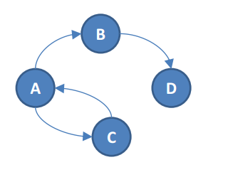
Graph recap
graph: abstract representation of a set of objects(vertices), where some pairs of these objects are connected by links (edges), which can be directed or undirected
图是对抽象事物的表示方法，用点来代替实物，点与点之间的边（有向或者无向）表示之间的关系。
Graphs can be used to model arbitrary things like road networks, social networks, flows of goods, etc.
图可以用来表示道路网络，社交网络，货物流等。
Majority of graph algorithms are iterative and traverse the graph in some way 大部分图的算法是以迭代或者某种方式遍历整个图的

Slide 5
Real world graphs are really large!
the World Wide Web has several billion pages with several billion links
Facebook‘s social graph had more than 700 million users and more than 68 billion friendships in 2011
twitter‘s social graph has billions of follower relationships

Slide 6
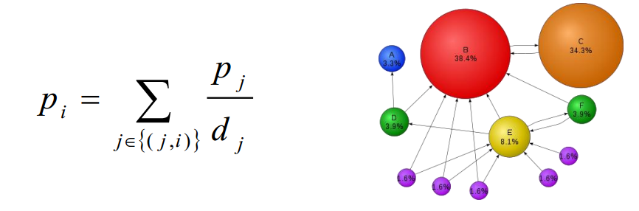
Why not use MapReduce/Hadoop?
Example: PageRank, Google‘s famous algorithm for measuring the authority of a webpage based on the underlying network of hyperlinks
defined recursively: each vertex distributes its authority to its neighbors in equal proportions

Slide 7
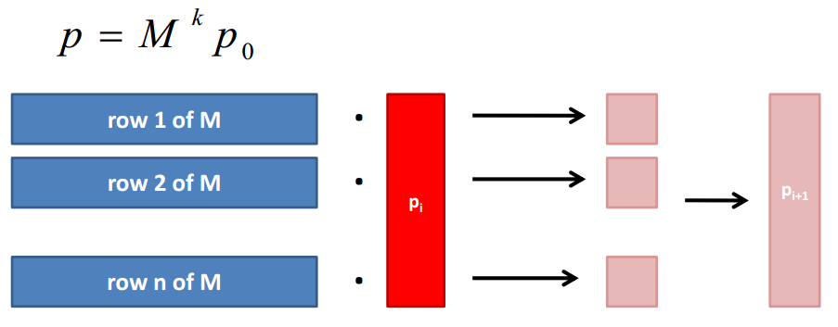
Textbook approach to PageRank in MapReduce
PageRank p is the principal eigenvector of the Markov matrix M defined by the transition probabilities between web pages
it can be obtained by iteratively multiplying an initial PageRank vector by M (power iteration)

Slide 8
Drawbacks
Not intuitive: only crazy scientists think in matrices and eigenvectors
Unnecessarily slow: Each iteration is scheduled as separate MapReduce job with lots of overhead – the graph structure is read from disk – the map output is spilled to disk – the intermediary result is written to HDFS
Hard to implement: a join has to be implemented by hand, lots of work, best strategy is data dependent

Slide 9
Google Pregel

Slide 10
Google Pregel
distributed system especially developed for large scale graph processing
能够处理大型图像的分布式系统
intuitive API that let‘s you ‚think like a vertex
非常直观的API让你能像点一样思考
Bulk Synchronous Parallel (BSP) as execution model（BSP作为执行模块）
fault tolerance by checkpointing
利用检查点容错

Slide 11
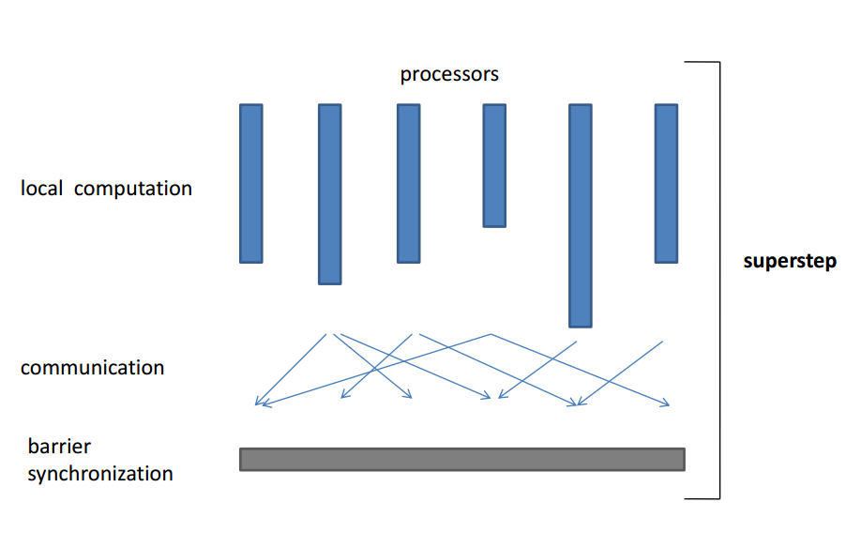
Bulk Synchronous Parallel (BSP)

Slide 12
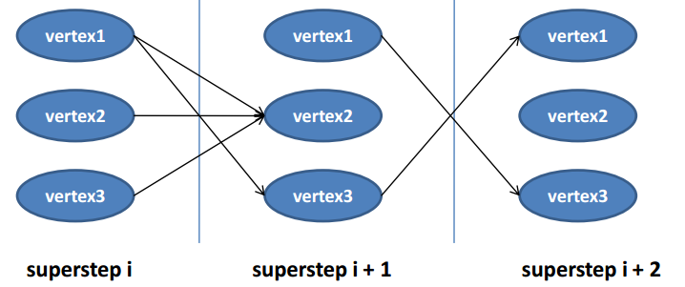
Vertex-centric BSP（以节点为中心的BSP）
each vertex has an id, a value, a list of its adjacent vertex ids and the corresponding edge values每个节点都有一个id和对应的值，还有其相邻节点的id列表和对应的边值
each vertex is invoked in each superstep, can recompute its value and send messages to other vertices, which are delivered over superstep barriers每个节点在每步superstep中都会被调用，可以重新计算它的值并将信息穿过superstep障碍而传给其他节点。
advanced features : termination votes, combiners, aggregators, topology mutations高端特点：结合，聚合，拓扑变化

Slide 13
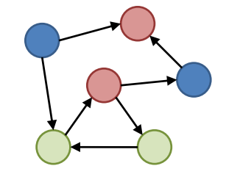
Master-slave architecture
vertices are partitioned and assigned to workers – default: hash-partitioning – custom partitioning possible
master assigns and coordinates, while workers execute vertices and communicate with each other
Master
Worker1
Worker2
Worker3

Slide 14
PageRank in Pregel
class PageRankVertex { void compute(Iterator messages) { if (getSuperstep() > 0) { // recompute own PageRank from the neighbors messages pageRank = sum(messages); setVertexValue(pageRank); } if (getSuperstep() < k) { // send updated PageRank to each neighbor sendMessageToAllNeighbors(pageRank / getNumOutEdges()); } else { voteToHalt(); // terminate } }}

Slide 15
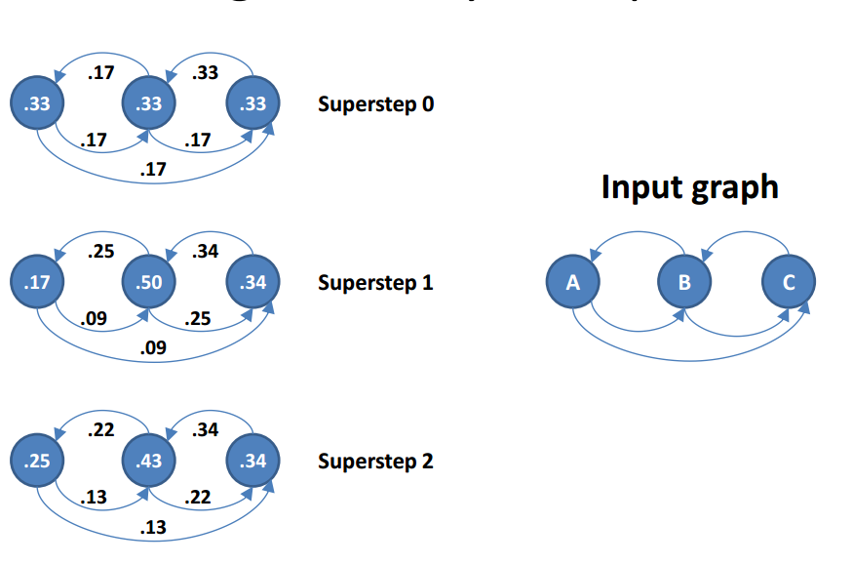
PageRank toy example

Slide 16

Cool, where can I download it?
Pregel is proprietary to Google, so sad

Slide 17
What is Apache Giraph?

Slide 18
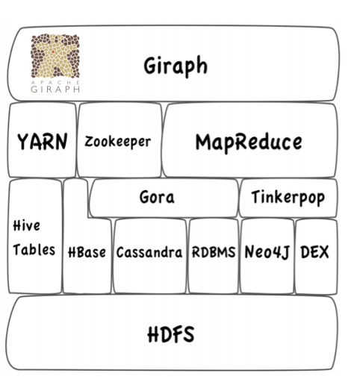
What is Apache Giraph?
Loose implementation of Pregel ideas on top of Hadoop M/R coming from yahoo在Hadoop的M/R基础上得到的Pregel想法
Explicitly designed for graph processing on top of the Hadoop ecosystem
在Hadoop原生态系统上的图形处理系统

Slide 19
Giraph – What is it ?
Graph processing for Hadoop V2 为HadoopV2的图像处理
For tasks that don’t fit Map Reduce 能处理不适用map reduce的工作
Better performance for those tasks 比这些工作的表现性能好
Processing by interations called super steps 通过迭代处理，即为superstep
Uses Bulk Synchronous Parallel computing ( BSP ) 利用BSP计算
Licensed via Apache 得到Apache许可
For distributed computing 能够分布式计算
For massive calculations 适用于大量计算

Slide 20
Setting Up安装

Slide 21
What does Apache Giraph need ?
Java 1.6 or higher
Maven 3 or higher
ZooKeeper
Hadoop
Yarn ( 2.0.3-alpha ) or
Version 0.20.x
Details see: http://giraph.apache.org/quick_start.html

Slide 22
How does it work ?

Slide 23
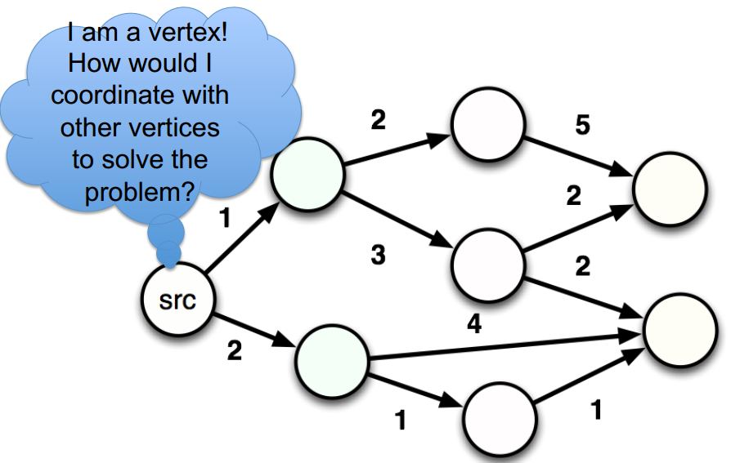
“Thinking like a vertex”

Slide 24
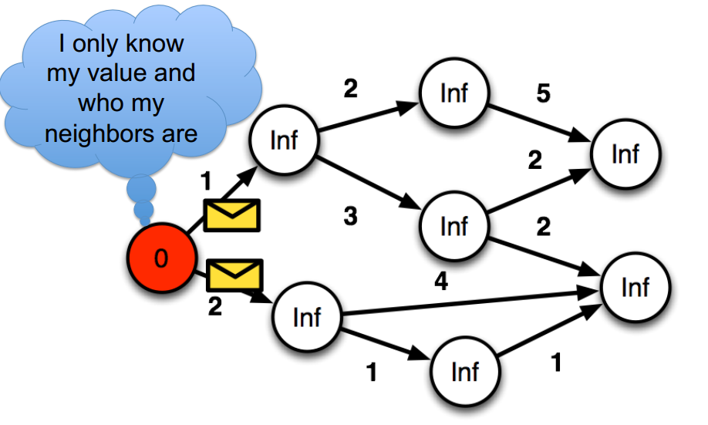
Shortest Paths

Slide 25
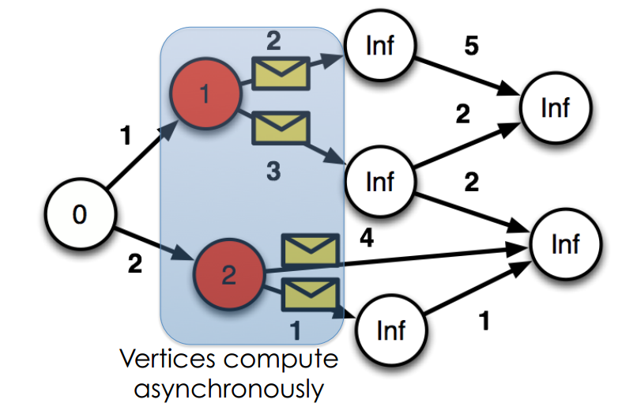
Receive messages a Update value a Send messages 接收到更改值的信息，更改发出的信息
节点异步计算

Slide 26
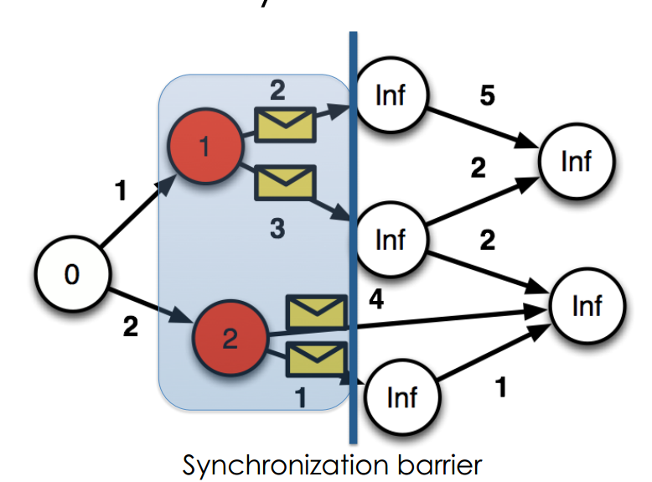
Global Synchronization
同步障碍

Slide 27
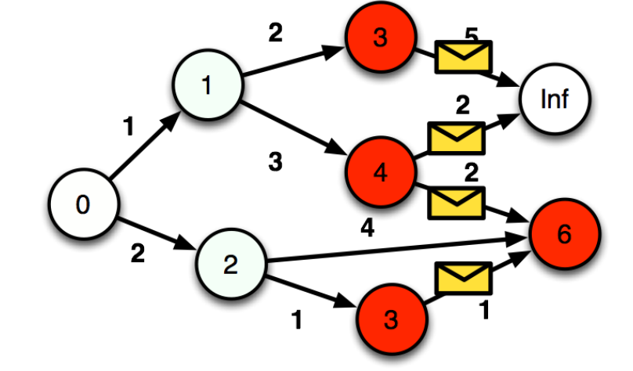
And again

Slide 28
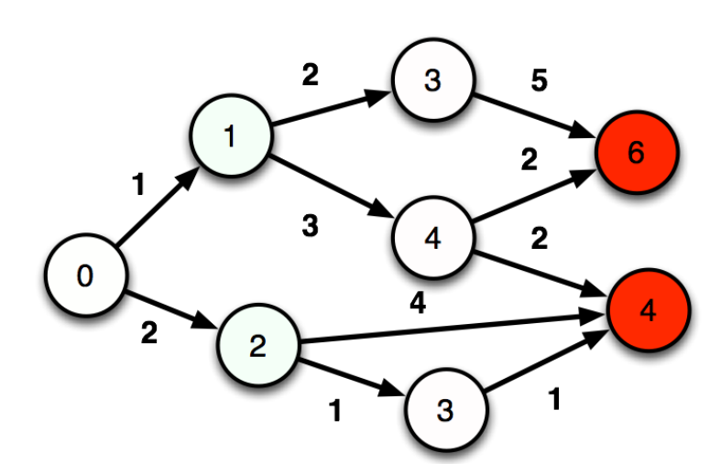
And again
每次顶点更新的值是前一顶点加上边值和的最小值

Slide 29
What’s more?

Slide 30
What’s more?
Okapi ML
The first advanced machine learning toolkit for Giraph
Available as open source
Code available at: https://github.com/grafos-ml-okapi
Documentation: http://grafos.ml/okapi.html

Slide 31
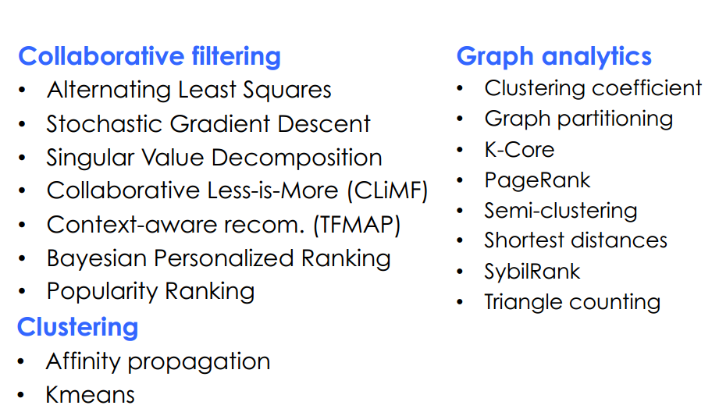
The Okapi library

Slide 32
See also
http://giraph.apache.org
Pregel: A System for Larg e-Scale Graph Processing
Claudio Martella: “Apache Giraph: Distributed Graph Processing in the Cloud” http://prezi.com/9ake_klzwrga/apache-giraph-distributed-graphprocessing-in-the-cloud/
https://cwiki.apache.org/confluence/display/GIRAPH/Shortest+Paths+Example
http://googleresearch.blogspot.com/2009/06/large-scale-graph-computing-atgoogle.html

