Slide 1
Design and Implementation of SMS Security Mechanism on Android Enabled Mobile Devices
Supervised by: Mr. Fayemiwo

Slide 2
Introduction
Short Message Service (SMS) also known has text message is a communication service standardized in the Global System for Mobile (GSM) system
SMS messages are not sent directly to the recipient; instead they travel through several nodes before reaching the recipient. This leads to serious security and privacy problems.

Slide 3
Introduction
Encryption and decryption provide powerful tools for protecting sensitive communications over a public network.
Currently, mobile SMS does not provide any specific security feature.
By implementing secure SMS system, many SMS security threats are greatly reduced

Slide 4
Introduction
The lack of security in current SMS communication for confidential data is a motivation to conduct this final year project.
The aim of this research is to identify the appropriate encryption method for mobile text messaging application and develop SMS security mechanism on android enabled mobile.

Slide 5
Introduction
The objectives are to:
Study and identify the appropriate encryption/decryption algorithm for mobile application;
Study and identify the appropriate security technique for end-to-end text message security;
Design the architecture of secure text message using android studio;

Slide 6
Introduction
Develop a prototype for secure text messaging application which enables the user to send and receive confidential information using any android enabled mobile phone; and
Evaluate the performance and quality of service after implementation of the secure system.

Slide 7
Introduction
The scope of this research is developing a prototype of secure text messaging tool using cryptography techniques for android enabled mobile phone
This application is to be restricted to android platform alone. That means it can only be used on android-enabled phones.

Slide 8
Introduction
Besides, it does not support concatenation of multiple text messages, when the size of the SMS extends 160 7-bit characters. This might be a good area for future researchers to look into.
In this final year project, an effective encryption based solution is proposed.

Slide 9
Design Methodology
In the proposed solution, symmetric (Blowfish) cryptography is to be used to encrypt/decrypt the SMS content and asymmetric (ECC) is to be used to transfer the secrete key which is used to secure the SMS content
The overall structure of the secure SMS messaging system is broken down into four subsystems.

Slide 10
Design Methodology
Encryption/Decryption subsystem
Combiner/Extractor subsystem
7-bit Encoder/Decoder and
Sender/Receiver subsystem.
This subsystem contains two type of encryption, the first one is symmetric (Blowfish) cryptography and the second is asymmetric (ECC) cryptography

Slide 11
Design Methodology
In general, ECC is more appropriate asymmetric cryptography for resource constraint devices such as mobile phones.
In this mobile application solution, Blowfish is used for encrypting the original SMS messages
Elliptic Curve Cryptography (ECC) is used in this system as a secure channel to transfer the onetime key which is used to encrypt the message.

Slide 12
Design Methodology
The onetime key is encrypted by ECC and sent to the receiver together with the message at a time.
Message Encryption/Decryption is part of Encryption/Decryption subsystem and it uses Blowfish symmetric cryptography technique to secure the SMS message.
Blowfish is a symmetric block cipher that supports a 64 bits block size input.

Slide 13
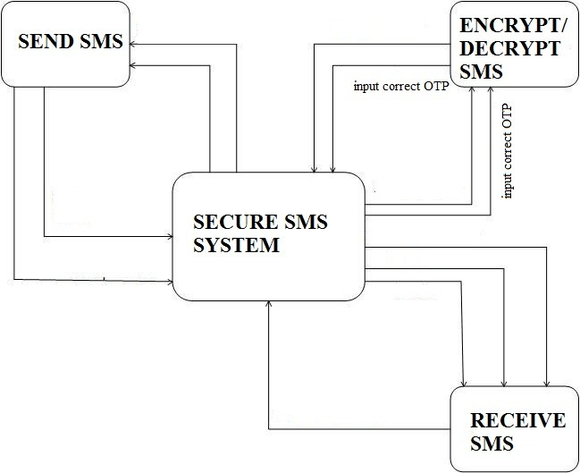
Dataflow diagram for the system

Slide 14
Design Methodology
It was decided to implement the android messaging system using Java programming language on android studio. Among the reasons are:
Familiarity;
Object Orientation;
Level of abstraction: Java provides a good level of abstraction and it includes rich set of APIs.

Slide 15
Design Methodology
In order to develop the secure SMS messaging application Java Wireless Toolkit development kit was integrated with android studio, android studio was used as development environment.
The message sender and receiver application uses the NetBeans Mobility Pack 3.0 to simulate mobile phone environment.

Slide 16
Results and Discussion
The development of this work was carried out on a HP GS78 Laptop Computer with the following specifications;
1 Terabytes Hard disk
8 Gigabytes RAM (Random Access Memory)
4 Gigahertz Processor Speed (Intel Pentium Dual Core).

Slide 17
Results and Discussion
64-bit Operating System (Windows 7)
The deployment and testing was carried out on HTC M9 mobile phone with the following specifications:
On first installation the user is asked to create pin so as to secure the app. After a pin has been selected the main layout (home page) is shown.

Slide 18
Results and Discussion
The home page of the secure SMS app shows an inbox tab and a sent tab and a send new message button.
The Inbox Tab shows a list of inbox (received) messages. The Sent Tab shows a list of sent messages.

Slide 19
Results and Discussion
The app takes over the SMS functionality of the mobile phone; this means all text messages sent to the mobile phone through the phone number enters the secure SMS app.
Only messages sent to the phone from another phone that has this secure SMS app would be encrypted, other text messages sent from the default SMS app will enter the app, but would not be encrypted

Slide 20
Results and Discussion
For an encrypted message, the key is generated at the point of creation of the text message.
At the recipient’s end, the key is extracted from the content and used to decrypt the main body of the message and it is displayed to the user.

Slide 21
Results and Discussion
When the “Create New Message” is clicked, a screen is brought forward and a prompt for the use to input the destination phone number and a message content.

Slide 22
Results and Discussion
There is also a button at the bottom of the screen to encrypt the message.
When the button is clicked a key is generated using ECC encryption and the key is used to encrypt the message using blowfish encryption algorithm and then encoded in base 64 so as to pass over the network and the encrypted message is sent over the mobile network

Slide 23
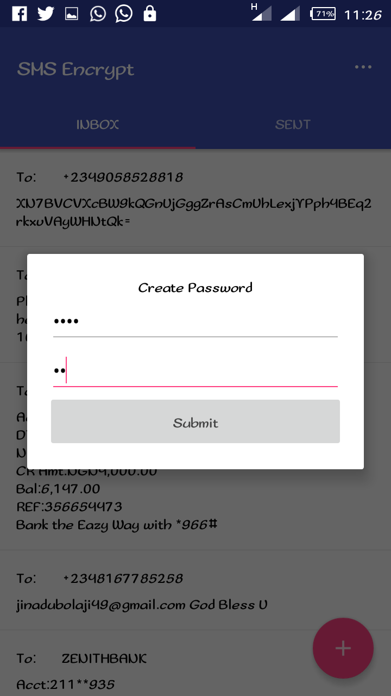
User creating username and password on the SMS app

Slide 24
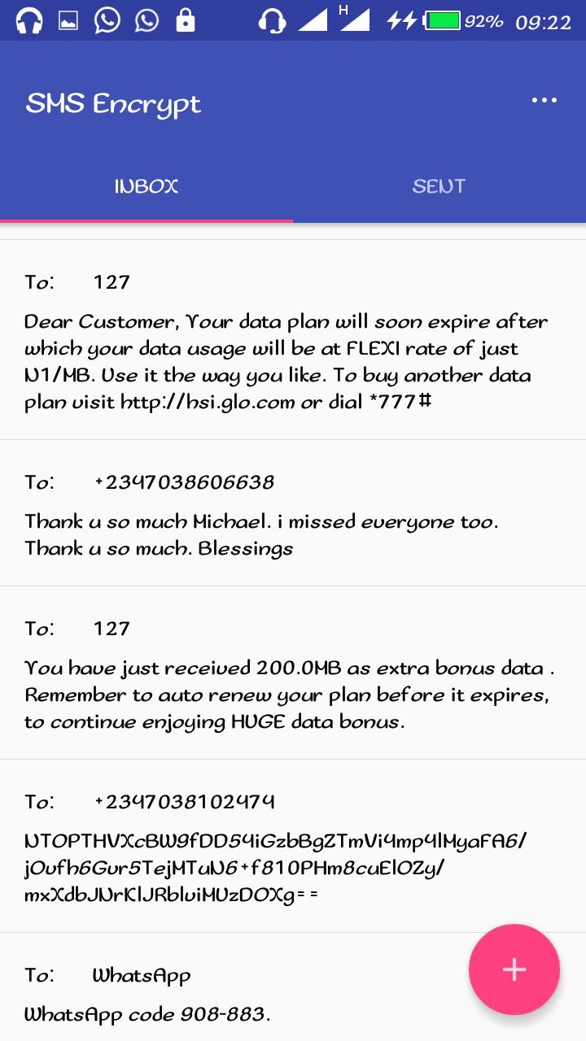
Normal and Encrypted Message List on the SMS app showing the inbox

Slide 25
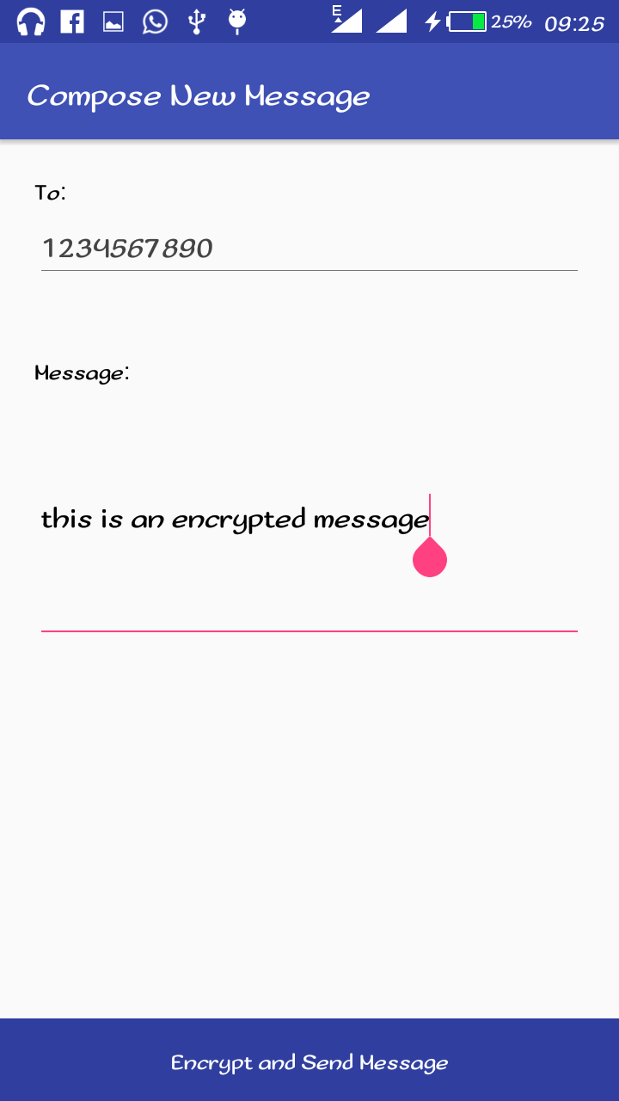
User composing a new message

Slide 26
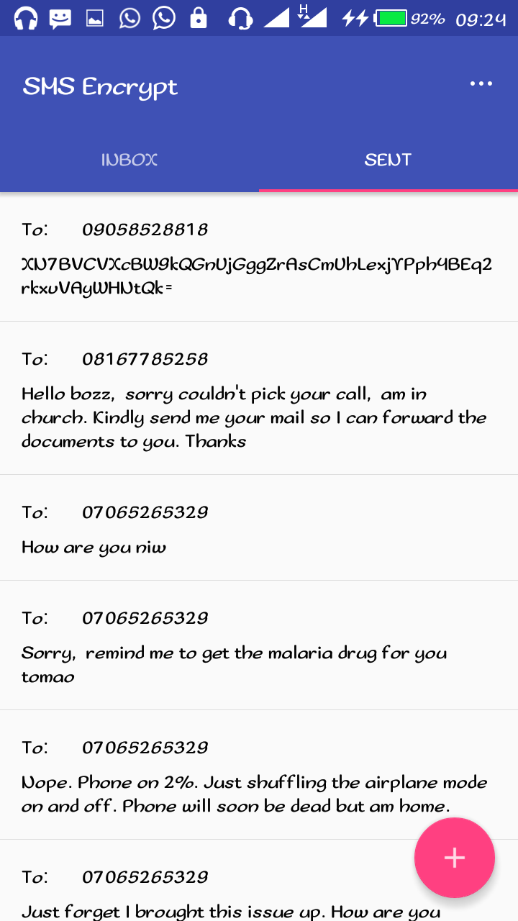
List of sent encrypted and Normal SMS

Slide 27
Conclusion
The study is motivated by the fact of ensuring privacy and security in SMS systems, but solution cost was also taken into account vigorously
However, the operators and handset /mobile phones providers need to be aligned with this approach and cumulative understanding can ensure secured messaging with high privacy.

Slide 28
Recommendation
The proposed system can be easily adapted to support secure SMS messaging solutions for many applications such as SMS based (USSD) banking, SMS based health and SMS based voting.
This solution is highly recommend to any commercial company and government organizations, which need confidential information transmitted over the GSM network

Slide 29
I THANK YOU

