Slide 1
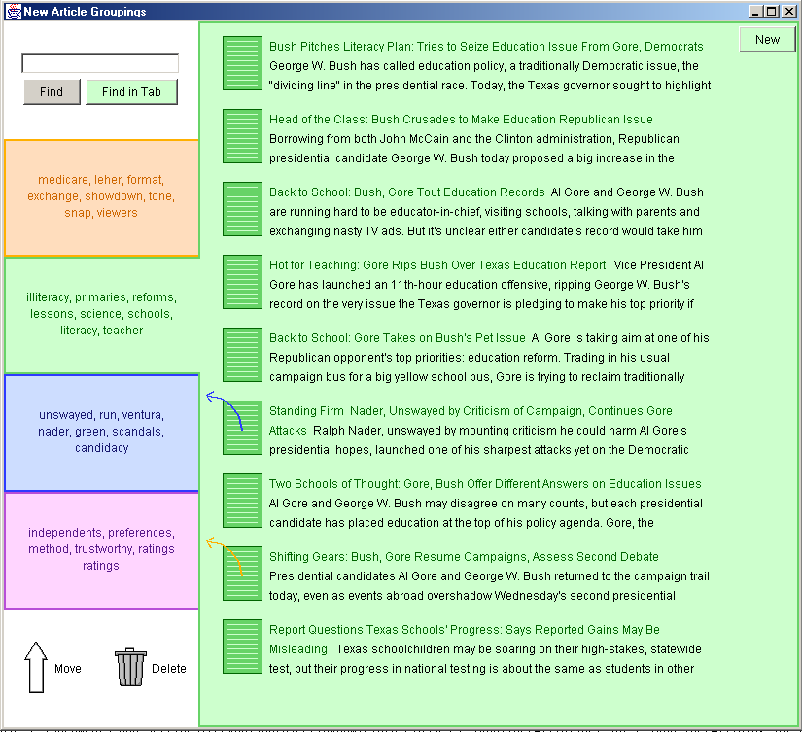
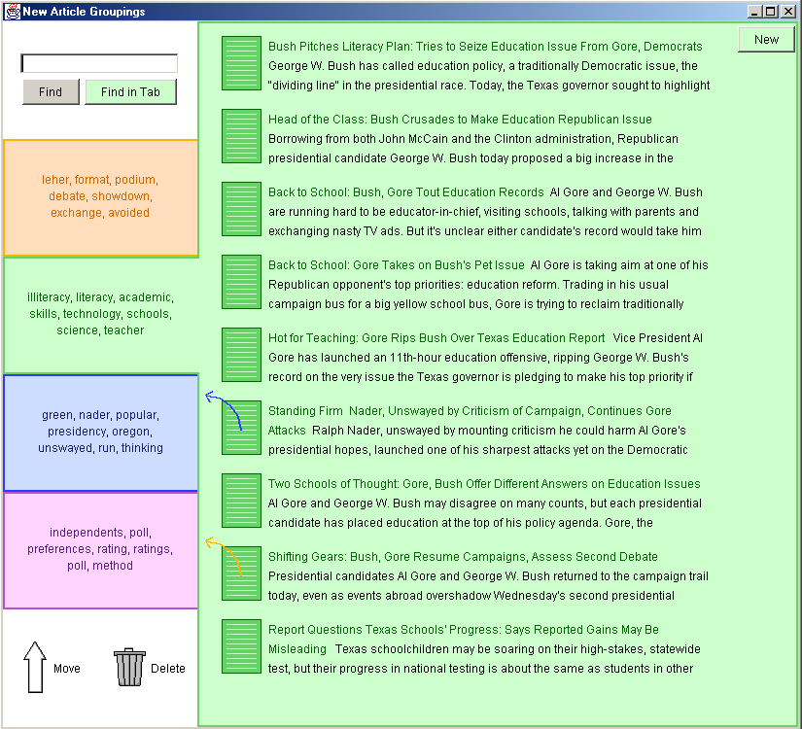
Displaying Dynamic Information
Jaime Teevan * Massachusetts Institute of Technology * teevan@mit.edu
The General Problem
The General Solution
Dynamic information
Information that changes, over time, outside of our control. As our interaction with shared information grows, so will our interaction with dynamic information.
Modern information access is dynamic:
  Information is time dependent
      New information arrives
      Old information expires
  Other agents than the user may modify the user’s data
Solution: A good interface for interacting with dynamic information
  Allows as much information as possible to change
  Ensures that the conceptual anchors a user develops remain constant.
Conceptual anchor
Users can only remember a small portion of what they see. A conceptual anchor is what the user specifically does remember.
Time dependent
Some information is dynamic because it becomes available over time. Examples of this include stock prices and news stories.
Question: How should user interfaces reflect dynamic information?
Understanding conceptual anchors:
  The user will use the conceptual anchors he sets into his data to return to a specific piece of information later
  Conceptual anchors are a function of the user’s expectations of the data
    When watching the news on TV, you understand that the information is time dependent, and remember the time you saw the story
    When reading the news in a newspaper, you may instead remember the section where you saw the story
  A user has no expectation about the information that has not been displayed to him
  A user doesn’t develop expectations about much of the information that he has seen
Difficulty:
  A user builds context through her experience with her information.
  She should not lose the context she has developed when that information changes.
Other agents
Information may be dynamic because agents other than the user (family, colleagues, automated processes) also interact with it.
Related work: While there has been some work with dynamic display of information, such as Ahlberg and Shneiderman’s work with dynamic queries, the question of how an individual interacts with changes outside of his control is largely unexplored. While the problem is new, it relates to issues of UI consistency, discussed by Grudin and others.
Lo-fidelity prototyping
Prototype UI designs not developed on a computer. Prototyping this way allows for many design iterations.
An Example Problem
Are these the same?
An Example Solution
Test problem: Clustering news stories
  Example of time dependency
      - New articles arrive over wire
      - People are aware of time dependency issues relating to of news stories
  Example of other agents: Clustering algorithm also interacts with data
      - A good clustering algorithm cannot produce results immediately
      - Clustering algorithm first produces a rough initial clustering which is presented to the user immediately
      - As the user works with initial clustering, algorithm works to improve clustering
      - People are not used to the idea of another agent manipulating their data. The fact that the news articles are time dependent helps them accept the fact that the articles may change location due to multiple agents as well.
Clustering problem experimental framework:
  Initial clustering provided to the user
  User performs information seeking task with initial clustering
  Clustering is modified:
      - Document presentation ordering changes
      - Documents move to other clusters
      - Keywords representing the clusters are updated
  User asked to perform tasks that require a return to information that she has seen before
  Observe what changes the user notices, and what changes make it easier/more difficult for the user to complete the task
Anchor
Users associate the color of the tab with its content, and use the color, more than the keywords, for navigation
Anchor
Users tend to remember that the first document in the list was first.
Changed
The keywords describing the tab can change as long as the general meaning doesn’t.
Changed
Small ordering changes with documents that aren’t first or last in the list go unnoticed.
Anchor
Documents shouldn’t change clusters without the user’s permission. Arrows request that the document be moved.
User testing: 15 users, lo-fidelity prototypes, canned clusters
About clustering interfaces:
  There has been previous work with clustering interfaces (e.g. Scatter/Gather)
  Previous clustering interfaces require the clustering process to be entirely finished before clusters can be displayed
  By allowing partially completed clusters to be presented that can later be updated, a better, more time consuming, clustering algorithm can be used
  Note: I use clusters as a convenient source of dynamic information, and am not asking whether clusters are helpful for information access
Conceptual anchors:
The color associated with a cluster
Documents listed in cluster summary
Which document is first
NOT Conceptual anchors:
Keywords used to describe a cluster
Ordering of documents within cluster
Documents not seen in a cluster
This work was done as a course project for Professor Stephen Intille.
Future work:
Develop a better understanding of what information a person uses to build her conceptual anchors
Investigate the problem in other domains (e.g. Haystack)

