Slide 1
Chapter 6 Methods

Slide 2
Opening Problem
Find the sum of integers from 1 to 10, from 20 to 30, and from 35 to 45, respectively.

Slide 3
Problem
int sum = 0;
for (int i = 1; i <= 10; i++)
sum += i;
System.out.println("Sum from 1 to 10 is " + sum);
sum = 0;
for (int i = 20; i <= 30; i++)
sum += i;
System.out.println("Sum from 20 to 30 is " + sum);
sum = 0;
for (int i = 35; i <= 45; i++)
sum += i;
System.out.println("Sum from 35 to 45 is " + sum);

Slide 4
Problem
int sum = 0;
for (int i = 1; i <= 10; i++)
sum += i;
System.out.println("Sum from 1 to 10 is " + sum);
sum = 0;
for (int i = 20; i <= 30; i++)
sum += i;
System.out.println("Sum from 20 to 30 is " + sum);
sum = 0;
for (int i = 35; i <= 45; i++)
sum += i;
System.out.println("Sum from 35 to 45 is " + sum);

Slide 5
Solution
public static int sum(int i1, int i2) {
int sum = 0;
for (int i = i1; i <= i2; i++)
sum += i;
return sum;
}
public static void main(String[] args) {
System.out.println("Sum from 1 to 10 is " + sum(1, 10));
System.out.println("Sum from 20 to 30 is " + sum(20, 30));
System.out.println("Sum from 35 to 45 is " + sum(35, 45));
}

Slide 6
Objectives
To define methods with formal parameters (§6.2).
To invoke methods with actual parameters (i.e., arguments) (§6.2).
To define methods with a return value (§6.3).
To define methods without a return value (§6.4).
To pass arguments by value (§6.5).
To develop reusable code that is modular, easy to read, easy to debug, and easy to maintain (§6.6).
To write a method that converts hexadecimals to decimals (§6.7).
To use method overloading and understand ambiguous overloading (§6.8).
To determine the scope of variables (§6.9).
To apply the concept of method abstraction in software development (§6.10).
To design and implement methods using stepwise refinement (§6.10).

Slide 7
Defining Methods
A method is a collection of statements that are grouped together to perform an operation.

Slide 8
Defining Methods
A method is a collection of statements that are grouped together to perform an operation.

Slide 9
Method Signature
Method signature is the combination of the method name and the parameter list.

Slide 10
Formal Parameters
The variables defined in the method header are known as formal parameters.

Slide 11
Actual Parameters
When a method is invoked, you pass a value to the parameter. This value is referred to as actual parameter or argument.

Slide 12
Return Value Type
A method may return a value. The returnValueType is the data type of the value the method returns. If the method does not return a value, the returnValueType is the keyword void. For example, the returnValueType in the main method is void.

Slide 13
Calling Methods, cont.
animation

Slide 14
Trace Method Invocation
animation
i is now 5

Slide 15
Trace Method Invocation
animation
j is now 2

Slide 16
Trace Method Invocation
animation
invoke max(i, j)

Slide 17
Trace Method Invocation
animation
invoke max(i, j)
Pass the value of i to num1
Pass the value of j to num2

Slide 18
Trace Method Invocation
animation
declare variable result

Slide 19
Trace Method Invocation
animation
(num1 > num2) is true since num1 is 5 and num2 is 2

Slide 20
Trace Method Invocation
animation
result is now 5

Slide 21
Trace Method Invocation
animation
return result, which is 5

Slide 22
Trace Method Invocation
animation
return max(i, j) and assign the return value to k

Slide 23
Trace Method Invocation
animation
Execute the print statement

Slide 24
CAUTION
A return statement is required for a value-returning method. The method shown below in (a) is logically correct, but it has a compilation error because the Java compiler thinks it possible that this method does not return any value.
To fix this problem, delete if (n < 0) in (a), so that the compiler will see a return statement to be reached regardless of how the if statement is evaluated.

Slide 25
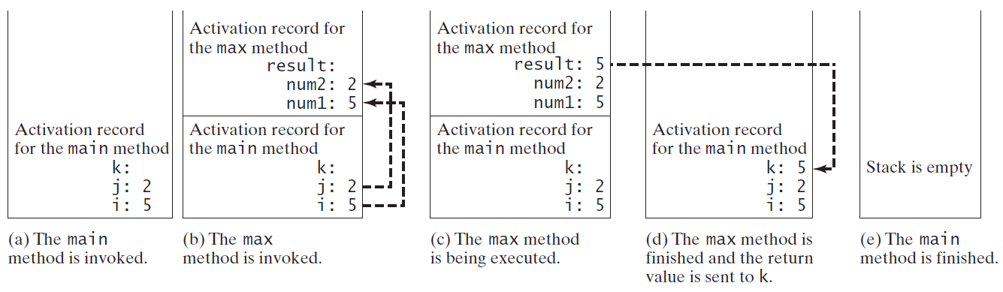
Call Stacks

Slide 26
Trace Call Stack
animation
i is declared and initialized

Slide 27
Trace Call Stack
animation
j is declared and initialized

Slide 28
Trace Call Stack
animation
Declare k

Slide 29
Trace Call Stack
animation
Invoke max(i, j)

Slide 30
Trace Call Stack
animation
pass the values of i and j to num1 and num2

Slide 31
Trace Call Stack
animation
Declare result

Slide 32
Trace Call Stack
animation
(num1 > num2) is true

Slide 33
Trace Call Stack
animation
Assign num1 to result

Slide 34
Trace Call Stack
animation
Return result and assign it to k

Slide 35
Trace Call Stack
animation
Execute print statement

Slide 36
Passing Parameters
public static void nPrintln(String message, int n) {
for (int i = 0; i < n; i++)
System.out.println(message);
}
Suppose you invoke the method using
nPrintln(“Welcome to Java”, 5);
What is the output?
Suppose you invoke the method using
nPrintln(“Computer Science”, 15);
What is the output?
Can you invoke the method using
nPrintln(15, “Computer Science”);

Slide 37
Pass by Value
This program demonstrates passing values to the methods.
Increment

Slide 38
Pass by Value
Testing Pass by value
This program demonstrates passing values to the methods.
TestPassByValue

Slide 39
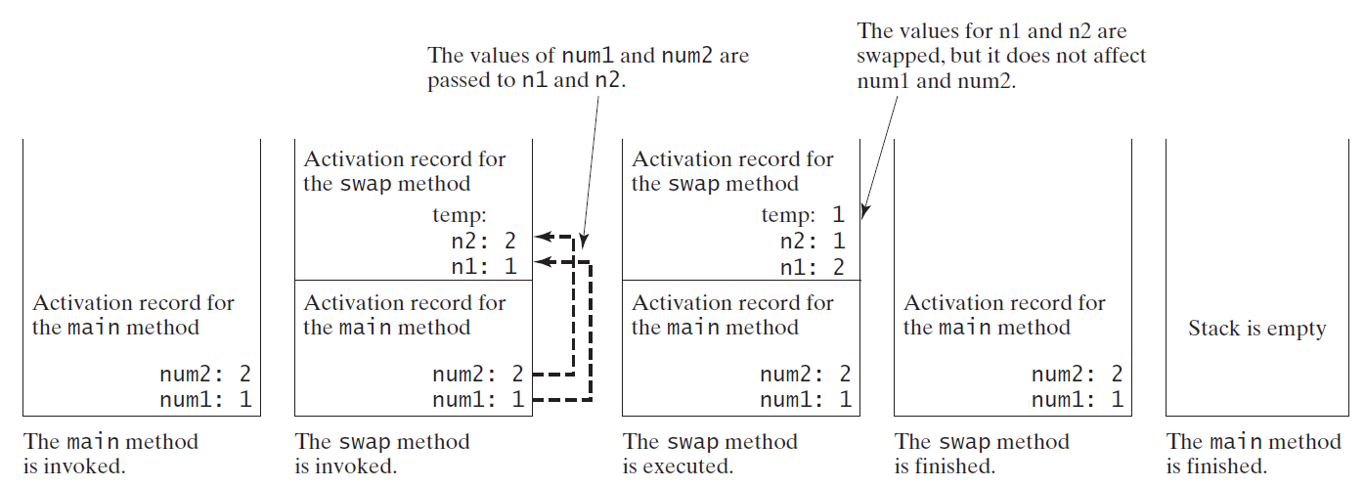
Pass by Value, cont.

Slide 40
Overloading Methods
Overloading the max Method
public static double max(double num1, double num2) {
if (num1 > num2)
return num1;
else
return num2;
}
TestMethodOverloading

Slide 41
Ambiguous Invocation
Sometimes there may be two or more possible matches for an invocation of a method, but the compiler cannot determine the most specific match. This is referred to as ambiguous invocation. Ambiguous invocation is a compile error.

Slide 42
Ambiguous Invocation
public class AmbiguousOverloading {
public static void main(String[] args) {
System.out.println(max(1, 2));
}
public static double max(int num1, double num2) {
if (num1 > num2)
return num1;
else
return num2;
}
public static double max(double num1, int num2) {
if (num1 > num2)
return num1;
else
return num2;
}
}

Slide 43
Scope of Local Variables
A local variable: a variable defined inside a method.
Scope: the part of the program where the variable can be referenced.
The scope of a local variable starts from its declaration and continues to the end of the block that contains the variable. A local variable must be declared before it can be used.

Slide 44
Scope of Local Variables, cont.
You can declare a local variable with the same name multiple times in different non-nesting blocks in a method, but you cannot declare a local variable twice in nested blocks.

Slide 45
Scope of Local Variables, cont.
A variable declared in the initial action part of a for loop header has its scope in the entire loop. But a variable declared inside a for loop body has its scope limited in the loop body from its declaration and to the end of the block that contains the variable.

Slide 46
Scope of Local Variables, cont.

Slide 47
Scope of Local Variables, cont.
// Fine with no errors
public static void correctMethod() {
int x = 1;
int y = 1;
// i is declared
for (int i = 1; i < 10; i++) {
x += i;
}
// i is declared again
for (int i = 1; i < 10; i++) {
y += i;
}
}

Slide 48
Scope of Local Variables, cont.
// With errors
public static void incorrectMethod() {
int x = 1;
int y = 1;
for (int i = 1; i < 10; i++) {
int x = 0;
x += i;
}
}

Slide 49
Benefits of Methods
Write a method once and reuse it anywhere.
Information hiding. Hide the implementation from the user.
Reduce complexity.

