Slide 1
Microprocessor Introduction
Seung-Ho Lim
Hankuk University of Foreign Studies

Slide 2
Class Information
Instructor:
Seung-Ho Lim
E-mail : slim@hufs.ac.kr
Office : Engineering Building 417
Lecture hours : Wednesday 78, Friday 56
Teaching Assistant
Sohoon Jin
Course Objective:
Interpret and design hardware and software for simple digital systems
which use Cortex-M3 microcontroller
Study the fundamentals of microprocessor organization and operation
Assembly and C programming based on the Cortex-M3 microcontroller
instruction set
Study the basis for interaction between the Cortex-M3 microcontroller and
external hardware with experiments

Slide 3
Class Information
Lecture Book
The Definitive Guide to ARM Cortex-M3, second edition
Lecture Contents
Microprocessor & microcontrollers
The ARM cortex-M3 microcontroller hardware details
The ARM cortex-M3 instruction set
The ARM cortex-M3 assembly/C programming
GPIO Control, Interrupt, Timer, UART, Step Motor, KeyPAD, etc…
Grading:
Mid-term exam – 37%
Final exam – 38%
HW/ Labs reports and experiments, projects – 20%
Attendance – 5%

Slide 4
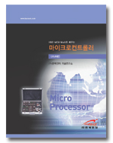
Experimental Materials
HBE-MCU-Multi
HBE-MCU-Multi 로 배우는 마이크로컨트롤러(cortex-M3)

Slide 5
Class Tentative Schedule
Week | Wednesday
 | Friday
1 | (9/4) Introduction of the Course (Lec)
 | (9/6) Basic Computer Architecture, Overview of Cortex-M3 (Lec)
2 | (9/11) Basic Computer Architecture, Overview of Cortex-M3 (Lec)
 | (9/13) Holliday
3 | (9/18) Cortex-M3 ISA – Assembly Programming (Lec)
 | (9/20) Experimental Environment Setup & simple test labs (Lab)
4 | (9/25) Cortex-M3 ISA – Arithmetic and Logic (Lec)
 | (9/27) Cortex-M3 Microcontroller – Assembly Programming Labs (Lab)
5 | (10/2) Cortex-M3 ISA – Branch, Control, Memory Map (Lec)
 | (10/4) Cortex-M3 Assembly Programming – Arithmetic and Logic Labs (Lab)
6 | (10/9) Holliday
 | (10/11) Cortex-M3 Assembly Programming – Arithmetic and Logic Labs (Lab)
7 | (10/16) Cortex-M3 ISA & Cortex-M3 Memory Map, GPIO (Lec)
 | (10/18) GPIO Labs (Lab)
8 | Middle Exam

Slide 6
Class Tentative Schedule
Week | Wednesday
 | Friday
9 | (10/30) Cortex-M3 Interrupt (Lec)
 | (11/1) Interrupt Labs (Lab)
10 | (11/6) Cortex-M3 Timer (Lec)
 | (11/8) Timer Labs(Lab)
11 | (11/13) Cortex-M3 Timer PWM (Lec)
 | (11/15) Timer PWM Labs(Lab)
12 | (11/20) Serial Port(Lec)
 | (11/22) UART(Serial) Labs (Lab)
13 | (11/27) Cortex-M3 TextLCD (Lec)
 | (11/29) Cortex-M3 TextLCD Labs (Lab)
14 | (12/4) Step Moter and KeyPAD (Lec)
 | (12/6) Step Moter and KeyPAD Labs (Lab)
15 | (12/11) Term Project
 | (12/13) Term Project Demo
16 | Final Exam

Slide 7
Topics covered in this course
Introduction to microprocessor organization and operations, emphasizing the Comtex-M3 microcontroller subset.
Introduction to computer architecture, with emphasis on systems involving the Comtex-M3 microcontroller.
Machine and assembly language programming for the ARM Comtex-M3 and variants.
C language programming for embedded systems.

Slide 8
By the end of the course,
You should be able to :
Understanding the organization of a simple microcontroller.
Analyze and design hardware and software for small digital systems involving microcontrollers.
Program embedded computer systems in Assembly and C.
Use the Comtex-M3 microcontroller and its standard peripherals.

Slide 9
Why this course is important
Microcontrollers are use extensively in process control, instrumentation, home appliances, automobiles, etc.
They represents a basic building block of modern digital systems design.
If you go into virtually any form of engineering design, there is a high probability that knowledge of microcontrollers will be required.
Microcontrollers area the basis of embedded systems.

Slide 10
Preliminarily studies
Numbering for computer systems
Digital primer
Gates
Decoder
Mux
register

Slide 11
Numbering and Coding Systems
Human beings use base 10(decimal) arithmetic
There are 10 distinct symbols, 0~9
Computers use base 2(binary) system
There are only 0 and 1
These two binary digits are commonly referred to as bit
converting from decimal to binary
divide the decimal number by 2 repeatedly
keep track of the remainders
continue this process until the quotient becomes zero
write the remainders in reverse order to obtain the binary number

Slide 12
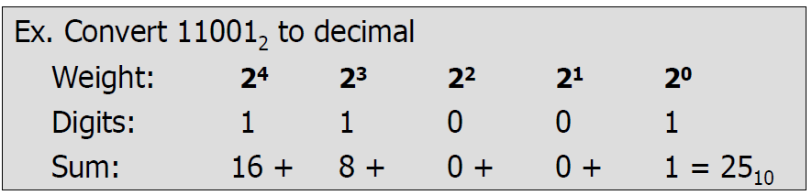
Numbering and Coding Systems
Converting from binary to decimal
Know the weight of each bit in a binary number
Add them together to get its decimal equivalent

Slide 13
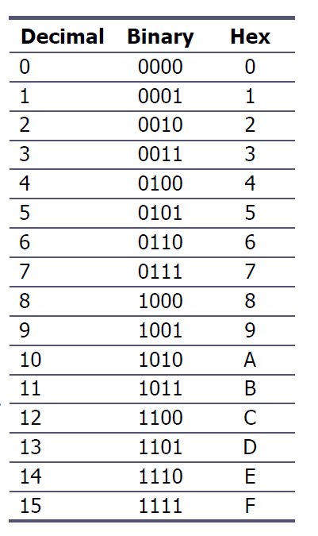
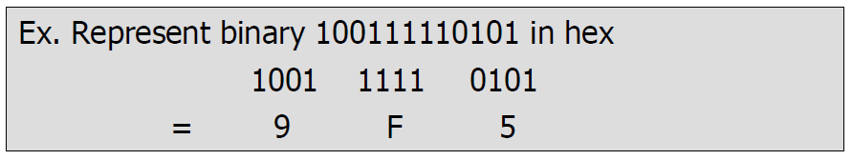
Numbering and Coding Systems
Hexadecimal system
Base 16, the hexadecimal system, is used ad a convenient representation of binary numbers
To represent a binary number as its equivalent hexadecimal number
Start from the right and group 4 bits at a time
replacing each 4-bit binary number with its hex equivalent

Slide 14
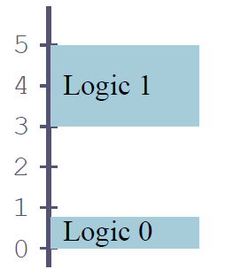
Binary Logic
Two voltage levels can be represented as the two digits 0 and 1
Signals in digital electronics have two distinct voltage levels with built-in tolerances for variations in the voltage
A valid digital signal should be within either of the two shaded areas

Slide 15
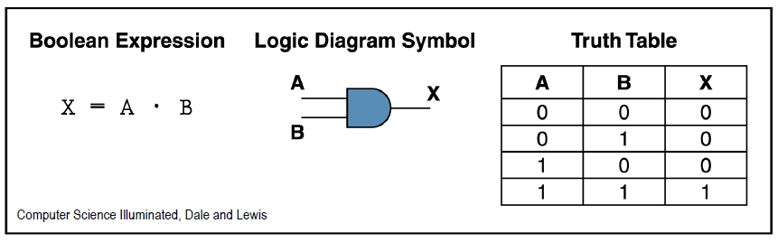
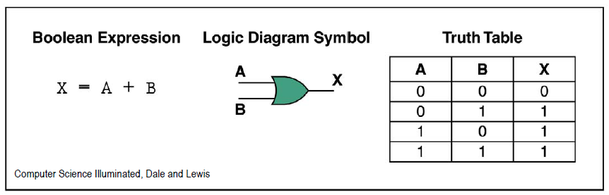
Very basic components of Computer
Logic Gates
AND gate
OR gate

Slide 16
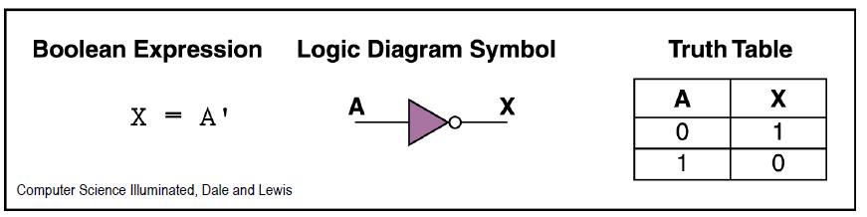
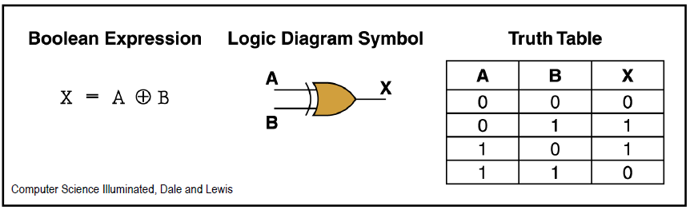
Very basic components of Computer
Logic gates
Inverter
XOR gate

Slide 17
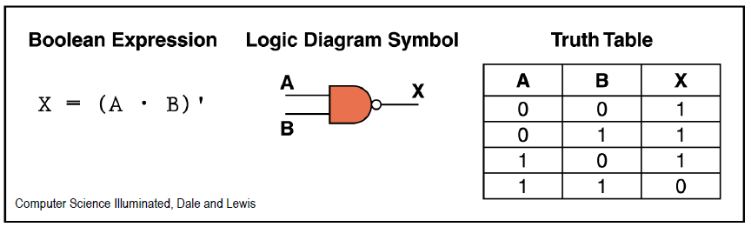
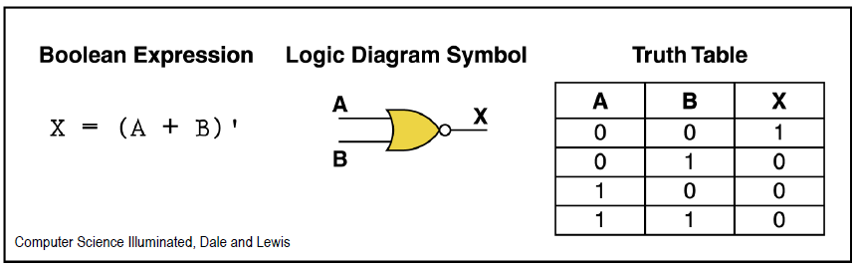
Very basic components of Computer
Logic gates
NAND gate
NOR gate

Slide 18
Basic Digital Logic Components
Microprocessor composed of several digital Logic components
Adder
Decoder
Mux(Multiplexor)
Register
Bus
Etc.

Slide 19
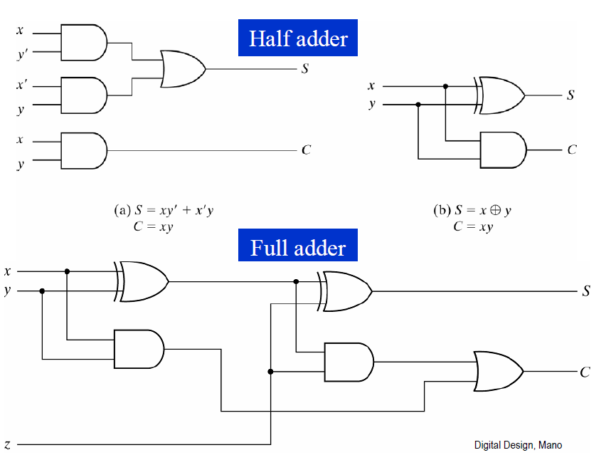
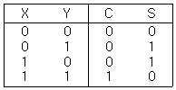
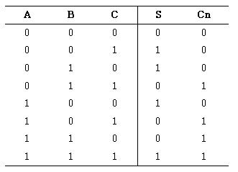
Digital Logic Design using Gates
Adder
Adders are used for arithmetic operations of two operands

Slide 20
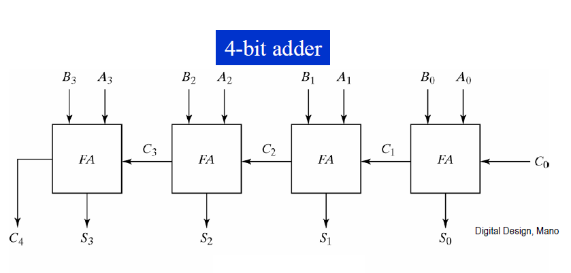
Digital Logic Design using Gates

Slide 21
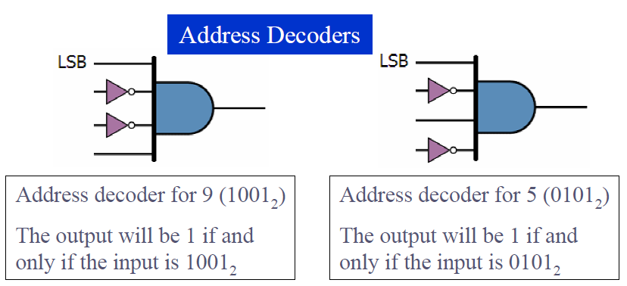
Digital Logic Design using Gates
Decoders
Decoders are widely used for address decoding in computer system

Slide 22
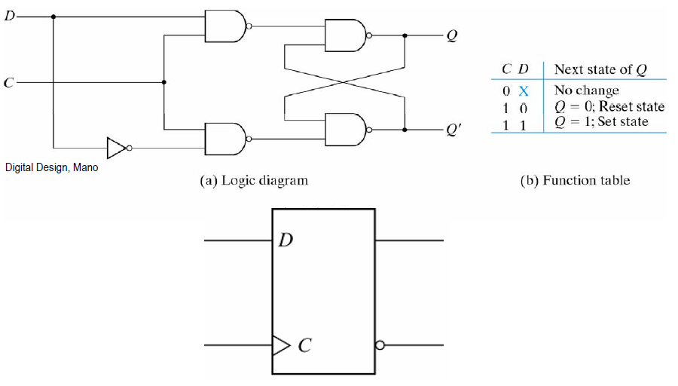
Digital Logic Design using Gates
Flip-flops
Flop-flops are frequently used to store data

Slide 23
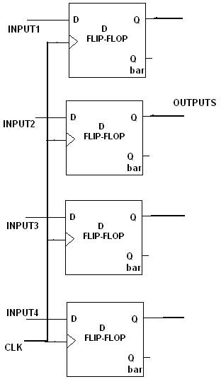
Digital Logic Design using Gates
Register
3-dimensional flip-flops are register
Stack 4 flip flops to get 4 bit data register
Strobe clk(clock) to get D = Q

Slide 24
Summary
Introduction to Coursework
Basic Computing System
Basic modules for microprocessor

