Slide 1
Chapter 3 Selections

Slide 2
Motivations
If you assigned a negative value for radius in Listing 2.2, ComputeAreaWithConsoleInput.java, the program would print an invalid result. If the radius is negative, you don't want the program to compute the area. How can you deal with this situation?

Slide 3
Objectives
To declare boolean variables and write Boolean expressions using relational operators (§3.2).
To implement selection control using one-way if statements (§3.3).
To implement selection control using two-way if-else statements (§3.4).
To implement selection control using nested if and multi-way if statements (§3.5).
To avoid common errors and pitfalls in if statements (§3.6).
To generate random numbers using the Math.random() method (§3.7).
To program using selection statements for a variety of examples (SubtractionQuiz, BMI, ComputeTax) (§§3.7–3.9).
To combine conditions using logical operators (&&, ||, and !) (§3.10).
To program using selection statements with combined conditions (LeapYear, Lottery) (§§3.11–3.12).
To implement selection control using switch statements (§3.13).
To write expressions using the conditional expression (§3.14).
To examine the rules governing operator precedence and associativity (§3.15).
To apply common techniques to debug errors (§3.16).

Slide 4
The boolean Type and Operators
Often in a program you need to compare two values, such as whether i is greater than j.
Java provides six comparison operators (also known as relational operators) that can be used to compare two values.
The result of the comparison is a Boolean value: true or false.
boolean b = (1 > 2);

Slide 5
Relational Operators

Slide 6
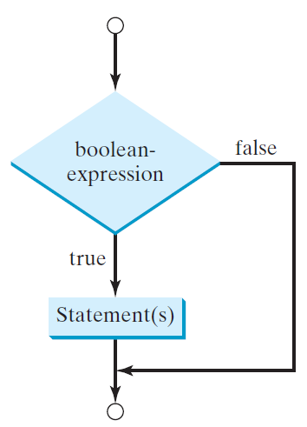
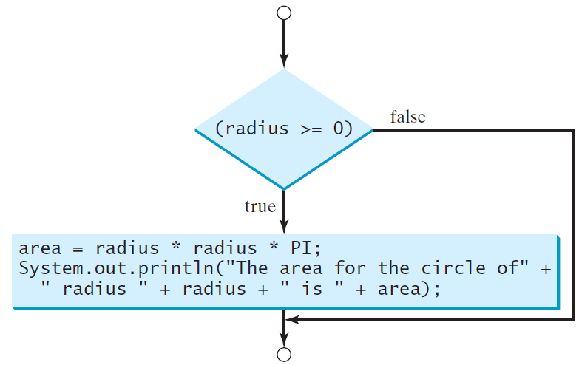
One-way if Statements
if (radius >= 0) {
area = radius * radius * PI;
System.out.println("The area"
+ " for the circle of radius "
+ radius + " is " + area);
}
if (boolean-expression) {
statement(s);
}

Slide 7
Note

Slide 8
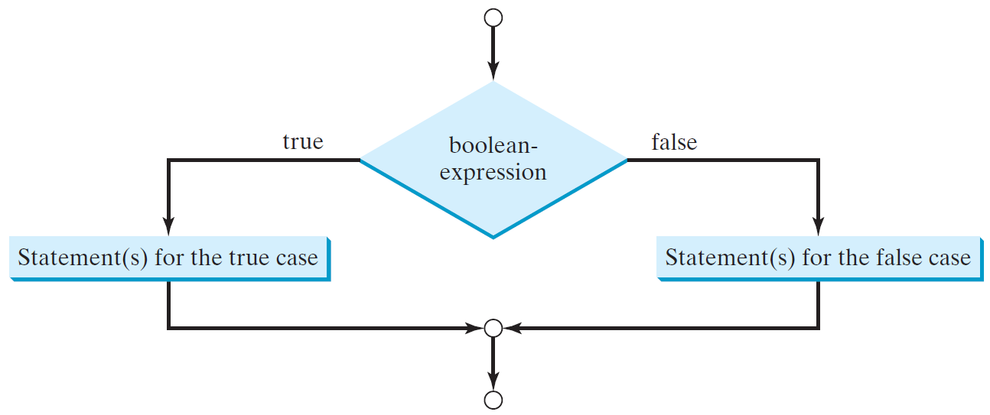
The Two-way if Statement
if (boolean-expression) {
statement(s)-for-the-true-case;
}
else {
statement(s)-for-the-false-case;
}

Slide 9
if-else Example
if (radius >= 0) {
area = radius * radius * 3.14159;
System.out.println("The area for the “
+ “circle of radius " + radius +
" is " + area);
}
else {
System.out.println("Negative input");
}

Slide 10
Multiple Alternative if Statements

Slide 11
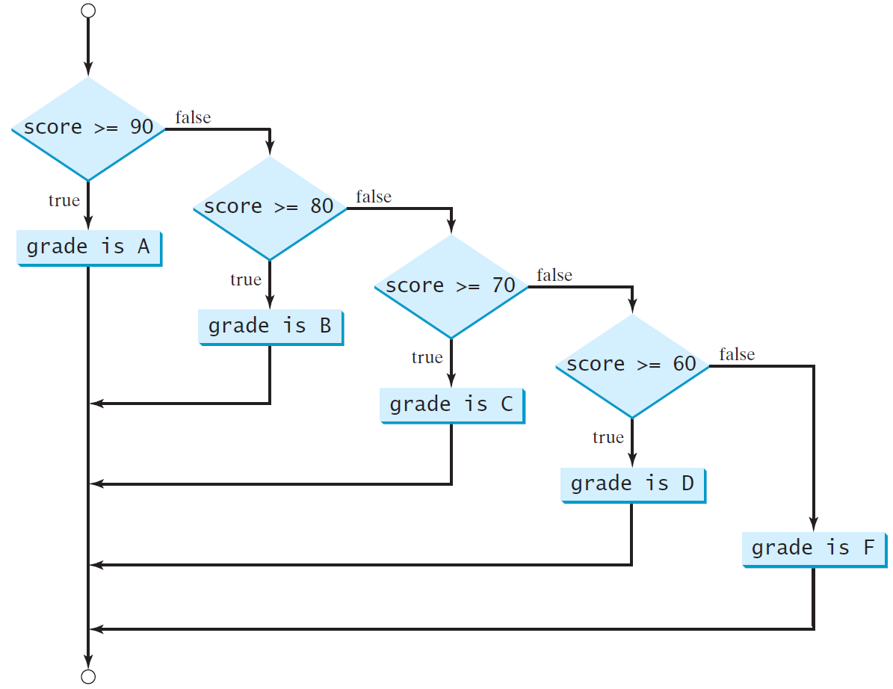
Multi-Way if-else Statements

Slide 12
Trace if-else statement
animation
Suppose score is 70.0
The condition is false
if (score >= 90.0)
System.out.print("A");
else if (score >= 80.0)
System.out.print("B");
else if (score >= 70.0)
System.out.print("C");
else if (score >= 60.0)
System.out.print("D");
else
System.out.print("F");

Slide 13
Trace if-else statement
animation
Suppose score is 70.0
The condition is false
if (score >= 90.0)
System.out.print("A");
else if (score >= 80.0)
System.out.print("B");
else if (score >= 70.0)
System.out.print("C");
else if (score >= 60.0)
System.out.print("D");
else
System.out.print("F");

Slide 14
Trace if-else statement
animation
Suppose score is 70.0
The condition is true
if (score >= 90.0)
System.out.print("A");
else if (score >= 80.0)
System.out.print("B");
else if (score >= 70.0)
System.out.print("C");
else if (score >= 60.0)
System.out.print("D");
else
System.out.print("F");

Slide 15
Trace if-else statement
animation
Suppose score is 70.0
grade is C
if (score >= 90.0)
System.out.print("A");
else if (score >= 80.0)
System.out.print("B");
else if (score >= 70.0)
System.out.print("C");
else if (score >= 60.0)
System.out.print("D");
else
System.out.print("F");

Slide 16
Trace if-else statement
animation
Suppose score is 70.0
Exit the if statement
if (score >= 90.0)
System.out.print("A");
else if (score >= 80.0)
System.out.print("B");
else if (score >= 70.0)
System.out.print("C");
else if (score >= 60.0)
System.out.print("D");
else
System.out.print("F");

Slide 17
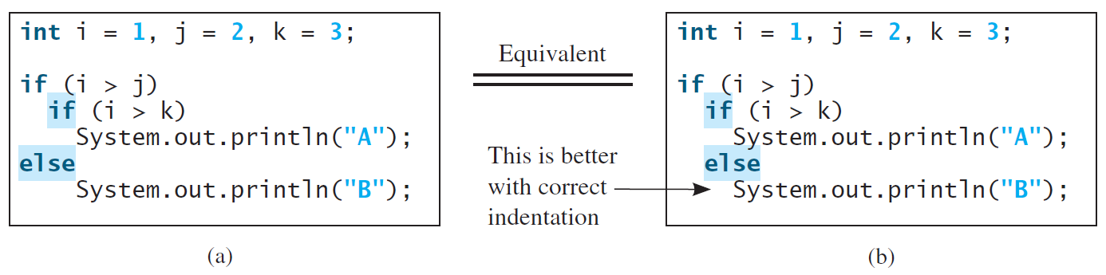
Note
The else clause matches the most recent if clause in the same block.

Slide 18
Note, cont.
Nothing is printed from the preceding statement. To force the else clause to match the first if clause, you must add a pair of braces:
int i = 1;
int j = 2;
int k = 3;
if (i > j) {
if (i > k)
System.out.println("A");
}
else
System.out.println("B");
This statement prints B.

Slide 19
Common Errors
Adding a semicolon at the end of an if clause is a common mistake.
if (radius >= 0);
{
area = radius*radius*PI;
System.out.println(
"The area for the circle of radius " +
radius + " is " + area);
}
This mistake is hard to find, because it is not a compilation error or a runtime error, it is a logic error.
This error often occurs when you use the next-line block style.
Wrong

Slide 20
TIP

Slide 21
CAUTION

Slide 22
Problem: Body Mass Index
Body Mass Index (BMI) is a measure of health on weight. It can be calculated by taking your weight in kilograms and dividing by the square of your height in meters. The interpretation of BMI for people 16 years or older is as follows:
ComputeAndInterpretBMI

Slide 23
Logical Operators
Operator | Name | Description
! | not | logical negation
&& | and | logical conjunction
|| | or | logical disjunction
^ | exclusive or | logical exclusion

Slide 24
Truth Table for Operator !
p | !p | Example (assume age = 24, weight = 140)
true | false | !(age > 18) is false, because (age > 18) is true.
false | true | !(weight == 150) is true, because (weight == 150) is false.

Slide 25
Truth Table for Operator &&
p₁ | p₂ | p₁ && p₂ | Example (assume age = 24, weight = 140)
false | false | false | (age <= 18) && (weight < 140) is false, because (age > 18) and (weight <= 140) are both false.
false | true | false
true | false | false | (age > 18) && (weight > 140) is false, because (weight > 140) is false.
true | true | true | (age > 18) && (weight >= 140) is true, because both (age > 18) and (weight >= 140) are true.

Slide 26
Truth Table for Operator ||
p₁ | p₂ | p₁ || p₂ | Example (assume age = 24, weihgt = 140)
false | false | false
false | true | true | (age > 34) || (weight <= 140) is true, because (age > 34) is false, but (weight <= 140) is true.
true | false | true | (age > 14) || (weight >= 150) is false, because (age > 14) is true.
true | true | true

Slide 27
Truth Table for Operator ^
p₁ | p₂ | p₁ ^ p₂ | Example (assume age = 24, weight = 140)
false | false | false | (age > 34) ^ (weight > 140) is true, because (age > 34) is false and (weight > 140) is false.
false | true | true | (age > 34) ^ (weight >= 140) is true, because (age > 34) is false but (weight >= 140) is true.
true | false | true | (age > 14) ^ (weight > 140) is true, because (age > 14) is true and (weight > 140) is false.
true | true | false

Slide 28
Examples
Here is a program that checks whether a number is divisible by 2 and 3, whether a number is divisible by 2 or 3, and whether a number is divisible by 2 or 3 but not both:
TestBooleanOperators
Run

Slide 29
Examples
System.out.println("Is " + number + " divisible by 2 and 3? " +
((number % 2 == 0) && (number % 3 == 0)));
System.out.println("Is " + number + " divisible by 2 or 3? " +
((number % 2 == 0) || (number % 3 == 0)));
System.out.println("Is " + number +
" divisible by 2 or 3, but not both? " +
((number % 2 == 0) ^ (number % 3 == 0)));
TestBooleanOperators
Run

Slide 30
The & and | Operators
If x is 1, what is x after this expression?
(x > 1) & (x++ < 10)
If x is 1, what is x after this expression?
(1 > x) && ( 1 > x++)
How about (1 == x) | (10 > x++)?
(1 == x) || (10 > x++)?

Slide 31
Problem: Determining Leap Year?
This program first prompts the user to enter a year as an int value and checks if it is a leap year.
A year is a leap year if it is divisible by 4 but not by 100, or it is divisible by 400.
(year % 4 == 0 && year % 100 != 0) || (year % 400 == 0)
LeapYear
Run

Slide 32
switch Statements
switch (status) {
case 0: compute taxes for single filers;
break;
case 1: compute taxes for married file jointly;
break;
case 2: compute taxes for married file separately;
break;
case 3: compute taxes for head of household;
break;
default: System.out.println("Errors: invalid status");
System.exit(1);
}

Slide 33
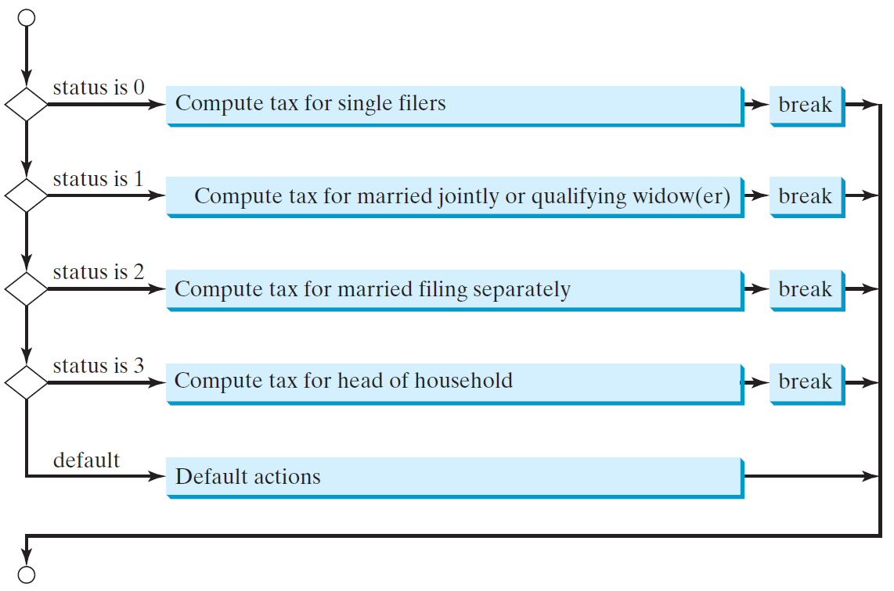
switch Statement Flow Chart

Slide 34
switch Statement Rules
The switch-expression must yield a value of char, byte, short, or int type and must always be enclosed in parentheses.
switch (switch-expression) {
case value1: statement(s)1;
break;
case value2: statement(s)2;
break;
…
case valueN: statement(s)N;
break;
default: statement(s)-for-default;
}
The value1, ..., and valueN must have the same data type as the value of the switch-expression. The resulting statements in the case statement are executed when the value in the case statement matches the value of the switch-expression. Note that value1, ..., and valueN are constant expressions, meaning that they cannot contain variables in the expression, such as 1 + x.

Slide 35
switch Statement Rules
The keyword break is optional, but it should be used at the end of each case in order to terminate the remainder of the switch statement. If the break statement is not present, the next case statement will be executed.
switch (switch-expression) {
case value1: statement(s)1;
break;
case value2: statement(s)2;
break;
…
case valueN: statement(s)N;
break;
default: statement(s)-for-default;
}
The default case, which is optional, can be used to perform actions when none of the specified cases matches the switch-expression.
When the value in a case statement matches the value of the switch-expression, the statements starting from this case are executed until either a break statement or the end of the switch statement is reached.

Slide 36
Trace switch statement
animation
Suppose day is 2:
switch (day) {
case 1:
case 2:
case 3:
case 4:
case 5: System.out.println("Weekday"); break;
case 0:
case 6: System.out.println("Weekend");
}

Slide 37
Trace switch statement
animation
Match case 2
switch (day) {
case 1:
case 2:
case 3:
case 4:
case 5: System.out.println("Weekday"); break;
case 0:
case 6: System.out.println("Weekend");
}

Slide 38
Trace switch statement
animation
Fall through case 3
switch (day) {
case 1:
case 2:
case 3:
case 4:
case 5: System.out.println("Weekday"); break;
case 0:
case 6: System.out.println("Weekend");
}

Slide 39
Trace switch statement
animation
Fall through case 4
switch (day) {
case 1:
case 2:
case 3:
case 4:
case 5: System.out.println("Weekday"); break;
case 0:
case 6: System.out.println("Weekend");
}

Slide 40
Trace switch statement
animation
Fall through case 5
switch (day) {
case 1:
case 2:
case 3:
case 4:
case 5: System.out.println("Weekday"); break;
case 0:
case 6: System.out.println("Weekend");
}

Slide 41
Trace switch statement
animation
Encounter break
switch (day) {
case 1:
case 2:
case 3:
case 4:
case 5: System.out.println("Weekday"); break;
case 0:
case 6: System.out.println("Weekend");
}

Slide 42
Trace switch statement
animation
Exit the statement
switch (day) {
case 1:
case 2:
case 3:
case 4:
case 5: System.out.println("Weekday"); break;
case 0:
case 6: System.out.println("Weekend");
}

Slide 43
Conditional Expressions
if (x > 0)
y = 1
else
y = -1;
is equivalent to
y = (x > 0) ? 1 : -1;
(boolean-expression) ? expression1 : expression2
Ternary operator
Binary operator
Unary operator

Slide 44
Conditional Operator
if (num % 2 == 0)
System.out.println(num + “is even”);
else
System.out.println(num + “is odd”);
System.out.println(
(num % 2 == 0)? num + “is even” :
num + “is odd”);

Slide 45
Conditional Operator, cont.
boolean-expression ? exp1 : exp2

Slide 46
Operator Precedence
var++, var--
+, - (Unary plus and minus), ++var,--var
(type) Casting
! (Not)
*, /, % (Multiplication, division, and remainder)
+, - (Binary addition and subtraction)
<, <=, >, >= (Relational operators)
==, !=; (Equality)
^ (Exclusive OR)
&& (Conditional AND) Short-circuit AND
|| (Conditional OR) Short-circuit OR
=, +=, -=, *=, /=, %= (Assignment operator)

Slide 47
Operator Precedence and Associativity
The expression in the parentheses is evaluated first. (Parentheses can be nested, in which case the expression in the inner parentheses is executed first.) When evaluating an expression without parentheses, the operators are applied according to the precedence rule and the associativity rule.
If operators with the same precedence are next to each other, their associativity determines the order of evaluation. All binary operators except assignment operators are left-associative.

Slide 48
Operator Associativity
When two operators with the same precedence are evaluated, the associativity of the operators determines the order of evaluation. All binary operators except assignment operators are left-associative.
a – b + c – d is equivalent to ((a – b) + c) – d
Assignment operators are right-associative. Therefore, the expression
a = b += c = 5 is equivalent to a = (b += (c = 5))

Slide 49
Example
Applying the operator precedence and associativity rule, the expression 3 + 4 * 4 > 5 * (4 + 3) - 1 is evaluated as follows:

