Slide 1
Chapter 5 Loops

Slide 2
Motivations
Suppose that you need to print a string (e.g., "Welcome to Java!") a hundred times. It would be tedious to have to write the following statement a hundred times:
System.out.println("Welcome to Java!");
So, how do you solve this problem?

Slide 3
Opening Problem
Problem:
System.out.println("Welcome to Java!");
System.out.println("Welcome to Java!");
System.out.println("Welcome to Java!");
System.out.println("Welcome to Java!");
System.out.println("Welcome to Java!");
System.out.println("Welcome to Java!");
…
…
…
System.out.println("Welcome to Java!");
System.out.println("Welcome to Java!");
System.out.println("Welcome to Java!");
100 times

Slide 4
Introducing while Loops
int count = 0;
while (count < 100) {
System.out.println("Welcome to Java");
count++;
}

Slide 5
Objectives
To write programs for executing statements repeatedly using a while loop (§5.2).
To follow the loop design strategy to develop loops (§§5.2.1–5.2.3).
To control a loop with a sentinel value (§5.2.4).
To obtain large input from a file using input redirection rather than typing from the keyboard (§5.2.5).
To write loops using do-while statements (§5.3).
To write loops using for statements (§5.4).
To discover the similarities and differences of three types of loop statements (§5.5).
To write nested loops (§5.6).
To learn the techniques for minimizing numerical errors (§5.7).
To learn loops from a variety of examples (GCD, FutureTuition, Dec2Hex) (§5.8).
To implement program control with break and continue (§5.9).
To write a program that displays prime numbers (§5.11).

Slide 6
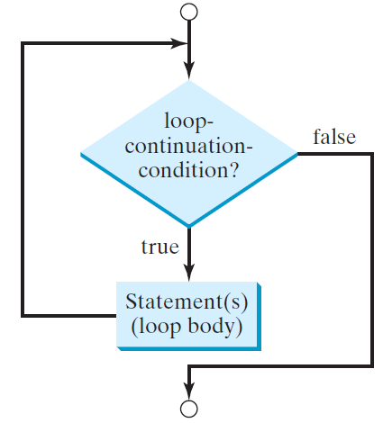
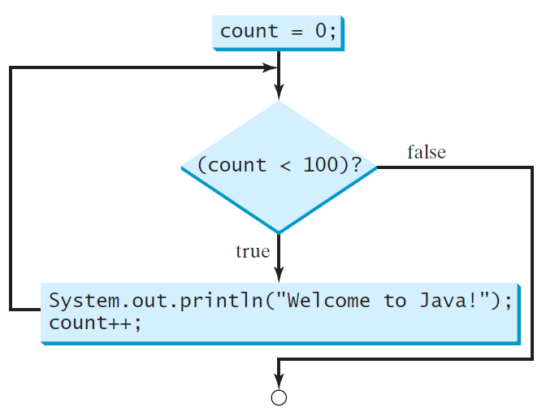
while Loop Flow Chart
int count = 0;
while (count < 100) {
System.out.println("Welcome to Java!");
count++;
}
while (loop-continuation-condition) {
// loop-body;
Statement(s);
}

Slide 7
Trace while Loop
animation
Initialize count
int count = 0;
while (count < 2) {
System.out.println("Welcome to Java!");
count++;
}

Slide 8
Trace while Loop, cont.
animation
(count < 2) is true
int count = 0;
while (count < 2) {
System.out.println("Welcome to Java!");
count++;
}

Slide 9
Trace while Loop, cont.
animation
Print Welcome to Java
int count = 0;
while (count < 2) {
System.out.println("Welcome to Java!");
count++;
}

Slide 10
Trace while Loop, cont.
animation
Increase count by 1
count is 1 now
int count = 0;
while (count < 2) {
System.out.println("Welcome to Java!");
count++;
}

Slide 11
Trace while Loop, cont.
animation
(count < 2) is still true since count is 1
int count = 0;
while (count < 2) {
System.out.println("Welcome to Java!");
count++;
}

Slide 12
Trace while Loop, cont.
animation
Print Welcome to Java
int count = 0;
while (count < 2) {
System.out.println("Welcome to Java!");
count++;
}

Slide 13
Trace while Loop, cont.
animation
Increase count by 1
count is 2 now
int count = 0;
while (count < 2) {
System.out.println("Welcome to Java!");
count++;
}

Slide 14
Trace while Loop, cont.
animation
(count < 2) is false since count is 2 now
int count = 0;
while (count < 2) {
System.out.println("Welcome to Java!");
count++;
}

Slide 15
Trace while Loop
animation
The loop exits. Execute the next statement after the loop.
int count = 0;
while (count < 2) {
System.out.println("Welcome to Java!");
count++;
}

Slide 16
Problem: Guessing Numbers
Write a program that randomly generates an integer between 0 and 100, inclusive. The program prompts the user to enter a number continuously until the number matches the randomly generated number. For each user input, the program tells the user whether the input is too low or too high, so the user can choose the next input intelligently. Here is a sample run:
GuessNumberOneTime
GuessNumber

Slide 17
Caution
Don’t use floating-point values for equality checking in a loop control. Since floating-point values are approximations for some values, using them could result in imprecise counter values and inaccurate results. Consider the following code for computing 1 + 0.9 + 0.8 + ... + 0.1:
double item = 1; double sum = 0;
while (item != 0) { // No guarantee item will be 0
sum += item;
item -= 0.1;
}
System.out.println(sum);

Slide 18
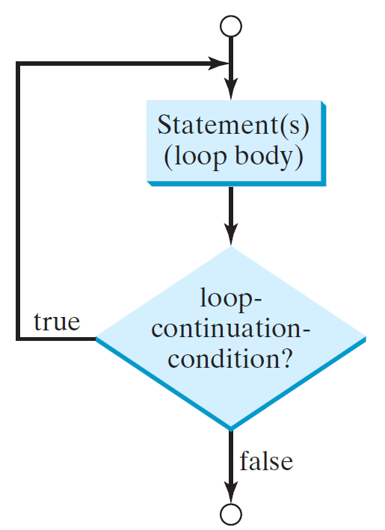
do-while Loop
do {
// Loop body;
Statement(s);
} while (loop-continuation-condition);

Slide 19
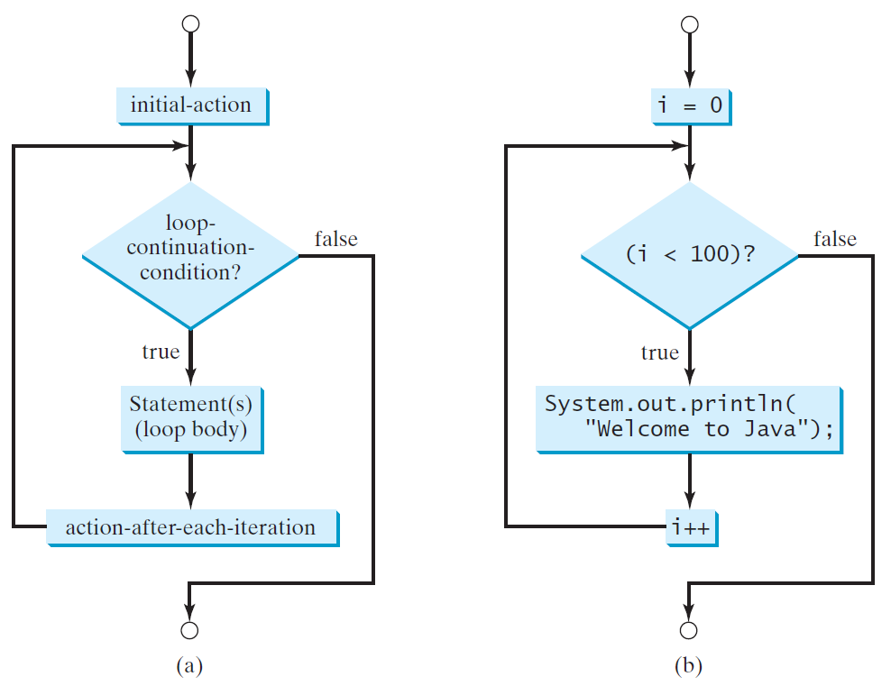
for Loops
for (initial-action; loop-continuation-condition; action-after-each-iteration) {
// loop body;
Statement(s);
}
int i;
for (i = 0; i < 100; i++) {
System.out.println(
"Welcome to Java!");
}

Slide 20
Trace for Loop
animation
Declare i
int i;
for (i = 0; i < 2; i++) {
System.out.println(
"Welcome to Java!");
}

Slide 21
Trace for Loop, cont.
animation
Execute initializer
i is now 0
int i;
for (i = 0; i < 2; i++) {
System.out.println(
"Welcome to Java!");
}

Slide 22
Trace for Loop, cont.
animation
(i < 2) is true
since i is 0
int i;
for (i = 0; i < 2; i++) {
System.out.println( "Welcome to Java!");
}

Slide 23
Trace for Loop, cont.
animation
Print Welcome to Java
int i;
for (i = 0; i < 2; i++) {
System.out.println("Welcome to Java!");
}

Slide 24
Trace for Loop, cont.
animation
Execute adjustment statement
i now is 1
int i;
for (i = 0; i < 2; i++) {
System.out.println("Welcome to Java!");
}

Slide 25
Trace for Loop, cont.
animation
(i < 2) is still true
since i is 1
int i;
for (i = 0; i < 2; i++) {
System.out.println("Welcome to Java!");
}

Slide 26
Trace for Loop, cont.
animation
Print Welcome to Java
int i;
for (i = 0; i < 2; i++) {
System.out.println("Welcome to Java!");
}

Slide 27
Trace for Loop, cont.
animation
Execute adjustment statement
i now is 2
int i;
for (i = 0; i < 2; i++) {
System.out.println("Welcome to Java!");
}

Slide 28
Trace for Loop, cont.
animation
(i < 2) is false
since i is 2
int i;
for (i = 0; i < 2; i++) {
System.out.println("Welcome to Java!");
}

Slide 29
Trace for Loop, cont.
animation
Exit the loop. Execute the next statement after the loop
int i;
for (i = 0; i < 2; i++) {
System.out.println("Welcome to Java!");
}

Slide 30
Note
The initial-action in a for loop can be a list of zero or more comma-separated expressions.
The action-after-each-iteration in a for loop can be a list of zero or more comma-separated statements.
Therefore, the following two for loops are correct. They are rarely used in practice, however.
for (int i = 1; i < 100; System.out.println(i++));
for (int i = 0, j = 0; (i + j < 10); i++, j++) {
// Do something
}

Slide 31
Note
If the loop-continuation-condition in a for loop is omitted, it is implicitly true.
Thus the statement given below in (a), which is an infinite loop, is correct.
Nevertheless, it is better to use the equivalent loop in (b) to avoid confusion:

Slide 32
Caution
Adding a semicolon at the end of the for clause before the loop body is a common mistake, as shown below:
Logic Error
for (int i=0; i<10; i++);
{
System.out.println("i is " + i);
}

Slide 33
Caution, cont.
Similarly, the following loop is also wrong:
int i=0;
while (i < 10);
{
System.out.println("i is " + i);
i++;
}
In the case of the do loop, the following semicolon is needed to end the loop.
int i=0;
do {
System.out.println("i is " + i);
i++;
} while (i<10);
Logic Error
Correct

Slide 34
Which Loop to Use?
The three forms of loop statements, while, do-while, and for, are expressively equivalent; that is, you can write a loop in any of these three forms.
For example, a while loop in (a) in the following figure can always be converted into the following for loop in (b):
A for loop in (a) in the following figure can generally be converted into the following while loop in (b) except in certain special cases (see Review Question 3.19 for one of them):

Slide 35
Recommendations
Use the one that is most intuitive and comfortable for you.
In general, a for loop may be used if the number of repetitions is known, as, for example, when you need to print a message 100 times.
A while loop may be used if the number of repetitions is not known, as in the case of reading the numbers until the input is 0.
A do-while loop can be used to replace a while loop if the loop body has to be executed before testing the continuation condition.

Slide 36
Problem: Finding the Greatest Common Divisor
Problem: Write a program that prompts the user to enter two positive integers and finds their greatest common divisor.
Solution: Suppose you enter two integers 4 and 2, their greatest common divisor is 2. Suppose you enter two integers 16 and 24, their greatest common divisor is 8. So, how do you find the greatest common divisor? Let the two input integers be n1 and n2. You know number 1 is a common divisor, but it may not be the greatest commons divisor. So you can check whether k (for k = 2, 3, 4, and so on) is a common divisor for n1 and n2, until k is greater than n1 or n2.
GreatestCommonDivisor
Run

Slide 37
Case Study: Converting Decimals to Hexadecimals
Hexadecimals are often used in computer systems programming (see Appendix F for an introduction to number systems). How do you convert a decimal number to a hexadecimal number? To convert a decimal number d to a hexadecimal number is to find the hexadecimal digits h_{n}, h_{n-1}, h_{n-2}, ... , h₂, h₁, and h₀ such that
These hexadecimal digits can be found by successively dividing d by 16 until the quotient is 0. The remainders are h₀, h₁, h₂, ... , h_{n-2}, h_{n-1}, and h_{n}.
Dec2Hex
Run

Slide 38
Using break and continue
Examples for using the break and continue keywords:
TestBreak.java
TestBreak
TestContinue.java
TestContinue

Slide 39
break

Slide 40
continue

