Slide 1
Informatica CDGC Publisher
Prototype

Slide 2
What are we trying to do?
An automated way to publish items into CDGC.
Uses templates for different use cases
Allows for otherwise unsupported automation

Slide 3
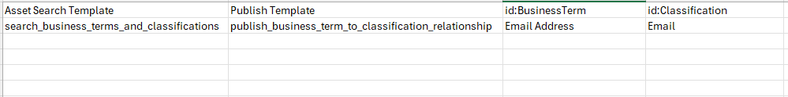
Configure with csv file
Provide the Template to use to publish. These templates may contain replacement tokens.
Asset Search Template. Optional. This will perform a search, and write the results to “assets.json”. Only needed if other templates need to lookup IDs
All other fields are completely dependent on which Template you use.
If the header starts with “id:”, that indicates that the system will look up the id, based on the name provided
Also, if the header starts with “id:”, then it will use the rest of the header name, to filter the type of asset. If the name is within the “core.name” of the asset. For example: id:Classification, if will look for the word “Classification” within the core.name. So “core.DataElementClassification” and “core.DataEntityClassification” would be included in consideration.

Slide 4
Use Case: Automate Relationship between BusinessTerm and Classification
For This use Case:
Asset Search Template: search_business_terms_and_classifications
Publish Template: publish_business_term_to_classification_relationship
id:BusinessTerm: <Provide the name of the Business Term>
id:Classification: <Provide the name of the Classification>
Example:

Slide 5
Templates: Search Templates
Search templates are simply elastic searches, in JSON format. Whatever the result of the search is, it will writeinto the “extracts/assets.json” file. This file is then used in case ID’s need to be looked up.
Here is an example of:
search_business_terms_and_classifications.json
{
"size": 10000,
"query": {
"bool": {
"filter": {
"terms": {
"core.classType": [
"core.DataElementClassification",
"core.DataEntityClassification",
"com.infa.ccgf.models.governance.BusinessTerm"
]
}
}
}
}
}

Slide 6
Additional Information
You will be prompted to choose a csv file to use for configuration
Template files are stored in the “./templates” folder
extracts are stored in the “./extracts” folder
Additional flags can be set on the script (or via command line using --<parameter>=<value> run with --help for all parameters):
default_pod. Set this to the default Informatica POD to use. Example: dm-us
default_user. Set this to the default user to use. Example: shayes_compass
default_pwd. Set this to the default password to use. Example: 1234
prompt_for_login_info. True/False. Whether or not to prompt. If False, will not prompt, unless default is not set
pause_before_loading. True/False. Whether or not to pause after payload files are created, before loading the classifications.
If desired, you can create a credentials to save your defaults in ~/.informatica_cdgc path (c:\users\<username>\.informatica_cdgc). Example of that file is:
[default1] pod = dmp-us user = shayes_example pwd = xyz [shayes_compass] pod = dmp-us user = shayes_compass pwd = abc [reinvent] pod = dm-us user = reinvent01 pwd = zyx

Slide 7
Command Line Options
Optionally, you can set parameters:
--help
This will display all command line options
--default_user
You can specify the username to use. if you do now specify one, it will look in the
~/.informatica_cdgc/credentials file (as shown below)
Example:
--default_user=shayes_compass
--default_pwd
You can specify the password to use. if you do now specify one, it will look in the
~/.informatica_cdgc/credentials file (as shown below)
Example:
--default_pwd=12345
--default_pod
You can specify the pod to use. if you do now specify one, it will look in the
~/.informatica_cdgc/credentials file (as shown below)
Typically this "pod" can be shown in the url: for example: "dm-us"
Example:
--default_pwd=dm-us
--csv_file
You can specify the config csv file to use directly, by setting it here.
It will default to the directory where the script/exe file resides.
Example:
--csv_file=my_classifications.csv
--csv_file_path
You can specify the config csv file to use directly, by setting it here.
Setting it with this option, will allow you to specify the full path (use linux forward slashes)
Example:
--csv_file_path=c:/junk/my_classifications.csv
--extracts_folder
You can specify a different location to write the temporary files that the api downloads.
These files are raw collection of resources, and assets (in the case of using the api)
It will default to <script_location>/extracts
Example:
--extracts_folder=/my_files/data
--templates_folder
You can specify a different location where the template files exist
It will default to <script_location>/templates
Example:
--templates_folder=/my_files/templates

Slide 8
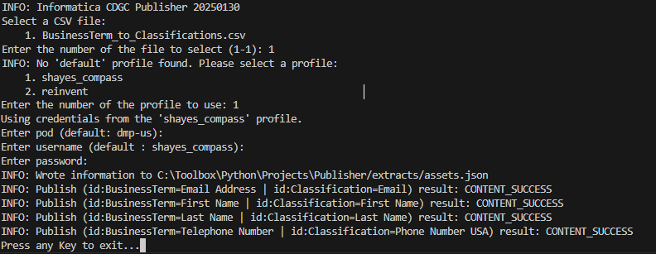
Output
Sample Output:
Note that if an error occurs, it will skip that publish and continue

Slide 9
Thank You
Questions / Issues / Suggestions:
Scott Hayes
shayes@informatica.com

