Slide 1

12345: Graph Analysis
Prof Muise (cm290)

Slide 2
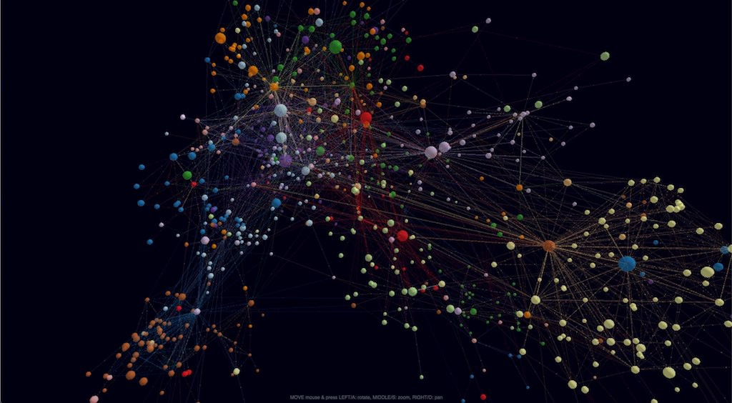
Summary
The aim of this project is to model certain properties of a graph and measure others. This should allow us to answer questions such as “how likely is a graph’s width 5, assuming that it’s connected” or “how likely is a graph with n nodes connected, assuming it has m edges?”

Slide 3
Propositions
edge_x_y: There is an edge from node x to node y
degree_x_n: Node x has degree n
connection_x_y_n: Node y is the nth connection starting at node x
connected: Graph is connected
distance_x_y_n: A path exists of length n from node x to y
…

Slide 4
Constraints
If an edge exists between nodes, then their distance is 1
edge_x_y → distance_x_y_1
If a node x can reach y with distance n, and y can reach z with distance n’, x can reach z with distance n+n’
(distance_x_y_n /\ distance_y_z_n’) → distance_x_z_(n+n’)
If distance_x_y_n holds, then distance_x_z_(n-1) must hold for some z connected to y
If we can reach every node with some distance, then the graph is connected
If a node has degree k, then there are exactly k adjacent edges
…

Slide 5
End

