Slide 1

999: Tsuro
Prof Muise (cm290)

Slide 2
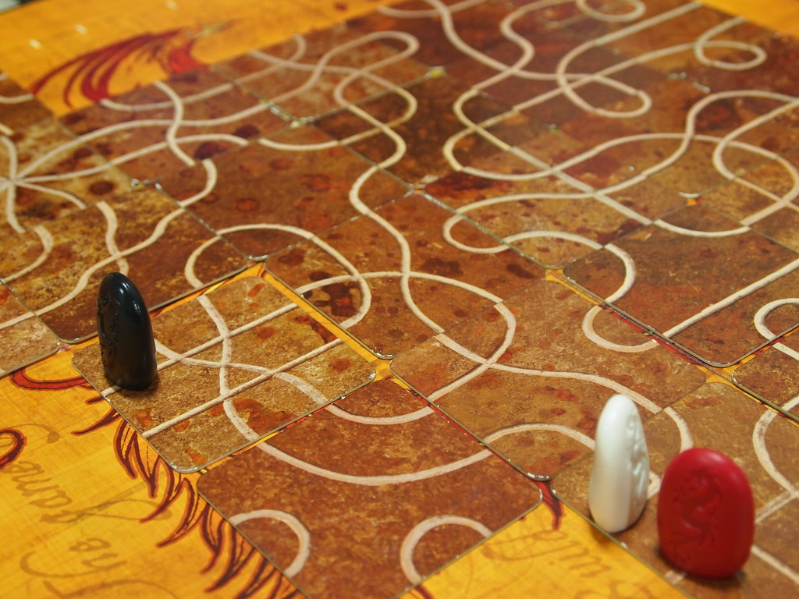
Summary
The idea behind the game of Tsuro is that you place tiles (from your hand of 3 tiles) onto a cell in front of your piece. Then you must follow the path in front of you, until you can follow no further. Also, any other piece in front of your tile must move as well.
There are multiple players, and the last one standing, wins. We will model the idea of what happens when you place a tile, and determine which pieces remain and where they end up on the board.
https://en.wikipedia.org/wiki/Tsuro

Slide 3
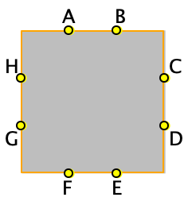



Propositions
T1
edge_connected(x,y,t): says that edge point x is connected to edge point y, on tile t. There are 7 possible target points for every individual entry point. E.g., in the figure to the top right for tile T1, we could have edge_connected(H,C,T1) – this is shown with the red line
configuration(t, o): tile t is oriented in direction o. The orientation can be NSEW, and we will assume that A,B endpoints are on the N side (again, see the figure above)
location(t, loc): tile t is at location loc. The location is where on the board that things exist.
at(p, t, ep): piece p is on tile t, at the edge point ep (e.g., A, B, …).
can_reach(p, t, ep): given the path in front of it, piece p can reach tile t’s endpoint ep
connected(t1, ep1, t2, ep2): there is a direct connection between tile t1’s edge point ep1 and tile t2’s edge point ep2

Slide 4
Constraints
No tile can be in two locations at the same time. For every tile and pair of unique locations loc1 and loc2, we have,
¬ (location(t, loc1) /\ location(t, loc2))
No pair of tiles can be at the same location. For every tiles t1 and t2 and location loc, we have,
¬ location(t1, loc) \/ ¬ location(t2, loc)
If things are connected, then reachability transitively holds. For example,
(edge_connected(x,y,t) /\ can_reach(p, t, x)) → can_reach(p, t, y)
  I am not yet sure how to force can_reach(p, t, y) to be false, when there is no way to actually reach it. Halp!!!
If there is a connection in a tile, then the edge points are connected: edge_connected(x,y,t) → connected(t, x, t, y)
Connect neighbouring edge points for tiles next to each other. For loc1 and loc2 that are next to each other,
“right/top of loc1” /\ “left/top of loc2” → connected(t1, “right/top”, t2, “left/top”)
  “right/top of loc1” needs to be a logical formula that captures the edge point of the tile that is located at loc1, and needs to take the orientation into account. Not yet sure how to best do this.

Slide 5
End

