Slide 1
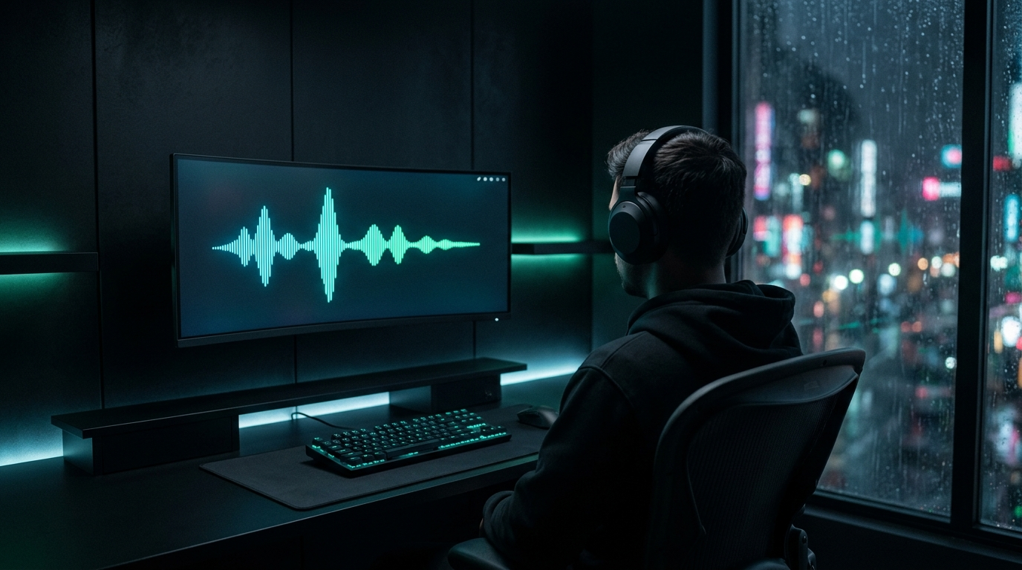
FINAL PROJECT · AI CONTENT PRODUCTION · 2026
NEURALIS
CONTENTFLOW
An end-to-end, AI-powered content system for a focus-tech brand: from strategy to a full week of blog, social, image, video and voice content.
[Your Name]
Yapay Zeka ile İçerik Üretimi Eğitimi — Final Projesi
NEURALIS is a fictional concept brand.

Slide 2
STAGE 01 · BRAND ANALYSIS
The brief & the brand
THE BRIEF
THE BRAND
A software company wants to reduce its marketing team's weekly content workload and keep its brand voice consistent across every channel.
Goal: design an end-to-end content system with AI tools: strategy → calendar → text, image, video and voice → review.
NEURALIS
Neuro-adaptive focus audio for knowledge workers.
Sector Cognitive wellness tech · Productivity SaaS
Model B2C subscription · B2B team plans
Promise Focus, by design.
POSITIONING STATEMENT
For knowledge workers who lose their best hours to constant switching, NEURALIS is the focus-audio platform that adapts to how you work, not just what time it is, so deep work becomes the default, not a fight.
NEURALIS · CONTENTFLOW
02 / 12

Slide 3
STAGE 01 · COMPETITOR ANALYSIS
Four competitors, one clear gap
Brain.fm
Endel
Focus@Will
Freedom
DOES WELL
DOES WELL
DOES WELL
DOES WELL
Functional music. Publishes peer-reviewed research.
Adapts to time of day, weather and heart rate. Strong design.
Curated focus-music channels by listener type.
Cross-device app & site blocking. Clear value.
GAP
GAP
GAP
GAP
Sessions are chosen manually. Sound doesn't react to what you're doing.
Broad wellbeing focus. No work-context signals, no team layer.
Static playlists, little personalisation.
Only removes distractions. Doesn't improve the working state.
NEURALIS opportunity → audio that adapts to work-context signals (typing cadence, session phase, calendar load), plus a team layer for B2B.
NEURALIS · CONTENTFLOW
03 / 12

Slide 4
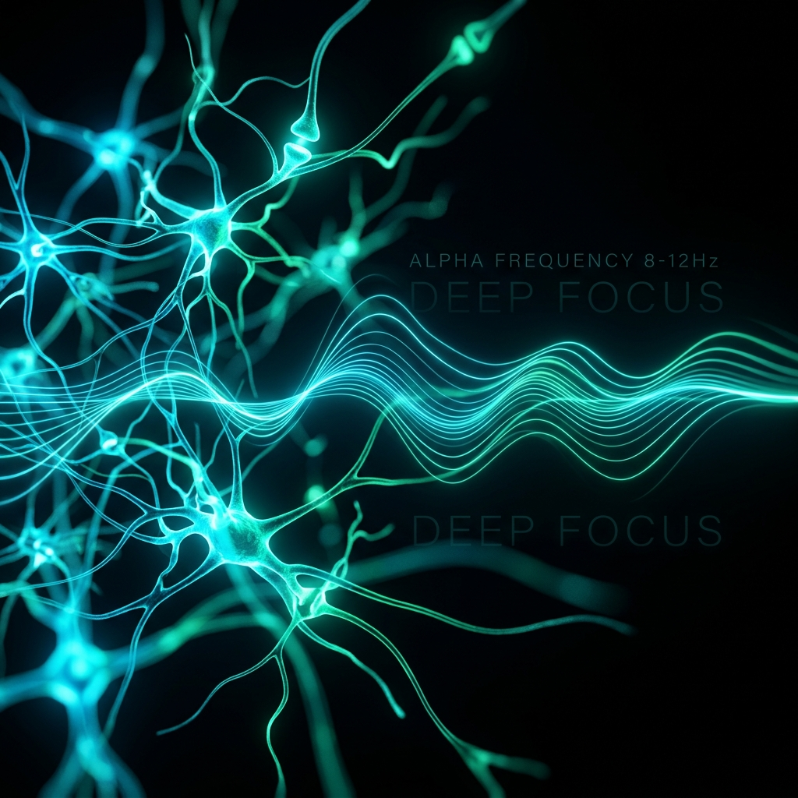
STAGE 01 · BRAND IDENTITY CARD
Identity: calm, precise, evidence-first
VALUES
Evidence over hype
Calm over urgency
Sustainable performance
Respect for attention
PALETTE
#0B0F14
#00F2FE
#10B981
#8B5CF6
#F8FAFC
Obsidian
Synapse Cyan
Bio-Emerald
Pulse Violet
Neural White
TYPOGRAPHY
Space Grotesk
Inter
Headlines · technical, precise
Body · high legibility
Visual style dark cyber-minimal UI, one soundwave motif, soft volumetric light
Avoid clinical imagery, robot clichés, neon clutter, real brand logos
NEURALIS · CONTENTFLOW
04 / 12

Slide 5
STAGE 02 · AUDIENCE & STRATEGY
Why · Who · What · How
WHY
WHO
Deniz, 31
Senior Software Engineer · primary
Attention is the scarcest resource in modern work. We exist to protect it.
Engineers, analysts, designers and founders doing 4+ hours of demanding screen work a day.
Pain: pings and meetings fragment the day; foggy by 4 pm.
Goal: two protected 90-min deep-work blocks a day.
LinkedIn · X · Hacker News
WHAT
HOW
Selin, 36
Startup Co-founder · B2B buyer
Adaptive focus audio + session insights that help people enter and sustain deep work.
Evidence-based, calm and precise communication. Never hype, never hustle.
Pain: decision fatigue; a team that's always on and always tired.
Goal: a sustainable focus culture for the whole team.
LinkedIn · newsletters · podcasts
NEURALIS · CONTENTFLOW
05 / 12

Slide 6
STAGE 02 · ONE-PAGE BRAND VOICE GUIDE
Voice: "a calm neuroscientist who also ships software"
Trait | We sound like… | We never sound like…
Evidence-based | "A 2005 field study found interrupted work took ~25 min to resume." | "Scientists PROVE this frequency makes you 10x smarter."
Precise | Short sentences. Numbers only when sourced. | Ornamental paragraphs, vague buzzwords.
Calm | Reassuring, low-pressure CTAs. | FOMO, countdowns, "Don't miss out!!!"
Humane | Rest is part of performance. | "Sleep is for the weak." "Grind harder."
USE
deep work · focus · research suggests · designed to support · recovery
AVOID
miracle · hack your brain · 10x · cures · grind · hustle
5 HARD RULES
1 No medical claims
2 No unsourced statistics
3 Hedge emerging science
4 No artist / voice imitation
5 No real brand marks in visuals
NEURALIS · CONTENTFLOW
06 / 12

Slide 7
STAGE 03 · CONTENT PILLARS & 7-DAY CALENDAR
One week, one arc: trust → value → product → habit
1 · Science of Focus
35%
2 · Deep Work Systems
30%
3 · Inside NEURALIS
20%
4 · Sustainable Performance
15%
Day | Channel · Format | Topic | Why today
Mon | LinkedIn · RTF post | The real cost of a "quick question" | Planning day: open to systems
Tue | Instagram · 5-slide carousel | Your brain at work: beta, alpha, theta | Saveable explainer builds authority
Wed | Blog · SEO article (hub) | Cognitive fatigue isn't a willpower problem | Evergreen hub mid-week
Thu | X · 6-post thread | Why your focus playlist stops working | Tech audience rewards depth
Fri | Reels / Shorts · 18 s video | Your focus isn't broken. It's overloaded. | Meets the Friday energy dip
Sat | Audio · TTS voiceover | The One-Minute Neural Reset | Weekend recovery
Sun | Email · weekly digest | Three rules for a clearer Monday | Closes the weekly loop
Full calendar with personas, rationale and KPI targets: content-calendar.xlsx
NEURALIS · CONTENTFLOW
07 / 12

Slide 8
STAGE 03 · BLOG POST · CO-STAR PROMPT
SEO blog: honest science, practical habits
Cognitive Fatigue Isn't a Willpower Problem: How Sound Can Help You Get Back to Deep Work
Meta: Cognitive fatigue isn't a lack of discipline. It's what constant switching does to your attention. Here's what research says, plus three habits to start today.
→ Interrupted work took ~25 min on average to resume (Mark et al., 2005)
→ Every task switch has a measurable cost (Rubinstein et al., 2001)
→ Focus-sound evidence is promising, not settled (meta-analysis, 2019)
→ 3 habits: batch interruptions · one 90-min block · steady soundscape
SEO SETUP
Primary keyword cognitive fatigue
Secondary deep work · context switching · focus music · binaural beats
Length ~1,050 words · 6 H2s · 1 table · 4 sources
Sources: Mark, González & Harris (2005) · Rubinstein, Meyer & Evans (2001) · Garcia-Argibay et al. (2019) · Woods et al. (2024)
Includes a "not a medical device" disclaimer.
NEURALIS · CONTENTFLOW
08 / 12

Slide 9
STAGE 03 · 3 SOCIAL POSTS · RTF FORMULA
Social: one idea per platform, written with RTF
LinkedIn
Instagram carousel
X / Twitter thread
Mon · Deep Work
Tue · Science
Thu · Product
R Evidence-driven thought leader
T Hidden cost of context switching; only the verified 25-min fact
F Hook · 3 paragraphs · question · 3 hashtags
R NEURALIS science editor
T Explain beta / alpha / theta as associations, not switches
F 5 slides · hook ≤ 8 words · caption + save CTA
R Senior engineer & community lead
T Why static playlists fade; cite 2019 meta-analysis; hedge
F 6 posts · ≤ 280 chars · no hashtags
A "quick question" is never quick for the person answering it.
When work was interrupted, it took around 25 minutes on average to get back to it. (Mark et al., CHI 2005)
What's one rule your team uses to protect deep work?
1 Your brain at work, in 3 states.
2 BETA ~13–30 Hz: alert, effortful
3 ALPHA ~8–12 Hz: relaxed wakefulness
4 THETA ~4–7 Hz: drifting, associative
5 Focus = fewer interruptions, so your brain can settle.
1/6 Your focus playlist works great for 20 minutes. Then you start skipping tracks…
4/6 A 2019 meta-analysis of 22 studies found a moderate effect, but results varied a lot…
5/6 So NEURALIS adapts instead of promising a magic frequency.
NEURALIS · CONTENTFLOW
09 / 12

Slide 10
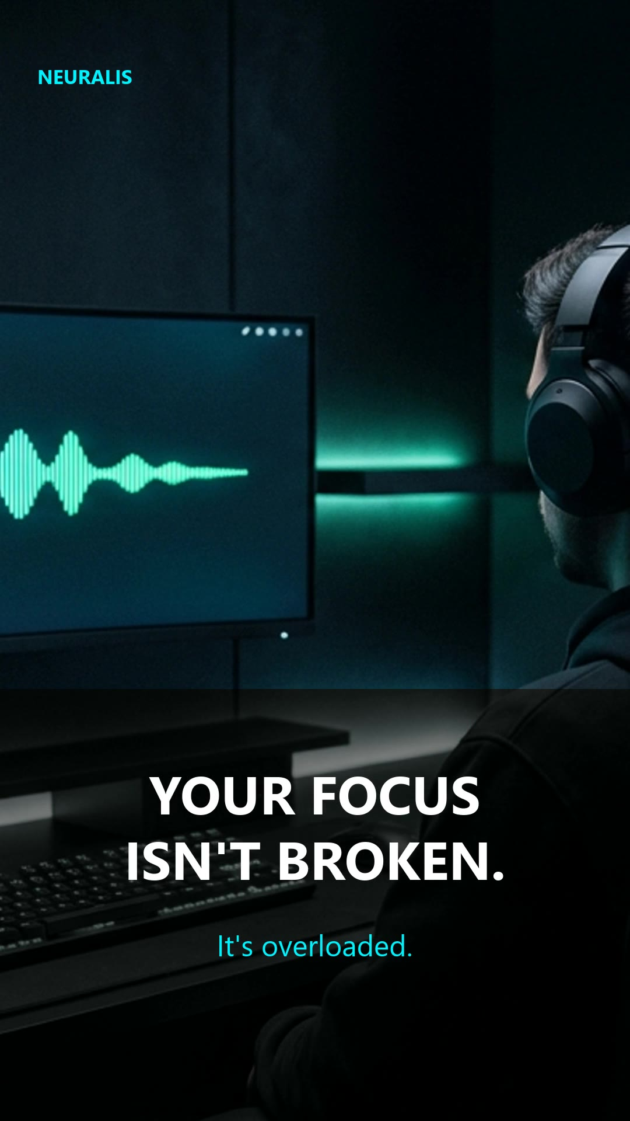
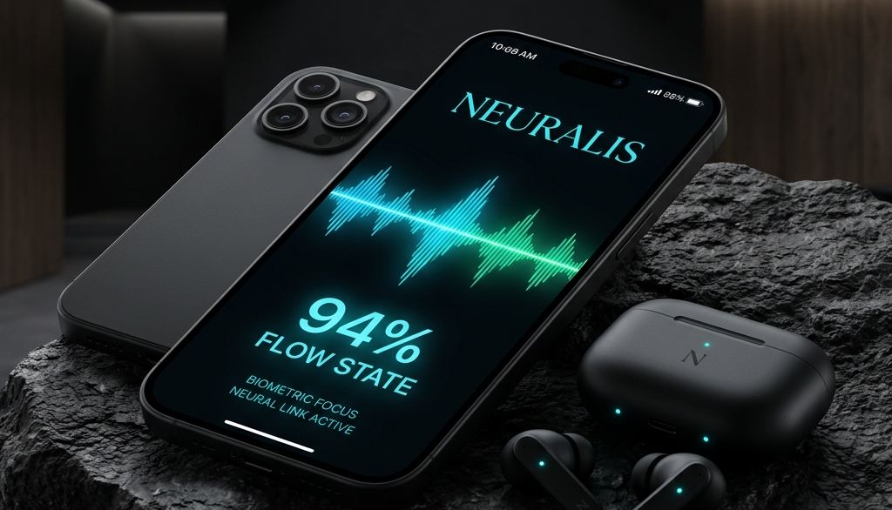
STAGE 03 · IMAGES, VIDEO & VOICEOVER
Images, an 18 s video and a TTS voiceover
Hero · 16:9
Brainwave · 1:1
Product · 1:1
Time | On-screen text | Voiceover
0–5 s | YOUR FOCUS ISN'T BROKEN. | "…It's overloaded."
5–10 s | SILENCE THE NOISE. | "Give your mind one thing to hold."
10–15 s | SOUND THAT ADAPTS TO YOU. | "…shapes sound around the way you work."
15–18 s | NEURALIS · Focus, by design. | "Neuralis. Focus, by design."
🔊 The One-Minute Neural Reset 49.6 s · Piper neural TTS (en_US-ryan-high) · ambient bed
"You are not failing at focus. You are carrying too much at once. So for the next minute… carry less."
[ add neural-reset-voiceover.mp3 here in Canva ]
NEURALIS · CONTENTFLOW
10 / 12

Slide 11
STAGE 04 · COPYRIGHT & HALLUCINATION CHECK
Review: what the AI got wrong, and how it was fixed
First draft said | Problem | Fix
"23 min 15 s to refocus" | Interview figure, not the paper | Peer-reviewed ~25 min
"2.1 hours lost per day" | No source exists | Removed
"40% more fatigue & errors" | Distorted estimate | Removed
"Alpha state in 15 minutes" | Unsupported claim | Hedged wording
Hinted at ADHD / anxiety help | Medical claim | Removed + disclaimer
Hero image v1 | Real brand logo on monitor | Regenerated, no logos
Voice dataset CC BY-NC-SA | Non-commercial licence | Documented
20
issues found & fixed
4 / 4
draft statistics failed review
0
unsourced numbers in final content
4 checks per piece: tone · keyword · copyright · sources
NEURALIS · CONTENTFLOW
11 / 12

Slide 12
PROCESS TRANSPARENCY · AI USAGE REPORT
Toolchain, the key lesson & what's next
Text
Images
Voice
MOST EFFECTIVE PROMPT CHANGE
Gemini (draft) → Claude (revision & fact-check) via Antigravity
Antigravity built-in image generation (Google model)
Piper neural TTS, offline & open source
Adding a source whitelist:
"Verified sources you MAY use: … Do NOT introduce other statistics."
This stopped the model from inventing numbers.
Video
Calendar
Fact-check
FFmpeg, fully scripted in Python
Python + openpyxl → .xlsx / .csv
Primary sources (DOIs) via web search
AUTOMATION DESIGN (OPTIONAL PRACTICE)
Calendar
(Sheets)
AI draft
+ images
Auto checks
Slack
approval
Buffer /
Meta API
GitHub github.com/hazalakks/neuralis-contentflow Full docs, prompt library, review log & reproducible media scripts
NEURALIS · CONTENTFLOW
12 / 12

