Slide 1
Student Information System Database
CMPE341-Database Design and Management Project

Slide 2
Introduction
Database for student information system. Entities in this database: Club, Student, Course, Project, Department and Instructor.
Students can register a department.
Departments have one or many students.
Students enroll zero or many courses.
Course have zero or many students. All students have a grade and a mark, when enroll a course.
Students can member many clubs.
Clubs can have many students.
Clubs manage by a student.

Slide 3
A student can manage one club.
Students can participate many projects.
Project have at least one student.
Each project manage by at least one instructor.
Instructors can supervise many projects.
Each course lecture by at least one instructor.
An instructor can lecture many course. Each course have a semester and a year.
All departments have at least one instructor.
An instructor be assigned a department.

Slide 4
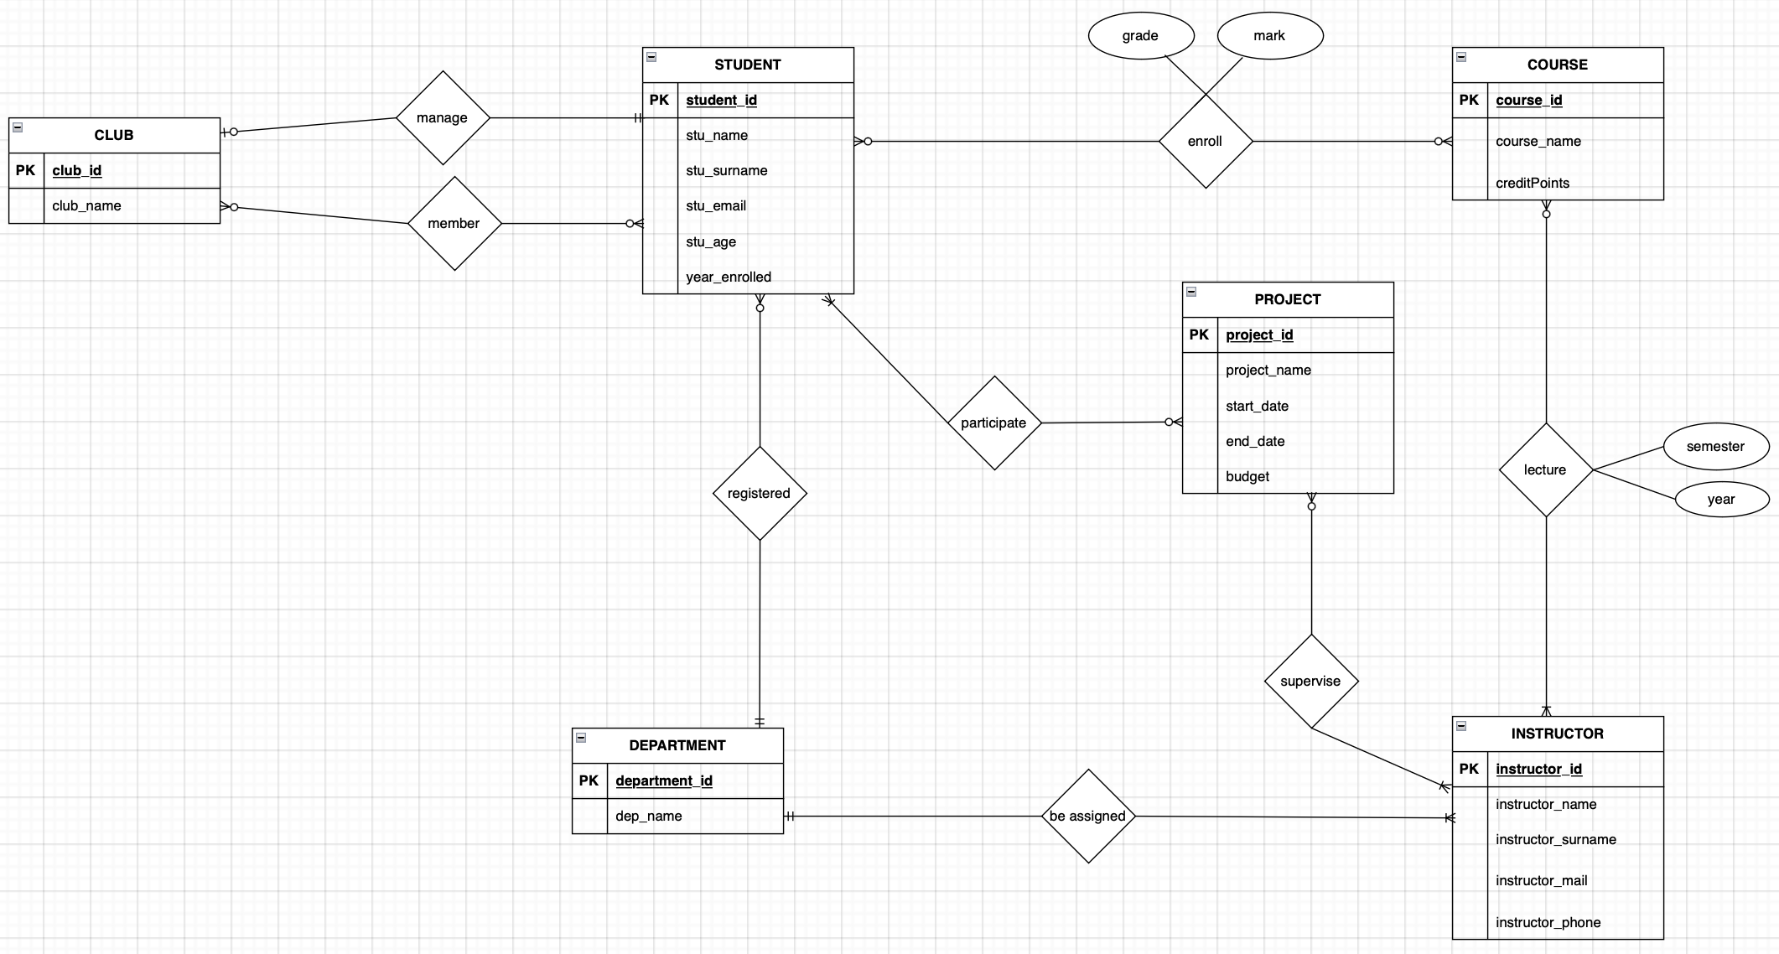
Conceptual Design

Slide 5
Logical Design
STUDENT (student_id, stu_name, stu_surname, stu_email, stu_age, year_enrolled, dep_id (FK refers to DEPARTMENT))
DEPARTMENT (department_id, dep_name)
COURSE (course_id, course_name, credit_points)
INSTRUCTOR (instructor_id, instructor_name, instructor_surname, instructor_mail, instructor_phone, dept_id(FK refers to DEPARTMENT))
PROJECT (project_id, project_name, start_date, end_date, budget)

Slide 6
SUPERVISE (p_id (FK refers to PROJECT), i_id (FK refers to INSTRUCTOR))
ENROLL (mark, grade, s_id(FK refers to STUDENT), c_id (FK refers to COURSE))
CLUB (club_id, club_name, stu_id (FK refers to STUDENT))
MEMBER (n_club_id(FK refers to CLUB), n_stu_id(FK refers to STUDENT)
PARTİCİPATE (p_id (FK refers to PROJECT), s_id (FK refers to STUDENT))
LECTURE (inst_id(FK refers to INSTRUCTOR), cour_id(FK refers to COURSE), semester, year)

Slide 7
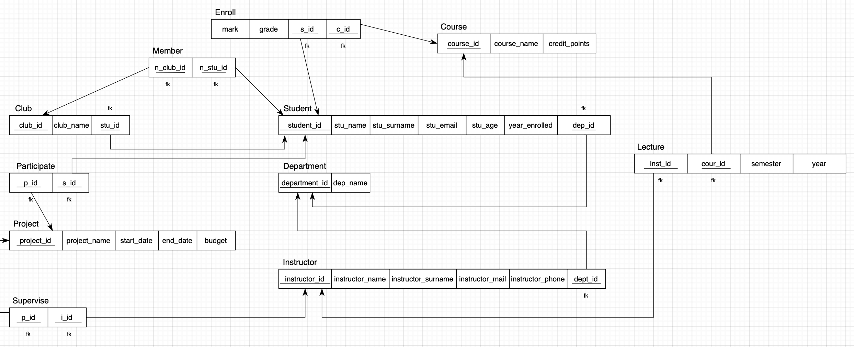

Slide 8
Physical Design-Create Tables&Insert Records(1)
1. STUDENT
Create table “hazal”.”student”(
“student_id” number(*,0),
“stu_name” varchar2(30 byte) not null enable,
“stu_surname” varchar2(30 byte) not null enable,
“stu_email” varchar2(30 byte),
“stu_age” number(*,0),
“year_enrolled” number(*,0) not null enable,
“department_id” number not null enable,
Primary key (“student_id”));
insert into student values(10020030010, ‘MUSTAFA’, ‘ÇELİK’, ’celik_mustafa@atilim.edu.tr’, 22, 2019, 2)
insert into student values(10020030002, ‘NECMİ MERT’, ‘KINAY’, ’ncmrt@atilim.edu.tr’, 21, 2019, 1)
insert into student values(10020030001, ‘DENİZ ARDA’, ‘KÜÇÜK’, ’dnzrd@atilim.edu.tr’, 21, 2019, 1)

Slide 9
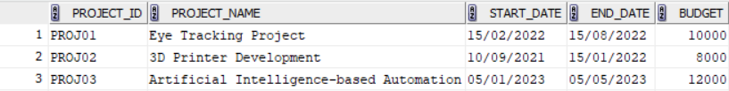
Physical Design-Create Tables&Insert Records(2)
2. PROJECT
Create table “hazal”.”project”(
“project_id” varchar2(10 byte),
“project_name” varchar2(50 byte) not null enable,
“start_date” date not null enable,
“end_date” date not null enable,
“budget” number(*,0),
Primary key (“project_id”));
insert into project values(‘PROJ01’, ’Eye Tracking Project’, ’15/02/2022’, ’15/08/2022’, 10000)
insert into project values(‘PROJ02’, ’3D Printer Development’, ’10/09/2021’, ’15/01/2022’, 8000)
insert into project values(‘PROJ01’, ’Artificial Intelligence-based Automation’, ’05/01/2023’, ’05/05/2023’, 12000)

Slide 10

Physical Design-Create Tables&Insert Records(3)
3. LECTURE
Create table “hazal”.”lecture”(
“instructor_id” number,
“course_id” varchar2(10 byte),
“semester” varchar2(10 byte),
“year” number,
Primary key (“instructor_id”, “course_id)
Foreign key (“instructor_id”)
References “hazal”.”instructor”(“instructor_id”) enable
Foreign key (“course_id”)
References “hazal”.”course”(“course_id”) enable
);
insert into lecture values(1,CMPE301’, ’23-24FALL’, 2023)
insert into lecture values(2,ISE302’, ’23-24FALL’, 2023)
insert into lecture values(3,MATH303’, ’23-24FALL’, 2023)

Slide 11
Physical Design-Create Tables&Insert Records(4)
4. INSTRUCTOR
Create table “hazal”.”instructor”(
“instructor_id” number(*,0),
“instructor_name” varchar2(100 byte) not null enable,
“instructor_surname” varchar2(100 byte) not null enable,
“instructor_mail” varchar2(100 byte) not null enable,
“instructor_phone” varchar2(15 byte) not null enable,
“department_id” number not null enable,
Primary key (“instructor_id”)
);
insert into instructor values(2, ’Ayşe’, ’Koç’, ‘koc_ayse@atilim.edu.tr’, 05422560002, 3)
insert into instructor values(3, ‘Mehmet’, ‘Demir’, ‘demir_mehmet@atilim.edu.tr’, 05422560003, 4)
insert into instructor values(1, ’Ahmet’, ‘Yildirim’, ‘yildirim_ahmet@atilim.edu.tr’, 05422560001, 3)

Slide 12

Physical Design-Create Tables&Insert Records(5)
5. ENROLL
Create table “hazal”.”enroll”(
“sudent_id” number,
“course_id” varchar2(10 byte),
“mark” number not null enable,
“grade” ” varchar2(10 byte),
Primary key (“student_id”,” course_id”)
Foreign key (“student_id”)
References “hazal”.”student”(“student_id”) enable,
Foreign key (“course_id”)
References “hazal”.”course”(“course_id”) enable,
);
insert into enroll values(10020030001, ‘CMPE301’, 90,’BA’)
insert into enroll values(10020030002, ‘CMPE301’, 61,’DD’)
insert into enroll values(10020030005, ‘CMPE301’, 78,’CB’)

Slide 13

Physical Design-Create Tables&Insert Records(6)
6. DEPARTMENT
Create table “hazal”.”department”(
“department_id” number(*,0),
“department_name” varchar2(10 byte) not null enable,
Primary key (“department_id”)
);
insert into department values(1,’ISE’)
insert into department values(2’, ‘CMPE’)
insert into department values(3, ’SE’)

Slide 14
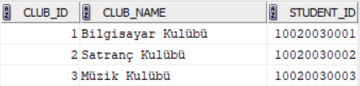
Physical Design-Create Tables&Insert Records(7)
7. CLUB
Create table “hazal”.”club”(
“club_id” number(*,0),
“club_name” varchar2(100 byte) not null enable,
“student_id” number(*,0),
Primary key (“club_id”)
References “hazal”.”student”(”student_id”) enable
);
insert into club values(1,’Bilgisayar Kulübü’, 10020030001)
insert into club values(2,’Satranç Kulübü’, 10020030002)
insert into club values(3,’Müzik Kulübü’, 10020030003)

Slide 15
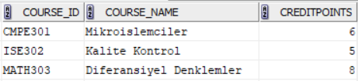
Physical Design-Create Tables&Insert Records(8)
8. COURSE
Create table “hazal”.”course”(
“course_id” varchar2(10 byte),
“course_name” varchar2(100 byte) not null enable,
“creditpoints” number(*,0) not null enable,
Primary key (“course_id”)
);
insert into course values(‘CMPE301’, ’Mikroislemciler’, 6)
insert into course values(‘ISE302’, ‘Kalite Kontrol’, 5)
insert into course values(‘MATH303’, ‘Diferansiyler Denklemler’, 8)

Slide 16
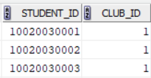
Physical Design-Create Tables&Insert Records(9)
9. MEMBER_CLUB
Create table “hazal”.”member_club”(
“student_id” number,
“club_id” number,
Primary key (“club_id”,”student_id”)
Foreign key (“club_id”)
References “hazal”.”club”(”club_id”) enable
Foreign key (“student_id”)
References “hazal”.”student”(”student_id”) enable
);
insert into member_club values(10020030001, 1)
insert into member_club values(10020030002, 1)
insert into member_club values(10020030003, 1)

Slide 17
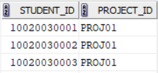
Physical Design-Create Tables&Insert Records(10)
10. PARTICIPATE_PROJECT
Create table “hazal”.”participate_project”(
“student_id” number,
“project_id” varchar2(10 byte),
Primary key (“student_id”,”project_id”),
Foreign key (“student_id”),
References “hazal”.”student”(”student_id”) enable,
Foreign key (“project_id”),
References “hazal”.”project”(”project_id”) enable,
);
insert into participate _projects values(10020030001, ‘PROJ01’)
insert into participate _projects values(10020030002, ‘PROJ01’)
insert into participate _projects values(10020030003, ‘PROJ01’)

Slide 18
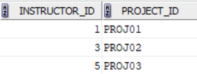
Physical Design-Create Tables&Insert Records(11)
11. SUPERVISE_PROJECT
Create table “hazal”.”supervise_project”(
“instructor_id” number,
“project_id” varchar2(10 byte),
Primary key (“instructor_id”,”project_id”),
Foreign key (“instructor_id”),
References “hazal”.”instructor”(”instructor_id”) enable,
Foreign key (“project_id”),
References “hazal”.”project”(”project_id”) enable,
);
insert into supervise_projects values(1, ‘PROJ01’)
insert into supervise_projects values(3, ‘PROJ02’)
insert into supervise_projects values(5, ‘PROJ03’)

Slide 19
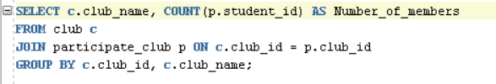
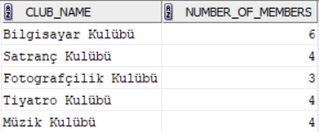
Physical Design-Queries(1)
1. Display data from multiple tables (join)
Display the club names and the count of registered members for each club. Count column should be displayed as Number_of_members.
Query:
Result:

Slide 20

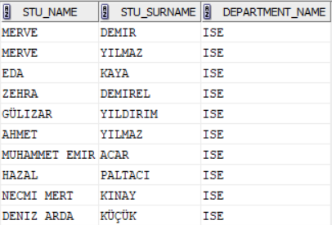
Physical Design-Queries(2)
2. Group by/Order by statements
Display the names and surnames of ISE students, ordering the results by student id in descending order.
Query:
Result:

Slide 21
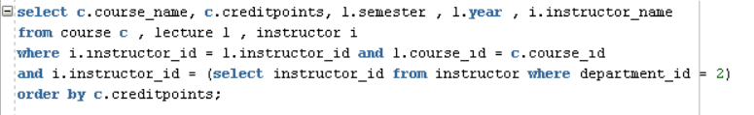
Physical Design-Queries(3)
3. Subqueries
Display the name, credit, semester, year, and instructor name of the course belonging to department id 2. Order the results by credit points.
Query:
Result:

Slide 22

THANKS FOR LISTENING!

